Slide 1

Industry: Volunteers & NGOs
The Community Reset
Redesigning what's possible in Alberta
Presented by Annand Ollivierre, Managing Director

Slide 2

Contributor(s)
Mark Holmgren – Director, Vibrant Communities
Pieter De Vos – Community Development Officer, Gov’t of AB
Sharon Matthias – Innovation Platform
Social Innovation Generation (SiG)
Social Enterprise Fund
Alberta Social Innovation Connect (ABSI)
Edmonton Chamber of Voluntary Organizations (ECVO)
CCVO
Propellus
FuseSocial
Volunteer Lethbridge
Jann Beeston, Katherine Topolniski & the entire VA Team

Slide 3
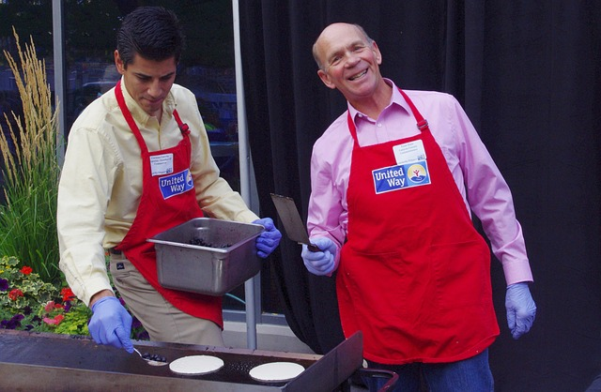
Notes:
Profile of the Nonprofit Sector
Number of NPVS in Alberta
Labour
Volunteerism rate and types of volunteers
Economic contribution
Subsectors
Common revenue model
Larger NPVS vs. common sector
Skilled labour force
Service based

Slide 4








Notes:
Forces and Sources of Change

Slide 5


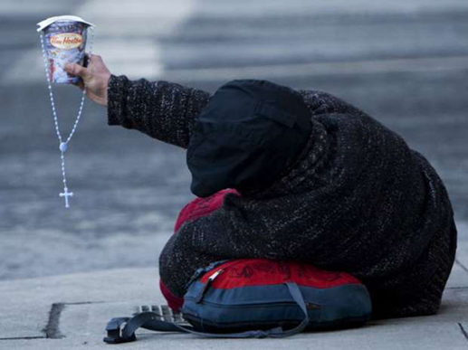
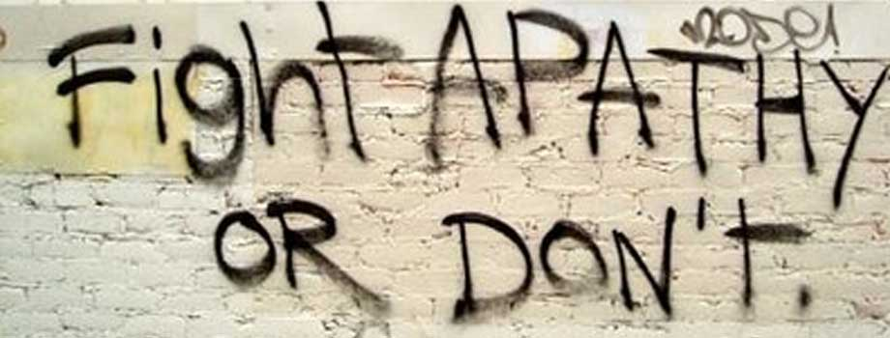
Notes:
Challenges
Growth of sector, expanding service(s) demand
Staffing
Traditional Revenue Model
Low barriers to entry
Shifting demographics
Hard to measure – demand for evidence

Slide 6
Quasi Autonomous NGO’s (AHS)
Not for Profit
Profit
Formal
Informal
Public Sector
Public
Private
The Sector is characterized by high levels of creativity and innovation
Parastatals (AIMCO)
Social Enterprises
Market/Private sector
Family & Community
The Sector is populated by diverse mandates and a variety of organizational forms
NPVS
Unincorporated Citizens Groups
Industry Advocacy Groups
“Reimaging the Nonprofit Voluntary Sector” Pieter De Vos Sept 2015
Notes:
Opportunities

Slide 7
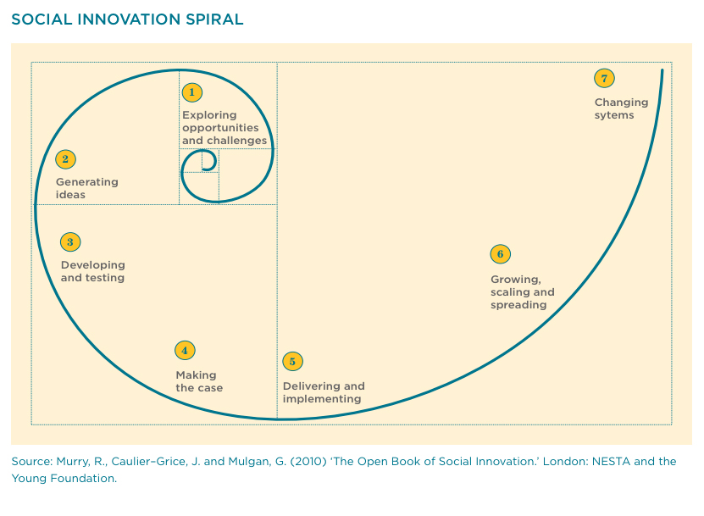
Notes:
Social Innovation

Slide 8

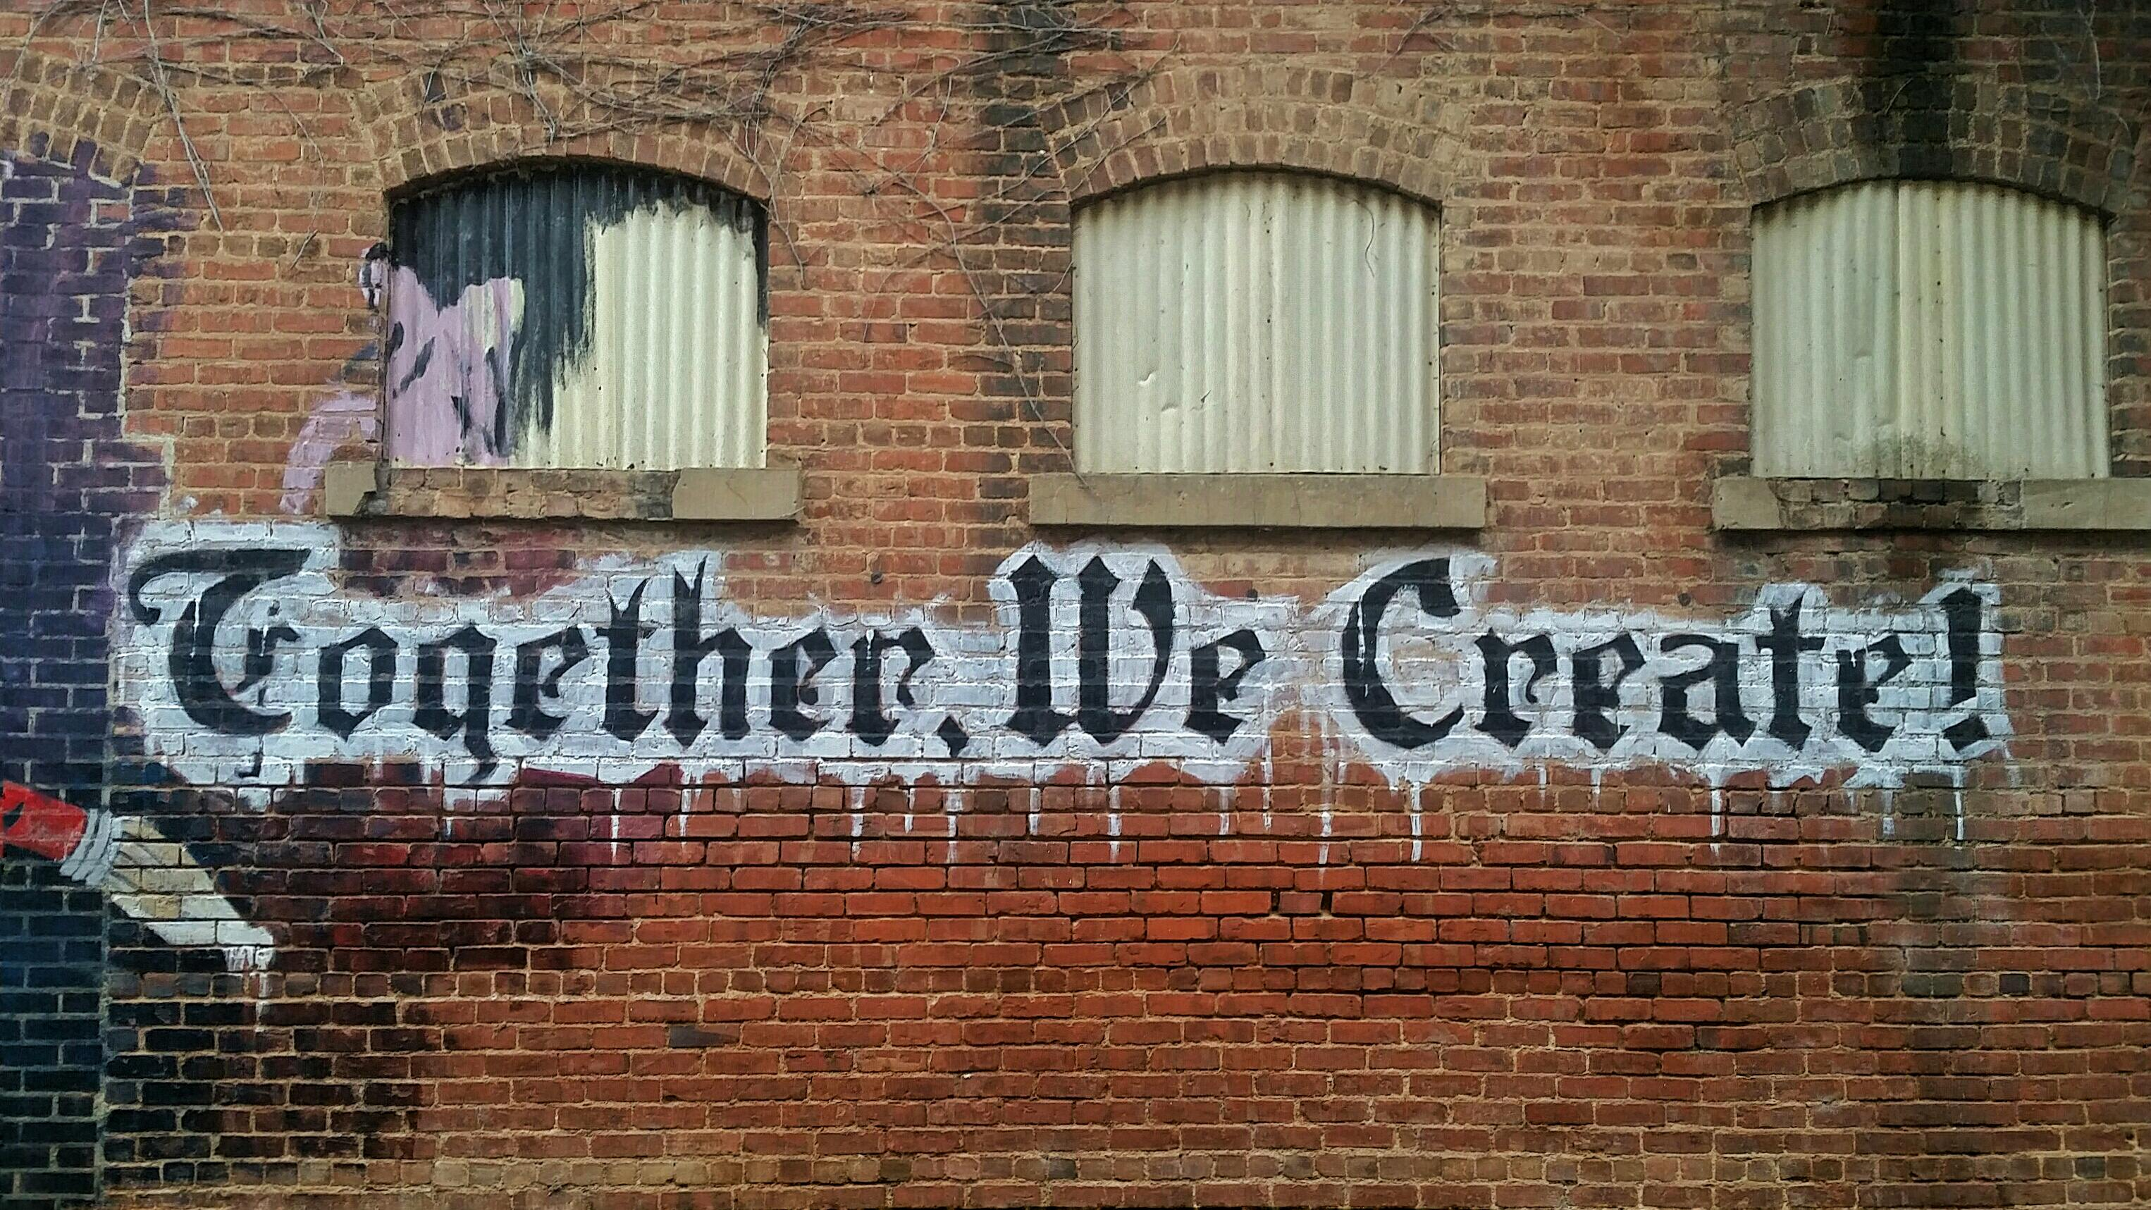

Notes:
Social Innovation

Slide 9

Notes:
Social Enterprise

Slide 10

Notes:
Social Enterprise

Slide 11

Notes:
Impact Investing

Slide 12

Notes:
Impact Investing

Slide 13

Notes:
Canadian Index of Wellbeing

Slide 14

Notes:
Guaranteed Annual Income

Slide 15

Notes:
These are tools not why!

Slide 16

Notes:
I•de•a ^{(noun)}
A thought or suggestion as to a possible course of action
The aim or purpose

Slide 17

Notes:
Designed Mindset – Community first!

Slide 18

Notes:
Why this Designed Mindset

Slide 19

Notes:
Recommendations

Slide 20

Recommendation:
A public facing campaign that is championed by a cross-sector collaboration that focusses on how ‘we’ are shifting to a community first approach and how people can be a part of the movement
Notes:
Recommendations

