Slide 1
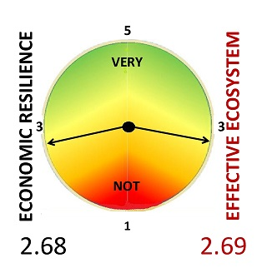

Alberta’s ECONOMIC RESILIENCE
April ‘21
Prepared for the Vantage Club
May 26, 2021

Slide 2
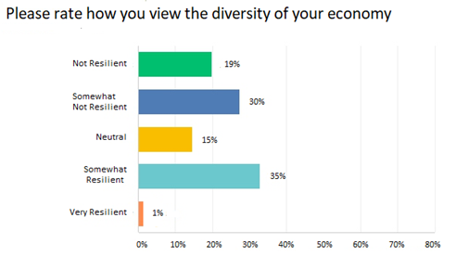
49%
36%

Slide 3
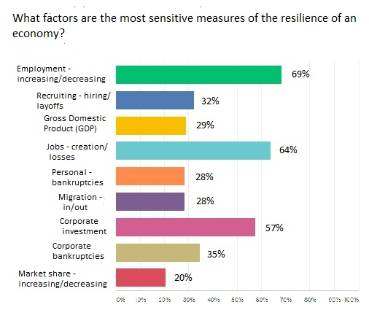

Slide 4
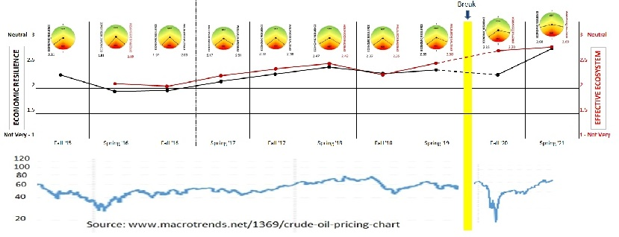
RESILIENCE SINCE 2015

Slide 5
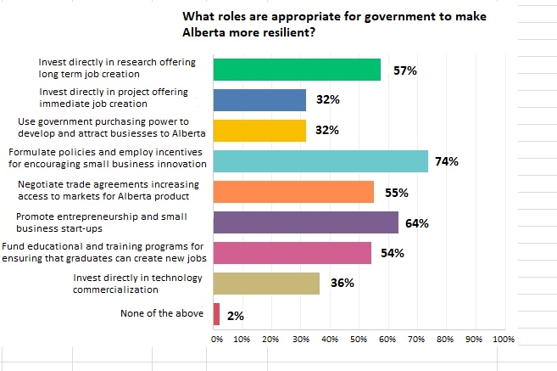
ROLE FOR GOVERNMENT

Slide 6
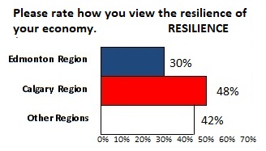
REGIONAL RESILIENCE – Spring ‘21
INDEX
ALBERTA 2.68
Edmonton 2.68
Calgary 2.76
Other 2.58
36%

Slide 7
SECTOR REPRESENTATION – Spring ‘21
INDUSTRIES – 36%
Mining & Mineral Processing - 4%
Energy & Distribution - 22%
Construction & Real Estate - 10%
Forestry & Wood Products - 3%
Tourism & Entertainment - 14%
Manufacturing & Export - 15%
Transportation & Logistics - 8%
Agriculture & Food Processing - 23%
PROFESSIONS – 29%
Communications & Marketing - 10%
Engineering & Design - 19%
Human Resources & Development - 10%
InfoTech & Analytics - 25%
Finance & Investment - 16%
Management & Strategy - 16%
Legal & Security - 4%
PUBLIC SERVICES – 35%
Health & BioTech - 24%
Government & Public Policy - 20%
NGOs – Non-gov’t Organization - 8%
Education & Research - 21%
Environment & CleanTech - 26%

Slide 8
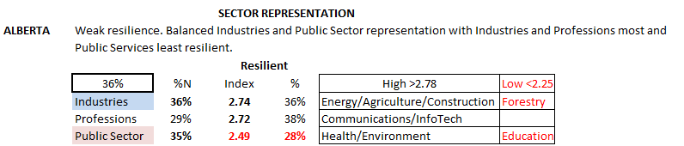
Spring ‘21

Slide 9
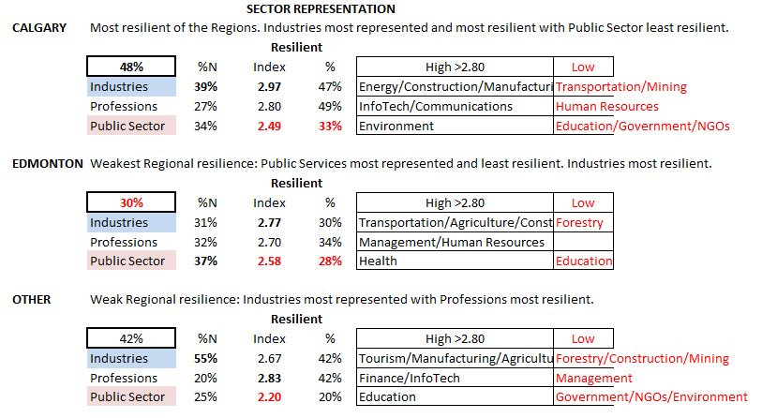
Spring ‘21

Slide 10
Spring ‘21
The Innovation Ecosystem
To achieve economic resilience/ diversification, economies need an effective and continuously improving Innovation Ecosystem that supports the survival, growth and retention of entrepreneurs and SMEs (small and medium enterprises). Do you agree?
 | INDEX | % Agree
ALBERTA | 4.56 | 90%
Edmonton |  | 89%
Calgary |  | 93%
Other |  | 100%
Scale and Comments
5 – “Without innovation there is no economic growth possible”
4 – “Innovation ecosystem is an essential but not sufficient for a vibrant
and sustainable economy”
3 – “I’ve witnessed personally some shortcomings from Accelerators,
Incubators, and other Venture Development organizations.”
2 – “Resilience can be achieved in other ways”

Slide 11
Spring ‘21
The Innovation Ecosystem
Please rate the effectiveness of your location's Innovation Ecosystem in supporting the survival, growth, and retention of entrepreneurs and SMEs. Scale 5 – Very Effective to 1 – Very non-effective)
 | INDEX | % Effective
ALBERTA | 2.69 | 29%
Edmonton | 2.55 | 23%
Calgary | 3.10 | 45%
Other | 2.50 | 25%
Scale and Comments
5 – “The number of private and public-sector-supported organizations and programs is significant.”
4 – “Early stages but much better than even a few years ago”
3 – “I truly don't see a great deal of survival, growth... and SMEs.”
2 – “No change for the last 50 years, only university and government environment.”
1 – “There presently is none locally. “ and “Too focused on oil and gas.”

Slide 12
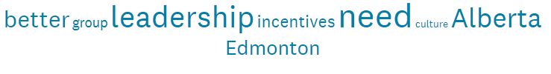
Spring ‘21
The Innovation Ecosystem
The following elements comprise an Innovation Ecosystem. Please rate them in terms of their effectiveness in supporting entrepreneurs and SMEs today? (Scale 5 – Very Effective to 1 – Very non-effective)
Elements | INDEX | % Effective
Vision & Leadership - purpose and inspiration | 3.21 | 62%
Resources - talent, financing, information, facilities/land, technology | 3.46 | 69%
Processes - communications, decision making, networking, organization, accountability | 3.12 | 55%
Infrastructure - internet, transportation/logistics, research, advisory services - incubators/ accelerators | 3.58 | 76%
Word cluster from comments

Slide 13
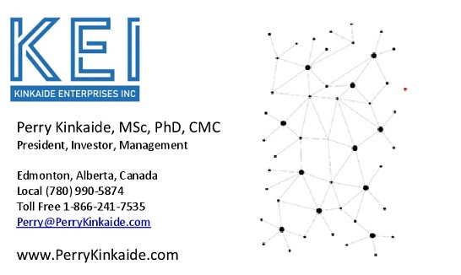
COMMENTS AND QUESTIONS?
Public link for accessing Friday 4pm Webinars
https://us02web.zoom.us/j/85896241732
Thank you!

