Slide 1
Tourism & Entertainment
Dave Kaiser, President & CEO
Alberta Hotel & Lodging Association
Notes:
thank you for the opportunity to speak today
Intro – 11 years in current role which has allowed me to learn and become knowledgeable about the tourism industry
I believe most of us can relate to tourism and entertainment as experiences
today I’d like to talk about them under the banner of tourism and why I believe “Tourism Works” as a way to diversify and grow Alberta’s economy

Slide 2
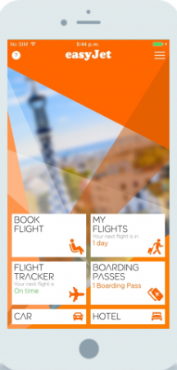





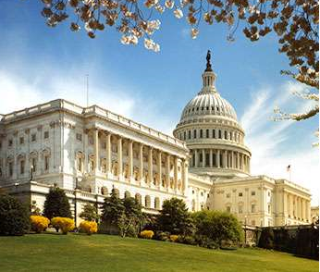

Contributors
Forces of Change
Notes:
Acknowledge friends from the Travel AB, the Ministry of Culture & Tourism, numerous industry colleagues, and a special shout out to Kent Stewart with Western Management Consultants who’s done a lot strategic work for the tourism sector
The forces shaping the future of the industry include - the growing influence of emerging travel markets and the rise of millennials, - advances in technology, – particularly as it relates to how we consume information – and, of course the global economy and government policy

Slide 3
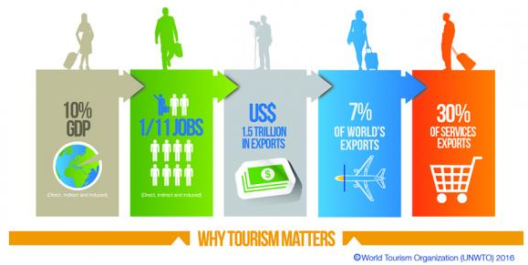
Notes:
So why does tourism matter?
it’s a significant export industry in the global economy
it’s growing at 4% per year – outpacing global GDP growth
it has tremendous growth potential due to increased travel from emerging economies like China
and, tourism is already Canada’s largest service export at $17.B per year

Slide 4
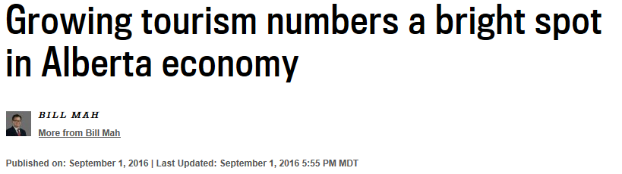
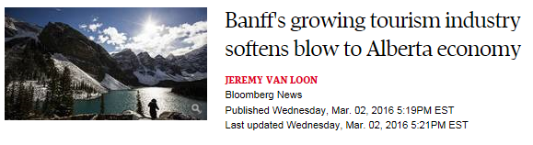
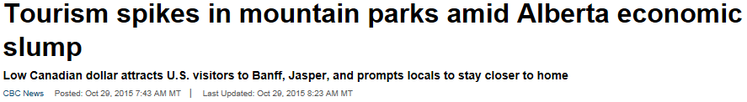
Notes:
And so what about tourism in Alberta?
in regions where we have developed product, it’s proven resilient in the current economic downturn
it’s not tied to the state of our energy sector
and it supports 19,000 businesses, 127,000 jobs, and generates $4B in total tax revenue
Clearly, growing tourism should be an opportunity for our province

Slide 5
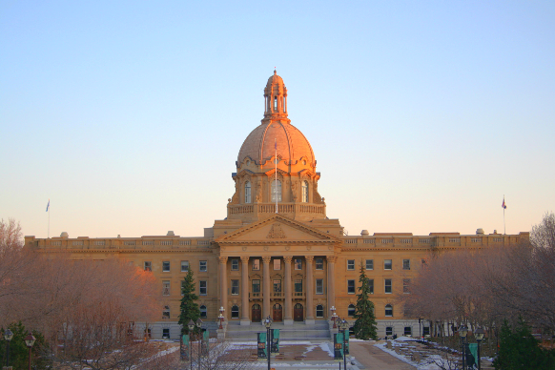
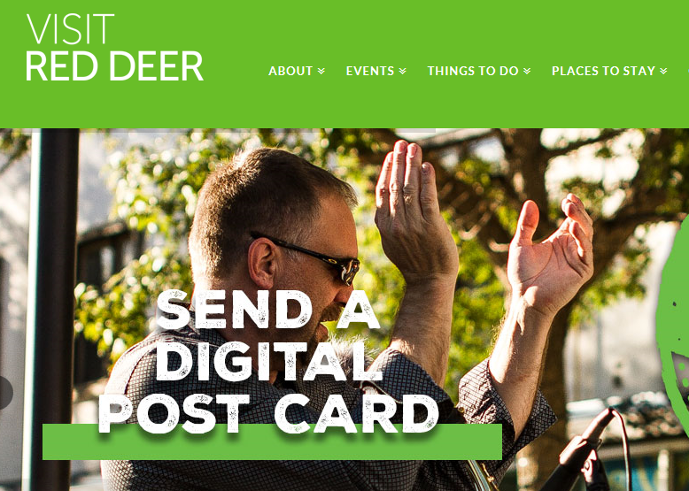
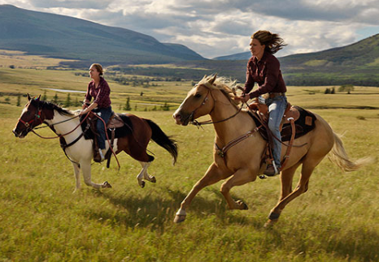

Notes:
And I believe there are 4 Pillars, let’s call them the 4 P’s, required for success:
Policy - government policy that is friendly to tourism
Promotion - effective marketing that works to attract international visitors
Product - new “export ready” tourism products & experiences beyond the mountain parks
People - a well-trained hospitality workforce focused on the guest experience

Slide 6
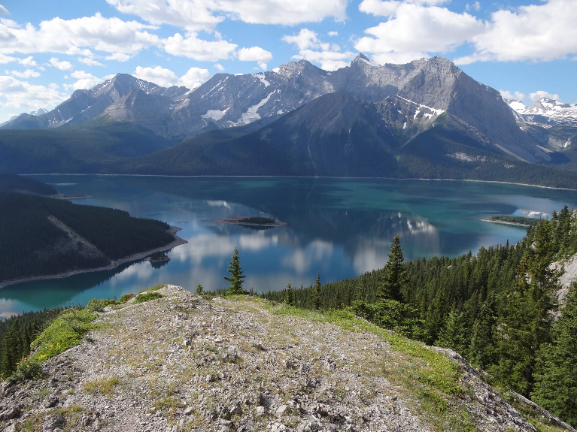
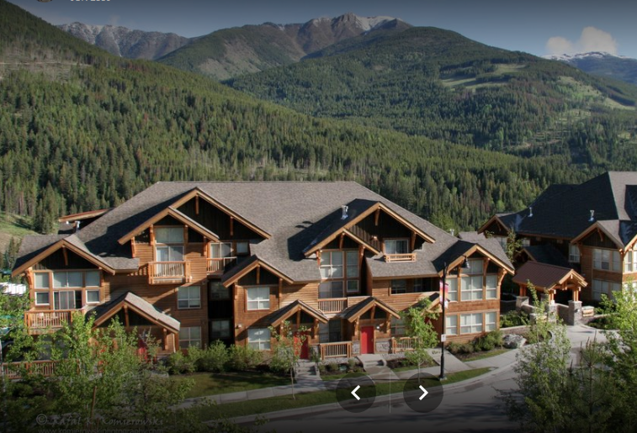
Kananaskis
Panorama
Notes:
Let’s start with policy
In 2005, the Tourism Levy Act was passed to create a 4% levy on hotel room night stays to fund the growth of tourism
However, in recent years this dedicated funding link has been broken.
As well, Alberta’s land use framework has not been friendly to investment in regions that offer tremendous growth potential
In fact, we’ve seen billions of dollars flow out of Alberta and invested on the other side of the Rockies, where development is encouraged and supported
Clearly these policies need to change

Slide 7
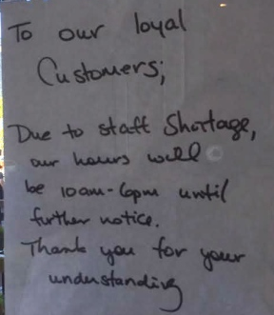
Notes:
And, for many tourism businesses, notes like these have been all too commonplace in recent years
Labour and immigration policy have constrained our capacity to serve visitors
Foreign worker programs that lead to permanent residency are required to ensure a supply of labour for a growing industry
Also, the steep increases proposed for AB’s minimum wage makes us less competitive and will discourage tourism investment

Slide 8
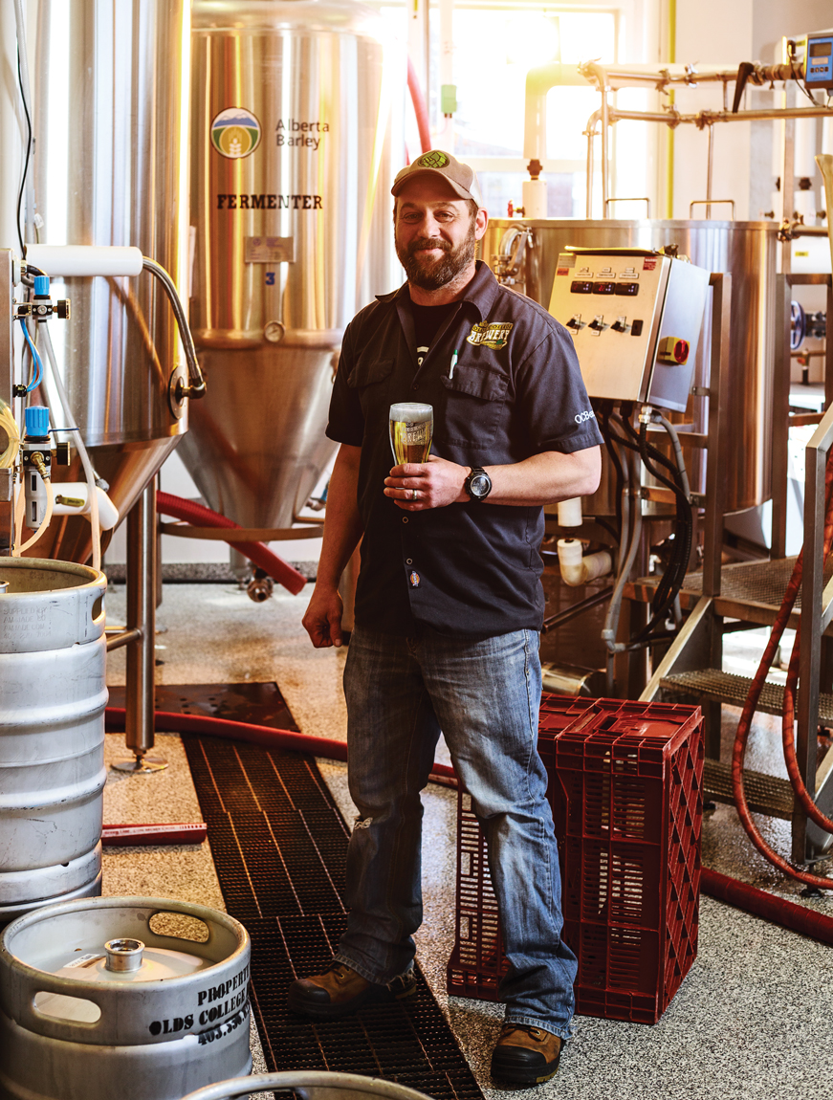
Notes:
But sometimes government does get it right.
in 2013 the AGLC dramatically lowered the production volume required for small brewers
this has led to a thriving craft brewing industry, with over 50 craft breweries now operating in the province
brewery tours are becoming popular with tourists and so are local brews as part of a cultural experience sought out by visitors

Slide 9
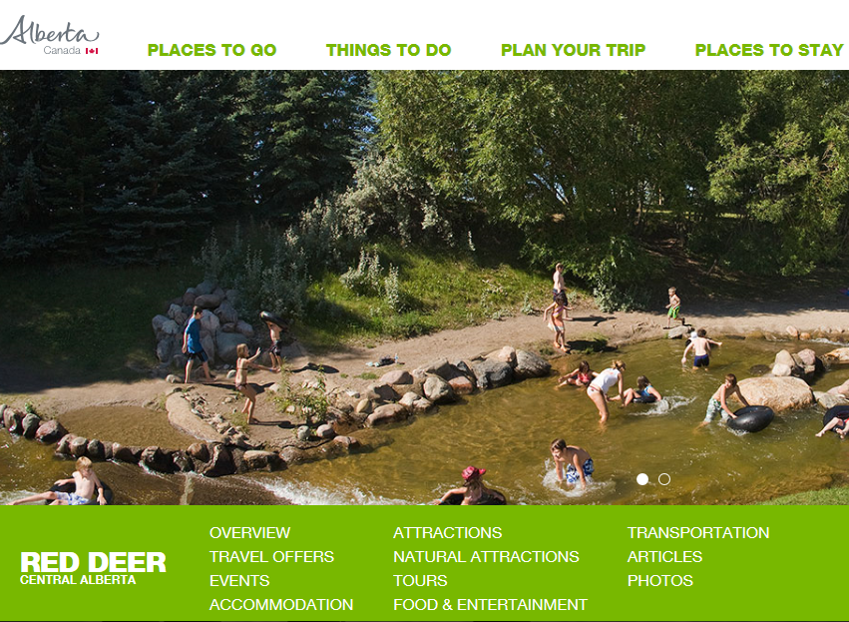
Notes:
On the marketing front, Travel Alberta has been a leader in developing a strong Alberta brand
At the regional level, we have local hotel associations collecting voluntary DMFs to support local DMOs and to attract major events
collaboration and alignment among the various tourism marketing organizations is key - if we are to maximize the ROI of our marketing investments

Slide 10
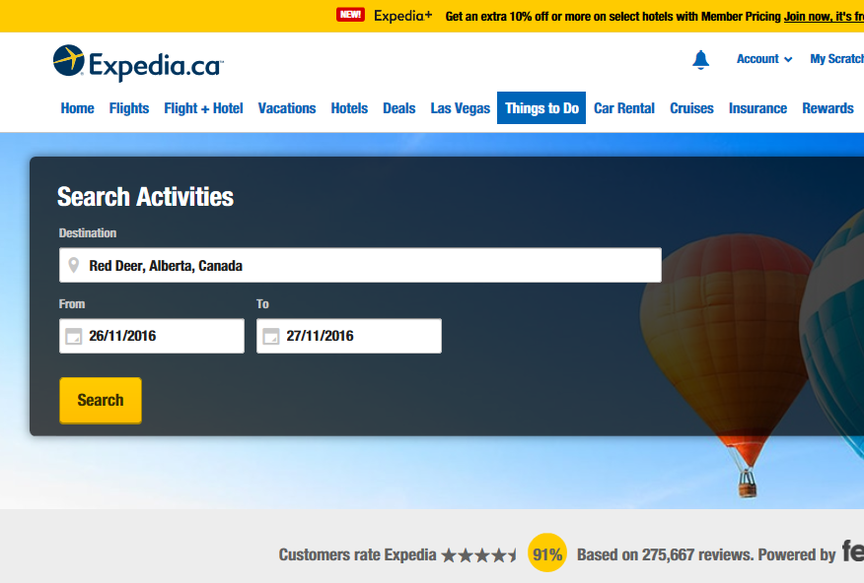
Notes:
Increasingly today, OTAs like Expedia are the dominant channels when it comes to the distribution of tourism content and booking travel
These digital platforms allow us to effectively reach a global audience, but they should be used strategically – as they come with a significant cost to industry, and threaten to commoditize destinations and travel brands
In this age of big-data marketing, owning the customer relationship is really the key to success and profitability

Slide 11

Notes:
When it comes to owning the customer, customer service is the new marketing
particularly in a “Trip Advisor” and Facebook world where “word of mouth” marketing is amplified and trusted more than brand hype
according to marketing guru, Jay Baer, “to succeed at customer service you need to respond every time, to every customer, and on every channel - especially when the whole world can see your inaction

Slide 12
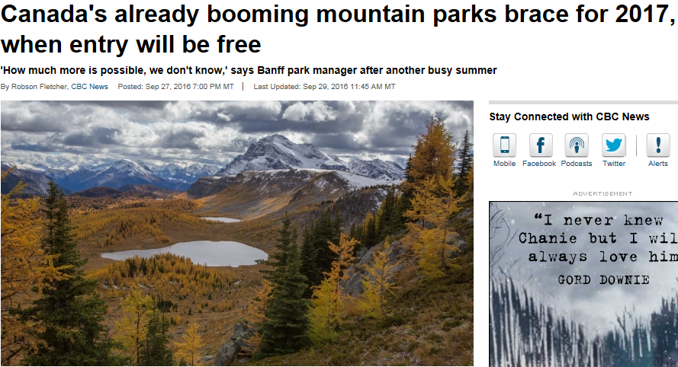
Notes:
However, marketing expenditures result in diminishing returns when our “export ready” tourism product is already near capacity
2016 has been a record year so far for our mountain resorts
with little to no vacancy at hotels, and traffic levels and congestion threatening the guest experience, we need to develop product for other seasons and in other regions of the province

Slide 13
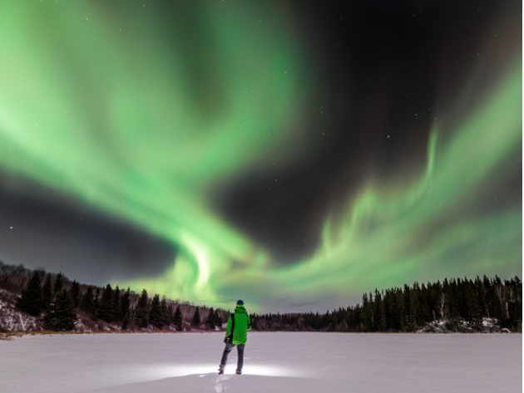
Notes:
One example is the Northern Lights Outdoor Excursion operating in Fort McMurray
This attraction is already in high demand with tremendous upside for growth
Sources tell me that similar, but more developed product in Yellowknife currently attracts 20K visitors per year – with growing numbers coming from China

Slide 14
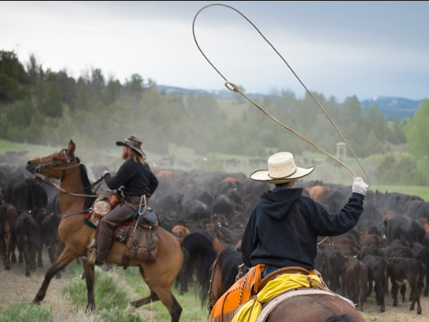
Notes:
And, in a province famous for its ranching heritage and the Calgary Stampede, there’s an obvious opportunity for world class guest ranches.
However, when I did a recent search for Canada on the “Top 50 Ranches” website which lists the top Guest Ranches in the world, there were 4 listings for BC, but none for our province

Slide 15
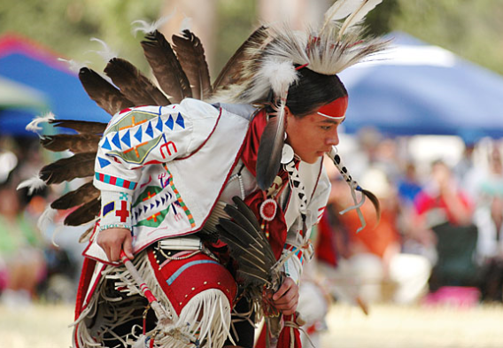
Notes:
Aboriginal tourism is another area of untapped potential.
This product is in demand, but here again we lag BC and Ontario when it comes to delivering these types of cultural experiences.
In addition to generating tourism revenue, initiatives in this area could also help us alleviate some of the economic and social challenges facing our indigenous communities.

Slide 16
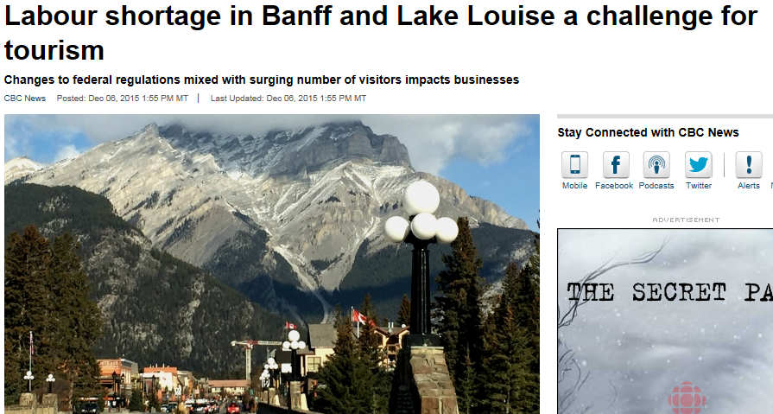
Notes:
Our last P is people.
I referenced earlier the important role that government policy plays in this area
As someone who represents industry, I also acknowledge that we need to do a better job - on recruitment, including tapping into underrepresented groups, - on retention, with greater focus on our workplace culture, and, perhaps most importantly, on training & development

Slide 17
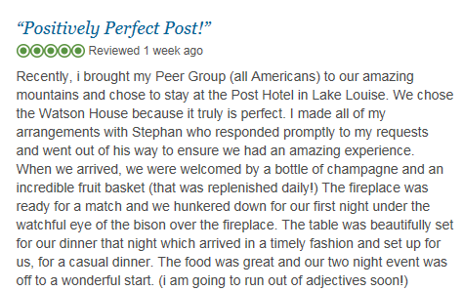
Notes:
Because, today it’s far more than just finding warm bodies to fill jobs.
The folks working in our industry are an integral part of the guest experience.
And as referenced earlier, the service they provide is the most effective marketing we have
We need to ensure they are supported and set up for success.

Slide 18
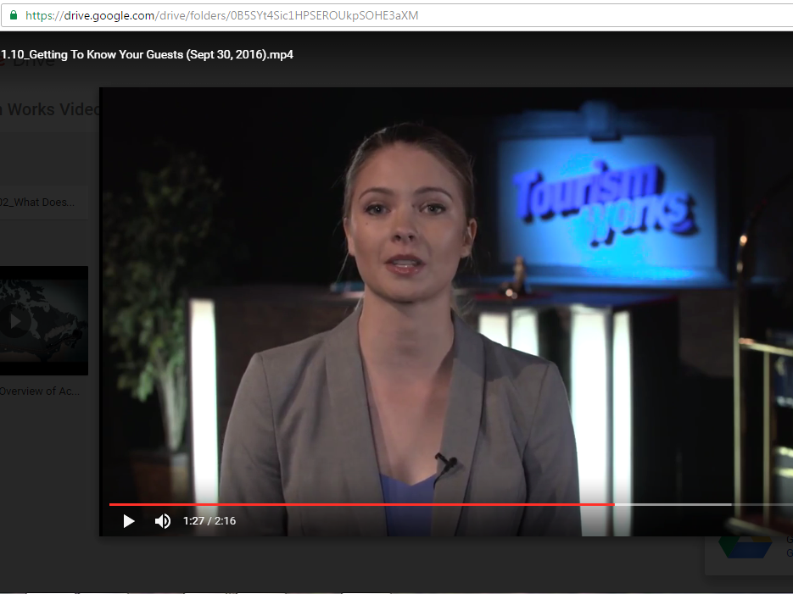
Notes:
One way we’re doing this is through an innovative hospitality training program delivered by Old College
This program is under development with financial support from our Association and the AB government.
the program features short YouTube training videos delivered on mobile devices
these training videos are based on the College’s course curriculum and can be viewed in the workplace, at home, anytime, and anywhere in the province.

Slide 19
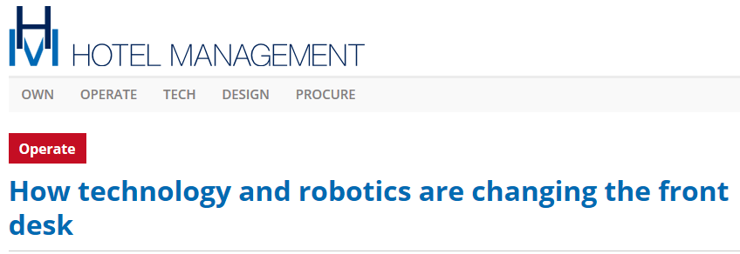
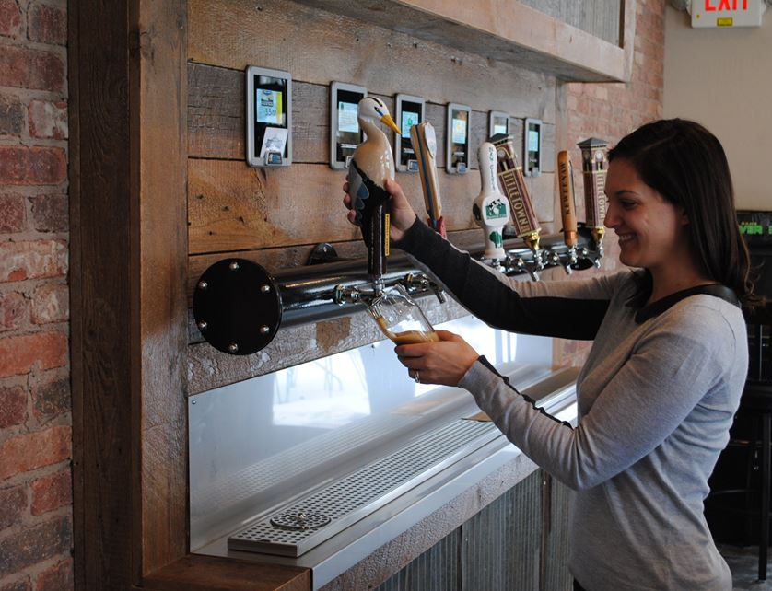

Notes:
And, with rising labour costs a huge headwind for our industry, we also need to embrace technology with potential to improve productivity and customer service
Some of this technology will free staff from basic tasks – like checking in guests and pouring beer - and allow them more time to interact with guests - enhancing their experience.

Slide 20
Notes:
So there you have it, 4 P’s for success:
policy – that works for tourism
promotion – that reaches and compels the global traveler
product – with potential to be world class
and people who help create an awesome guest experience
Do these right and “Tourism Works” to diversify and strengthen Alberta’s economy.

