Slide 1

Creating the New Alberta!
Mission. Technology is changing everything. Prepare the people - Education. Prepare the community – networking. Strengthen
Alberta’s innovation ecosystem

Slide 2

SHARING the VISION
“No More Crude Shocks”
A diversified, more resilient Alberta economy …
CREATING WEALTH and RESILIENCE
by commercializing emerging technologies

Slide 3
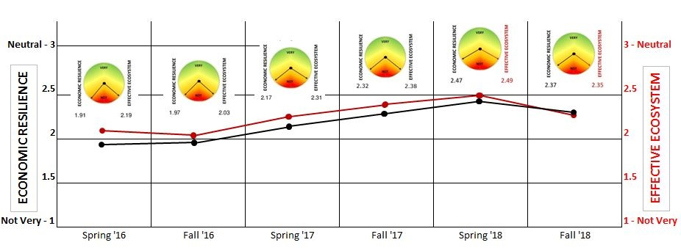
Albert’s economic resilience & innovation are weak
Calgary Region & Alberta Government
… are most vulnerable - Fall ‘18
Innovation in healthcare is timely and essential!

Slide 4

ABOUT ABCtech - Our constituency
Diverse technology and business interests
Over 21,000 contacts SHARING:
Technology is changing everything. Everywhere. And fast! Be prepared ….

Slide 5
Annual themes …
Access to Capital Advisory (2005)
Rural Broadband Development (2006)
Alberta/Canada Fusion Technologies Alliance (2007)
Alberta CleanTech Industry Alliance (2008)
Alberta Cell Therapies Alliance (2009)
Electrifying Transportation (2010)
ABCampus - Student enterprise (2010)
Off-loading Intelligence - When machines decide! (2011)
Alberta Analytics, Big Data, and The Cloud (2012)
Innovation & Enterprise - The People. The Passion. (2013)
The Missing ‘M’ in SME - Why SMEs fail to grow (2014)
Convergence & Creativity - Engineering Innovation (2015)
Creating the New Alberta! - Vision & Leadership (2016)
Leadership Transitions and Engaging Youth (2017)
Creating the Hemp Industry and Personalized Healthcare (2018)

Slide 6

CREATIVE discussion BIG ideas
CleanTech:
Fusion Energy & Climate Change
Electrifying and Automating Transportation
BioTech:
Genomics and Cell Therapies
Agriculture & Food Processing
InfoTech:
Off Loading Intelligence - Machine Learning
Robotics and Smart Drones
Analytics, Big Data & The Cloud
SMEs:
Access to Capital
Understanding SME Success & Failure
Regional Collaboration - Innovation Zones
Change Management:
Innovation & Enterprise
The People - The Passion
Creativity & Convergence
NEVER BORING,
ALWAYS EXPLORING

Slide 7

NETWORKING for small tech businesses and their services
"Meet someone you want to meet again“
Researchers and Entrepreneurs
Academic and Business
Youthful and Wise

Slide 8


