Slide 1
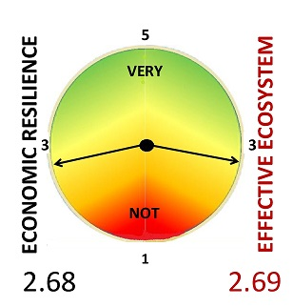

It’s the economy stupid! Who cares?
Spring ‘21
Prepared for the Rotary Edmonton South
August 25, 2021

Slide 2
OVERALL
The survey launched in 2015 is unique, standard, and independent. Seeking partners in distribution to extend beyond Alberta. Researching various reporting options.
Ontario discussions – interest in social enterprise and social issues. Alberta differs in attention paid to the economy and economic diversification/ resilience.
Alberta’s economic resilience is weak due to the extensive influence of the oil and gas industry though resilience has been improving. Government’s role is primarily in policy formulation supporting job creation through small business.
Regional differences in economic resilience between the Calgary and Edmonton Regions reflect the diversity and different contributions of Industry vs. Public Service sectors.
The Innovation Ecosystem is viewed as core to diversification and benefits from Resourcing and Infrastructure, less so for leadership and management processes.

Slide 3
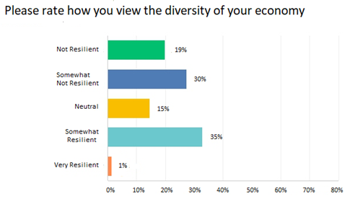
The economy? WEAK!
49%
36%

Slide 4
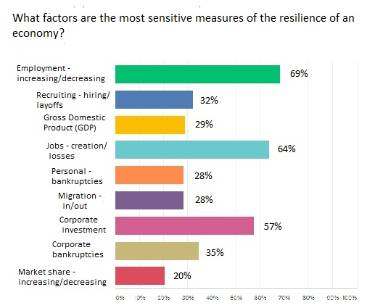
It’s all about jobs! And corporate investment

Slide 5
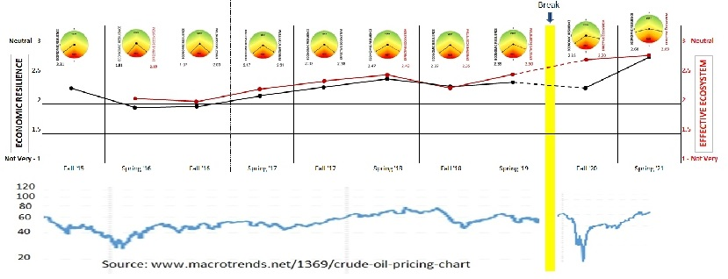
Resilience has been improving since 2015 with significant improvement/recovery between the fall of 2020 and spring of 2021
Sentiment continues to reflect - As goes the price of crude oil so goes the Alberta economy

Slide 6
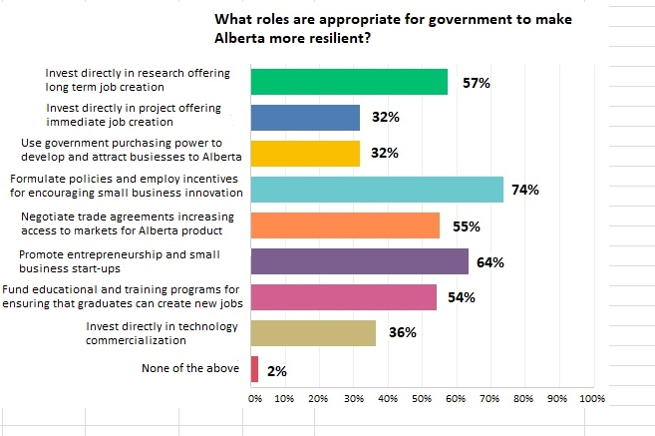
Role(s)for government – small business support, entrepreneurs and job creation/ research

Slide 7
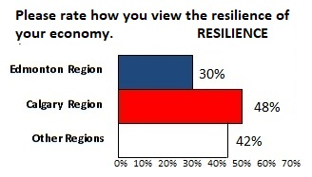
Edmonton Region respondents view of their economic resilience is weaker than Calgary’s
INDEX
ALBERTA 2.68
Edmonton 2.68
Calgary 2.76
Other 2.58
36%

Slide 8
Sectors of interest are balanced
INDUSTRIES – 36%
Mining & Mineral Processing - 4%
Energy & Distribution - 22%
Construction & Real Estate - 10%
Forestry & Wood Products - 3%
Tourism & Entertainment - 14%
Manufacturing & Export - 15%
Transportation & Logistics - 8%
Agriculture & Food Processing - 23%
PROFESSIONS – 29%
Communications & Marketing - 10%
Engineering & Design - 19%
Human Resources & Development - 10%
InfoTech & Analytics - 25%
Finance & Investment - 16%
Management & Strategy - 16%
Legal & Security - 4%
PUBLIC SERVICES – 35%
Health & BioTech - 24%
Government & Public Policy - 20%
NGOs – Non-gov’t Organization - 8%
Education & Research - 21%
Environment & CleanTech - 26%

Slide 9
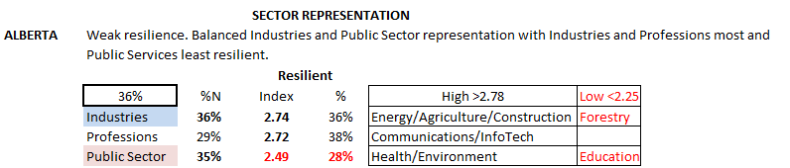
Alberta’s resilience is viewed as weakest by those with an interest in Public Sector particularly in Education

Slide 10
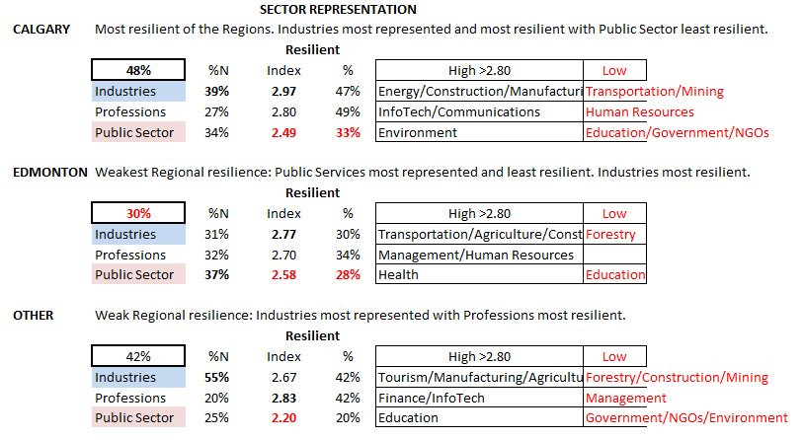
Regional economic resilience boosted by Industry interest, weighed down by Public Services

Slide 11
NEXT, the
Innovation Ecosystem

Slide 12
Spring ‘21
The Innovation Ecosystem
To achieve economic resilience/ diversification, economies need an effective and continuously improving Innovation Ecosystem that supports the survival, growth and retention of entrepreneurs and SMEs (small and medium enterprises). Do you agree?
 | INDEX | % Agree
ALBERTA | 4.56 | 90%
Edmonton |  | 89%
Calgary |  | 93%
Other |  | 100%
Scale and Comments
5 – “Without innovation there is no economic growth possible”
4 – “Innovation ecosystem is an essential but not sufficient for a vibrant
and sustainable economy”
3 – “I’ve witnessed personally some shortcomings from Accelerators,
Incubators, and other Venture Development organizations.”
2 – “Resilience can be achieved in other ways”

Slide 13
Spring ‘21
The Innovation Ecosystem
Please rate the effectiveness of your location's Innovation Ecosystem in supporting the survival, growth, and retention of entrepreneurs and SMEs. Scale 5 – Very Effective to 1 – Very non-effective)
 | INDEX | % Effective
ALBERTA | 2.69 | 29%
Edmonton | 2.55 | 23%
Calgary | 3.10 | 45%
Other | 2.50 | 25%
Scale and Comments
5 – “The number of private and public-sector-supported organizations and programs is significant.”
4 – “Early stages but much better than even a few years ago”
3 – “I truly don't see a great deal of survival, growth... and SMEs.”
2 – “No change for the last 50 years, only university and government environment.”
1 – “There presently is none locally. “ and “Too focused on oil and gas.”

Slide 14
The effectiveness of the innovation ecosystem has been improving since 2015

Slide 15
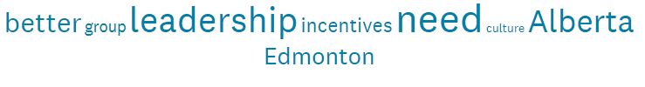
Spring ‘21
The Innovation Ecosystem
The following elements comprise an Innovation Ecosystem. Please rate them in terms of their effectiveness in supporting entrepreneurs and SMEs today? (Scale 5 – Very Effective to 1 – Very non-effective). Note, all are above 3.00
Elements | INDEX | % Effective
Vision & Leadership - purpose and inspiration | 3.21 | 62%
Resources - talent, financing, information, facilities/land, technology | 3.46 | 69%
Processes - communications, decision making, networking, organization, accountability | 3.12 | 55%
Infrastructure - internet, transportation/logistics, research, advisory services - incubators/ accelerators | 3.58 | 76%
Word cluster from comments

Slide 16
OVERALL
The survey launched in 2015 is unique, standard, and independent. Seeking partners in distribution to extend beyond Alberta. Researching various reporting options.
Ontario discussions – interest in social enterprise and social issues. Alberta differs in attention paid to the economy and economic diversification/ resilience.
Alberta’s economic resilience is weak due to the extensive influence of the oil and gas industry though resilience has been improving. Government’s role is primarily in policy formulation supporting job creation through small business.
Regional differences in economic resilience between the Calgary and Edmonton Regions reflect the diversity and different contributions of Industry vs. Public Service sectors.
The Innovation Ecosystem is viewed as core to diversification and benefits from Resourcing and Infrastructure, less so for leadership and management processes.

Slide 17
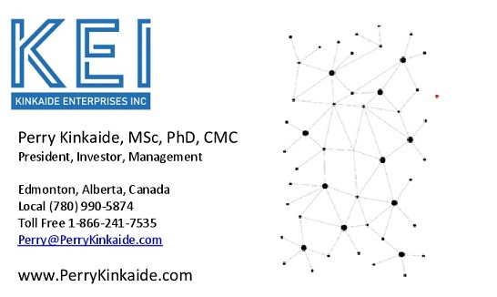
COMMENTS AND QUESTIONS?
Public link for accessing Friday 4pm Webinars
https://us02web.zoom.us/j/85896241732
Thank you!

