Slide 1

Governing Communities
The following presentation supporting three webinars was prepared for the KEI Network and webcast in March 2024. The presentation contains the findings of the on-line survey conducted in April of Alberta’s 317 municipal CAOs and their Councils.
Ten issues were surveyed and their importance established for the CAOs, Mayors and Councils in the Province’s Regions and Jurisdictions. Recommendations and action are proposed including revisions recommended to the Alberta Municipal Government Act.
The survey results are featured in the first 15 minutes of each of the following webinar recordings, followed by a webinar panel discussion in the remaining 45 minutes:
Episode #1. Governing Perspectives – From the inside and closest to the public https://youtu.be/UBaxADMf_78
Episode #2. Problems in Municipal Relationships and Recommendations https://youtu.be/aY_5Sp_1-KM
Episode #3. Series Conclusion. Where from here? Taking action https://youtu.be/uIO6IWB8-RI
Source – KEInetwork.net

Slide 2
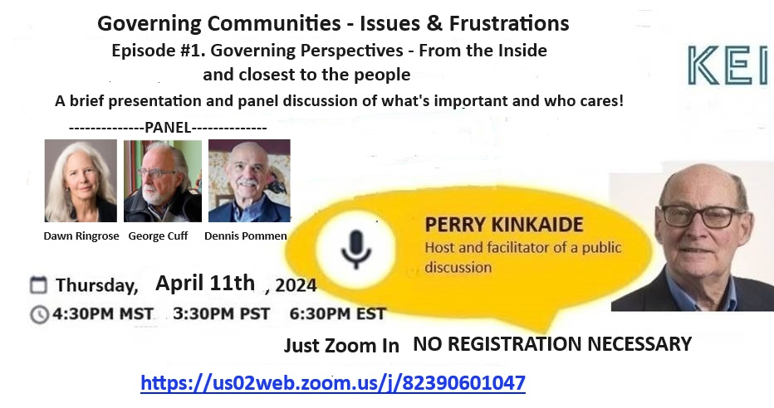

Governing Communities – Issues & Frustrations
Prepared for Alberta’s Municipalities – March/April 2024

Slide 3
Episode #1. Governing Perspectives - From the Inside and Closest to the People
AGENDA – Survey Results and Discussion
The Survey – Who, when and how
The Municipal issues and their Relationships
Issue importance – Overall and for each Relationship
Alignment or not on issue importance of:
            a) CAO’s and Councils
      b) Regions – North, Central, South
      c) Jurisdictions – City, Town, Villages, Rural
      5. Summary highlights

Slide 4
The Survey – why, who, when, and how

Slide 5
SURVEY OBJECTIVES AND METHODOLOGY
OBJECTIVES
1. Increase the awareness for Alberta’s various levels of government of common issues and advocate for collaboration in pursuing their resolution
2. Assess the importance to Municipalities of a number of current issues – 10 identified
3. Compare the perspectives of: CAO and Councils and between Mayors and
Councils
4. Identify differences in importance for thee Province’s Regions and Jurisdictions
5. Prepare DRAFT recommendations for addressing common issues

Slide 6
SURVEY OBJECTIVES AND METHODOLOGY
SURVEY METHODOLOGY
ChatGPT-Plus was prompted to identify 10 of the most important issues in governing
Alberta’s municipalities
Survey Monkey was employed incorporating 10 questions about the importance of each issue including several open-ended for gathering comments and recommendations
Two Surveys were designed for completion within 4-minutes each including two of the same questions and four different questions for a total of 6 questions in each survey plus the open-ended questions
Survey was conducted in March into early April 2024 through email with reminders to
CAO’s of 317 Alberta Municipalities
Engaging of Mayors and Councillors was through the CAOs who were encouraged to share the survey

Slide 7
SURVEY OBJECTIVES AND METHODOLOGY
COMMUNICATIONS & RESOLUTION
1. Prepare findings for sharing with the Municipalities and their representatives.
2. Consult with representatives on options for conveying findings and finalizing any recommendations.
NEXT – Who replied to the survey and their Municipalities?

Slide 8
DIVERSE & REPRESENTATIVE SURVEY RESPONSE
Extraordinarily high (>50%) open rates/interest and completion rates
317 CAOs emailed: 158 Survey 2 159 Survey 3
Open rates: Mar 5 90 (57.7%) 100 (62.9%)
Mar 16 82 (53.2%) 86 (55.1%)
Mar 20 74 (47.7%) 75 (48.4%)
Mar 29 74 (47.7%) 70 (44.6%)
95 Completed - one lacking a position identity
44 CAOs and Managers - 14% of all Municipal CAOs
50 Council members including:
37 Councillors & Reeves
13 Mayors & Deputy Mayors
59 Different Municipalities – 19% of the 317 Alberta Municipalities
MAYORs
COUNCILLORs
CAOs

Slide 9
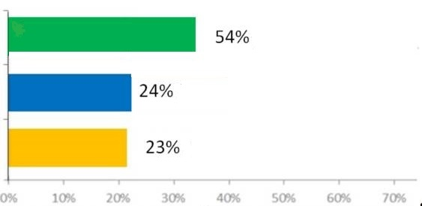
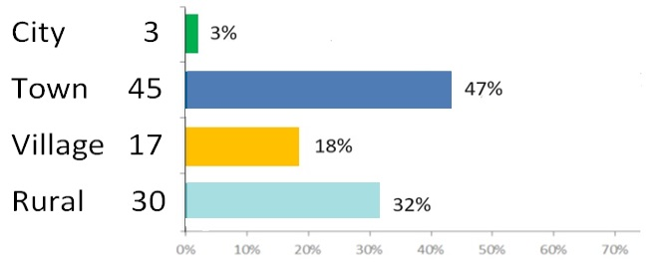
Respondent’s Municipalities
Majority in the North Region, Towns but Few Cities
REGIONS (Total 95)
North 50
Central 23
South 22
JURISDICTIONS ( Total 95)

Slide 10
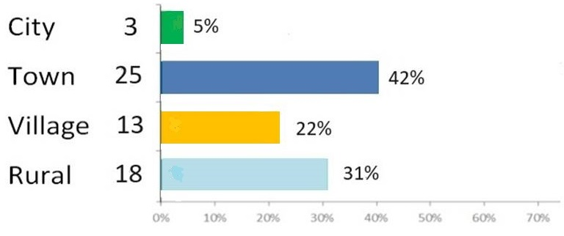
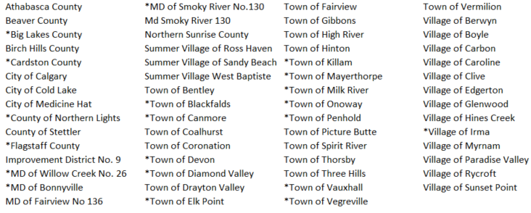
Respondent’s Municipalities – Majority in the North Region and Few Cities
59 Municipalities Represented
* 20 with multiple responses of
COAs engaging Councils

Slide 11
NEXT – Overall what Issues are Most Important and the Associated Relationships?

Slide 12
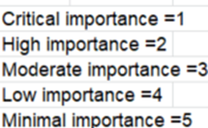
Overall Importance – the Top 3
1 1.52 Provincial downloading - Provincial
2 1.67 Role clarity and council direction - Council
3 1.68 Soaring public expectations - Public
Rank Index Avg Relationship Index Rating

Slide 13
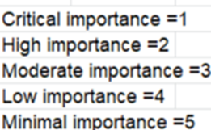
The REST – Ranked 4th through 10
Rank Index Avg. Relationship Index Scale
4 1.74 Provincial government grant cuts - Provincial
5 1.77 Tackling diverse roles beyond means - Provincial
6 2.02 Hindered collaboration due to competition - Inter-Municipal
7 2.33 Urbanization's toll on rural areas - Inter-Municipal
8 2.33 Elusive regional governance - Inter-Municipal
9 2.40 Addressing voter apathy and enhancing - Council
municipal accountability
10 3.02 Demand for inclusivity amid cultural shifts - Public

Slide 14

Overall Importance of All Issues Surveyed
Extraordinary spread between the most and least important issues. Also, the Provincial relationship issues (Downloading, Grant cuts, Diverse roles) are the most dominant in importance.
1 1.52 Provincial downloading - Provincial
2 1.67 Role clarity and council direction - Council
3 1.68 Soaring public expectations - Public
4 1.74 Provincial government grant cuts - Provincial
5 1.77 Tackling diverse roles beyond means - Provincial
6 2.02 Hindered collaboration due to competition - Inter-Municipal
7 2.33 Urbanization's toll on rural areas - Inter-Municipal
8 2.33 Elusive regional governance - Inter-Municipal
9 2.40 Addressing voter apathy and enhancing municipal accountability - Council
10 3.02 Demand for inclusivity amid cultural shifts - Public
Rank Index Avg. Relationship Index Scale

Slide 15
OBSERVATIONS
Extraordinary spread between the most and least important issues.
The Provincial relationship issues of Downloading, Grant cuts, and Diverse roles are the most dominant in importance.

Slide 16
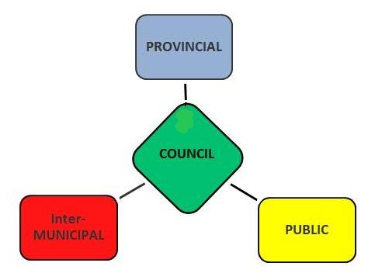
THE TEN MUNICIPAL ISSUES
AND THE ASSOCIATED RELATIONSHIPS
PROVINCIAL
1 - Provincial downloading
4 - Provincial government grant cuts
5 - Tackling diverse roles beyond means
INTER-MUNICIPAL
6 - Hindered collaboration due to competition
7- Urbanization's toll on rural areas
8- Elusive regional governance
PUBLIC
3 - Soaring public expectations
10 - Demand for inclusivity amid cultural shifts
COUNCIL
2 - Role clarity and council direction
9 - Voter apathy and enhancing municipal accountability

Slide 17
NEXT – How aligned are CAOs and Councils including Mayors and Councillors on what is important?

Slide 18
Good Alignment Between CAOs, Mayors and Councils - Except on Role Clarity
Are CAOs and their Councils aligned?
Overall yes, as they are never more than 1 or 2 issue rankings apart, with one glaring exception. Role clarity is ranked as the #1 issue for CAOs and #7 for Councils. They differ by 0.60 in rating 1.40 v 2.00.
Are Mayors and Councillors aligned?
Generally yes, with a few exceptions: Role clarity is ranked as #1 by Mayors but #7 by Councillors.
They and differ by 0.79 in rating (1.50 v 2.29).
They also differ on the importance of Hindered inter-Municipal collaboration with Mayors #9 and
Councillors #4 – a 0.41 rating difference and Voter apathy with Mayors #10 and Councilors #6 (0.48 ).
Other – All are aligned in ranking last (#10th) the Demand for inclusivity amid cultural shifts
OBSERVATION: Mayors and CAOs are more closely aligned on issues than they are with Councillors, both agreeing that the Role clarity issue is #1st in importance while Councillors rank it as #7th.

Slide 19
NEXT –
Are the Regions (North, Central, South) Aligned
and
Are the Jurisdictions (City, Town, Village, Rural) Aligned

Slide 20
Importance of Issues for the Regions
Generally a close alignment (within 3 ranks) between Regions of what is important, though the South Region views Role clarity and council direction less important than others
Issue Importance
North Central South Province
N=50 N=23 N=22 N=95 Notes
Provincial downloading 1 3 1 1
Role clarity and council direction 2 1 6 2 South Region an exception
Soaring public expectations 3 2 4 3
Provincial government grant cuts 4.5 4 2 4
Tackling diverse roles beyond means 4.5 5 3 5
Hindered collaboration due to competition 7 6 5 6
Urbanization's toll on rural areas 9 - 7 7
Elusive regional governance 6 - 9 8
Voter apathy and municipal accountability 8 - 8 9
Demand for inclusivity amid cultural shifts 10 10 10 10
Note. Central Region’s no/weak response to three issues warranted an adjustment to the Region’s rankings.

Slide 21
Importance of Issues for the Jurisdictions
Generally close alignment (within 3 ranks) between Jurisdictions as to what is important, though the Villages and Rural view Role clarity and Collaboration as less important and Regional governance more important than the larger Towns. Note. Skipped Cities as only 3 represented
Issue City Town Village Rural Province
N=3 N=45 N=17 N=30 N=95
Provincial downloading - 2 1 1 1
Role clarity and council direction - 1 7 7 2 Least important to Villages and Rural
Soaring public expectations - 4 3 3 3
Provincial government grant cuts - 3 2 2 4
Tackling diverse roles beyond means - 6 6 6 5
Hindered collaboration due to competition - 5 9 9 6 Least important to Villages and Rural
Urbanization's toll on rural areas - 7 4.5 4.5 7
Elusive regional governance - 9 4.5 4.5 8 More important to Villages and Rural
Voter apathy and municipal accountability - 8 8 8 9
Demand for inclusivity amid cultural shifts - 10 10 10 10

Slide 22
THE RELATIONSHIPS ASSOCIATED WITH
THE MOST IMPORTANT ISSUES
PROVINCIAL
1 - Provincial downloading
4 - Provincial government grant cuts
5 - Tackling diverse roles beyond means
INTER-MUNICIPAL
6 - Hindered collaboration due to competition
7- Urbanization's toll on rural areas
8- Elusive regional governance
PUBLIC
3 - Soaring public expectations
10 - Demand for inclusivity amid cultural shifts
COUNCIL
2 - Role clarity and council direction
9 - Voter apathy and enhancing municipal accountability

Slide 23

SUMMARY HIGHLIGHTS
A close alignment is apparent on the relative importance of issues among CAOs, Councils, Regions, and Jurisdictions with a few possible exceptions:
Role Clarity and council direction is most important for CAOs and Mayors though less so for Councillors who rate higher Voter Apathy and municipal accountability and Hindered collaboration due to competition
Role Clarity among the Regions appears to be less important for the South Region and Villages and Rural Jurisdictions
Regional governance among the four Jurisdictions appears to be more important to smaller Villages and Rural areas
Municipal issues associated with the Province appear to be the most important – 3 of the top 5.

Slide 24
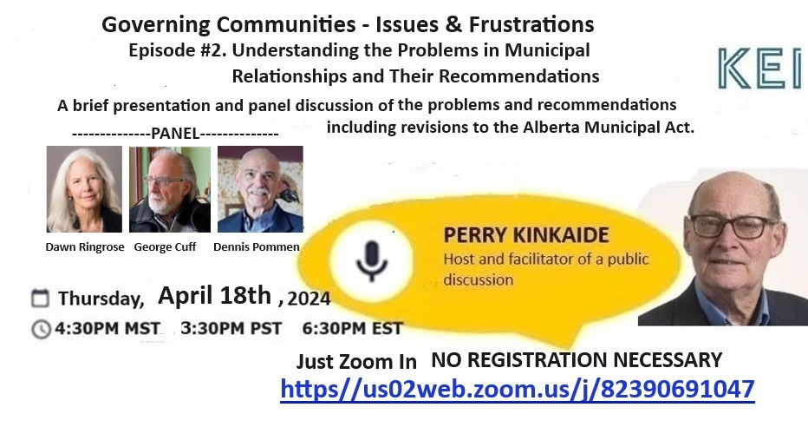

Slide 25

NEXT EPISODE #2
Clarify the RELATIONSHIP Issues,
Reviewing Comments and
Recommendations
First – briefly,what did we learn in Episode #1

Slide 26
SUMMARY HIGHLIGHTS
A close alignment is apparent on the relative importance of issues among CAOs, Councils, Regions, and Jurisdictions with a few possible exceptions:
Role Clarity and council direction is most important for CAOs and Mayors though less so for Councillors who rate higher Voter Apathy and municipal accountability and Hindered collaboration due to competition
Role Clarity among the Regions appears to be less important for the South Region and Villages and Rural Jurisdictions
Regional governance among the four Jurisdictions appears to be more important to smaller Villages and Rural areas
Municipal issues associated with the Province appear to be the most important – 3 of the top 5.

Slide 27

MUNICIPAL ISSUES AND
THE ASSOCIATED RELATIOINSHIPS
PROVINCIAL
1 - Provincial downloading
4 - Provincial government grant cuts
5 - Tackling diverse roles beyond means
INTER-MUNICIPAL
6 - Hindered collaboration due to competition
7- Urbanization's toll on rural areas
8- Elusive regional governance
PUBLIC
3 - Soaring public expectations
10 - Demand for inclusivity amid cultural shifts
COUNCIL
2 - Role clarity and council direction
9 - Voter apathy and enhancing municipal accountability
Each relationship is unique - with it’s own special problem(s)
PROVINCE FIRST

Slide 28
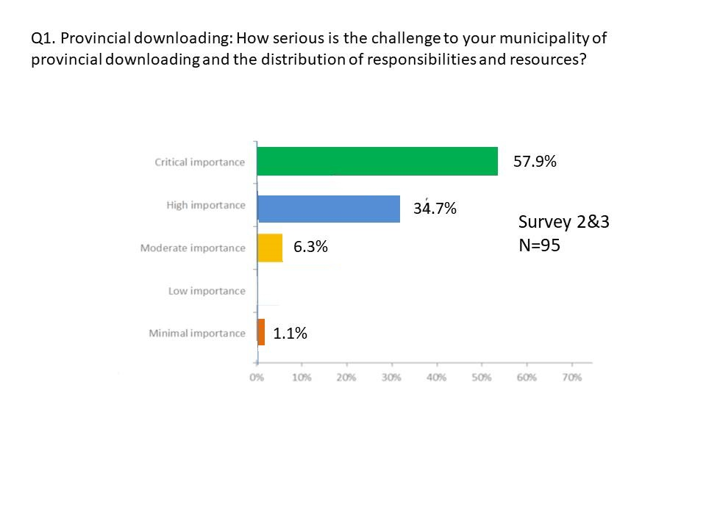
Q1. Provincial downloading: How serious is the challenge to your municipality of provincial downloading and the distribution of responsibilities and resources?
Q1. Provincial downloading: How serious is the challenge to your municipality of provincial downloading and the distribution of responsibilities and resources?
Rank 1st
1.52
34.7%
Observation: Provincial downloading is identified by over 90% of rural municipalities survey as the most important issue impacting several other issues such as the Council’s management of limited resources and Public expectations.
Over 90% of respondents view Provincial Downloading as of Critical/ High importance to their rural municipality.

Slide 29
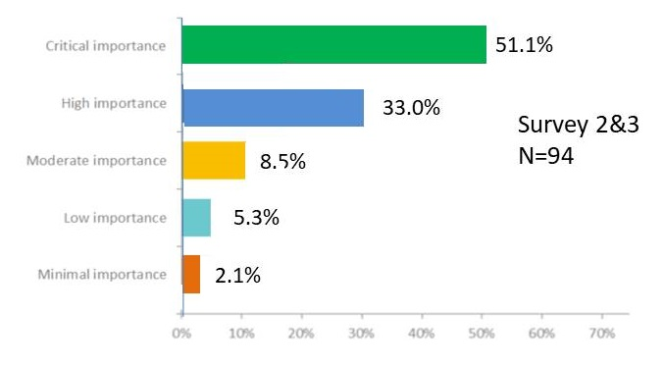
Q2. Provincial government grant cuts: Municipalities need to employ strategies to diversify revenue streams and reduce reliance on Provincial government grants amidst budgetary constraints.
Rank 4th
1.74
Observation. Municipalities (and their NGOs) that rely on Provincial grants are vulnerable to Provincial grant cuts with implications on other issues such as Public expectations.

Slide 30
Q3(3): Tackling diverse roles beyond means: Municipalities should prioritize and streamline their responsibilities to ensure efficient use of resources while still meeting community needs.
Rank 5th
1.77
Survey 3
N=53
Observation. Downloading and Grant cuts create significant issues on Council’s management of resources and Public services. Noteworthy is the unanimity with 100% viewing management of resources as Moderate to Critical in importance.

Slide 31
The PROVINCIAL Relationship – Municipal Views – Issues and Recommendations
Collaborative approach to school requisitions and infrastructure funding.
Conversations with federal, provincial, and municipal governments on the issues facing local government and how to collectively fund and address these issues.
Any provincial downloading should be in consultation and negotiated with municipalities.
The province should be open and transparent about the responsibilities placed upon municipalities, coming to the table to discuss how to move forward collectively and reinstate predictable and permanent funding.
The government downloads are seriously felt by municipalities, especially as infrastructure ages. Collaboration is needed, and a grant program for small municipalities with exclusive funds should be created.
These recommendations emphasize the importance of open communication, negotiation, transparency, and collaboration between municipalities and the provincial government to address challenges effectively.

Slide 32
Ranked 1st. Provincial downloading: How serious is the challenge to your municipality of provincial downloading and the distribution of responsibilities and resources?
DETAILED RECOMMENDATIONS
1. Ensure Adequate Funding Follows Downloading: Whenever the province downloads responsibilities to municipalities, it should provide sufficient financial support to cover the associated costs.
2. Transparent Consultation and Collaboration: Prioritize transparent communication and collaboration between different levels of government to address issues collectively and ensure municipalities are consulted before imposing new requirements or downloading responsibilities.
3. Distribute Resources Equitably: Ensure an even playing field between urban and rural municipalities by distributing resources fairly and considering the needs of all communities, regardless of their geographic location or tax base.
4. Prioritize Critical Services and Infrastructure: Focus on adequately funding essential services such as healthcare, education, and infrastructure, recognizing their significance in supporting community well-being and economic development.
5. Reassess Provincial Responsibilities and Funding Structures: Review provincial organizational structures and funding mechanisms to identify areas where adjustments can be made to alleviate the burden on municipalities and ensure sustainable service delivery.

Slide 33
Ranked 4th - Provincial government grant cuts: Municipalities need to employ strategies to diversify revenue streams and reduce reliance on Provincial government grants amidst budgetary constraints.
DETAILED RECOMMENDATIONS
1. Stop Grant Cuts: Municipalities urge the province to halt reductions in grant programs to prevent adverse impacts on essential services and infrastructure projects.
2. Diversify Revenue Streams: While recognizing the challenges, municipalities need to explore strategies to diversify revenue sources beyond provincial grants, including options like sales taxes and partnerships with industries and Indigenous communities.
3. Distribute Funding Equitably: Ensure funding mechanisms are fair and provide adequate support to smaller municipalities and rural areas with limited opportunities for revenue diversification.
4. Encourage Economic Development: The province should support economic development initiatives in rural communities, incentivize industry diversification, and consider decentralizing government jobs to promote growth outside major urban centers.
5. Advocate for Funding Stability: Municipalities should advocate for stable and predictable grant funding from the province to enable effective planning and service provision without overreliance on property taxes or user fees.
OVERALL. Is the continuing growth of public services sustainable?

Slide 34
Ranked 5th. Tackling diverse roles beyond means: Municipalities should prioritize and streamline their responsibilities to ensure efficient use of resources while still meeting community needs.
DETAILED RECOMMENDATIONS
1. Province Must Take Responsibility: The province should reassume responsibility for streamlining processes and reducing bureaucratic red tape to alleviate the burden on municipalities and prevent staff burnout.
2. Asset Management-Based Funding: Prioritize funding for essential infrastructure projects based on an asset management model, ensuring that core infrastructure needs are addressed before investing in non-essential projects like walking trails.
3. Clear Division of Responsibilities: Clearly define municipal roles and responsibilities, emphasizing regional sharing of services and revisiting the funding model to ensure fair distribution for shared services.
4. Provincial Support and Advocacy: Advocate for increased provincial support and funding for municipalities, particularly in light of economic challenges and inflationary pressures.
5. Community Understanding and Collaboration: Foster community understanding of municipal roles and encourage collaboration with larger communities to provide services at affordable rates.

Slide 35
Q4(3): Hindered collaboration due to competition: Municipalities should foster a culture of cooperation and collaboration among neighboring jurisdictions, despite competitive pressures.
32.7%
42.3%
19.2%
1.9%
3.8%
Recall – Mayors ranked this #9 with Councillors ranking it #4.

Slide 36
Q4(2). Urbanization's toll on rural areas: Rural municipalities need to reduce the impact of urbanization on rural communities, such as declining populations and limited resources.
6.7%
6.7%

Slide 37
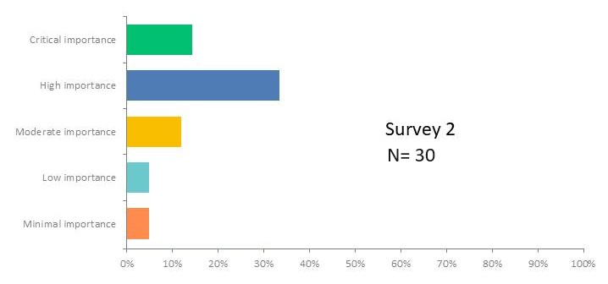
Q6(2). Elusive regional governance: Municipalities should be overcoming barriers to regional governance and promote collaboration across jurisdictions to address shared challenges effectively.
Rank 7.5
2.33
20.0%
46.7%
20.0%
6.7%
Survey 2
N=30
6.7%

Slide 38
The INTER-MUNICIPAL Relationship – Municipal Views – Issues and Recommendations
Fair and equitable ICF process: Municipalities should work together to ensure that the process for Inter-municipal Collaboration Framework (ICF) is fair and equitable. This may involve establishing clear guidelines, mechanisms for dispute resolution, and regular review processes to address any inequities.
Encourage amalgamation of municipalities: Municipalities could collaborate by exploring the possibility of merging or amalgamating to streamline governance structures and improve resource allocation. This may involve conducting feasibility studies, engaging with stakeholders, and negotiating agreements to facilitate the amalgamation process.
Foster a culture of cooperation and collaboration: Municipalities should actively promote a culture of cooperation and collaboration among neighboring jurisdictions. This could include establishing regular meetings, joint committees, and shared initiatives to address common challenges and opportunities. Collaboration efforts should focus on building trust, sharing information, and working towards shared goals.
Encourage engagement with all stakeholders on projects: Municipalities should engage with all relevant stakeholders, including residents, businesses, and community organizations, to ensure that collaborative projects are inclusive and address the needs of all parties involved. This may involve conducting public consultations, seeking input from diverse perspectives, and incorporating feedback into decision-making processes.
Implement revenue sharing and fair funding models: Municipalities should work together to establish fair funding models based on usage from neighboring municipalities. This may involve negotiating agreements for revenue sharing, pooling resources for joint projects, and ensuring that funding allocations are transparent and equitable.
Overall, collaboration between municipalities should be based on principles of fairness, inclusivity, and mutual benefit. By working together effectively, municipalities can address common challenges, maximize resources, and create positive outcomes for their communities.

Slide 39
Rank 6th - Hindered collaboration due to competition: Municipalities should foster a culture of cooperation and collaboration among neighboring jurisdictions, despite competitive pressures.
DETAILED RECOMMENDATIONS
1. Incentivize Collaboration: Encourage collaboration through incentives such as additional grant increases for regional projects involving multiple municipalities.
2. Fair Funding Models: Implement fair funding models based on usage from neighboring municipalities to avoid competition and ensure equitable distribution of resources.
3. Promote Outsourcing and Partnerships: Encourage municipalities to outsource or contract services to neighboring jurisdictions and foster partnerships to reduce duplication of services.
4. Force Amalgamation: Consider forced amalgamation of municipalities to facilitate cost-sharing, streamline administrative functions, and promote efficiency in service delivery.
5. Break Down Silos: Encourage municipalities to break down silos, work together, and focus on regional cooperation to enhance competitiveness on a global scale.

Slide 40
Rank 7.5 - Urbanization's toll on rural areas: Rural municipalities need to reduce the impact of urbanization on rural communities, such as declining populations and limited resources.
DETAILED RECOMMENDATIONS
1. Economic Development Collaboration: Encourage collaboration between rural municipalities and villages for economic development initiatives and revenue sharing to support growth.
2. Targeted Attention and Support: Provide increased attention and support to rural areas facing declining populations and infrastructure deficits, focusing on determining actual needs rather than imposing expensive master plans.
3. Fair Cost Allocation: Ensure that hamlets bear the full cost of services, improvements, and maintenance to prevent rural ratepayers from subsidizing them, implementing full-cost accounting for transparency.
4. Equitable Funding: Advocate for more equitable funding distribution to rural areas, moving away from solely per capita funding models that favor larger urban centers.
5. Increase Funding: Lobby for increased funding for rural areas, such as through the Local Government Fiscal Framework (LGFF), to provide consistent support and alleviate financial pressures.

Slide 41
Rank 7.5 - Elusive regional governance: Municipalities should be overcoming barriers to regional governance and promote collaboration across jurisdictions to address shared challenges effectively.
DETAILED RECOMMENDATIONS
1. Promote Collaboration: Encourage municipalities to work together regionally to address shared challenges effectively.
2. Focus on Communication and Support: Emphasize the importance of communication and support among jurisdictions, highlighting existing successful collaborations such as monthly CAO meetings and quarterly Mayor meetings within regional alliances.
3. Address Legislative Inequities: Enhance legislation governing intermunicipal collaboration to address inequities, particularly in exempt assessment impacting communities serving the greater region.
4. Voluntary Collaboration: Avoid mandating or enforcing regional collaboration, as it may be more effective when approached voluntarily.
5. Resource Sharing: Increase resource sharing among municipalities to cut costs and improve efficiency, recognizing the benefits of collaboration in reducing expenses, especially for rural areas.

Slide 42
Q3(2). Soaring public expectations: Municipalities need to effectively communicate with constituents about mandate and services to manage and align public expectations with available resources.
Survey 2
N = 41

Slide 43
Q5(3). Demand for inclusivity amid cultural shifts: Municipalities should promote diversity and inclusivity in decision-making processes and community engagement efforts.
9.8%
Rank 10
3.10
19.6%
41.2%
17.6%
11.8%
Note. This issue was rated as lowest in importance of the 10 surveyed.

Slide 44
The PUBLIC Relationship – Municipal Views – Issues and Recommendations
1. Enhanced Communication and Engagement: Municipalities should prioritize transparent communication with constituents, including advertising campaigns to demonstrate the challenges faced, while engaging residents through town hall meetings and surveys to gather feedback and manage public expectations effectively.
2. Clarity on Responsibilities and Diversity Considerations: Provide clear clarification on the roles and responsibilities of municipalities while being conscious of cultural differences within the region. This involves ensuring everyone is treated equally regardless of background or identity, fostering unity and inclusivity within the community.
3. Streamlining Processes and Equal Treatment: Cut unnecessary red tape to improve efficiency in delivering services and meeting public needs while promoting equal treatment of all residents. Municipalities should avoid promoting inclusivity of specific groups over others and focus on treating everyone equally as human beings.
4. Transparency in Decision Making and Community Engagement: Include diversity considerations in strategic planning processes and decision-making, listening to residents and ensuring opportunities for engagement exist for all. This fosters a sense of inclusion and unity within the community.
5. Collaborative Efforts and Community Support: Foster collaboration among municipalities and encourage community support for diverse perspectives in decision-making processes. By promoting unity rather than division and recognizing the importance of diversity, municipalities can effectively address both public expectations and inclusivity amid cultural shifts.

Slide 45
Rank 3rd - Soaring public expectations: Municipalities need to effectively communicate with constituents about mandate and services to manage and align public expectations with available resources.
DETAILED RECOMMENDATIONS
1. Manage Expectations Honestly: Acknowledge financial restraints and communicate honestly with constituents about the limitations in delivering services and meeting public expectations.
2. Enhance Communication: Utilize mass notification systems, community planning meetings, and advertising campaigns to directly communicate challenges faced by municipalities and engage citizens in decision-making processes.
3. Clarify Roles and Responsibilities: Provide clarification on the roles of different levels of government to help the public understand municipal responsibilities and limitations.
4. Hold Town Hall Meetings: Organize town hall meetings and surveys to gather feedback from residents and address concerns transparently.
5. Advocate for Funding: Advocate for funding from higher levels of government to support infrastructure upgrades and essential services, while also urging the reduction of red tape and reliance on unstable revenue sources like oil and gas.

Slide 46
Rank 10th - Demand for inclusivity amid cultural shifts: Municipalities should promote diversity and inclusivity in decision-making processes and community engagement efforts.
DETAILED RECOMMENDATIONS
1. Maintain Equality: Ensure that everyone is treated equally without favoring any specific group over others. Focus on hiring based on merit and providing equal opportunities for all individuals.
2. Promote Inclusivity: Encourage inclusivity in decision-making processes and community engagement efforts while avoiding promoting specific groups over others.
3. Respect Diversity: Recognize and respect cultural differences within the community and make efforts to communicate and cooperate with all groups, including First Nations.
4. Avoid Political Agendas: Municipalities should refrain from promoting political agendas and instead focus on providing essential services to all residents regardless of cultural backgrounds.
5. Listen to Residents: Actively listen to the concerns and needs of residents and incorporate their feedback into decision-making processes to ensure the sustainability and welfare of the community.

Slide 47
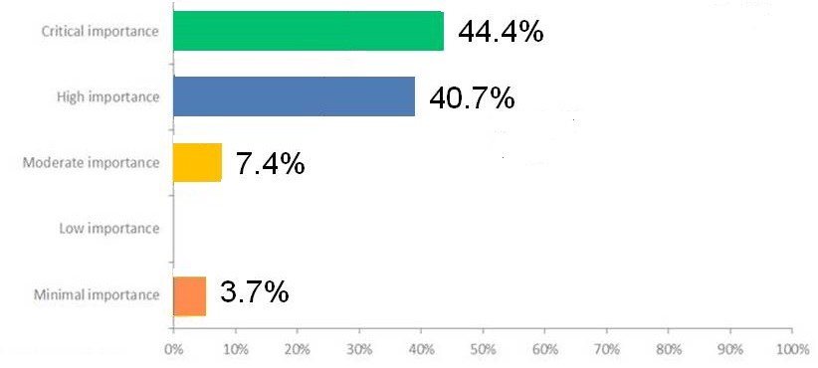
Ranked 2nd - Role clarity and council direction: Training is needed in governance for election candidates, new Councillors, and other council members, particularly about the roles and responsibilities for ensuring effective governance.
Rank 2
1.67
Survey 2
N=27
Recall - Mayors and CAOs ranked this 1st in importance with Councillors ranking it 7th.

Slide 48
Q6(3). Addressing voter apathy and enhancing municipal accountability: Initiatives should be implemented to increase civic engagement and hold municipal leaders accountable to their constituents.
17.3%
Rank 9
2.40
42.3%
25.0%
13.5%
Survey 3
N=52
1.9%
Recall – Mayors ranked this #10 and Councilors #6.

Slide 49
The COUNCIL Relationship – Municipal
Views – Issues and Recommendations
1. Mandatory Training and Education: Implement compulsory education and training programs, such as Munis101 and EOEP courses, for election candidates, new councillors, and other council members. This should include clear orientation on roles, responsibilities, code of conduct, and legal boundaries.
2. Enhanced Access to Information: Streamline access to information portals, particularly for smaller municipalities like hamlets, villages, and small towns. This could involve improving computer setups and ensuring easier access to essential resources.
3. Increased Civic Engagement: Create initiatives to boost civic engagement and hold municipal leaders accountable. This may involve implementing innovative solutions to attract citizens to participate in local politics, along with increasing communication to the public about the benefits of a strong local government.
4. Transparency and Accountability: Ensure transparency in decision-making processes and promote accountability among municipal leaders. This could include measures like meaningful engagement with the public, avoiding partisan politics, and making sure decisions are transparently made with taxpayer dollars.
5. Pre-Qualification of Municipal Leaders: Consider pre-qualification measures for municipal leaders and tax incentives for qualified voters to encourage more qualified individuals to run for local positions. This aims to shift the focus of municipal elections from popularity contests to the qualifications of the candidates and ultimately improve governance.

Slide 50
Ranked 2nd - Role clarity and council direction: Training is needed in governance for election candidates, new Councillors, and other council members, particularly about the roles and responsibilities for ensuring effective governance.
DETAILED RECOMMENDATIONS
1. Mandatory Training: Implement mandatory yearly training for all council members, including election candidates, to ensure understanding of roles and responsibilities in governance. Failure to complete training should result in removal from office.
2. Continual Education: Provide increased opportunities for learning and access to information portals, particularly for smaller municipalities facing challenges with technology and resources.
3. Legislated Training: Make courses like the Elected Officials Education Program (EOEP) mandatory by legislation, enabling councils to impose stronger sanctions for misconduct.
4. Pre-Election Education: Require mandatory training for election candidates before they can run for office, ensuring they understand governance rules and expectations.
5. Ongoing Training Support: Offer continued support through programs like Munis101 and EOEP courses, with all council members, new and existing, required to participate, especially during election years.

Slide 51
Ranked 9th - Addressing voter apathy and enhancing municipal accountability: Initiatives should be implemented to increase civic engagement and hold municipal leaders accountable to their constituents.
DETAILED RECOMMENDATIONS
1. Promote Qualifications: Implement pre-qualification measures for municipal leaders and provide tax incentives for informed voters to encourage civic engagement based on qualifications rather than popularity.
2. Pre-training Leaders: Ensure municipal leaders receive training before running for office and attend local council meetings to understand ongoing issues.
3. Refine Recall Legislation: Modify recall legislation to require only those who voted to have a voice in recall processes, thereby incentivizing voter engagement and responsibility.
4. Combat Polarization: Address the increase in extreme views and polarization in municipal politics by sanctioning citizen abuse of elected officials and protecting municipal politics from partisan influences.
5. Focus on Communication: Enhance communication strategies, increase outreach efforts, and utilize various mediums to disseminate information to residents, fostering transparency and accountability.

Slide 52
ALSO
RECOMMENDATIONS FOR REVISING
THE ALBERTA MUNICIPAL ACT
AND
OTHER COMMENTS

Slide 53
Q7. In Conclusion. Are there any points you would recommend be included in the next rewrite of the Alberta Municipal Government Act (MGA)?
1. Operate Municipalities Like A Business: Encourage municipalities to operate employing business principles, utilizing Municipal Controlled Corporations for development.
2. Strengthen Code of Conduct and Protection for CAOs: Enhance legislation on the Code of Conduct and provide stronger protection for Chief Administration Officers.
3. Ensure Transparency for Candidates: Advocate for unrestricted transparency of all candidates, including disclosure of FOIP-related information relevant to their qualifications.
4. Train and Educate: Mandate pre-election training for candidates and ongoing education for elected officials on roles, responsibilities, and the Municipal Government Act (MGA).
5. Improve Accountability and Governance: Strengthen accountability measures, such as establishing provincial bodies to investigate Code of Conduct violations, tightening conflict of interest rules, and providing support systems for enforcing disqualifications of councillors.
REMAINING COMMENTS

Slide 54
Q8. Are there any other comments you would like to make?
Asset Retirement Obligations: Concerns raised about the financial implications of asset retirement obligations on municipal financial statements.
MLA Support and Funding for Small Municipalities: Call for better MLA support for local government and increased unrestricted funding for small municipalities to prevent negative changes in Alberta's landscape.
Council Accountability and Corruption: Highlighted the need for stronger measures to address corruption among elected officials and ensure accountability.
Firefighters as Elected Officials: Proposal to establish a mandatory minimum timeframe between serving as a firefighter and holding elected office to prevent conflicts of interest.
Collaboration and Funding: Emphasis on the importance of collaboration among municipalities for long-term prosperity and suggestions for a municipal partnership program to incentivize collaboration and increase funding.
Safety Support for Council and Staff: Recognition of the need for safety supports for council members and staff, including emotional, mental, and physical safety.
…CONTINED

Slide 55
CONTINUED … Are there any other comments you would like to make?
Division of Municipalities Based on Needs: Proposal for a clearer division of municipalities based on needs for better allocation of funding opportunities.
7. Party Politics at the Municipal Level: Consistent opposition to introducing political parties into
municipal governance.
Financial Challenges and Downloading: Concerns about financial challenges resulting from downloading and a call for municipalities to primarily look inward for solutions during fiscal challenges.
9. Proper Funding for Policing: Request for proper funding for policing and criticism of federal
financial burdens on municipalities.
10. Avoiding Partisan Politics: Consistent emphasis on keeping partisan politics out of municipal
governance.
11. Enforcement of MGA Rules: Suggestion for government intervention in enforcing Municipal
Government Act rules when stalemates occur at the municipal level.

Slide 56
OVERALL
ALL MUNICIPALITIES ARE VULNERABLE TO PROVINCIAL DOWNLOADING AND GRANT CUTS. COUNCILS ARE CHALLENGED TO CLARIFY IT’S ROLE IN MANAGING MULTIPLE RELATIONSHIPS WITH LIMITED RESOURCES AMID SOARING PUBLIC EXPECTATIONS AND VOTER APATHY
RECOMMENDATIONS TARGET COUNCIL’S OPTIONS INCLUDING RECOMMENDED REVISIONS TO THE ALBERTA MUNICIPAL ACT
EPISODE #3 - WHERE FROM HERE?
SETTING PRIORITIES AND COLLABORATION
IS CONTINUING GROWTH MANAGEABLE … EVEN SUSTAINABLE?

Slide 57
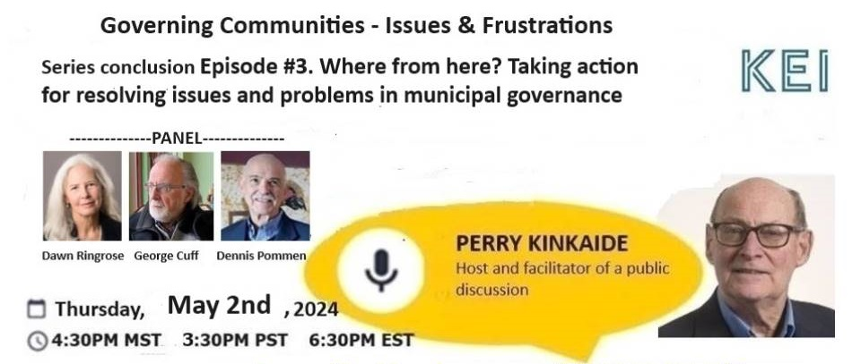

Slide 58
OUR OBJECTIVES TODAY
Overview of the survey and the results of what is important today
in the governing of municipalities and what is recommended
2. Propose action plans for following through on the recommendations for
each of the four relationships managed by the municipalities
3. Engage the panel and you the viewers in a discussion on taking action.
NEXT THE SURVEY

Slide 59
THE SURVEY
Recall in March we surveyed the 317 Alberta Municipal CAOs who also
engaged their Mayors and Councillors.
About 20% responded, a blend of the three. Also well represented were the Regions: North, Central, South, And each of the jurisdictions: Counties, Towns, Villages, Rural Areas – less so the cities.
The questions sought to rate the 10 issues identified in importance and the associated recommendations including the Municipal Government Act.
NEXT THE RANKING OF ISSUES IN IMPORTANCE
AND FOR EACH MUNICIPAL RELATIONSHIP

Slide 60
MUNICIPAL ISSUES AND
THE ASSOCIATED RELATIONSHIPS
PROVINCIAL
1 - Provincial downloading
4 - Provincial government grant cuts
5 - Tackling diverse roles beyond means
INTER-MUNICIPAL
6 - Hindered collaboration due to competition
7- Urbanization's toll on rural areas
8- Elusive regional governance
PUBLIC
3 - Soaring public expectations
10 - Demand for inclusivity amid cultural shifts
COUNCIL
2 - Role clarity and council direction
9 - Voter apathy and enhancing municipal accountability
Each relationship is unique - with it’s own special problem(s)

Slide 61
SUMMARY HIGHLIGHTS
A close alignment is apparent on the relative importance of issues among CAOs, Councils, Regions, and Jurisdictions with a few possible exceptions:
Role Clarity and council direction is most important for CAOs and Mayors though less so for Councillors who rate higher Voter Apathy and municipal accountability and Hindered collaboration due to competition
Role Clarity among the Regions appears to be less important for the South Region and Villages and Rural Jurisdictions
Regional governance among the four Jurisdictions appears to be more important to smaller Villages and Rural areas
Municipal issues associated with the Province appear to be the most important – 3 of the top 5.

Slide 62
OVERALL
ALL MUNICIPALITIES ARE VULNERABLE TO PROVINCIAL DOWNLOADING AND GRANT CUTS. COUNCILS ARE CHALLENGED TO CLARIFY THEIR ROLE IN MANAGING MULTIPLE RELATIONSHIPS WITH LIMITED RESOURCES AMID SOARING PUBLIC EXPECTATIONS AND VOTER APATHY
RECOMMENDATIONS TARGET COUNCIL’S OPTIONS INCLUDING RECOMMENDED REVISIONS TO THE ALBERTA MUNICIPAL ACT
EPISODE #3 - WHERE FROM HERE?
INITIATING CHANGE
IS CONTINUING GROWTH MANAGEABLE … EVEN SUSTAINABLE?
TURNING NOW TO TAKING ACTION

Slide 63
SHARED ACTION PLAN
The following strategies have been tailored to execute the recommendations associated with each relationship.
Communicate. Cooperate. Collaborate.
The intent is to effectively initiate policy changes and address municipal problems while strengthening relationships and engaging the various stakeholders.

Slide 64
REVIEW
COUNCIL ISSUES AND RECOMMENDATIONS
2nd - Role clarity and council direction
1. Mandatory Training
2. Continuous Education
3. Legislated Training
4. Mandatory Pre-Election
Training
5. Ongoing Training Support
5th - Tackling diverse roles
beyond means
1. Province Must Take
Responsibility
2. Asset Management-Based
Funding
3. Clear Division of
Responsibilities
4. Provincial Support and Advocacy
5. Community Understanding and
Collaboration
9th - Addressing voter apathy and enhancing municipal accountability
1. Promote Qualifications
2. Pre-training Leaders
3. Refine Recall Legislation
4. Combat Polarization
5. Focus on Communication
IS CONTINUING GROWTH MANAGEABLE … EVEN SUSTAINABLE?

Slide 65
Taking Action - Councils Themselves
Education and Training: Provide training sessions for council members on relevant policy issues and governance best practices. Introduce the orientation to Council and Council roles for Council election candidates.
Internal Communication: Foster open communication and collaboration among council members to build consensus on policy priorities.
Policy Development Process: Establish clear processes for policy development, including opportunities for input from council members and stakeholders.
Evaluation: Regularly evaluate the effectiveness of existing policies and make adjustments as needed based on feedback and outcomes.

Slide 66
REVIEW
PUBLIC ISSUES AND RECOMMENDATIONS
3rd - Soaring public expectations
1. Manage Expectations Honestly
2. Enhance Communication
3. Clarify Roles and Responsibilities
4. Hold Town Hall Meetings
5. Advocate for Funding
10th - Demand for inclusivity amid cultural shifts
1. Maintain Equality
2. Promote Inclusivity
3. Respect Diversity
4. Avoid Political Agendas
5. Listen to Residents

Slide 67
Taking Action - Public Relationship
Community Engagement: Conduct public consultations and town hall meetings to gather input on municipal issues.
Transparency: Communicate openly about the challenges faced by the municipality and the rationale behind proposed policy changes.
Education: Provide resources and information to help the public understand the importance of the proposed policy changes.
Feedback Mechanisms: Establish feedback mechanisms to allow the public to provide input throughout the policy development process.

Slide 68
REVIEW
INTER-MUNICIPAL ISSUES AND RECOMMENDATIONS
6th - Hindered collaboration due to competition
1. Incentivize Collaboration
2. Fair Funding Models
3. Promote Outsourcing and
Partnerships
4. Consider Forced
Amalgamation
5. Break Down Silos
7.5 - Urbanization's toll on rural areas
1. Economic Development
Collaboration
2. Targeted Attention and
Support
3. Fair Cost Allocation
4. Equitable Funding
5. Increase Funding
7.5 - Elusive regional governance
1. Promote Collaboration
2. Focus on Communication
and Support
3. Address Legislative Inequities
4.. Voluntary Collaboration
5. Resource Sharing

Slide 69
Taking Action - Other Municipalities
Networking: Build relationships with neighboring municipalities through regular meetings and forums.
Information Sharing: Share best practices and lessons learned to foster mutual learning and collaboration.
Joint Projects: Identify areas where collaboration can lead to more efficient service delivery or cost savings.
Advocacy Coalition: Form coalitions with other municipalities to advocate for shared interests at the provincial level.

Slide 70
REVIEW
PROVINCIAL ISSUES AND RECOMMENDATIONS
5th - Tackling diverse roles beyond means (A Council issue)
1. Province Must Take
Responsibility
2. Asset Management-Based
Funding
3. Clear Division of Responsibilities
4. Provincial Support and Advocacy
5. Community Understanding and
Collaboration
1st - Provincial downloading
1. Ensure Adequate Funding
Follows Downloading
2. Transparent Consultation
and Collaboration
3. Distribute Resources
Equitably
4. Prioritize Critical Services
and Infrastructure
5. Reassess Provincial Funding
and Responsibilities Structures
4th - Provincial grant cuts
1. Stop Grant Cuts
2. Diversify Revenue Streams
3. Distribute Funding Equitably
4. Encourage Economic
Development
5. Advocate for Funding Stability
THE IMPACT ON MUNICIPALITIES IS CHALLENGING THEIR SUSTAINABILITY

Slide 71
Taking Action - Provincial Relationship
Research and Analysis: Understand existing provincial policies and regulations affecting municipalities.
Engagement: Initiate dialogue with provincial representatives through meetings, correspondence, and presentations.
Proposal Development: Develop a clear, data-driven proposal outlining the issues and recommended solutions.
Advocacy: Advocate for policy changes that benefit municipalities while aligning with provincial goals.
Collaboration: Offer opportunities for collaboration on joint initiatives to address common challenges.

Slide 72
REVIEW
REWRITING THE MGA - RECOMMENDATIONS
1. Operate Municipalities Like A Business: Encourage municipalities employing business principles, utilizing
Municipal Controlled Corporations for development.
2. Strengthen Code of Conduct and Protection for CAOs: Enhance legislation on the Code of Conduct and
provide stronger protection for Chief Administration Officers.
3. Ensure Transparency for Candidates: Advocate for unrestricted transparency of all candidates, including
disclosure of FOIP-related information relevant to their qualifications.
4. Train and Educate: Mandate pre-election training for candidates and ongoing education for elected
officials on roles, responsibilities, and the Municipal Government Act (MGA).
5. Improve Accountability and Governance: Strengthen accountability measures, such as establishing
provincial bodies to investigate Code of Conduct violations, tightening conflict of interest rules, and providing support systems for enforcing disqualifications of councillors.

Slide 73
TIMELINES PROPOSED
Spring ‘24 – Prepare and send the survey Report to all CAOs including reference to the webinar recordings for review, sharing, comment
Summer ‘24 - Meet with AUMA and RMA to share the Report and propose further action including measures to engage:
The Public, the Municipalities, the Province
The Councils for design of a standard training program
Spring '25 – Provide assistance in co-hosting a Provincial Conference to finalize any recommended action and responsibilities for each municipal relationship.

