Slide 1
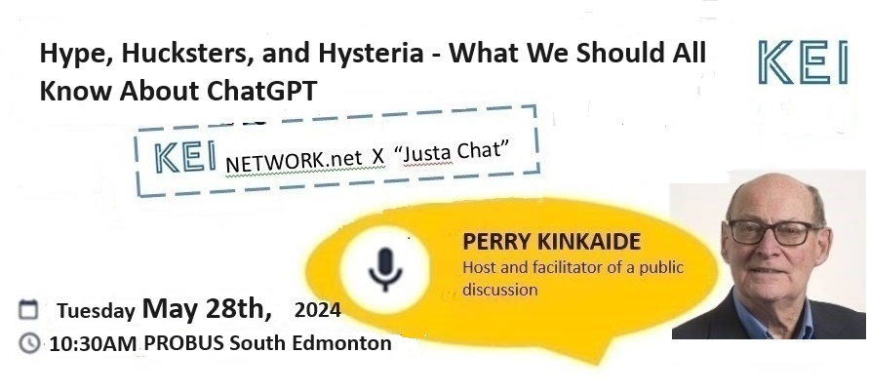

Slide 2
ChatGPT - a Ripple in a Greater Tsunami
Rapid advancements in artificial intelligence (AI), large language models (LLMs - such as ChatGPT), and machine learning (ML) have generated significant excitement, but they also come with misconceptions and challenges.
Consider

Slide 3
Understanding the AI Landscape
Hype … exaggerated claims
Hucksters … aggressive sales agents
Hysteria … exaggerated emotion
Hype & Hucksters
Hucksters & Hysteria
Hype & Hysteria
Hype & Hucksters & Hysteria
The AI market is new/unfamiliar, volatile/
chaotic. Opportunities/threats abound.
Caution is warranted.

Slide 4
Hype vs. Reality
While AI has made remarkable progress, many claims are exaggerated. It's important to distinguish between what's currently possible and what remains speculative.

Slide 5
2. General AI vs. Narrow AI
Most ot today’s AI systems are narrow AI, designed for specific tasks. General AI, with human-like reasoning, remains a distant goal.

Slide 6
3. Overestimation of Capabilities
AI systems can perform specific tasks exceptionally well but often lack common sense and contextual understanding.

Slide 7
4. Data Dependency
ML models require vast amounts of data for training. The quality and diversity of this data significantly impact performance.

Slide 8
5. Bias and Fairness
AI systems can inherit biases present in training data, leading to unfair or discriminatory outcomes. Addressing bias is a critical ongoing challenge.

Slide 9
6. Explainability
Many AI and ML models, especially deep learning ones, operate as "black boxes," making it difficult to understand their decision-making processes.

Slide 10
7. Ethical Concerns
The deployment of AI raises ethical questions around privacy, surveillance, job displacement, and decision-making autonomy.

Slide 11
8. Regulation and Governance
There is a growing need for regulatory frameworks to ensure responsible AI development and deployment.

Slide 12
9. Impact on Jobs
AI will transform many industries, potentially displacing certain jobs while creating new opportunities. The net effect remains a topic of debate.

Slide 13
10. Security Risks
AI systems can be vulnerable to adversarial attacks, where small changes in input data can lead to incorrect outputs

Slide 14
11. Environmental Impact
Training large AI models consumes significant computational resources and energy, raising concerns about environmental sustainability.

Slide 15
12. Hype from Hucksters
Some companies and individuals over-promote AI capabilities to attract investment or sell products, contributing to misinformation.

Slide 16
13. Hysteria and Fear
Popular media often sensationalizes AI, leading to undue fear about machines taking over or other dystopian scenarios.

Slide 17
14. Human-in-the-Loop
Many AI applications still require human oversight to ensure accuracy and reliability, especially in high-stakes environments.

Slide 18
15. Interdisciplinary Collaboration
Effective AI solutions often require collaboration across fields like computer science, ethics, law, and domain-specific expertise.

Slide 19
16. Continuous Learning
AI models need ongoing updates and training to remain effective as contexts and data evolve.

Slide 20
17. Transparency and Accountability
There is a push for greater transparency in AI development and clear accountability for decisions made by AI systems.

Slide 21
18. Open Research and Collaboration
Sharing research and promoting open-source development can accelerate progress and democratize AI benefits.

Slide 22
19. Long-Term Perspective
The evolution of AI is a long-term journey. Measured expectations and a focus on incremental progress will be more productive than chasing hype cycles.

Slide 23
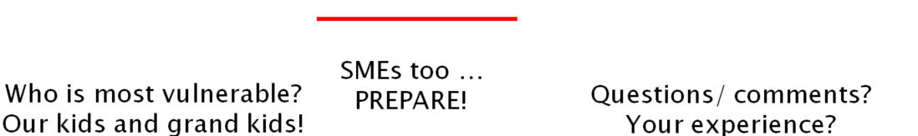
20. Public Perception
Educating the public about AI's true capabilities and limitations is crucial to counteract hype and hysteria.

Slide 24

Exploring the clash of public and personal interests
Newsletters Webinars Seances
Visit KEInetwork.net
Perry Kinkaide
Editor@KEInetwork.net
780 990 5874

