Slide 1


Slide 2


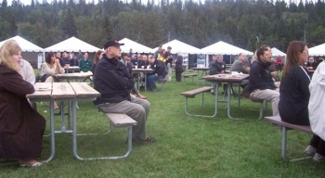
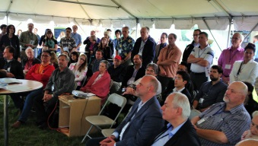
MOONLIGHT IN THE MEADOWS
4:30 - ??? Tuesday, June 21st
The Alberta Council of Technologies Regional, all-industry, summer networking BBQ and after-party at the Hotel Selkirk
In the Heart of Edmonton's lush river valley - An event like none other
Meet someone you want to meet again – entrepreneurs and small business, technology and public policy influencers.
Creating the New Alberta!

Slide 3

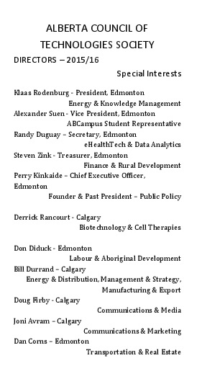
1. Board Introductions

Slide 4

2016 ABCtech’s AGM Agenda
Board Introductions & Assess Quorum (min. 20)
Approval – Agenda
Approval – 2015 AGM Minutes
President’s Report – Klaas Rodenburg
Approval – 2015 Financial Statement
Approval – 2016/17 Election Slate
  Haley Simons Peter Fenwick
  Bon Fessenden Sharon MacLean
7. Approval – AGM Closing
2. Resolution – Approve the Agenda

Slide 5
3. Resolution – Approve the 2015 AGM Minutes

Slide 6

AGM 2015 Meeting Minutes
4:30-5:15pm June 29th, 2015
Whitemud Equine Learning Centre, Edmonton
Klaas Rodenburg, President, opened the Annual General Meeting – Quorum of 20 Members was present as per By-Law 5.03. Klaas welcomed everyone and provided an overview of this year’s AGM.
Agenda – Motion was made to approve the agenda as circulated. Motion: Don Diduck, seconded by Paul Stinson. The motion was passed.
2014 AGM’s Minutes – Randy Duguay briefly reviewed last year’s minutes. He then moved that the 2014 AGM’s minutes be approved as circulated. Motion: Steve Zink, seconded by Michael Kryton. The motion was passed.
President’s Annual Report – Klaas Rodenburg. Klaas remarks at the AGM as this is ABCtech's 10th anniversary it provides the perfect opportunity for us to envision the next 10-years and adjust our course accordingly. Further, we are now starting our planning for a Creativity & Convergence #2 (CC#2) conference in the Fall as a follow-up to our CC#1 in the Spring and springboard to a larger CC#3 conference in the Spring of 2016.
2014 Financials – Presented by Steve Zink.
Motion was made to approve the 2014 Financial Statement. Motion: Hubert Lau, seconded by Alex Suen. Motion was passed.
Motion was made to approve a financial review in lieu of audit. Motion: Hubert Lau, seconded by Michael Kryton. The motion passed.

Slide 7
2014 Election. Klaas Rodenburg outlined that currently thirteen directors are allowed in the By-laws and that propose a motion to increase the Board to 15 to provide for further involvement outside of Edmonton. Motion: Ron Main, seconded by Steve Zink. Motion was passed.
The following Board members were presented for election to the 2015 Slate:
  Joni Avram Dan Pigeon Doug Firby Bill Durand
Appointed 2014:
  Hubert Lau Allan Bly Steve Zink Michael Kryton
Motion was made to approve and elect the above members to the Board. Motion: Don Diduck, seconded by Alex Suen. The motion passed.
All other Directors have been elected and were returning.
Guest Speaker: Ted Morton, University of Calgary – School of Public Policy. Ted presented materials relating to his recent policy paper (co-authored with Meredith McDonald) about the challenges and pitfalls of economic diversification as public bodies may engage with via direct government involvement. The presentation and paper provided an overview of Alberta’s historically poor performance of public sector involvement, following the election of Peter Lougheed and subsequent governments, due to a number of difficulties. The presentation was followed by a Q&A period.
Closing Remarks: Klaas Rodenburg thanked everyone for coming and encouraged people to circulate and meet others including at the trade booths. Klaas called upon Perry to offer his thoughts. Perry highlighted ABCtech’s journey over the past year and extended thanks to everyone who helped with all of the initiatives being led by ABCtech and invited everyone to take a part in the organization. Perry concluded his remarks by adjourning the meeting.

Slide 8
4. President’s Report – Klaas Rodenburg

Slide 9
5. Resolution – Approve the 2015 Financial Statement
5.1 Resolution – Approve conduct of a fiancial review in lieu of a financial audit

Slide 10
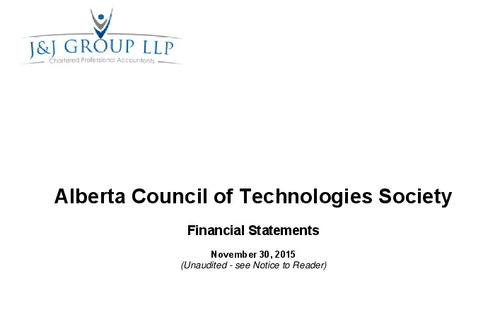

Slide 11
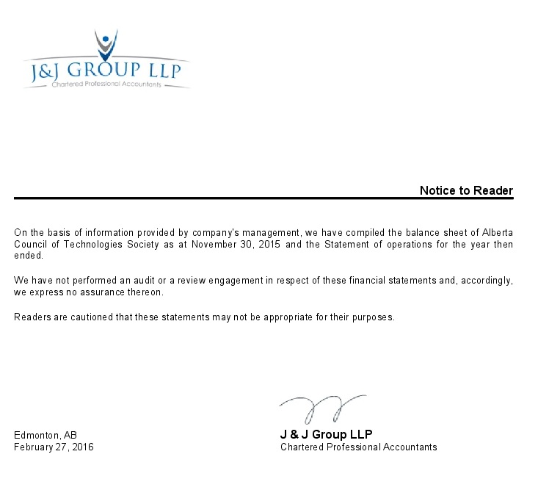

Slide 12
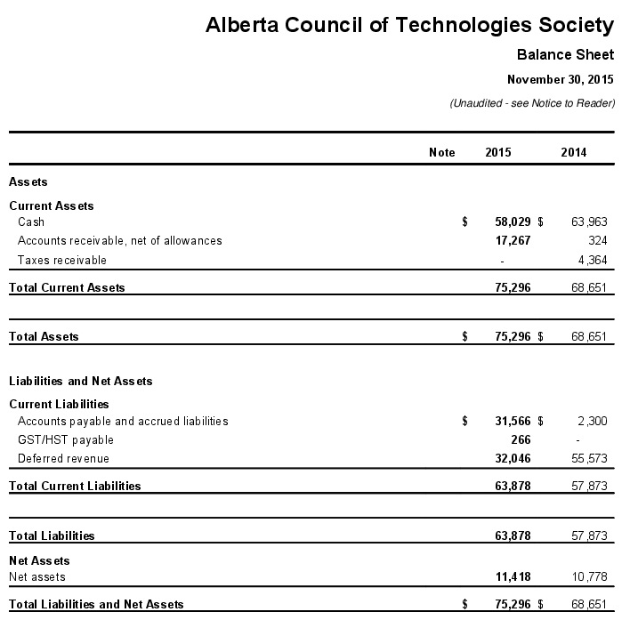
Note. Includes an account administered for the Alberta/Canada Fusion Technologies Alliance

Slide 13
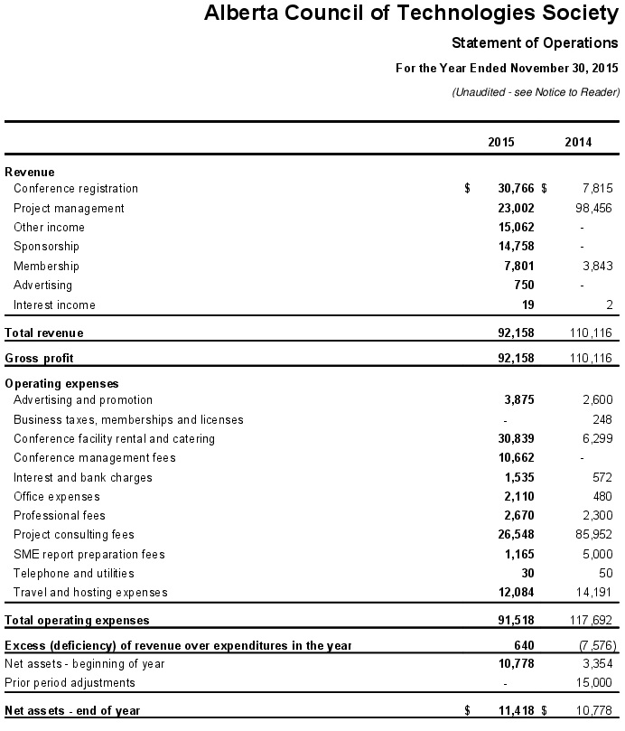
Note. Includes an account administered for the Alberta/Canada Fusion Technologies Alliance

Slide 14
Resolution 5.1 Approve – Annual Membership fees of $100 General and $25 Students/Seniors for 2016/17
Resolution 5.2 Approve – Introduction of Corporate Membership with a fee of $500/year

Slide 15
6. Approval – 2016 Election Slate

Slide 16
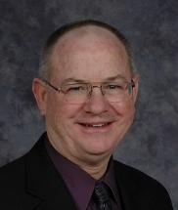

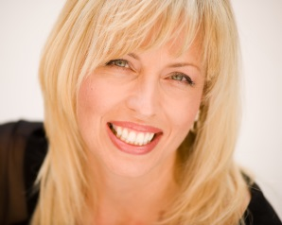
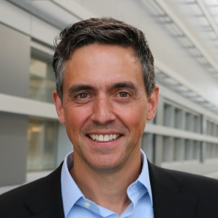
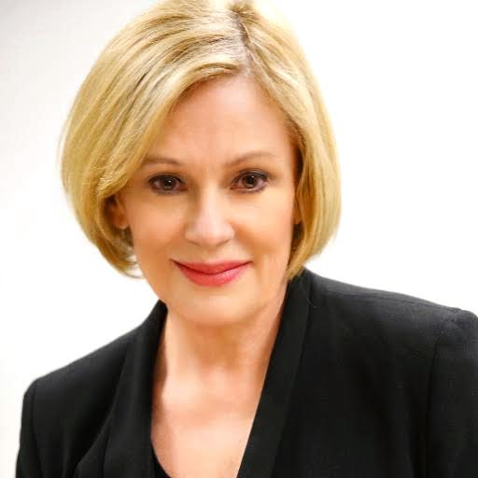
2016/17 Election Slate
Bob Fessenden
Haley Simons
Peter Fenwick
Sharon MacLean
Note. The Board of Director’s elects the officers

Slide 17
TODAY’ AGENDA

Slide 18
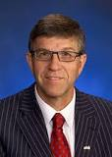
Greetings
Introducing – Nolan Crouse
Mayour – City of St. Albert
Chair – Capital Region Board

Slide 19


Slide 20


Slide 21


Slide 22


Slide 23

Certified Management Consultants - Alberta

Slide 24


Slide 25


Slide 26


Slide 27

Site Sponsor

Slide 28


ABCampus
Volunteer Support

Slide 29


Slide 30

Catering and after-Party at Hotel Selkirk

Slide 31

Singing great is easy
Entertainment Sponsor

Slide 32

Media Sponsor

Slide 33
Bryn Lipinski
Event Photographer

