Slide 1
Mining &
Mineral
Processing
Creating the New Alberta
Attracting New Ideas
The Time is NOW!
A Sparkling Opportunity!
Presenter – Michael Dufresne, Apex Geoscience Ltd.

Slide 2
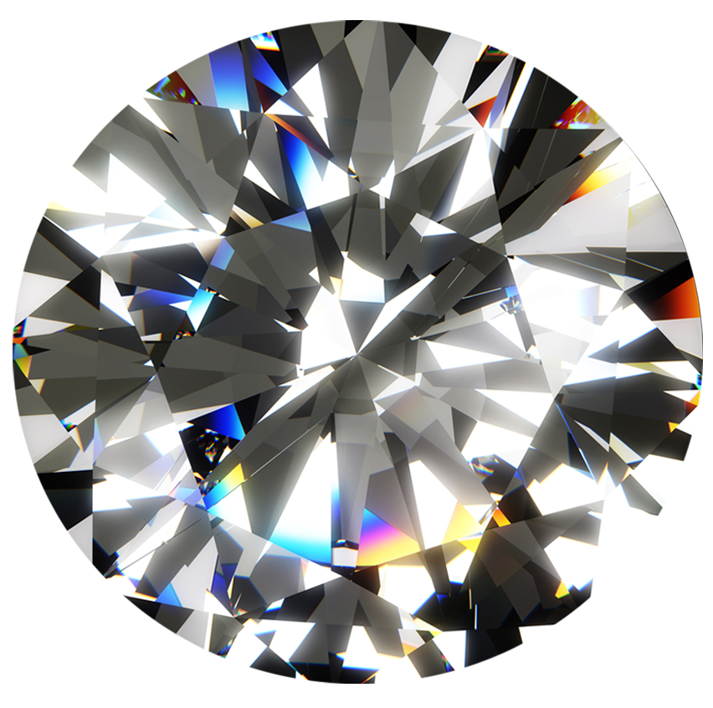
Recognizing the Contributors
Brian Testo – President, CEO, Grizzly Discoveries, Inc.
Mike Dufresne, President and Principal, Apex Geoscience Ltd.
Roy Eccles, Operations Manager, Apex Geoscience Ltd
Larry Staples, Executive Director, Alberta Chamber of Resources
Tom Ormsby, Head of External and Corporate Affairs, DeBeers Canada
Karen Simmons, GG, President, Gem Gallerie Jewellers,

Slide 3
The Forces and Sources of Change
Threats and opportunities buffeting the industry
Warm winters
Changing consumer preferences
Competition
State of the industry
Mineral & Processing Potential in Alberta
Global supply of Commodities of the Future
Cutting diamonds & processing of minerals such as iron, potash, lithium
Export of diamonds & other minerals

Slide 4
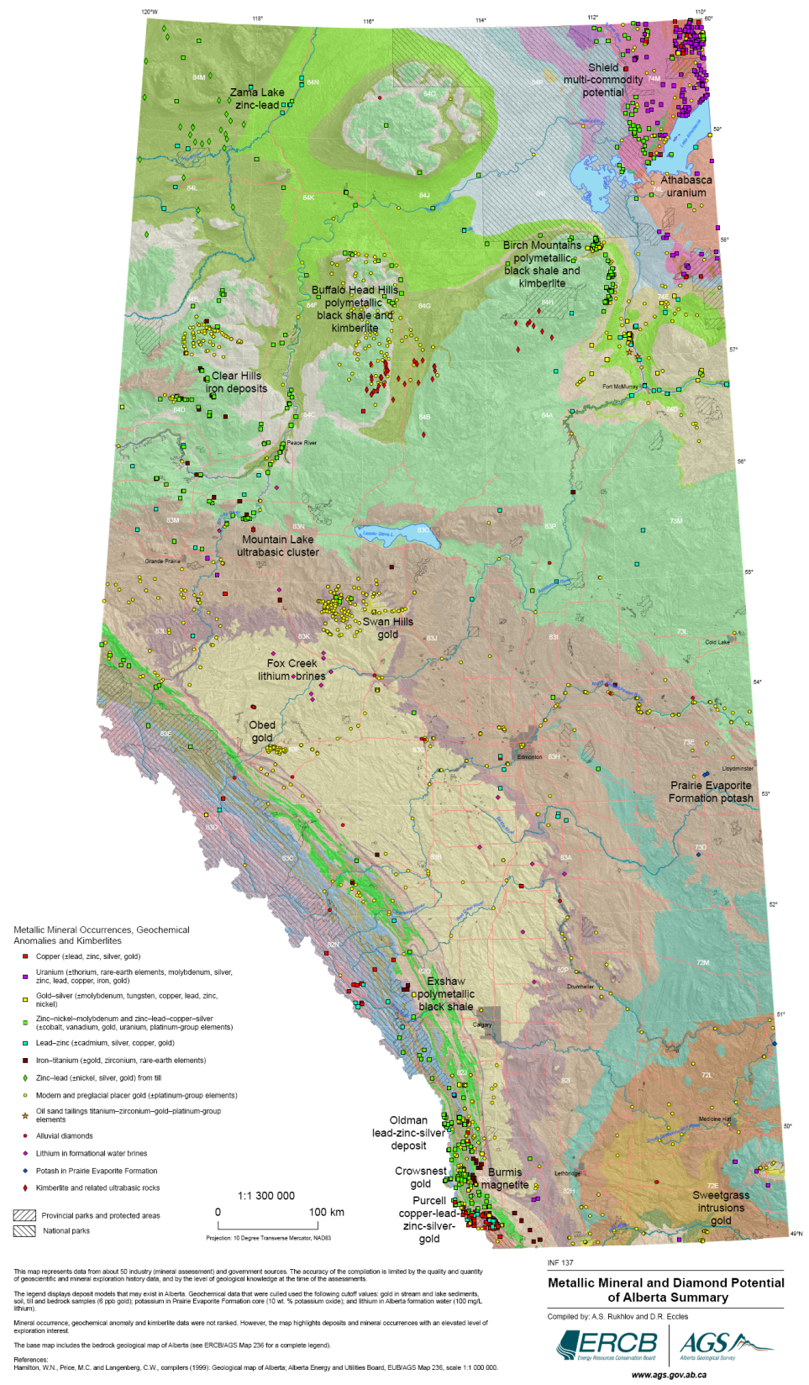
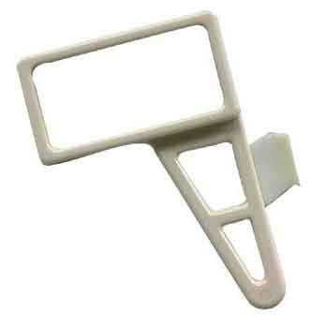
MINERAL POTENTIAL OF AlBERTA
AGS Information Series 137
Rukhlov and Eccles (2010)
Updated compilation of metallic mineral potential from industry and government reports
>4000 deposits and occurrences
825 mineral assessment reports by commodity
There are no producing non-energy mineral mines in Alberta
Other non-
metallics (251)
Metals
(417)
Diamonds
(157)

Slide 5
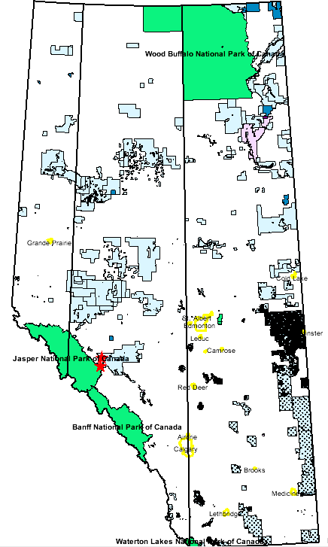
Commodities & Areas
There is plenty of Potential for Non-energy minerals including traditional & hi tech specialty
There is little to no exploration
Alberta is perceived as a non-mineral Province
Government tax incentives to explore & spending on baseline geological studies are non-existent in comparison to other Provinces
Rare earth elements
Potash
Base/precious metal
Lithium
Diamond
Titanium
Iron
Uranium
Limestone
Magnetite
Sand and gravel

Slide 6
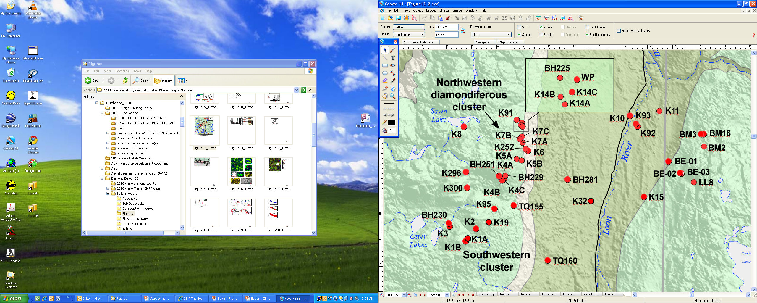
Potential Diamond mining
Buffalo Head Hills Kimberlite Field
Canterra/Shore Gold/Encana
K252 with grades of 55 cpht and up to 85 cpht
Grizzly Diamonds
BE-2 & BE-3 highly diamondiferous & require bulk sampling
BHH Kimberlite Field

Slide 7
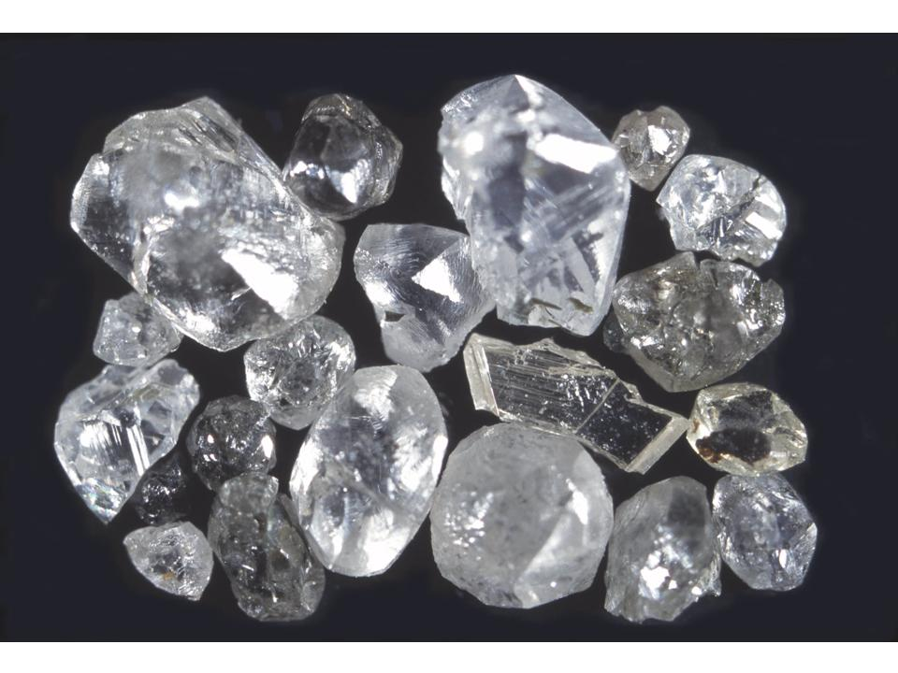
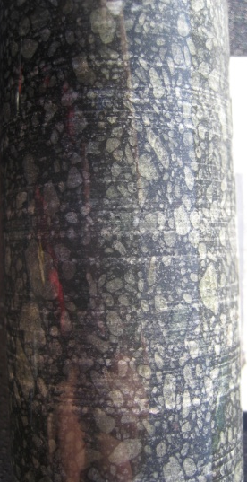
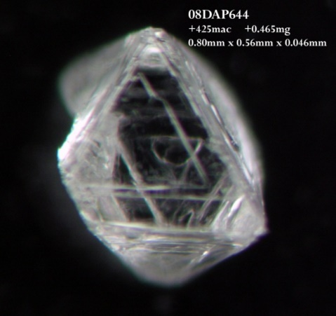
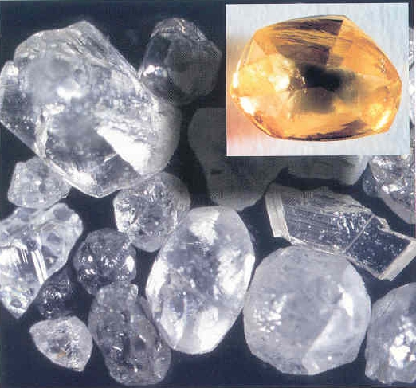
BHH Diamonds – Potential Cutting & Export
Gem quality diamonds recovered from a number of the Canterra/Shore Gold/Encana BHH Kimberlite Pipes – no exploration since 2008
Either grade or size of the pipes to date is not economic
Yellow macro diamond from K6 weighs 0.76 carats & was of high value in $
Cantered/Shore Gold/Encana’s K252 yielded an average of 0.55 carats per tonne – but the pipe is a bit small
New explorer Grizzly Diamonds discovered 3 new kimberlites, two of which yielded abundant microdiamonds and require bulk sampling
Grizzly has been conducting some exploration over the last few years – but Northern AB has been quiet

Slide 8
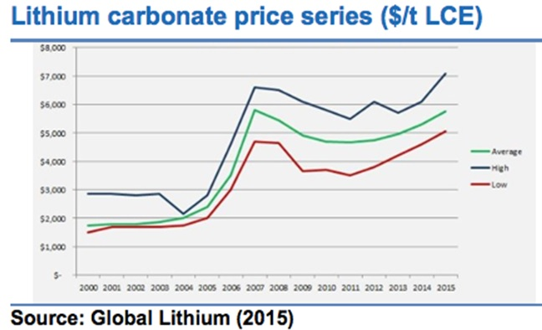
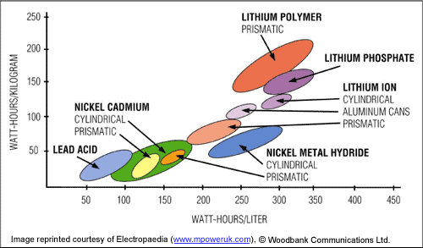
Lithium – New EnERGY FUTURE
Lithium is leading the way in new battery technologies ie Tesla Giga Factory & Cars
Not just for cars but for major industrial use
Need way to store energy from renewable sources such as wind & solar etc

Slide 9
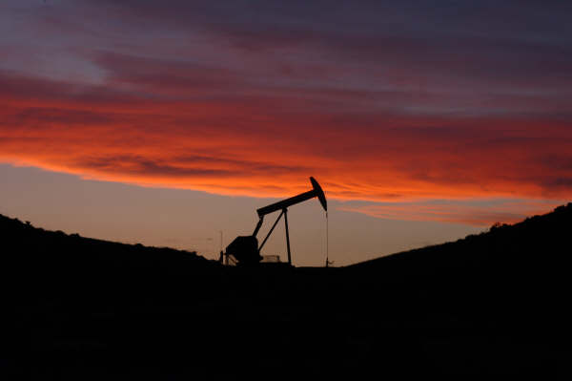
Brine iNTO Wine – LitHium + K, B, Br, I
Lithium-Rich Oilfield Formation Water
Jurassic Smackover brine,
Arkansas and Texas, USA
(50-572 ppm)
Cretaceous
Heletz-Kokhav, Israel
(97-228 ppm)
Texas Cretaceous reservoirs
(132-333 ppm)
Permian Altmark gasfield,
Germany (263 ppm)
North Dakota Devonian
Formations (100-288 ppm)
And the…
west-central Alberta area of the
Western Canada Sedimentary Basin (70-140 ppm)

Slide 10
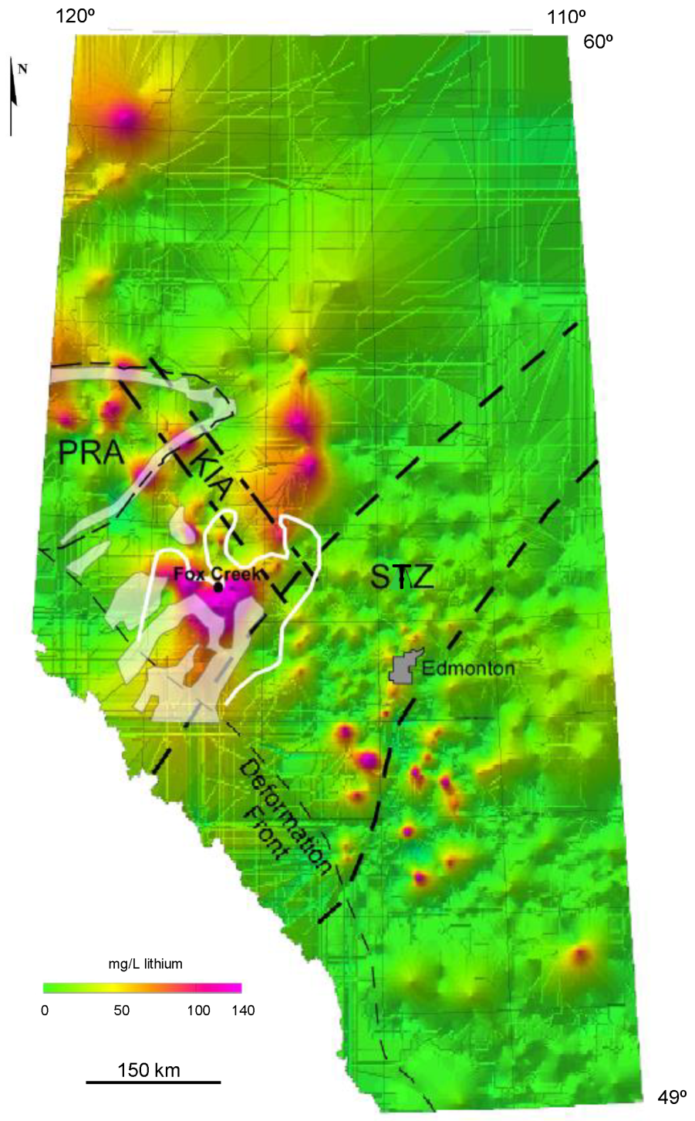
Li Brine Potential in Alberta
Other associated metals/elements that are potentially of economic & industrial interest K, B, Br & I
Also another potential by-product of potential processing is clean water
Excellent potential to make use of existing O&G infrastructure such as wells, pipelines and water knockouts
Devonian
reef
outlines

Slide 11
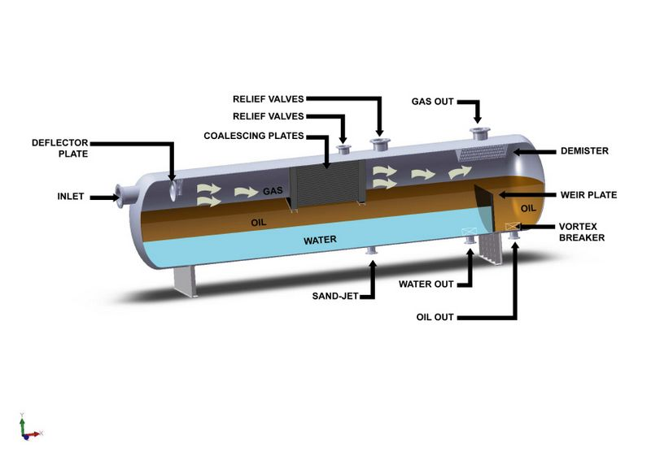
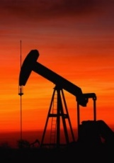
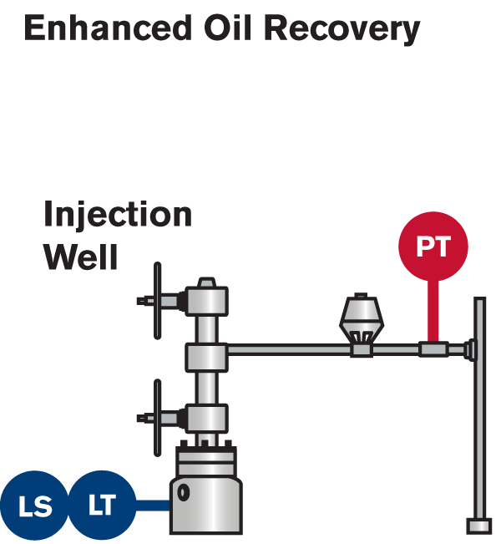

The Challenge is technology
Production
Well
Injection
Well
Reservoir
O&G production formation water/brine challenges:
May require multi-processing to recover additional oil
May require treatment for producing and injection zone compatibility
High salinity, and therefore, corrosive
Represents largest-volume waste stream associated with O&G production
May require new or modified existing technology to extract all the potential products

Slide 12
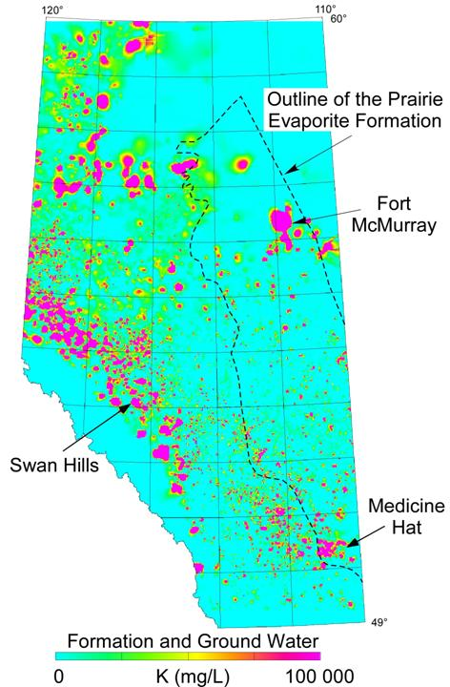
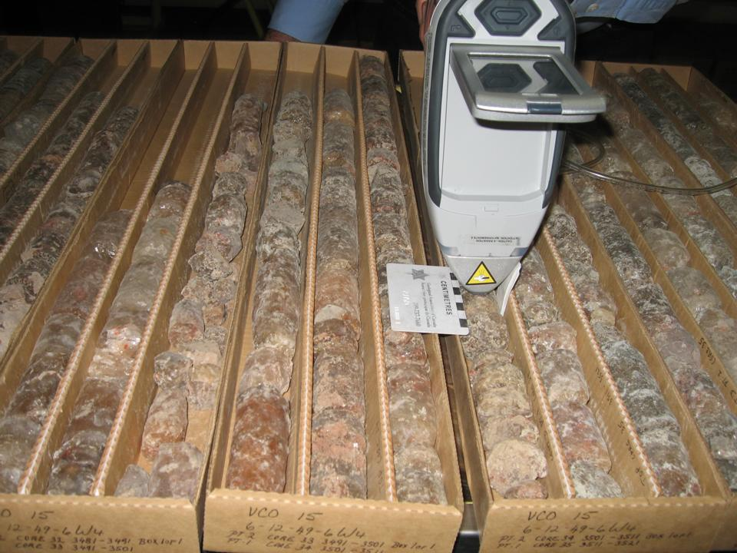
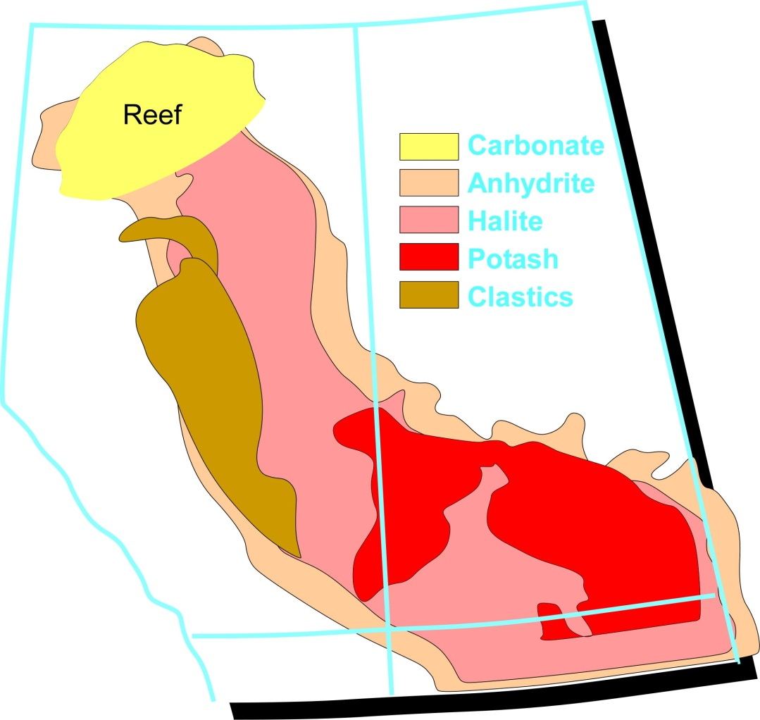
Potash In Alberta
?
?
Up to 19 wt. % K₂O Average of 11 wt. % K₂O over 9 m
AGS OF Report 2009-20 Eccles et al., 2009

Slide 13
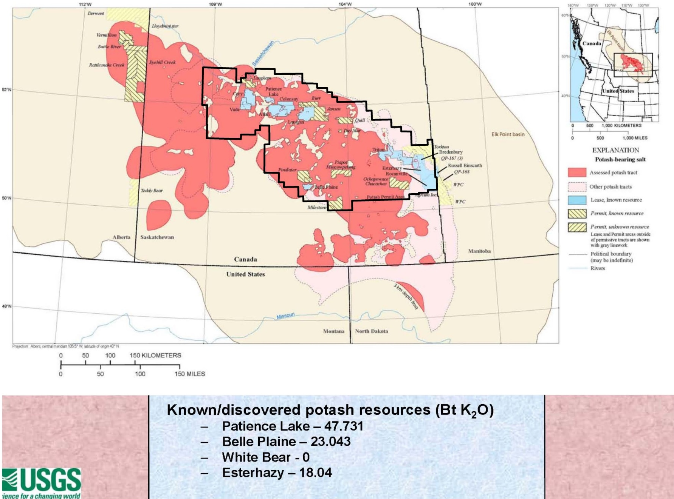
challenges
Alberta not perceived as having potash potential
Expensive exploration
Access to O & G infrastructure
AB
SK
Potash
Mineable Area
Grizzly Permit
Blocks
MB
Potential Potash Resources - USGS
Source: Slide taken from USGS talk entitled “The US Geological Survey’s assessment of undiscovered potash resources in the Prairie Evaporite Formation, Elk Point Basin, Canada and United States” given December 5, 2010 (Cocker, Orris, Yang & Dunlap, 2010) at Saskatchewan Geological Survey’s Open House www.ir.gov.sk.ca/Default.aspx?DN=b9c6e106-45f7-4b37-bc7b-17a715ac1aae

Slide 14
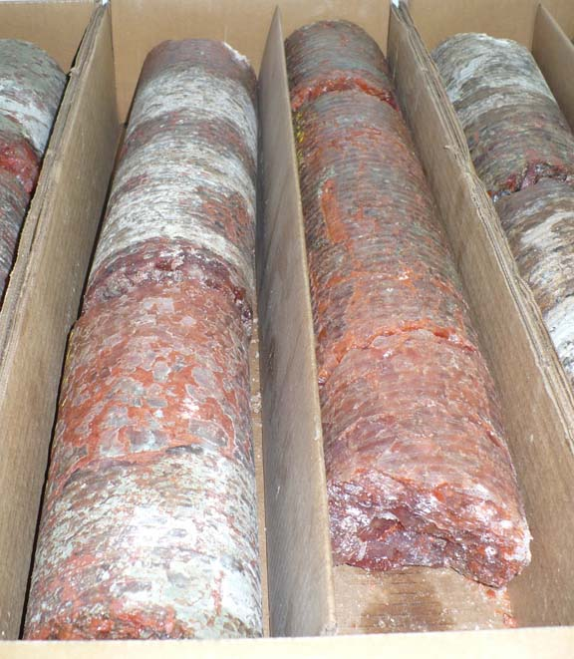
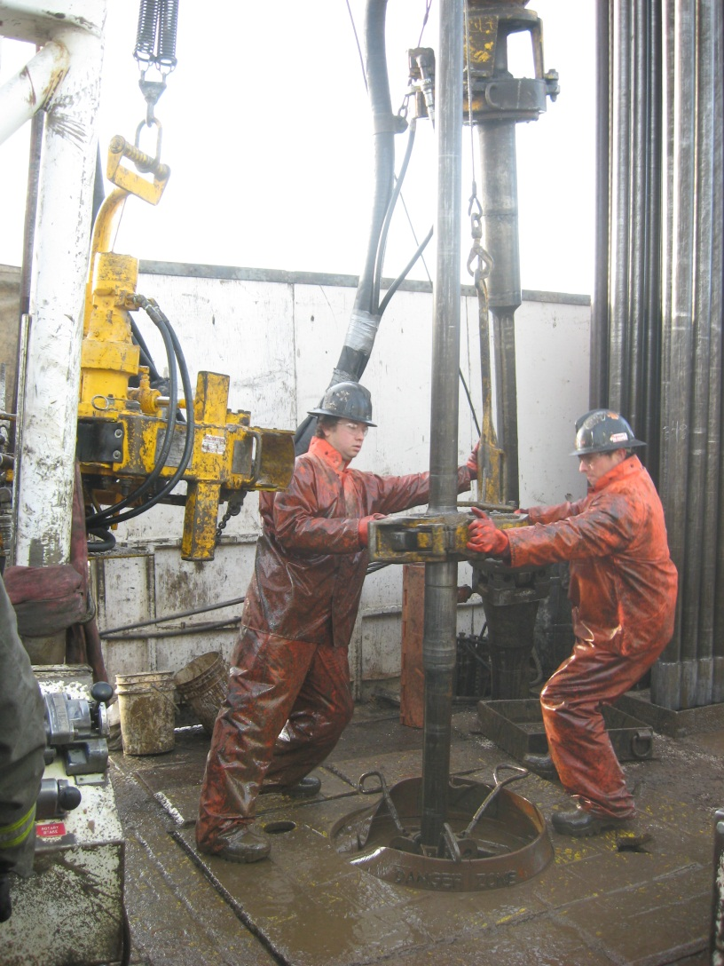
Potash Intersected Near Medicine Hat & Provost
Pacific Potash Well PPC-37 near Provost drilled in 2011
Intersected potash at a depth of 1327 m with a grade of 11.85% K₂O over 3.1 m
Photo showing potash (pink salt)
comingled with mud & halite
Grizzly Discoveries Well 8-36-19-1W4 was drilled to a total of 1745 m depth in 2011
Intersected narrow ore grade potash mineralization at about 1651 m depth – up to 13% K₂O over 1.15 m

Slide 15
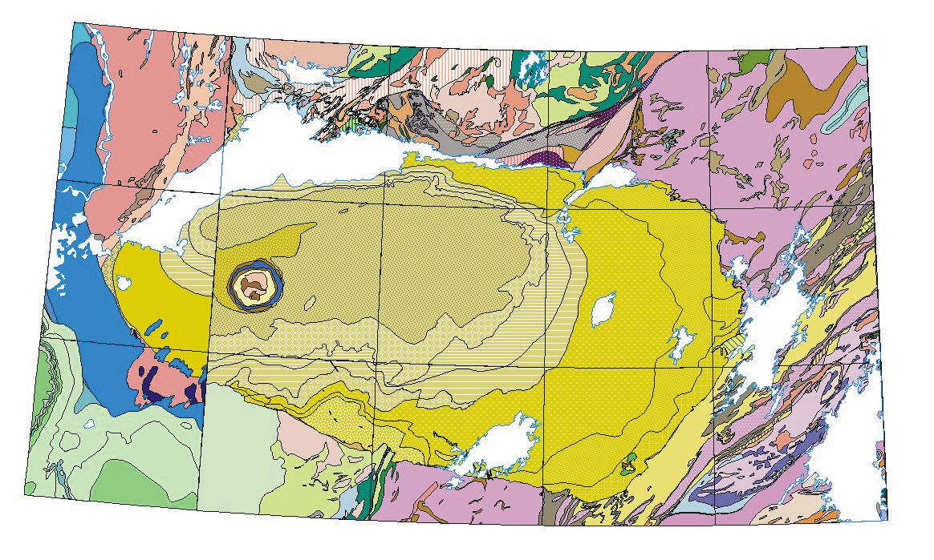
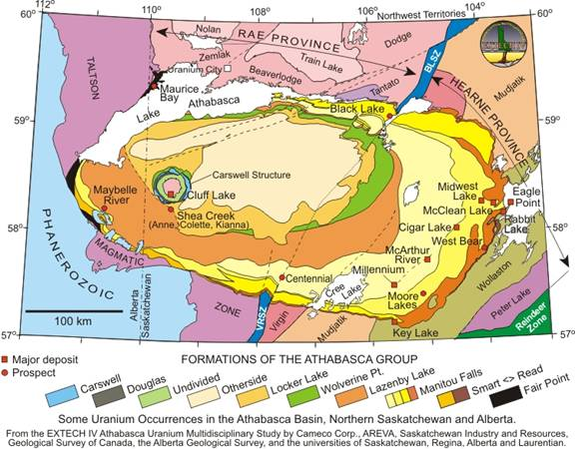
Uranium in Alberta
Pre 2000
Post Extech IV
Athabasca Uranium Multidisciplinary Study
ALBERTA
SASKATCHEWAN
‘Border fault’; little staking in AB
Maybelle
River
prospect
Contiguous geology; new staking and interest on the Alberta side of the border

Slide 16

Maybelle River – Clean Energy For Oil Sands?
W
E
West East
Grano-
diorite
Wylie Lake
granitoids
Pelitic
gneiss
Overburden
Lazenby Lk Fm.
Micro-
granite
Mineralized
zone
Illite
alteration
halo
Graphitic
gneiss
200 m
Manitou Falls Fm.
Up to 21% U₃O₈ over 5 m
Assays up to 54.5% U
Halo extends for 200 m
Fair Point Fm.
Illite/chlorite/dickite
(69/26/5%)
Unconformity
Paleo-weathering
Maybelle River shear zone
Granodiorite
Wylie Lake
granitoid
AREVA Resources Inc. (2007)

Slide 17
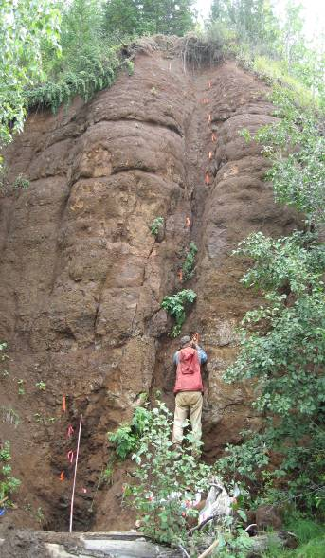
Clear Hills Iron Ore
1953 - Phillips Petroleum Co.
intersects “oolitic hematite” in
‘Phil C No. 1’ at Rambling Creek
1954 to 1967 - Extensive explor-
ation, including ~340 drill holes
1959 - Premier Steel and AGS ‘historical’ estimate 1.02 Bt at 32% to 35% iron
1960’s - Peace River Mining &
Smelting set up a pilot plant at
AB Research Council, Edmonton
1960s & 1970s - Canmet and AGS
evaluate potential of the ooidal
ironstone: results deemed not encouraging due to complex metallurgy

Slide 18
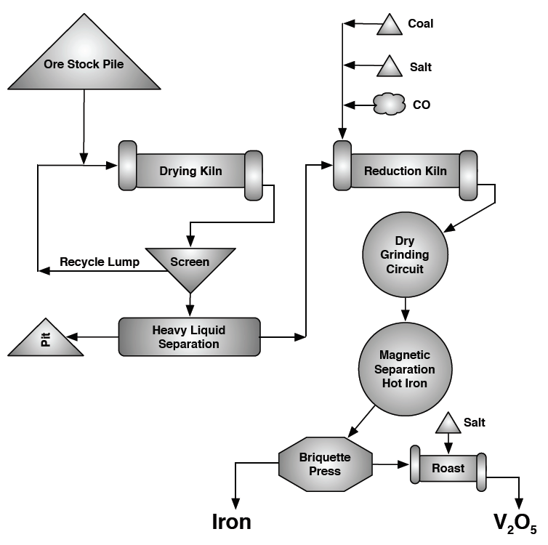
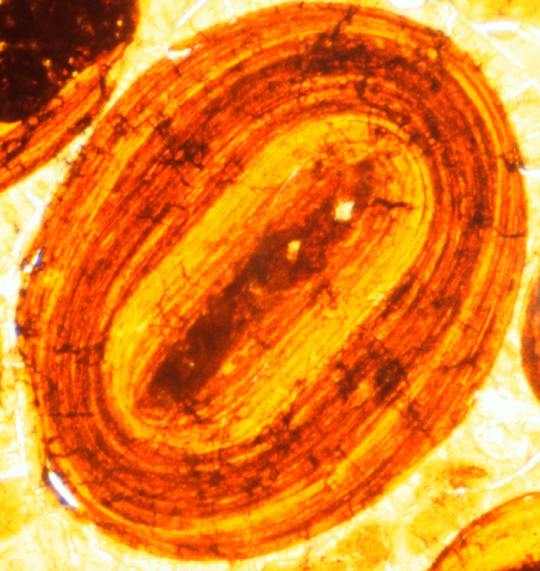
Iron Ore – Botryoidal vs Banded Mineralogy is a Challenge
Ironstone Resources Ltd.

Slide 19
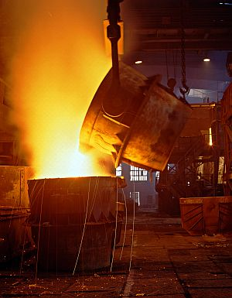
Iron Ore – The Challenge – Metallurgy & Process Technology
Alberta is one of Canada’s biggest consumers of iron in the form of steel
We do not produce iron ore which is used to make steel, nor do we have foundries that make steel – we import all our steel
We have a world class iron ore deposit but it requires technology advances and innovation in processing techniques
Spins off could be steel foundries
Development of metallurgical expertise

Slide 20
Conclusions & recommendations
Alberta has potential for a number of mineral deposits that could yield mines over time and spinoff industries in the process and technology world
Alberta is not perceived as a minerals mining Province and is challenged for investment
Mining could be a huge winner for rural Alberta
Metallurgy and Process Technology are a challenge for some Project & Commodities
For others, more spending on exploration is required - Alberta needs to find a way to compete on the world stage and provide a better environment for investment for the minerals sector

