Slide 1

Manufacturing & Export –
Growth, Innovation and Prosperity for Canada
David MacLean
Divisional Vice President – Alberta
Canadian Manufacturers & Exporters
November 26, 2016

Slide 2
David MacLean
Alberta Vice President
Canadian Manufacturers & Exporters
David.maclean@cme-mec.ca
780.965.4691
www.industrie2030.ca
www.cme-mec.ca
www.manufacturingourfuture.ca

Slide 3
Manufacturing Matters
Direct Economic Impacts:
  Employs 1.7 million Canadians – constant since 2008
  Has wages of $118 billion – the highest of any sector
  Represents over 90,000 companies of all sizes in all regions of the country
  Has annual sales of over $600 billion – 10.5% of GDP
  Responsible for nearly $350 billion in exports – 2/3rds of Canada’s total

Slide 4
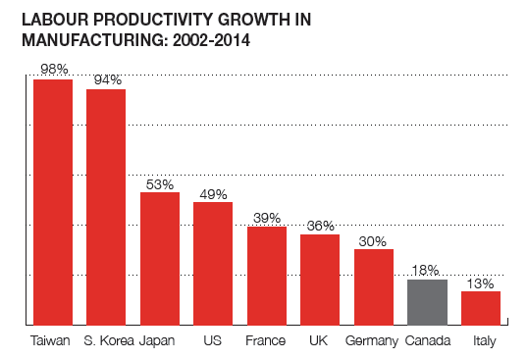
Manufacturing Productivity
Canada’s labour productivity rates are declining compared to major competitors

Slide 5
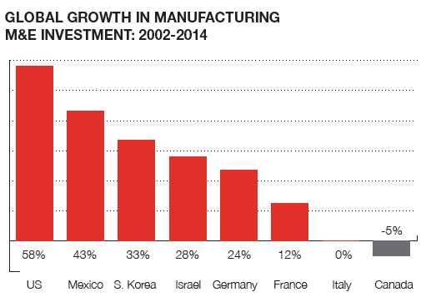
Capital Investment
Canada’s investment in new machinery and equipment and technology is declining

Slide 6
Innovation and Commercialization
Canadian companies are investing less in innovation
Fewer product innovations
More companies with no innovations

Slide 7
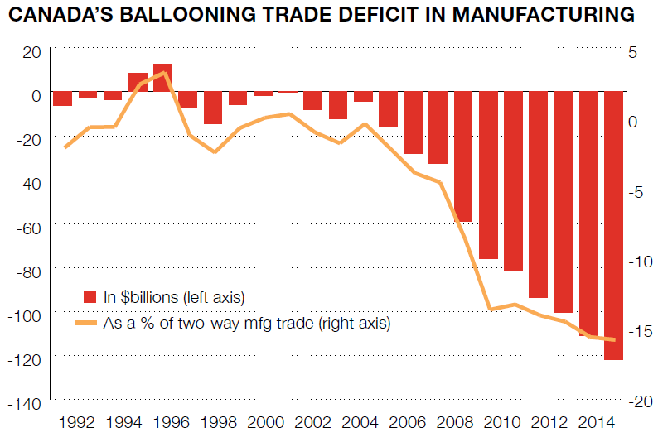
Sales
We are selling less manufactured goods to the world and more is being imported

Slide 8
Industrie 2030
A strategy to double manufacturing output and value-added exports by 2030
Consultation of more than 1250 industry leaders in person and on-line across the country
Detailed economic analysis of the current state of manufacturing in Canada
Action plan for Growth – Manufacturing Growth, Innovation and Prosperity for Canada

Slide 9
MIS Overview
Focus on understanding current business conditions and challenges in manufacturing, including:
  Business and Investment Outlook
  Labour and Skills
  Innovation and Commercialization
  Tax and Regulatory Policy
  Global Markets
  Climate Change and Carbon Pricing

Slide 10
General Observations
Businesses have been challenged by recent economic conditions
They are cautiously optimistic about the future
But they face many obstacles that threaten future growth and competitiveness
They are looking to governments to help facilitate technology adoption and drive expansion

Slide 11
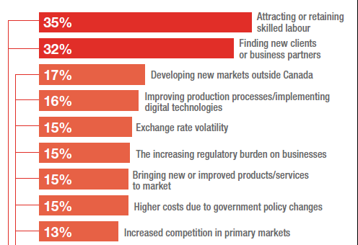
Business Outlook
What are the most pressing challenges facing your company today?

Slide 12
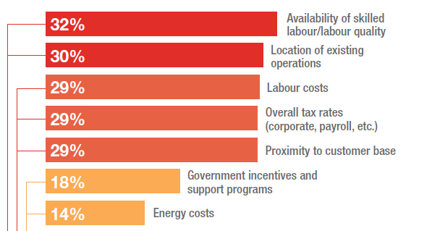
Business Outlook
What are the most important factors you consider when deciding where in Canada to invest?

Slide 13
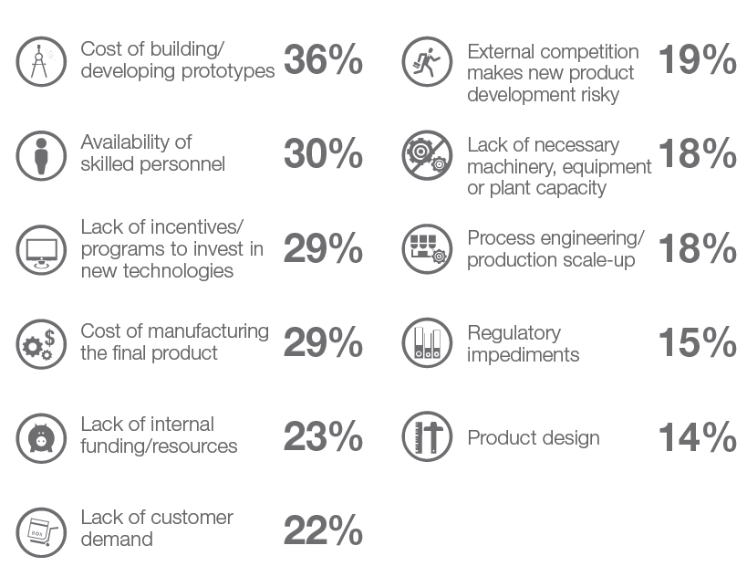
Business Innovation
What are the biggest obstacles you face in bringing new products to market?

Slide 14
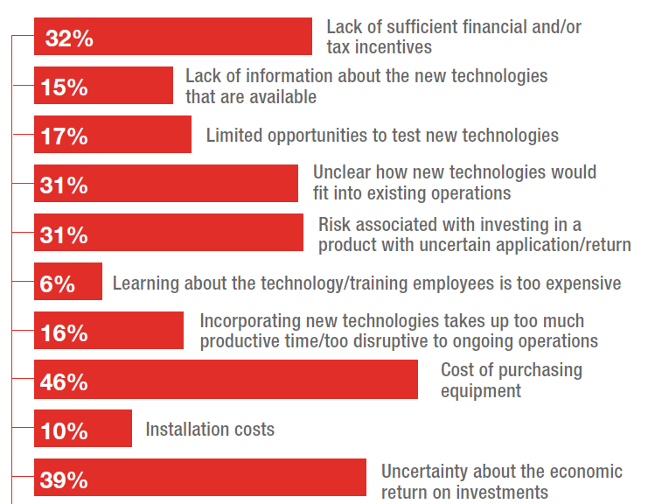
Business Innovation
What are the biggest obstacles you face in adopting new technologies?

Slide 15
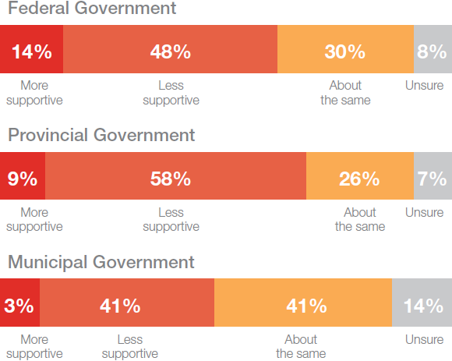
Policy Climate
Have tax and regulatory policies become more supportive in the last three years?

Slide 16
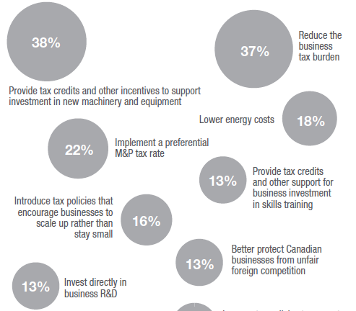
Policy Climate
What more should governments do to support manufacturing in Canada?

Slide 17
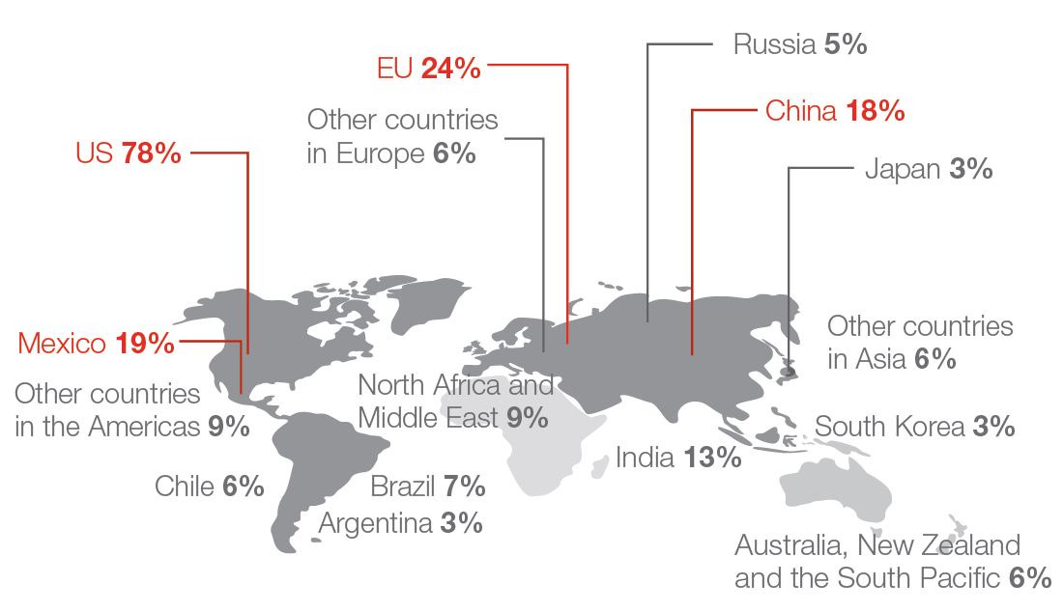
Global Markets
Where do you see the greatest opportunities for growth over the next five years?

Slide 18
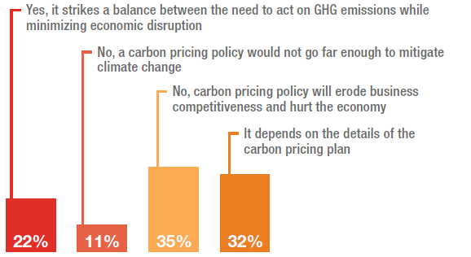
Carbon Pricing
Do you support carbon pricing as a means to reduce industrial emissions?

Slide 19
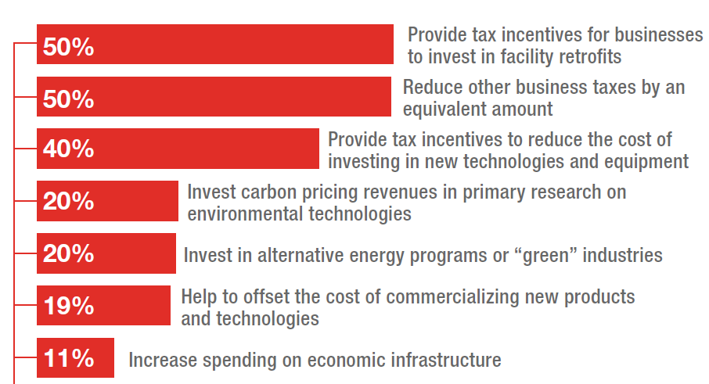
Carbon Pricing
How should governments help businesses adjust to new prices on carbon?

Slide 20
Industrie 2030 Plan
Improve access to a skilled workforce, including management training
Accelerate Adoption of Advanced Manufacturing Technologies
Foster Innovation, Commercialization and New Product Development
Create a Competitive Business Environment in Canada
Increase Access to Domestic and Foreign Markets

