Slide 1

Legal & Security - Knowledge, Wisdom, Trust, and Big Ideas
Presenter: Robbie Nissen
Patent & Trademark Lawyer

Slide 2
Contributors
Robbie Nissen
  Registered Patent Agent
  Registered Trademark Agent
  Lawyer
  Nissen Patent Law
  LES, CBA, IPIC member
Robert Hubbs
  Business Consultant
  Tech Entrepreneur

Slide 3
The Forces & Sources of Change
Desire for low-cost, efficient legal services by non-lawyers
The rise of the internet and access to knowledge
Artificial Intelligence
Increased reliance on computer systems and electronic document storage
Increased exposure to online security risks from anywhere on the planet

Slide 4
Big Idea: Non-lawyer legal services
Driven by opportunity-seekers who identify a portion of legal work that can be efficiently carried out by artificial intelligence
Many provide free or low-cost access to databases of legal precedents

Slide 5
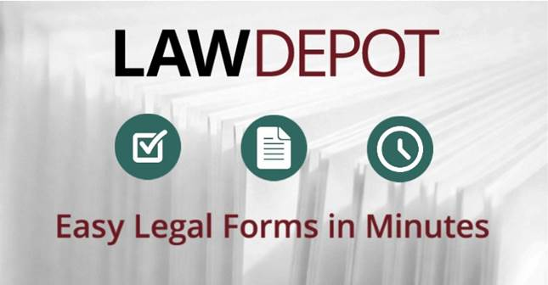
Big Idea: Non-lawyer legal services
Ex. LawDepot
  2 million users
  4 million legal documents
  $1 billion dollars of savings in legal fees
  Legal precedents for a wide variety of legal areas including incorporations, wills and estates, real estate, business, family, and others
  Documents assembled by lawyers
  Field-fillable online forms as precedents

Slide 6
Big Idea: Non-lawyer legal services
Invention promotion companies
Offer commercialization, licensing, investment, and/or patent services to new inventor-entrepreneurs
Client may pay a lump sum (~$15k) AND a royalty (~10%)
Many are scams – unclear how to assess value of deliverables and whether any were carried out

Slide 7
Big Idea: Non-lawyer legal services
Some illegally file provisional patent applications without a license to do so
Emphasis on filing bare bones provisional patent applications can create a false sense of security
These companies are highly regulated in the U.S.

Slide 8
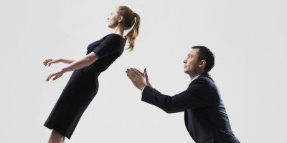
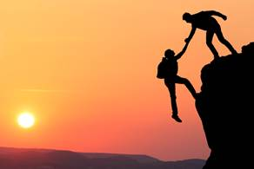
Big Idea: Open-Source Trust
Access to knowledge has increased through the internet
Lawyers still needed for wisdom – i.e. proper use of knowledge
How does one find a good lawyer?
High stakes – the wrong professional may cost you time and money
Notes:
Catching picture link: https://millpondporch.com/2015/04/16/trust-and-drinking-water/
Pulling picture link: http://www.danielehenkel.com/2016/05/trust-a-rare-asset/

Slide 9
Big Idea: Open-Source Trust
Classical scenario - potential client asks a friend or business associate where to find a lawyer.
Modern scenario - potential client checks the internet, reviews the law firm’s website, reads online reviews
How do we build a reliable trust metric into the online system to help people find the right lawyer?

Slide 10
Big Idea: Open-Source Trust
Early development - client testimonials posted on web page
  Presumed bias - not inherently credible
More recently – trust evaluation administered by a neutral third party such as Google

Slide 11
Big Idea: Open-Source Trust
Search engine algorithms - used to authenticate a website as a law firm
  Pro: search algorithms are generally effective
  Con: SEO can be used by fraudsters to infiltrate the results lists
  Con: rankings can be improved by force, i.e. Google adwords

Slide 12
Big Idea: Open-Source Trust
3rd Party reviewers – ex. Online reviews on Google+ or Yellow pages
  Pro: 3rd party results inherently credible, particularly if the identity of the reviewer is posted
  Con: Fake reviews are possible. Problem somewhat mitigated by certain measures, such as cell phone number and other intrusive verification methods

Slide 13
Big Idea: Valid and Secret
Authentication v. Confidentiality
Business transactions require authentication
  Potential buyer needs to know product is legitimate.
Buyers and sellers often wish to remain anonymous
  Difficult in the internet and cellphone age

Slide 14

Big Idea: Valid and Secret
Enter Bitcoin
Based on serial chain encryption
Bitcoin can be traced to confirm that the ownership in a particular product, such as a piece of rare art, was legally and validly passed, while protecting the confidentiality of the previous owners
Now accepted in many countries
Notes:
Link: https://bitcoin.org/en/

Slide 15
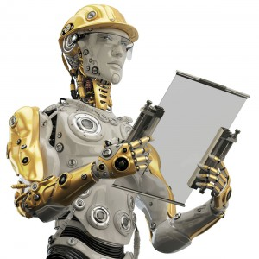
Big Idea: Rise of AI
Artificial intelligence has a dark and light side
Positive applications
  Language processing and search algorithms
  Data processing
  Marketing
Notes:
Picture link: https://blogs.cdc.gov/niosh-science-blog/2015/11/20/working-with-robots/

Slide 16
Big Idea: Rise of AI
Negatives
  Security issues
  Infiltration and infections from robots and viruses
  Chat bots and fishing tools
  Reduced enjoyment - spambots, malware

Slide 17
Big Idea: Rise of AI
Difficult to police with legal solution
  Perpetrators are difficult to track and may be out of the jurisdiction
Physical solutions required – anti-spam, anti-virus, anti-malware software
Anti-spam regulations have not solved the real problem
  *Reduction in spamming by honest people and organizations

Slide 18
Big Idea: Rise of AI
Need increased protection for “things”
Internet of Things
  Webcams
  Any device with an IP address
Things are susceptible to hijacking and misuse by hackers.

Slide 19
Recommendations
Lawyers and the Alberta Law Society should safeguard the public - report and prosecute unauthorized practise of law
  Should embrace change, be open-minded to more efficient solutions, and outsourcing of simpler matters to 3rd party non-lawyers
  Invention promotion companies need regulation
Albertans should review their lawyers online

Slide 20
Recommendations
Albertans should consider adopting alternative currency methods, such as Bitcoin
Albertans should invest in advancing AI
  More physical protection measures
  Cloud computing infrastructure

