Slide 1

BIG IDEAS
INFOTECH & ANALYTICS
Patricia Glenn, Hon FCIPS, ISP, ITCP
CIPS Alberta (Alberta’s Association of IT Professionals)

Slide 2




CONTRIBUTORS
Information obtained through the ongoing research of
Technology
Alberta

Slide 3
THE FORCES & SOURCES OF CHANGE
The threats and opportunities confronting the industry.
  IT is the driver of the future
  Profession/industry less likely to decrease as a result of computerization
  Without a strong local industry, become users rather than creators of IT products and services
  Misconception of creator of job losses

Slide 4
BIG IDEA: DATA POWER
ICT is a driver of the future:
  pervasive, smart and integrated into our lives as partners
  captures knowledge from aging workforce

Slide 5
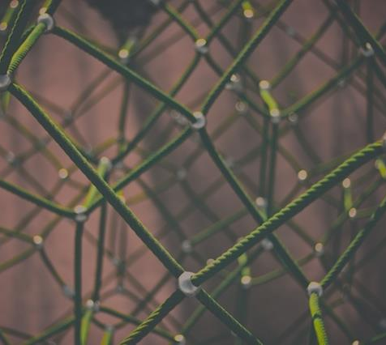



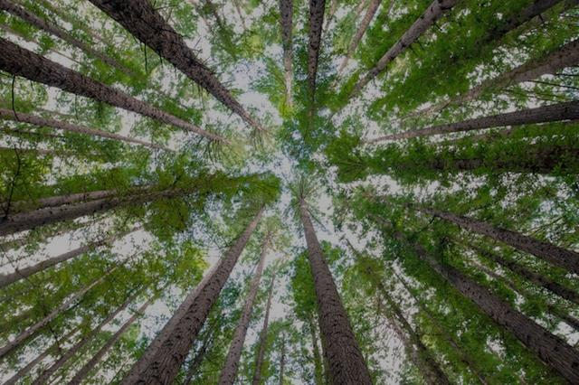
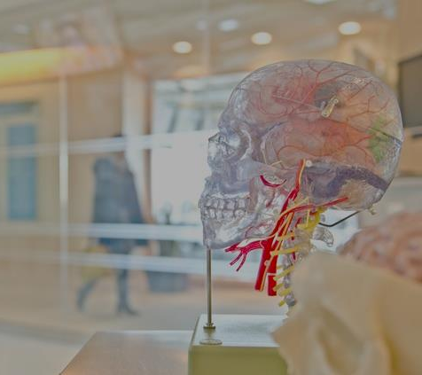
PARTNER OF PROFESSIONS
ENGINEERS
AGRICULTURISTS
EDUCATORS
HEALTH
PROFESSIONALS
ENVIRONMENTALISTS
FORESTERS

Slide 6
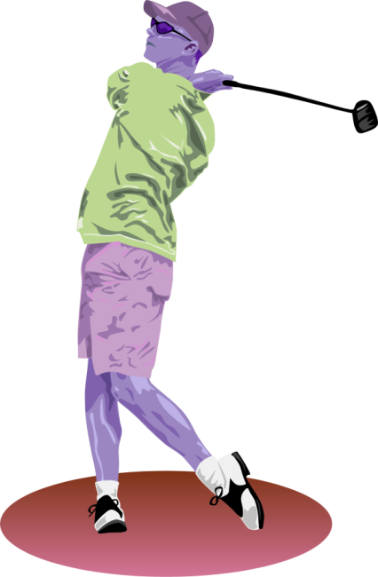
CREATOR OF NEW OPPORTUNITY
Change of one occupation to another
Computer-using occupations grow faster
Analytics research applied to Alberta industries
new solutions to global markets
educating the public in decision making

Slide 7

INTERNET OF THINGS
Endless opportunities & endless connections:
Open, worldwide standard for intelligent systems
Canada/Alberta global leaders
Successful technology/communications companies
+
Impressive talent
+
Technology incubators

Slide 8
BIG DATA
Vast amounts of data Economic development | Decisions
  Real world challenges: O&G; coal; nuclear; hydro & other renewable resources
  Scientific models that make sense of disparate information
  Assess cumulative effects of multiple operations and explore scenarios
  Living with Big Data
  AVID (decisions informed by engagement with visualization)
  DIGHUM (new ways to gather and store cultural records and communicate results)

Slide 9
DATA VISUALIZATION
  Data visualization tools to locate exploratory drilling targets
  Time Span – tool to better understand temporal aspects of stroke treatment
  Data visualization in the diagnoses of disease

Slide 10
ARTIFICIAL INTELLIGENCE:
MACHINE LEARNING
AlphaGo | Climate modelling Complex disease analysis
  Cancer detection
  Social Network Analysis & Visualization (Meerkat)

Slide 11
SMART MACHINES
Smart machine are truly disruptive technology (Gartner, 2016)
intelligent artificial limbs
computational intelligence | Industrial products and cutting edge products

Slide 12
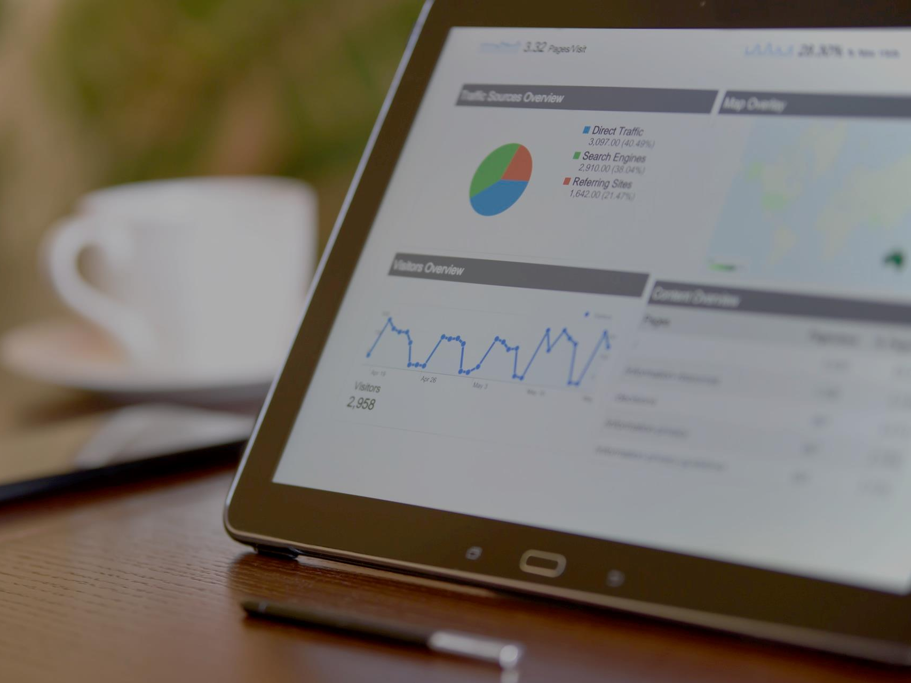
  BIG IDEAS:
  Demographics

Slide 13
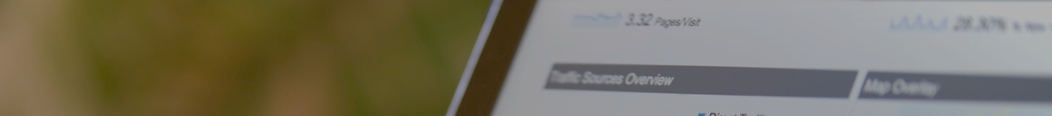
BRAIN DRAIN
  BRAIN DRAIN //BRAIN GAIN
    Analytics for broader use
    globalization

Slide 14
ENERGIZING COMMUNITIES
  Energizing Communities
    ICT in the classroom/meetings
      Flipped process
      ENGAGE
    Aging communities
      Smart Condo

Slide 15

  BIG IDEAS:
  Global Uncertainty

Slide 16
CYBER THREATS
Solving the game of poker | preventing terrorists or cyber security
Privacy with Twitter accounts
Web-based interference detection

Slide 17
HEALTH INFORMATION
  Knowledge networking for organizational work
  Tools to support collaborative interaction and shared experiences
  Math against disease (models and infectious disease dynamics)

Slide 18

  INITIATIVES

Slide 19
IDENTIFICATION OF BIG IDEAS
Collaboration | Economic development Economic diversification Enables industry Enables education Enables health care

Slide 20
BIG IDEAS
  New ICT products and services
  Economic diversification for Alberta

