Slide 1
Human Resources
& Development
- Risk = Opportunity
How workplace culture can advance Alberta’s economy

Slide 2
Contributors/affiliations:
Dan Boucher
Director, Regulatory Affairs, Research & Registrar

Slide 3
Forces and sources of change
What is the impact of the recession – and changes in global workforce planning – on organizational effectiveness?
Low morale
Hidden underground economy
Succession crises
Unused/atrophying labour skills

Slide 4

International business culture is as much of a threat to our economy as low oil prices.
(Image curtesy of Interbrand: http://interbrand.com/newsroom/interbrand-releases-2015-best-global-brands-report/)

Slide 5
Aiding recovery: Understanding the productivity gap

Slide 6
Aiding recovery: Building organizational resiliency through morale.

Slide 7



Aiding recovery: Success can be duplicated!

Slide 8
Long-term diversification:
Help Alberta create the best workplaces to grow productivity, morale and resiliency.

Slide 9

Aiding recovery: Are contractors an HR trend?

Slide 10
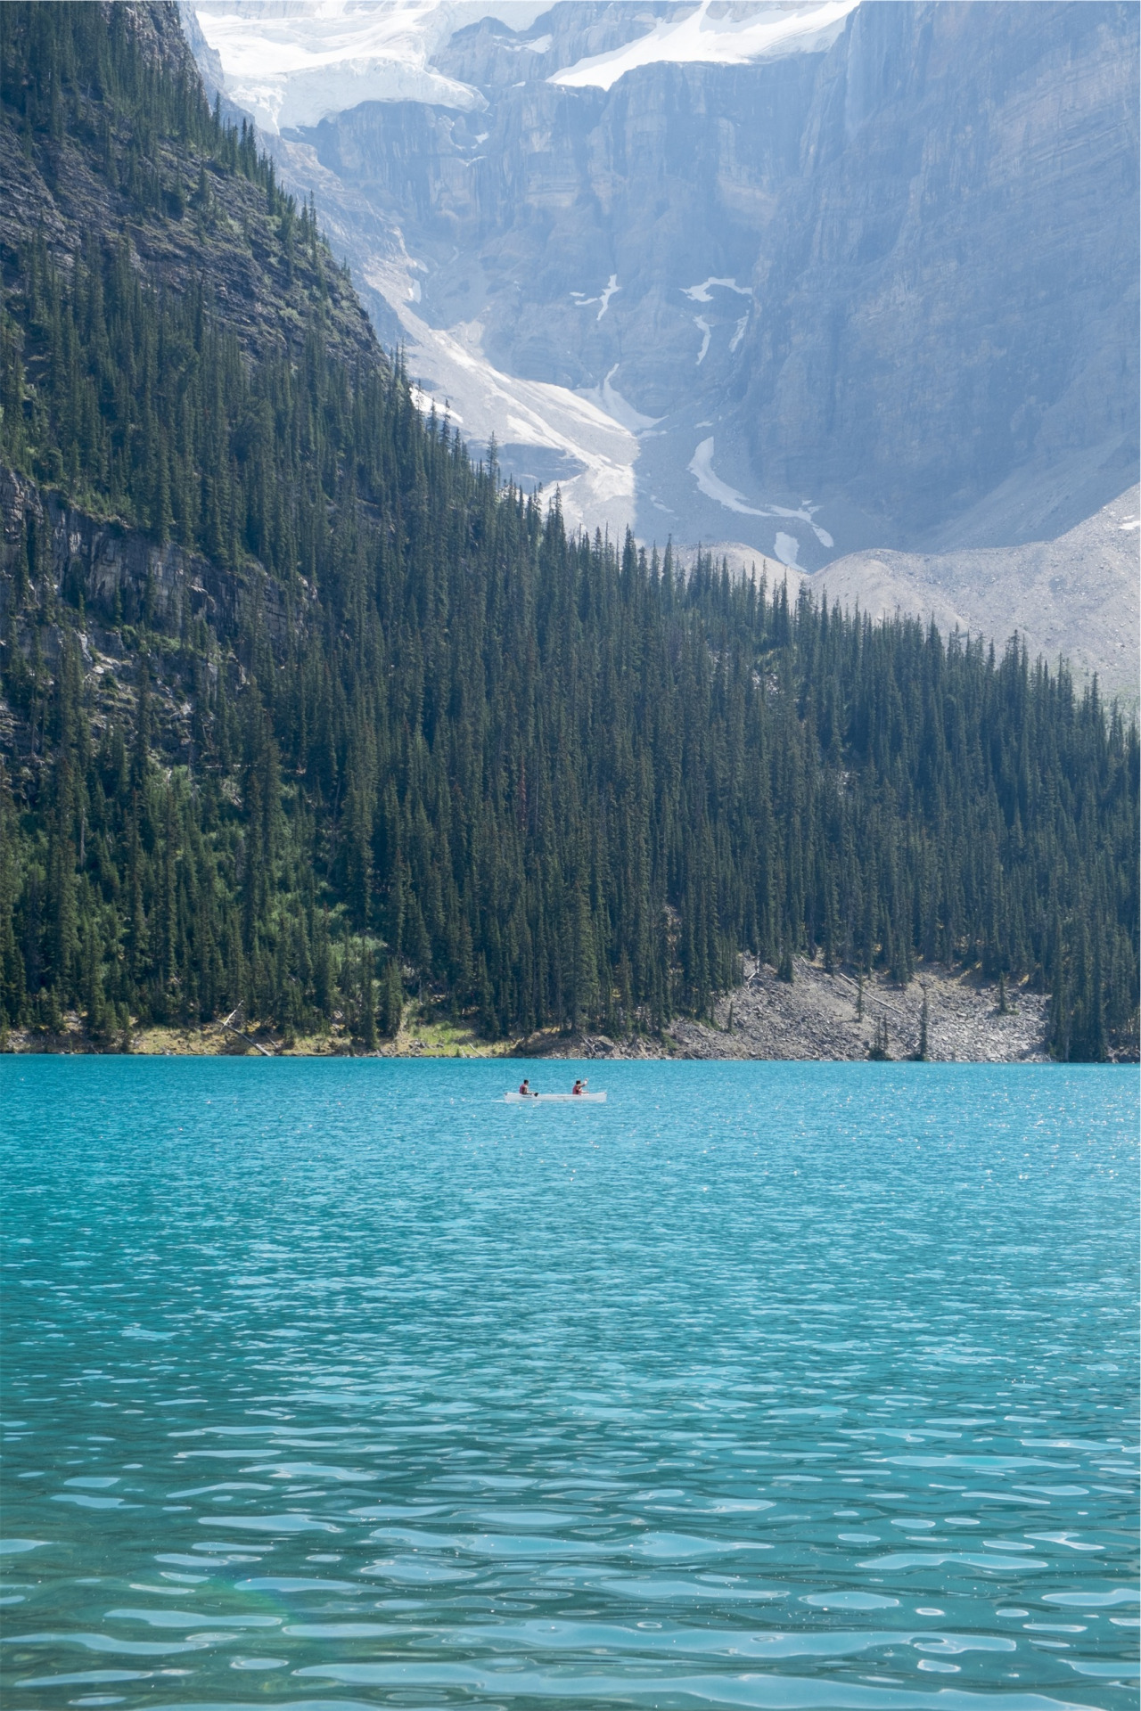
Aiding recovery: Who wants to live in Toronto anyway?

Slide 11

Aiding recovery: Gigs are more than Uber

Slide 12
Long-term diversification : Alberta can lead as a high-volume remote worker centre

Slide 13
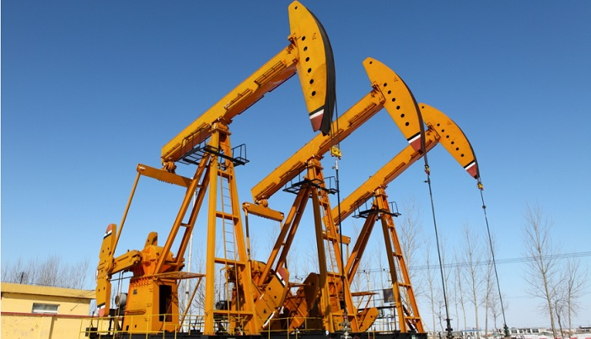
Aiding recovery: Is this high-tech?
(Image curtesy of VentureBeat: http://venturebeat.com/2012/03/28/5-trends-in-oil-gas-technology-and-why-you-should-care/

Slide 14
Aiding recovery: Liberate the engineers!

Slide 15
Long term diversification :
When is O+G not O+G?

Slide 16

Aiding recovery: Every company needs to recognize low-oil day.

Slide 17

Aiding recovery: HR can uncover entrepreneurs

Slide 18
Aiding recovery: Entrepreneur does not mean traitor

Slide 19

Long-term diversification : Building a pipeline of new businesses through culture

Slide 20
Recommendations: Better Workplaces

