Slide 1

Health & Bio Tech
Creating the New Alberta - Vision & Leadership
Presenter:
Peter Fenwick - @strategytosales

Slide 2
Contributors
Jasmine Brown Institute of Health Economics
Eric Cook Research Productivity Council
Randy Duguay Salu Design Group
Peter Fenwick @strategytosales
Michael Flood BioAlberta
Don Juswishzin Alberta Health Services
Randy Krebes Alberta Health Services
Bradley Prince University of Calgary MD/MBA student
Bob Schulz University of Calgary, Haskayne School of Business
The Economist “Disrupting the health care eco-system”
Notes:
Special thanks to the following people who contributed a great deal of content towards this presentation.

Slide 3
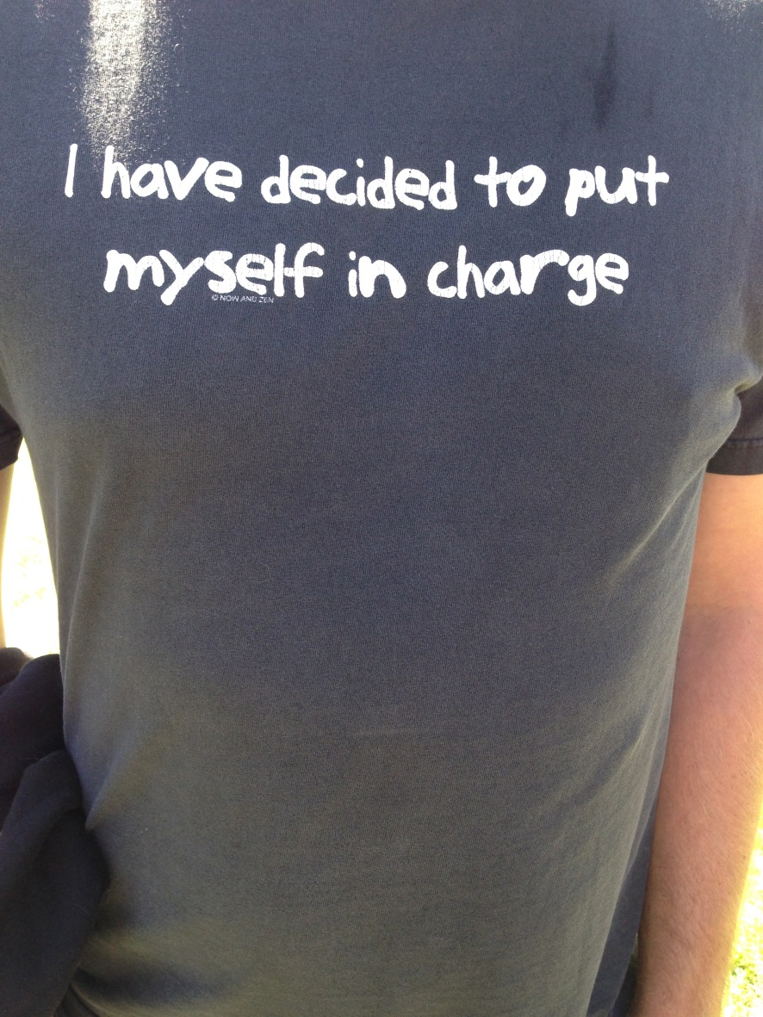
We know it’s coming
Consumers living longer and expecting a higher quality service experience
Changing demographics - immigrants, aboriginal and the seniors “tsunami”
Precision/personalized health care – adopting big data and emerging innovations in biotechnology
Knowledge transfer – recognizing a changing professional/client relationship
Rising personal/public costs of healthcare
Accountability - a driver of payment reform
Random dude: dragon boating Glenmore reservoir
Notes:
We know what’s coming and have been projecting the demand impact for years.
Supply side innovation is incremental at best, and agency effects, combined with an outdate ideological view on how health care should be run, prevents truly disruptive business model innovation .. Which is what Alberta and Canada needs.”
Listen to PATIENTS without patience. The “Include me” movements
Policy shifts to value based care = accountable care becoming a driver
Driving the industry/ profession to adop
t/ eg/ sociademographics, regulations, economy, technology
Is Solving Cancer a real moon shot?
Medical Home – wrong model?

Slide 4
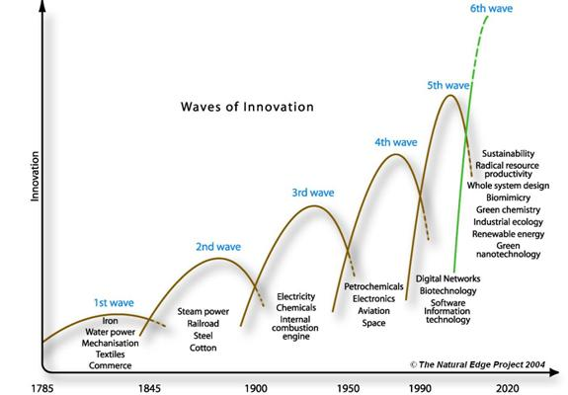
Innovation Waves
6th Wave, Biotech, Genomics, eDNA
Notes:
The next innovation wave complements some of the natural resource industry
{pivot from inside of Alberta activities to what’s from away?

Slide 5

INNOVATION: Scaling User-led Co-development and real-world testing of New Innovations
Stronger Collaboration - Unique Network Building.
NEW: Crowdsourcing - Innovation Platform (www.ihe.ca)
Government
+
Academia
+
Industry
+
Providers
+
Patients
Notes:
No big ideas can be implemented without collaboration.
Collaborate is a verb, not a concept.
The IHE has established networks in Health Technology Assessment, and is creating new networks and employing new collaborative models - bringing movers, shakers and advocates together, to take ideas from words to action. We want co-development and real-world testing of new innovations – networks where members take ownership, and have the connections, tools and confidence at hand to secure follow-through.
Health Technology Assessment International and the International Network of Agencies for Health Technology Assessment (existing) (www.inahta.org; www.htai.org)
NEW: Network of Alberta Health Economists (www.NOAHE.ca)

Slide 6
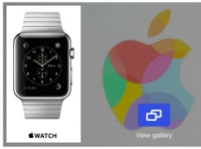
INNOVATION: Precision Medicine to Precision Wellness
Internet of Health-things (IoHT) / clinical & wellness settings
New opportunities for large number of people
to participate & collaborate in big data research
Increased ability to use Machine Learning
techniques to support wide demographic analysis
Increased opportunities for patient / consumer consent and engagement
New opportunities to support compliance in care programs and medications management
Notes:
Connecting Precision Medicine to Precision Wellness
Emerging role of AI???
We must embrace complexity to fully understand patient physiology and disease “A complex adaptive system has three characteristics. The first is that the system consists of a number of heterogeneous agents, and each of those agents makes decisions about how to behave. The most important dimension here is that those decisions will evolve over time. The second characteristic is that the agents interact with one another. That interaction leads to the third—something that scientists call emergence: In a very real way, the whole becomes greater than the sum of the parts. The key issue is that you can’t really understand the whole system by simply looking at its individual parts”. - Michael J. Mauboussin (investment banker)

Slide 7

Innovation: Technology Push
INNOVATION: Market Driven Research
Curiosity
Fundamental or Basic Research
Discovery invention
Opportunity Application Problem
Commercial Value
Applied Research
Discovery Invention
Opportunity Application Problem
Commercial Value
Notes:
This lead with research Push play has been Canada’s primary innovation strategy. Leads to frustration when discoveries cannot be matched up with problems or opportunities.
Arrow indicates infamous “innovation gap” bringing capturing commericial value. Actually is an invention gap.
Strong innovation performance relies on a well-functioning system involving both “push” and “pull” (demand) factors
OECD’s Innovation Strategy: Key Findings and Policy Messages

Slide 8

INNOVATION: Paradigm Shift to Health/ Wellness
AHS cost centres transition to global wellness/ business leaders
Key perspectives/”dots”:
1. AHS spends >$100MM/year on disability claims for own employees
2. >40% homeless brain-injured beforehand and some cost Province >$1MM /year
3. Medical doctors limited by “professional standards of practice” & “do no harm”
4. “Medicine” limited to listening and assessments (X-rays, blood/urine, etc.), with therapy alternatives limited to “do nothing”, pills, or surgery
5. Medical “innovation” typically limited to “policy”, small %changes, long-term lab-based possibilities, and some new devices

Slide 9
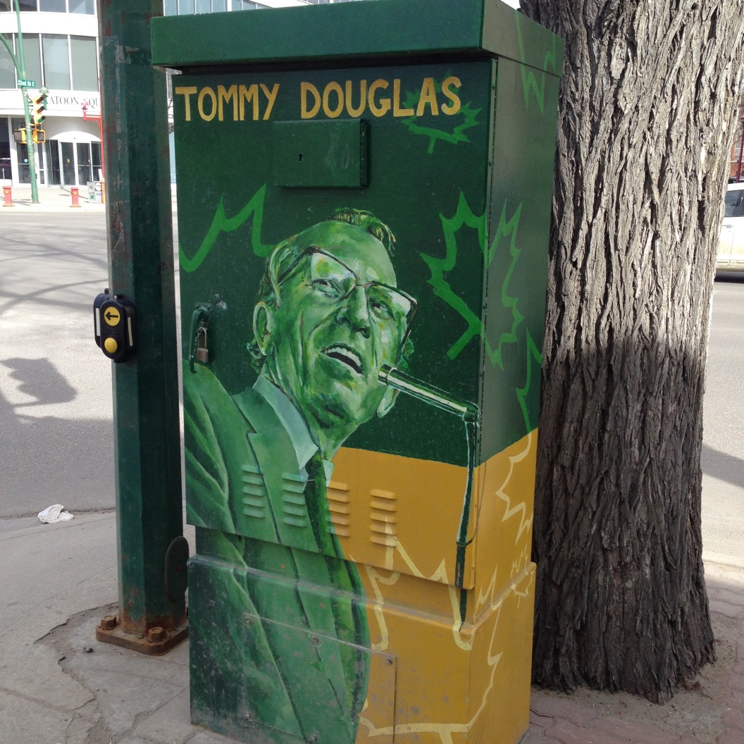
“Health care is broken. Go fix it.”
“…is what he (Tommy Douglas) would say if he was alive today” Bob McInnis, Impact Investing Forum, April 2016
“ very few people today have the courage to do what Douglas and L.B. Pearson did. Citizen agitation is needed” Chris Eagle, (former) CEO Alberta Health Services, CCHL event, November 2016
Downtown Saskatoon, SK during CADTH 2015 Symposium
Notes:
“There is no legitimate burning platform in Canadian health care because we inherently lack the information to make educated decisions, as consumers, as taxpayers, as bureaucrats, as politicians.
What is driving a sense of urgency to change? Is the ‘system’ we have is good enough or does it drives complacency?
PEOPLE - Everyone in Alberta is either an innovator OR wants to be! Too many constraints. ENCOURAGE
- Tell this story, not incrementalism .. Sell incremental and give disruptive change
- Build deck around this theme
- Revamp co-operative business model to transitioning industries
- Not protecting monopolies
- Role of municipalities verses Provinces, AMGA
- Mission, mandate, model (Robert)
- What is the pointing edge of the spear
- Alternative energy industry application
- Similar to charter school disruption challenges

Slide 10

Performance improvement: More regularly re-assess current practice.
Health economics research seeks the best distribution of resources (labour, money, etc.) to reach the best outcome (high quality, economically sustainable, healthcare) to guide choices.
The patients , balancing between our decisions, are the most important consideration.
And that’s just counting what Provincial taxes pays for….
FACT: “Every hour we will spend $2.3 million – $56 million per day – to maintain and improve Alberta’s health care system.” – Alberta Health
Notes:
Health economics evaluation is often used in consideration of new innovations. More effort should be taken on evaluation of what is in place now to extract savings to try new things out.
Health Economics leads to evidence-informed policy and the better allocation of resources – health economics is often applied in the evaluation of NEW innovations. We should also be applying it to what innovations are already in place, to determine a better allocation of resources. Our first idea – “don’t set it in place and forget about it.”
Picture: We cannot forget the patient, who is often balancing between our yes and no decisions.

Slide 11


Performance improvement: Culture often trumps change
De-adoption
Use less, stop & remove
Evaluate
Did innovation produce intended results?
Acclimatize to Culture
‘Just the way things are done around here”
Notes:
We, as they do, recognize that there is no vacumn allowing creativity, technology or other forms of innovation to enter the Culture …

Slide 12
Performance improvement: High Performance Process Elements
Identify Innovations –Push & Pull
Comprehensively Assess Innovations
Make Evidence Informed Decisions
Adopt, Implement and De-adopt Innovations
Evaluate Innovations
Acclimatize Innovations
Notes:
All know the path, but few walk it.
Our regional integrated and single health authority recognized the elements for high performance are needed

Slide 13
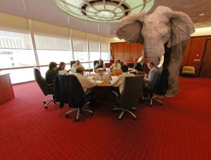
Managing Innovation: IP Policy and practice changes
U Manitoba unveils liberal IP policy in bid to speed negotiations, attract companies - March 2013, Technology Transfer Tactics.
Companies interested in research at can make use of the research until products/ services begin generating revenue. Companies are then expected to remit between 1% and 2% of sales.
Faster to market

Slide 14

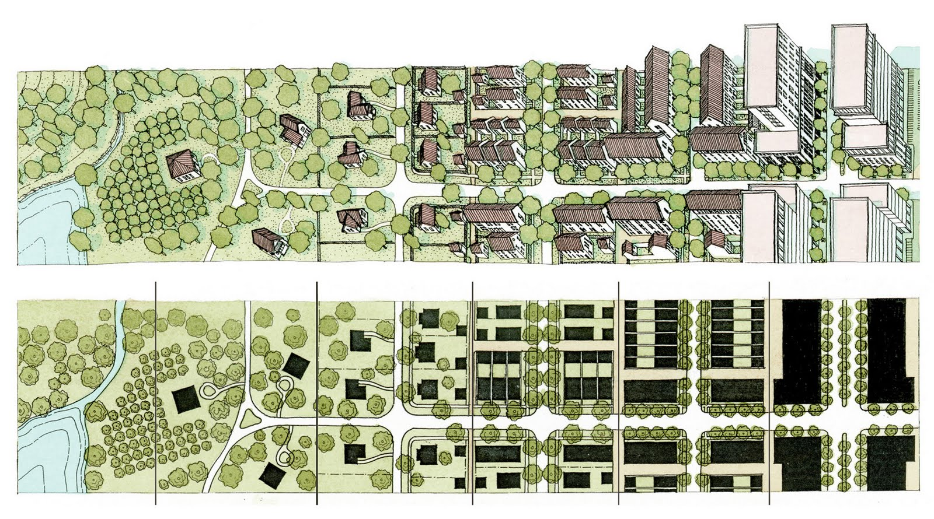
Managing Innovation: Health Care Facility Design
& Procurement
Notes:
Big projects have lead much of Canada’ sinnoovagion over the decades .. CPR, st lawerence seaway. Oila sands .. CDN comms satelites
Not how we’re looking at health
That said, and Just as Alberta has the opportunity to lead via mega-project innovation with the northern corridor this can happen in Health care
Health Care Facility Design & Procurement Innovations
- Buildings today focus on treating disease. They co-locate patients, providers and resources.
- Health spending for prevention and ICTs will shatter this model and drive the move from ‘at-place’ to ‘in-place’ care.
- Alberta’s population distribution is both the challenge and opportunity.
- Design and construction teams will become fully-integrated.
- Clients and stakeholders will be a vital part of the design process.
Teams will share risks and rewards and be selected because they can work together, solve problems and improve productivity.
try first, buy first, scale fast???

Slide 15

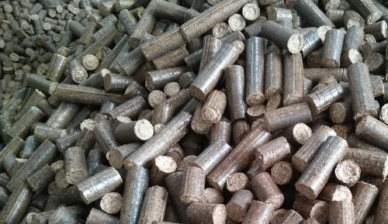
Biotechnology: Converting agricultural waste biocoal
Life science (bio-industrial)
  AB energy producers mandated to phase out coal by 2030, replacing with … what?
  (>10,000 tons annually in AB) to biocoal – CO2 neutral, ready to use in existing power plants
Notes:
Alberta’s energy producers are mandated to phase out coal by 2030. That’s 50% of Alberta’s energy generation that needs to be replaced in 14 years.
The coal-fired power plants are a huge installed generating base. Converting them to another fuel or opening new power plants will be difficult and expensive
A cost-saving, job creating solution: biocoal, a hydrocarbon made from agricultural waste burned in an inert environment. Yields zero net carbon, lower air pollution (does not release the heavy metals that regular, mined coal does)

Slide 16


Managing Innovation: More clinicians as entrepreneurs
More professional management in health care service delivery
More clinical leadership in starting co-operative enterprise
More cross disciplinary collaboration with clinicians, engineers and entrepreneurs.
(5) Entrepreneur Magazine Oct 2015, Are you a Rebel ?
Notes:
To take advancratg eof the six wave we need a mindset
Role of people and the professions needs to shift for the Alberta economcy to capotalize on healht and biotech

Slide 17

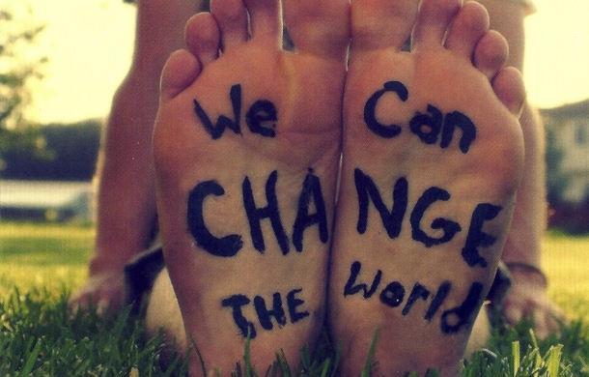

Leadership: ”Healthy Cities” => Global Wellness/Business Leader
1. Social entrepreneurs
2. Single health-care delivery system
3. Levering ALBERTA’s leadership in:
No-needles, no-drugs clinical psychophysiology/biofeedback
Mobile & cloud solutions/health analytics & AI
Expertise in computing, wireless, geomatics
.
Linda Rottenberg on The Future of Social Entrepreneurship – FounderDating, April 2, 2015
Notes:
1. Social entrepreneurs, AITF, VC, tech companies to fund initially
2. Lever world-class Alberta-based no-needles, no-drugs clinical psychophysiology/biofeedback Myosymmetries
3. Lever Alberta mobile & cloud solutions Calgary Scientific
4. Lever Alberta expertise in computing, wireless, geomatics, GE
5. Become wellness solution everywhere/one desperately needs
6. Result = Alberta global wellness and business leadership

Slide 18

Leadership: Sell incremental and give disruptive
What is the pointing edge of the spear?
Revamp a co-operative business model to transitioning industries
Engage municipalities together with Provinces for leading change
Health has similar disruption challenges to educations but competition has improved quality
Notes:
Habits are environmental, so Albertans should be focusing on creating healthy communities.
Disruptive is the BIG IDEA; not incremental BUTto be successful at scaling in the health and biotech we may need to sell incremental and give disruptive change.
Every other country around the world has modified governance around city states … MORE
Medical Home – wrong model?
Why protect state run monopolies when they no longer serve the interests of the public or deliver a public good

Slide 19
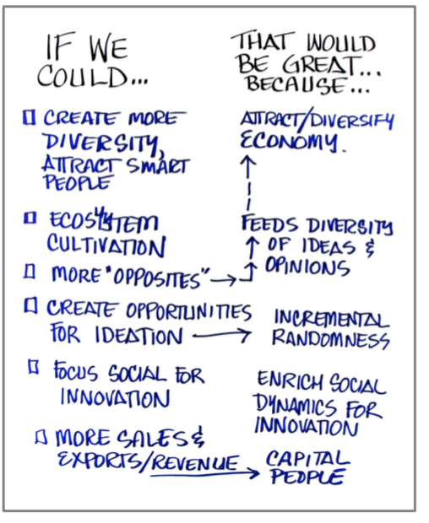

Leadership: ECO-SYSTEM Alignment
Notes:
try first, buy first, scale fast

Slide 20
Recommendations
Vision - People count: personalize accountability for health and democratize local service delivery and make the transition to wellness and quality of life
Precision/ personalized health – improve access to and usage of data and intelligence
Innovation – establish an entrepreneurial friendly eco-system, employ procurement for stirring innovation, and prepare for the rapid arrival of emerging technologies
Fix Performance - reinforce collaboration, adopt and measure performance to international quality standards, and expect continuous learning
Fiscal transparency and reallocation – balancing supply and demand and facilitating system transitions
Notes:
Consumers are not slaves to insurance programs any more
POP health mgmt, policy shift to value based care = accountable care becoming a driver
International engagement to validate – complexities due to issues with going abroad, access to capital, hindered domestically, we have artificial boundaries between provinces ..

