Slide 1
BIG IDEAS
Forestry & Wood Products
A world where products from sustainable forests contribute to every aspect of daily life.
Dalibor Houdek, Ph.D.
Provincial Leader – Alberta, FPInnovations
Creating the New Alberta – Vision and Leadership, Nov. 26, 2016

Slide 2
Presentation Contributors
Al Ward, Vice President, Alberta Innovates Technology Futures
Daniel Lux, Executive Director, Alberta Agriculture and Forestry
Gordon Sanders, Chief Forester, West Fraser
Howard Ewashko, President, Northlands Forest Products
Ian de la Roche, Adjunct Professor, University of British Columbia
Paul Whittaker, CEO, Alberta Forest Product Association
Stan Blade, Dean Faculty of Agricultural, Life & Environmental Sciences, U of A
Stephen Murgatroyd, President, futureTHINK Press
Tom Thompson, Mill Manager, Millar Western
Trevor Stuthridge, Executive Vice President, FPInnovations
…. and many others….

Slide 3
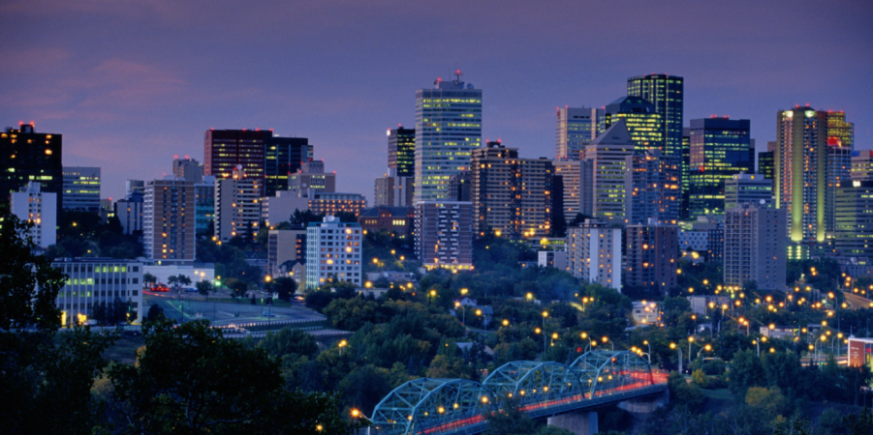
Forces of Change - Demographics
Growing population (from 1B to 7.5B people in last 200 years)
We need shelter, food & water
We need wood products
(fuel wood, building materials,
packaging, hygiene, etc.)

Slide 4
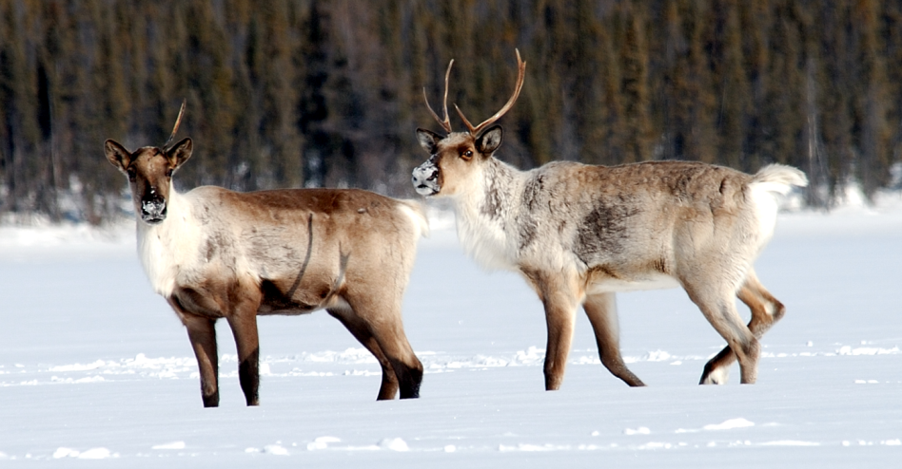
Forces of Change - Environmental
Need to reduce CO₂ emissions and environmental footprint (social licence)
Biodiversity (Caribou, grizzly
bears…)
Cumulative effects

Slide 5
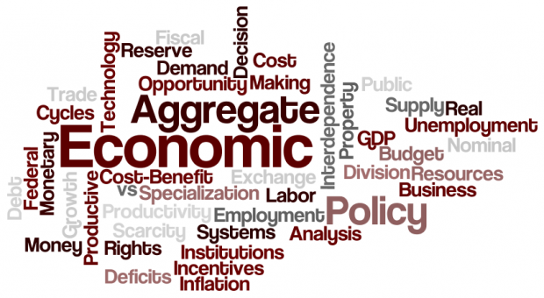
Forces of Change - Economics
Balancing economics with variety of desired outcomes (bio-diversity, water, air, communities, indigenous rights, etc.)
Competitiveness to ensure
business sustainability
Cost of fibre

Slide 6
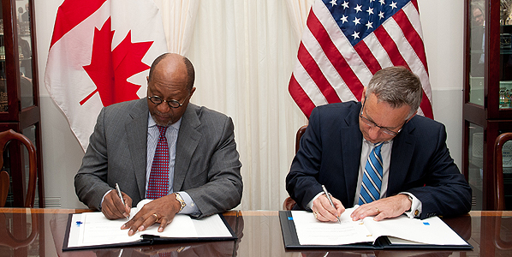
Forces of Change - Political and Regulatory
Fibre access and availability of productive public land
Environmental and carbon
regulations (carbon tax,
wages, power cost)
Trade and market access

Slide 7
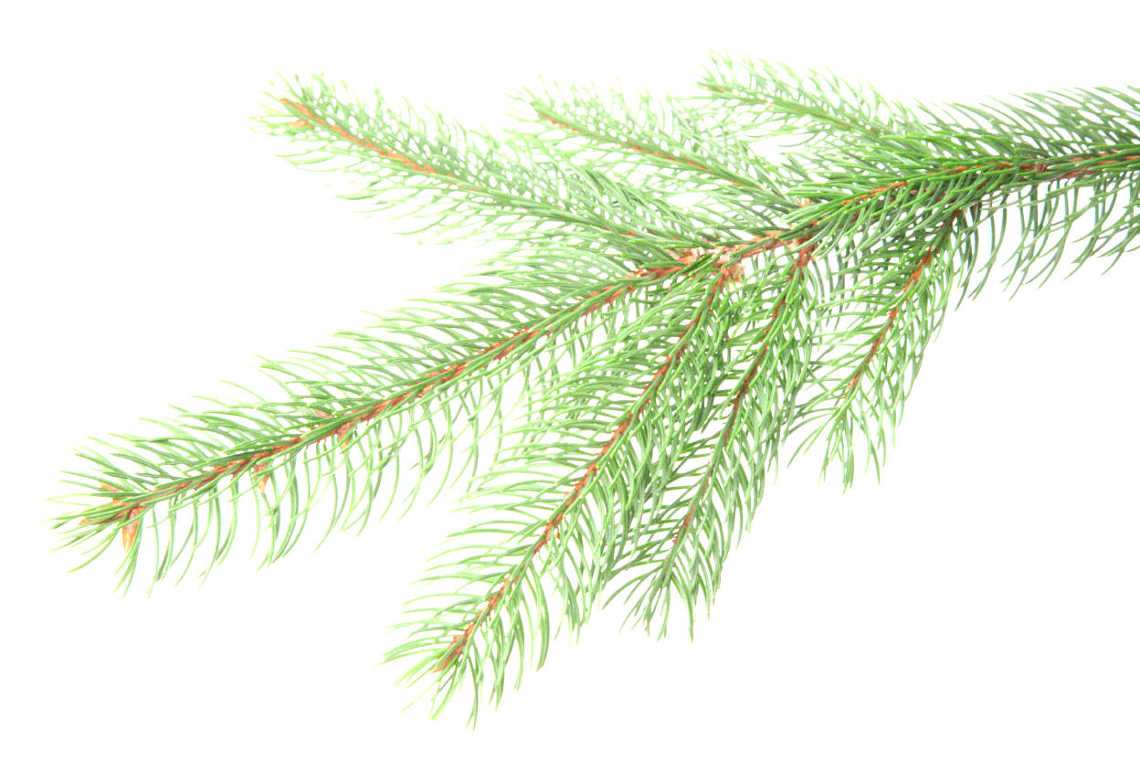
BIG IDEA #1 - Carbon Capture & Storage by Nature
60% of Alberta is covered by trees (82% of forest is third- party certified)
Nearly 50% of wood mass is carbon captured from the atmosphere through photosynthesis.
47 B m³ of biomass in Canada's forests (15 Gt of C).

Slide 8
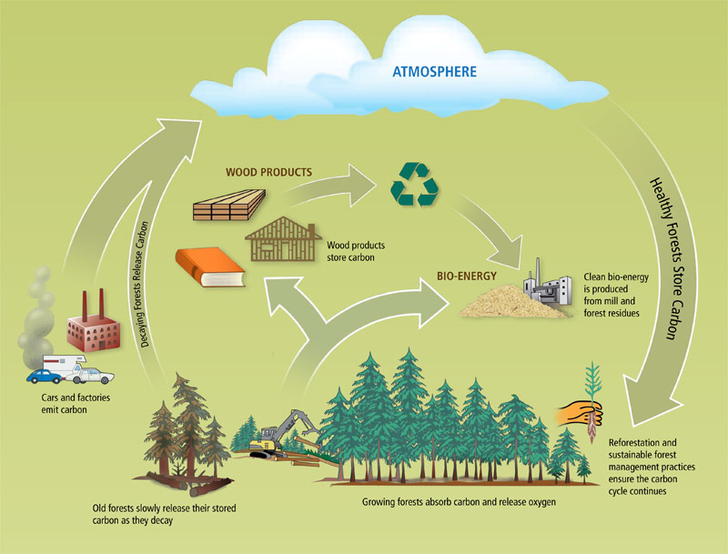
BIG IDEA #1 - Carbon Capture & Storage by Nature

Slide 9
BIG IDEA #1 - Carbon Capture & Storage by Nature
Carbon capture in forests (reforestation of marginal land, more trees per ha, application of genomics and genetics…)
Opportunities in ecological services (for energy sector)
Maximize the bioenergy generation from residual & recycled biomass to replace coal power generation

Slide 10
BIG IDEA #2 - Forest to Buildings
Cities are built with concrete and steel (8% of GHG’s)
New wood materials such as CLT can replace concrete in many applications (lower environmental footprint)
Opportunity in wooden bridges and other infrastructure

Slide 11
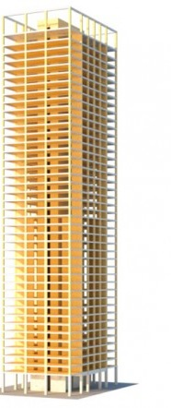
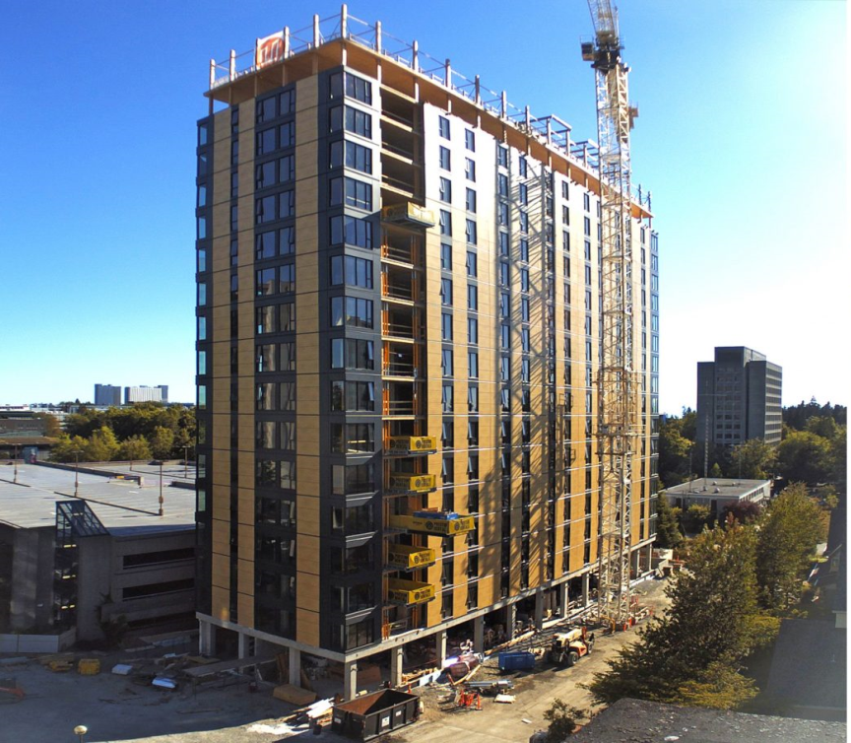
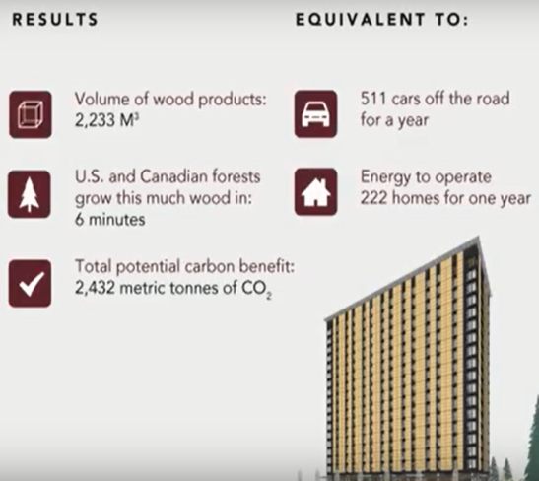
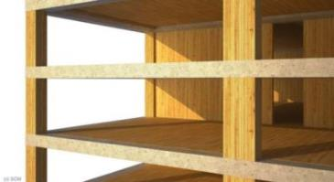
BIG IDEA #2 - Forest to Buildings
42-Storey
SOM Tall Wood Concept

Slide 12
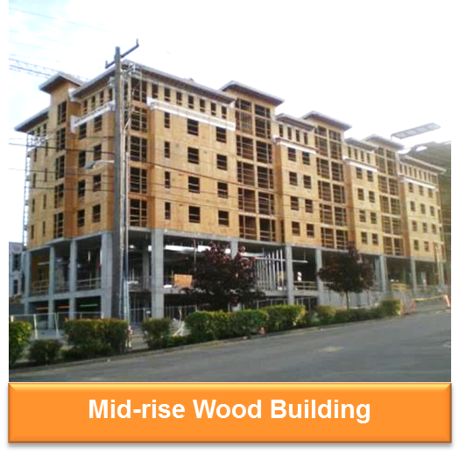
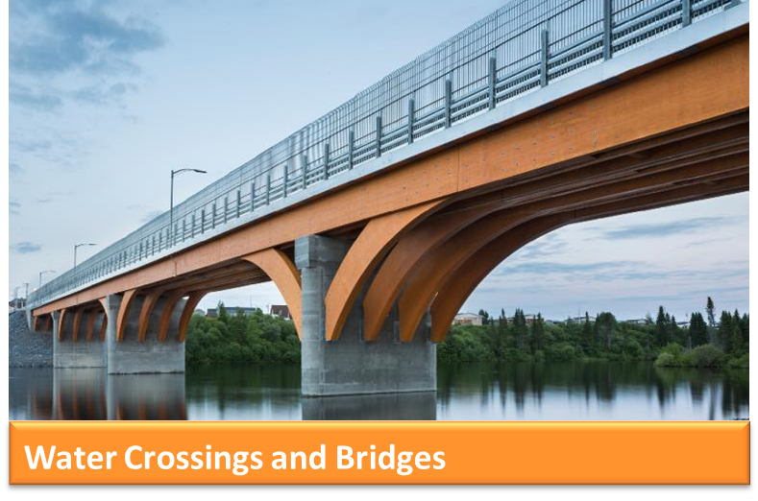
BIG IDEA #2 - Forest to Buildings

Slide 13
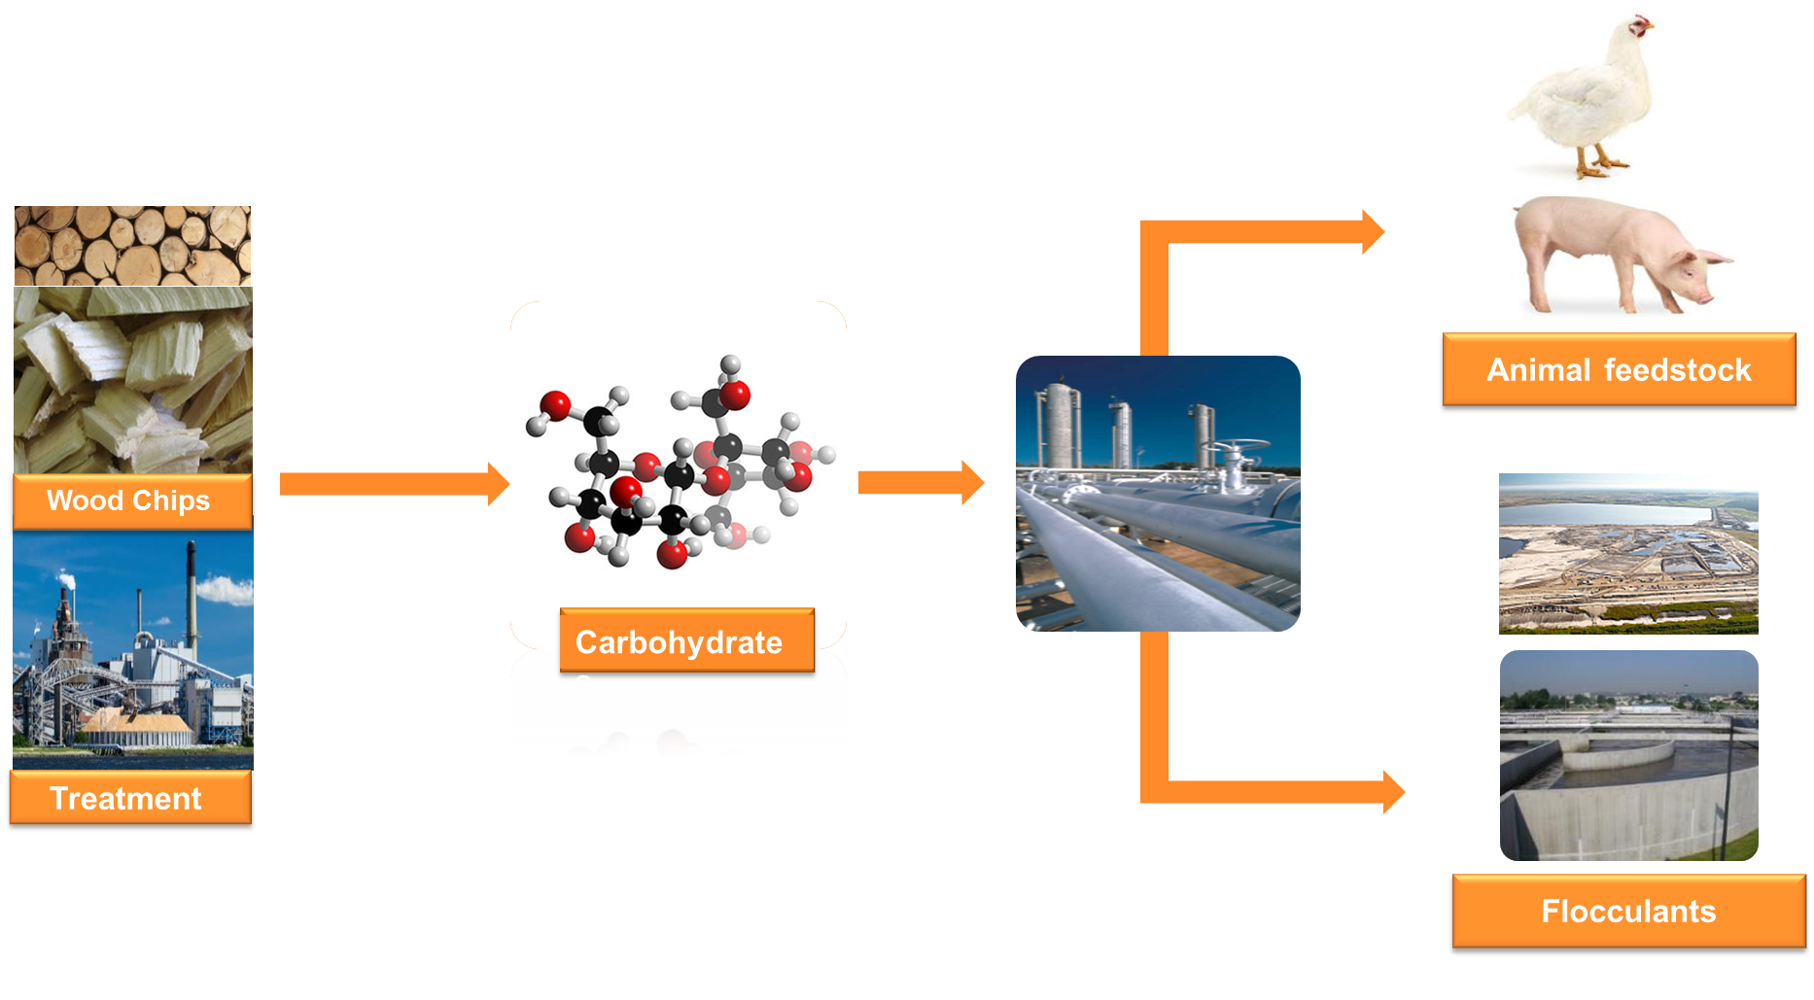
BIG IDEA #3 - New Platforms from Wood

Slide 14
BIG IDEA #3 - New Platforms from Wood
Cellulose platforms like CNC (hydrocarbons, tissue, towel, thermoplastics, nonwovens) or Filaments (rheology, strength reinforcement, optical)
Lignin-based platforms (adhesives, surfactants, composites)
Bio-Refining (renewable alternatives to petroleum-based products for construction, automotive, aerospace, mining etc.)

Slide 15
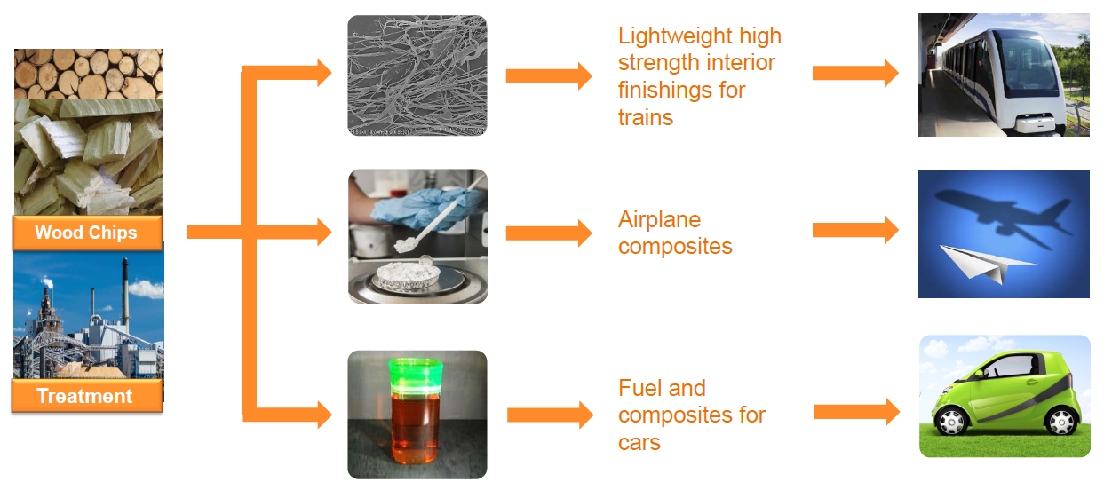
BIG IDEA #3 - New Platforms from Wood

Slide 16
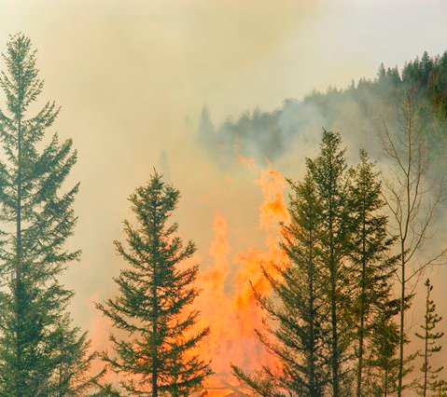
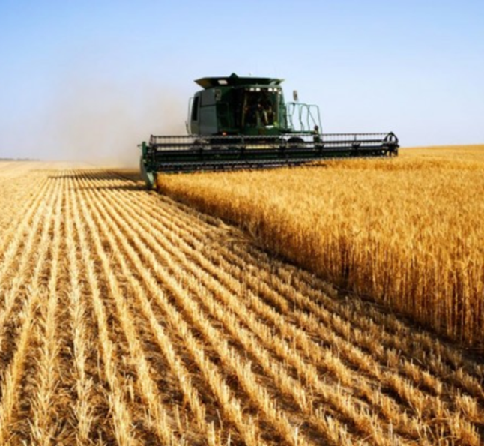
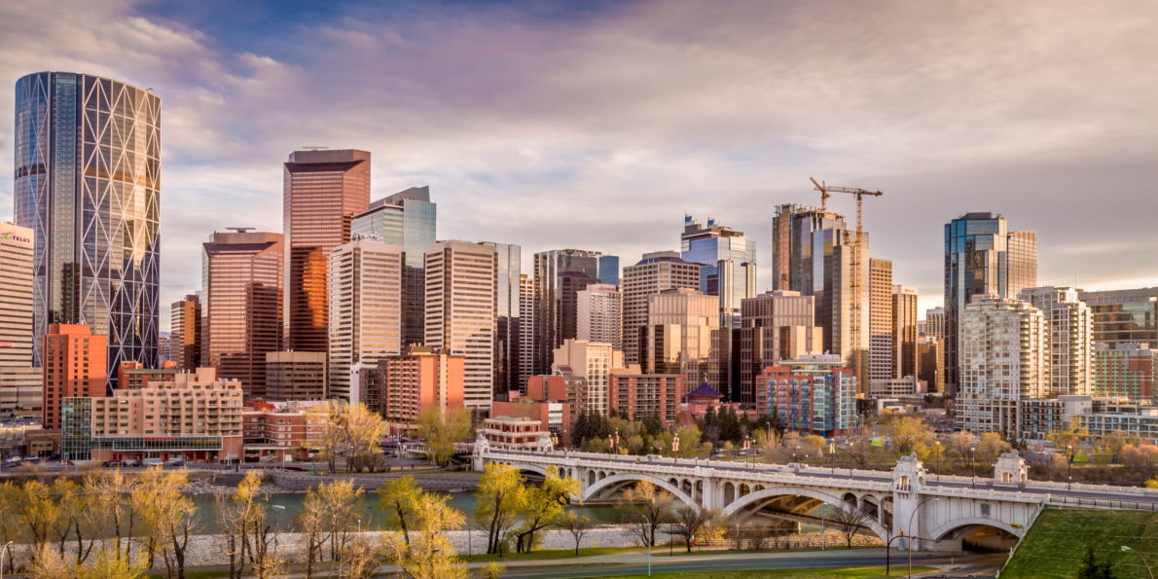
BIG IDEA #4 - Setting the Record Straight
Causes of deforestation in Alberta

Slide 17
BIG IDEA #4 - Setting the Record Straight
74,000,000 trees planted in 2016 by Alberta forest industry (3 for each harvested), nearly 2 billion trees in the last 20 years!
15,500 Albertans & 70 communities depend on forests
400+ MW of renewable power generated from residues (power for 4 cities size of Grande Prairie), and more opportunities exist.

Slide 18
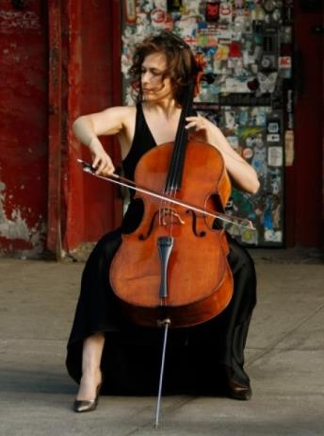
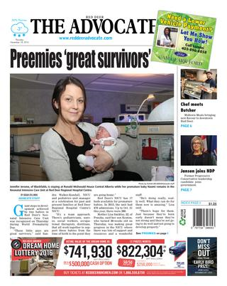
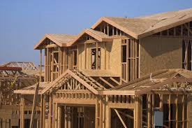
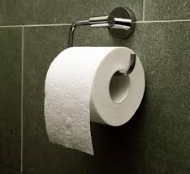
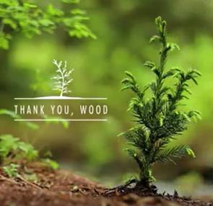
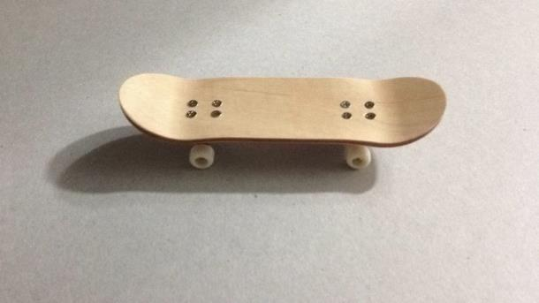
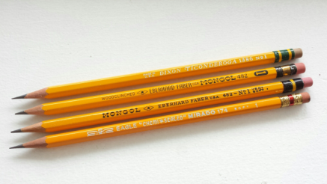
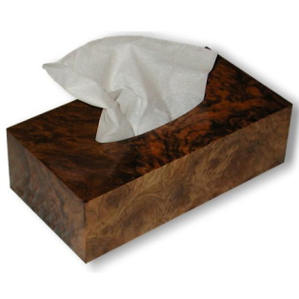
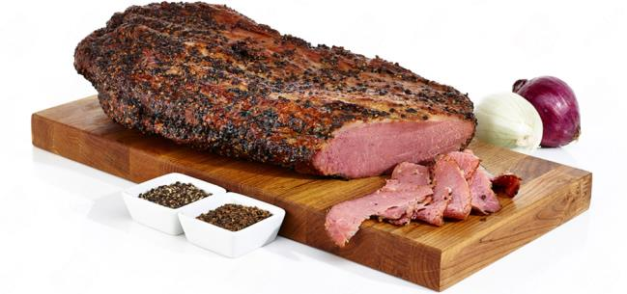
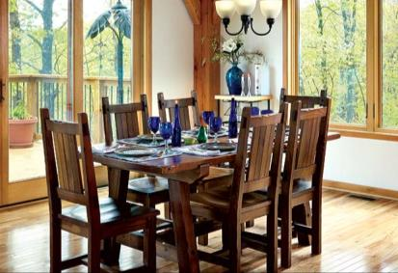
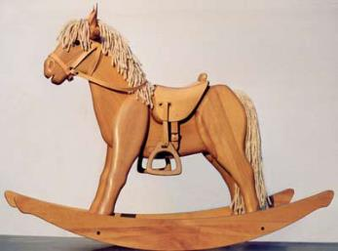

BIG IDEA #4 - Setting the Record Straight

Slide 19
Recommendations - Call to Action!
Need to recognize and champion the value and benefits of forest and grow socially responsible green economy.
Need to stabilize policies related to fibre supply to spark new investment (more productive forest)
Need to maintain access to markets

Slide 20
Recommendations - Call to Action!
Incent climate-smart forestry! More healthy and resilient trees capture more carbon & provide more opportunities
Greater investment in innovation/commercialization of new applications/platforms from wood (beyond first of a kind)
Set environmental impact targets for buildings and infrastructure projects (Wood Charter) as a the key metrics

