Slide 1

Finance and Accounting Profession
Leveraging Intangibles for Technology Success
Presenter: Robert McGarvey

Slide 2
Contributors
Pro-Ventures Pathway Inc, Edmonton, AB
    Joseph Batty CA, Ron Palfery, Robert McGarvey
Beckett Advisors, Pasadena, CA
    Gayle Turner, Sharon Beckett
Economic Research Council, London, UK
    Jim Bourlet, Director and former Editor of Britain and Overseas
    Damon de Laslo: Chairman
Genuine Wealth Institute, Edmonton, AB
    Bill Craig & Mark Anielski, partners and co founders
ipVA Licensing Limited, London, UK
    Andrew Watson, founder and CEO
Price Waterhouse Coopers, Calgary, AB

Slide 3
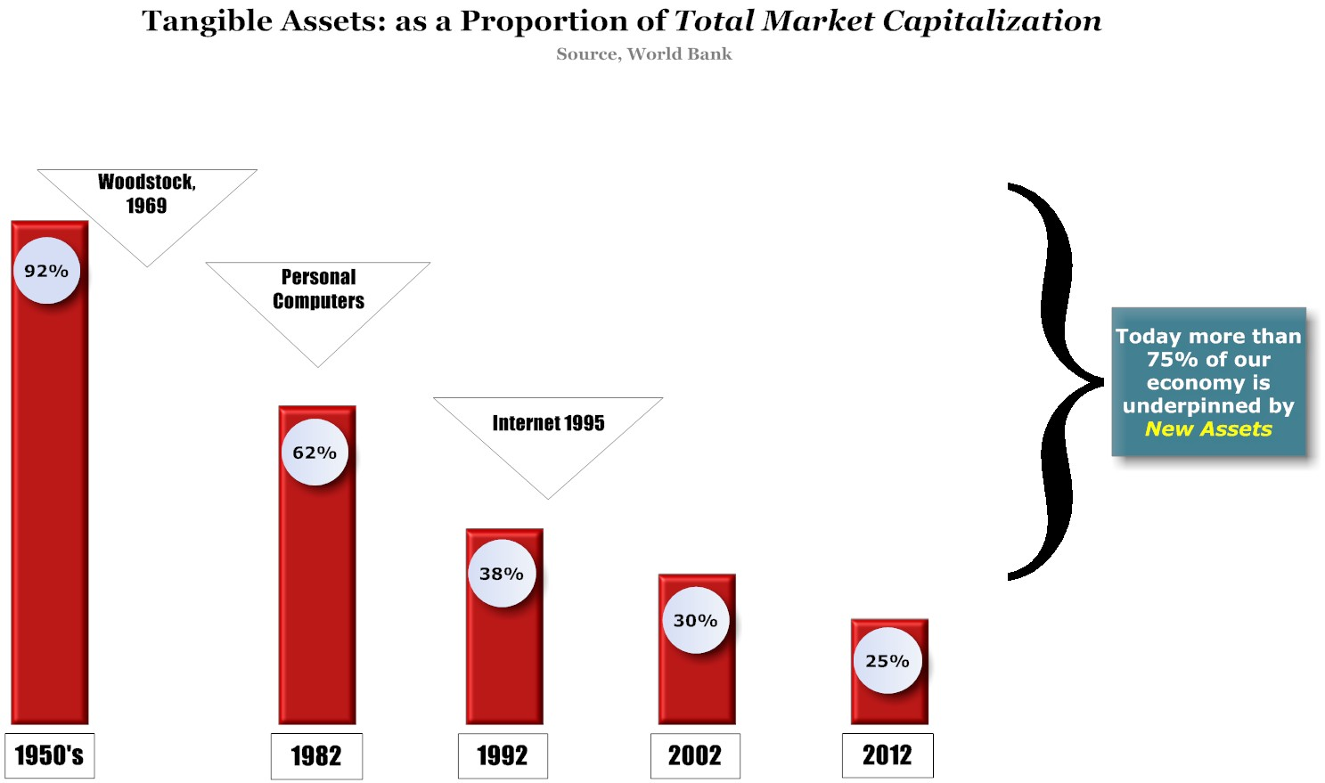
The World has Changed!
Notes:
This graph illustrates what is hurting the Canadian economy and the economies of the G40 countries.
This is a very complex issue and will need a great deal of time to discuss. It does not need to be addressed until later in this implementation.
We show this so you can see the massive transition that has taken place in a very short period of time in the world’s history.
As the traditional asset base declines the competition for placing investments in this shrinking asset pool becomes incredibly intense.
Money managers like AIM Co. and the Canada Pension Fund are having enormous problems placing their money because they simply have not adapted to the New Reality – THE ASSET BASE HAS CHANGED
This also illustrates is the problem our citizens have in finding decent investments opportunities.
As an example, seniors today that have graduated from their work life, sold their business interests, sold their real estate and downsized
Sitting on a cache of money
No decent place to invest this money
Must now pay for their everyday living costs out of their savings (rather than from investment income)
Hopefully their savings last longer than they do.

Slide 4
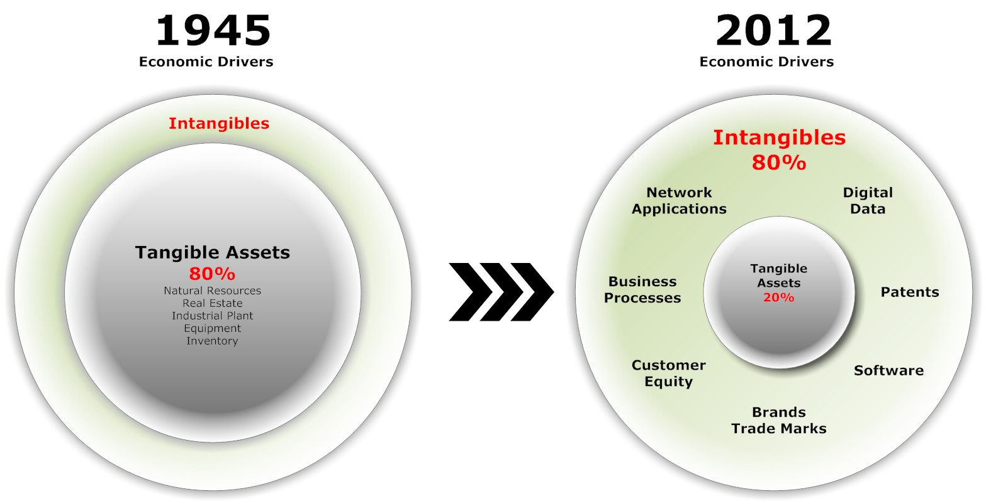
The Rise of Intangible Assets

Slide 5

The Capital Disconnect

Slide 6
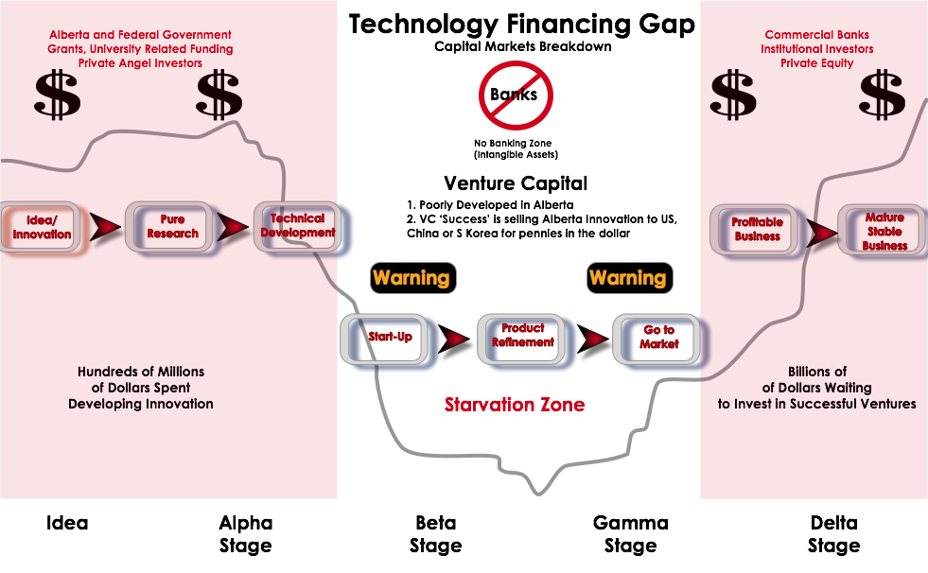
The Starvation Zone
Notes:
Alberta spends $100’s of millions on R&D and innovation
Virtually no one has money available for the next step – see the Financing Gap shown.
One of PVP’s specific expertise is structuring businesses (in this Financing Gap) properly so that the maturing and implementation needed in this Gap is at a investment risk that is manageable.
There are several techniques that PVP uses – the most important technique is to spread the early high risk investment over a large group so no investor would be hurt if the R&D/innovation proved to be inconclusive or erroneous.
We can show you a detailed example of this at a later time. (e.g. Syngar needing $1 to 2 million to prove scale-up, spread over 20,000 investors means the cost to each investors would be limited to $50 to $100).
If this scale-up proves to be successful, the Syngar investment opportunity would be made available to the members of our “Alberta First Fund”. If there is limited interest by these people, the investment opportunity would next be made available to Albertans in general then if necessary to the general Canadian public.

Slide 7
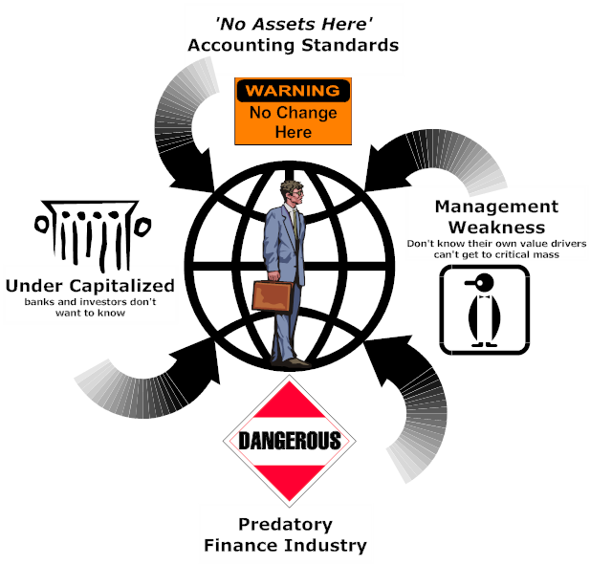
The Present Reality: Technology Jail

Slide 8
Current System is NOT working
Over 90% of technology ventures fail
95% of technology IPOs end up as penny stocks
Success often comes at the expense of original innovators and early stage investors, who get diluted massively
Venture capital success = technology sale to US, Chinese or South Korean entities

Slide 9

Step One: Focus on the ‘Assets’
Identify, Capitalize Non-traditional assets

Slide 10



Institutions are Starting to Move

Slide 11
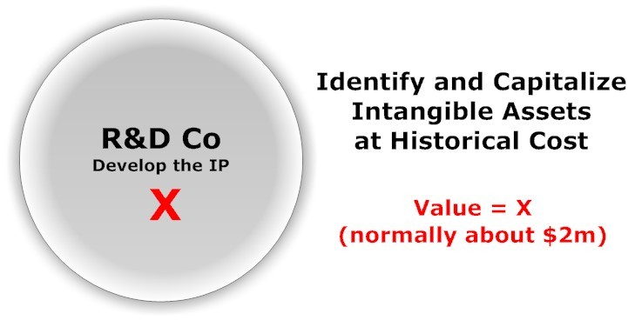
Step One: Focus on the ‘Assets’
Identify, Capitalize Non-traditional assets

Slide 12
New Accounting Standards
IAS 38 Intangible Assets outlines the accounting requirements for intangible assets
(IASB) an asset is a resource that is controlled by the enterprise as a result of past events (for example, purchase or self-creation) and from which future economic benefits (inflows of cash or other assets) are expected.
(IAS 38.8): An intangible assets is an identifiable non-monetary asset without physical substance.
Three critical criteria are: [IAS 38.8],
  the asset must meet the GAAP standard of Identifiability
  the company must demonstrate its control (power to obtain benefits from the asset
  an expectation of future economic benefits (such as revenues or reduced costs in future).

Slide 13
Identify, Capitalize Your Assets
IASB, 30 new classes of Intangible assets
Your Accountant probably won’t help you identify these assets
Yes, you can write off expenses for tax or SRED purposes and still capitalize your intangible assets

Slide 14

Step Two: Establish Enterprise Value
Highest and Best Use Valuation

Slide 15
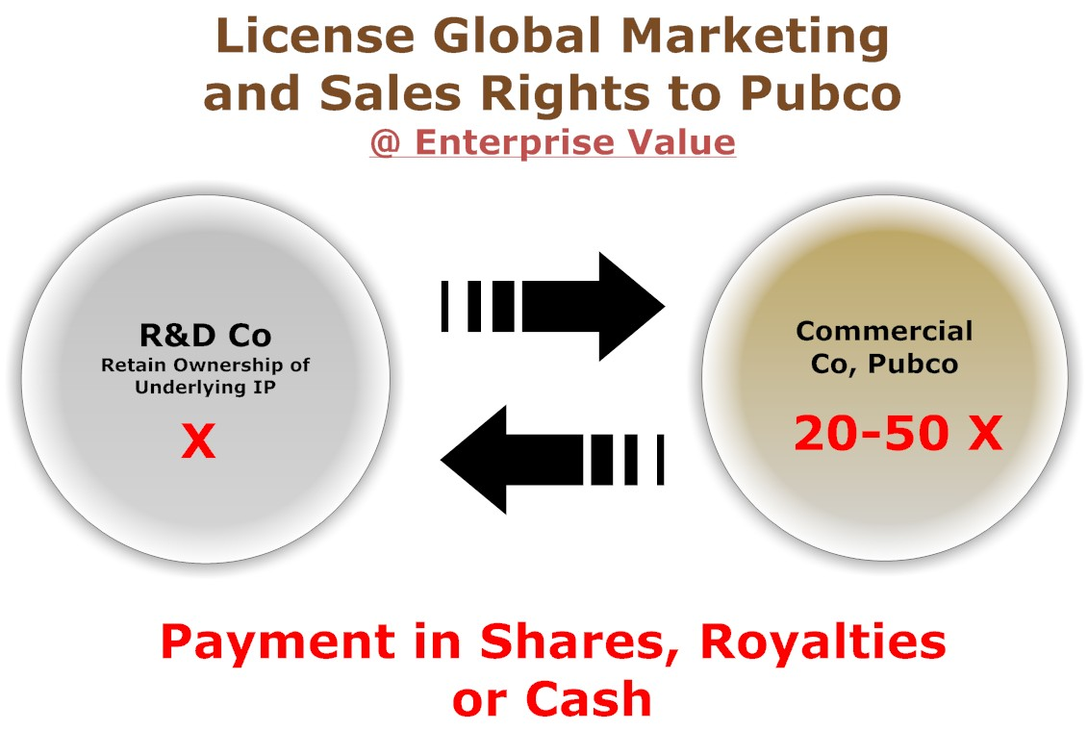
Step Three: License Strategy
Highest and Best Use Valuation

Slide 16
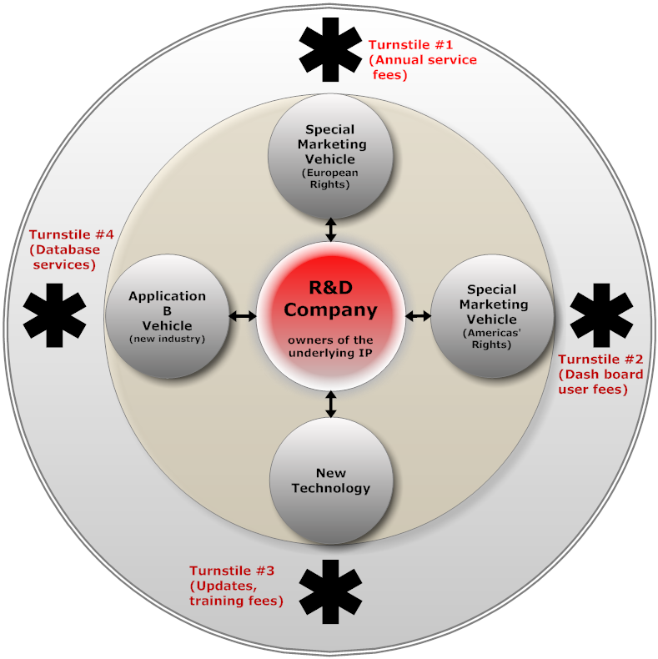
Step Four: Structuring for Growth

Slide 17

Step Five: Go Pubic @ Enterprise Value

Slide 18
R&D Co Benefits of New Strategy
Maximize Value of your Technology
Minimize Dilution
Control your own Destiny
Unimpeded freedom to do more R&D
Increase your Leverage
Provide a Legitimate Liquidity Event

Slide 19
Commercialization Benefits of
New Strategy
Enterprise Value = Can fit a large investment into the company
Strict commercialization Focus
Reduced conflicts with ‘founders’
No corporate baggage, Ready to go public
Lots of equity for new capital, management and JV partners

Slide 20
Recommendations
Technology Leaders
    Understand that your technology and other value drivers are assets, start treating them as such
Accountants, Bookkeepers
    The asset revolution we’re experiencing at present is not part of your training. Intangibles dominate the economy and need specialized treatment.
Bankers & Financiers
    The virtue of assets is they can be used as collateral for debt or equity. It’s time to get up to speed on these new asset classes.

