Slide 1
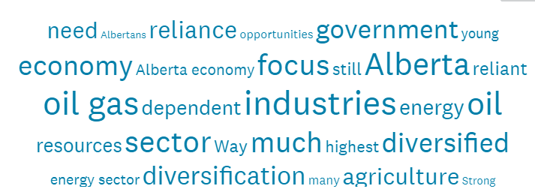

2020 Test of Alberta’s Economic Resilience: Significant downturn overall. Uneven across Locations and Sectors. Quick recovery and fix unexpected.
Episode #5. For Broadcast
December 3rd, 2020

Slide 2
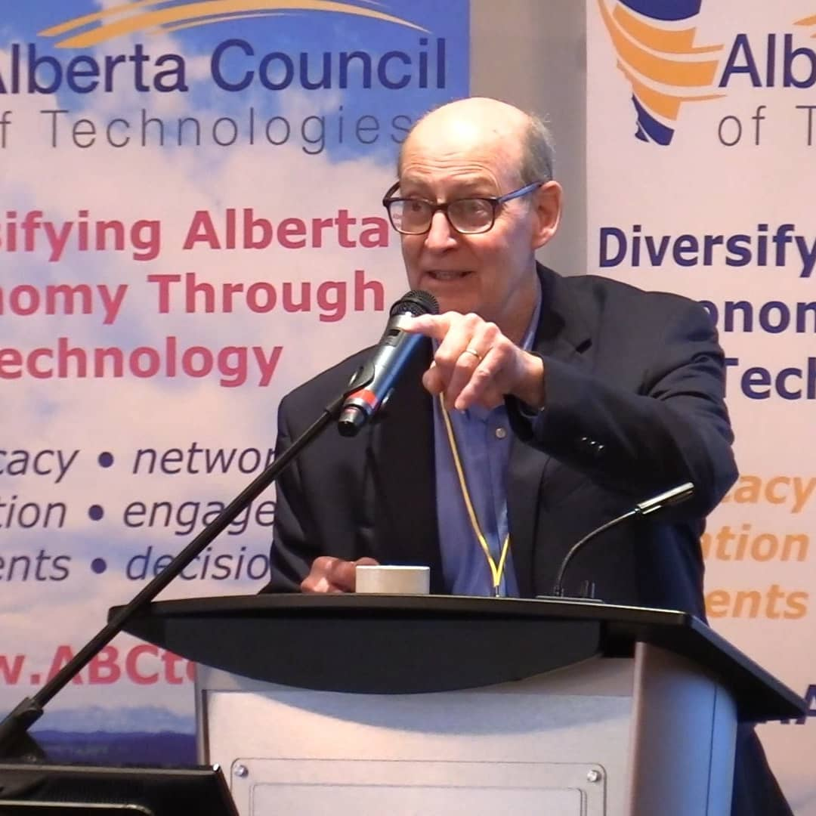

Welcome
Perry Kinkaide, MSc, PhD, CMC | A celebrated change agent throughout a varied career including senior positions as an academic and leader of NGOs, manager and consultant for numerous public and private organizations. Now in “retirement” Perry - as President of Kinkaide Enterprises Inc., mentors and finances start-ups employing emerging technologies, and routinely monitors the status of Alberta’s economy, diversification, and associated innovation ecosystem. Recognized as one of 50 most influential Albertans.
Contact: Perry@PerryKinkaide.com
Website: PerryKinkaide.com

Slide 3
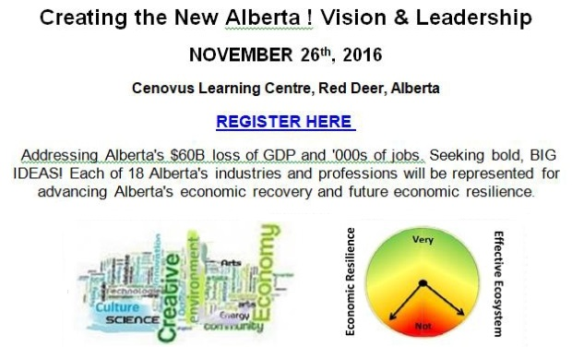

Slide 4
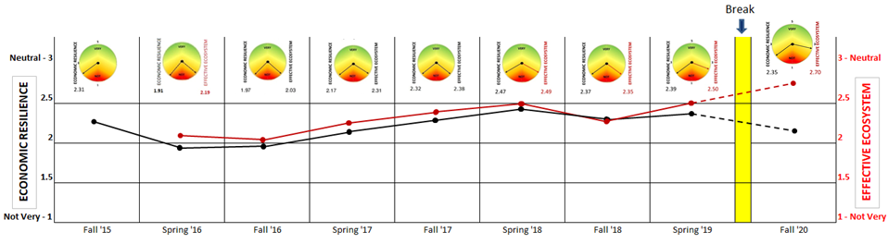
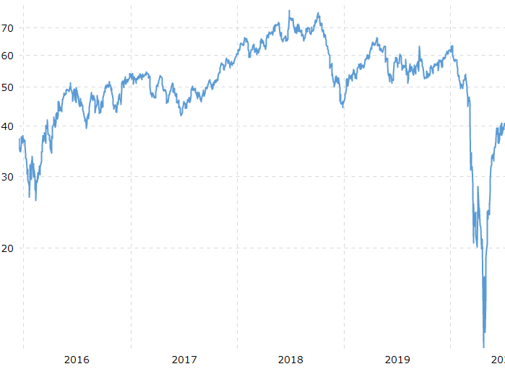
A gradual increase in economic resilience (the black line) from 2015 into the spring of 2018.
Weaker since, triggered by issues in the energy industry and more so recently with the pandemic
Crude Oil Prices
https://www.macrotrends.net/1369/crude-oil-price-history-chart
2016
2017
2018
2019
2020
Review

Slide 5
Episode #5. Our objectives:
To revisit Alberta’s economy and separate the impact of the economic downturn attributable to Alberta’s economic vulnerability to changes underway in energy from those attributable to Covid-19.
Pose recommendations for addressing problems associated with the lack of economic resilience for Alberta, it’s Regions, and Sectors:
1. Energy Transitions. Expediting transitions in energy to reduce Alberta’s exposure to the industry’s volatility
2. Economic Resilience. Changing the mix of economies for improving Regional and Sectoral economic resilience
3. Leadership in Innovation. Development of Alberta’s “Innovation Ecosystem” to address the failure of SMEs in Alberta to survive, to grow, and to stay
Special sections: The role of Government, Resistance to change, and Economic Recovery

Slide 6
Roles for Government in Achieving Economic Resilience
Rank | % | Role Options
1 | 69% | Formulate policies and employ incentives for encouraging small business innovation
2 | 65% | Promote entrepreneurship and small business start-ups
3 | 60% | Fund educational and training programs for ensuring that graduates can create new jobs
4 | 59% | Negotiate trade agreements increasing access to markets for Alberta products and services
5 | 54% | Invest directly in RESEARCH offering long term job creation
6 | 42% | Use government purchasing power to develop and attract business to Alberta
7 | 37% | Invest directly in technology commercialization
8 | 26% | Invest directly in PROJECTS offering immediate job creation
Rankings are consistent overall other than Central and Northern Alberta that ranked the negotiation of trade agreements (Agriculture?) higher than elsewhere.
Ref. Slide 8. Episode 4

Slide 7

Concluding Episode #5.
Wrapping-up the “2020 TESTING Economic Resilience” Program series.
Thank you for visiting.
Contact: Perry@PerryKinkaide.com
Comments welcome
PerryKinkaide.com

Slide 8


Thank you! CREDITS
Webinar Production
Fission Media – Tom Dodd
https://www.fissionmedia.com:-tom@fissionmedia.com
Websites in Edmonton – Michelle Lessard
https://websitesinedmonton.com/
Canada Institute for International Trade – Kevin McNulty
Survey Support
Economic Developers Alberta
Alberta Council of Technologies Society
AB POL ECON

