Slide 1
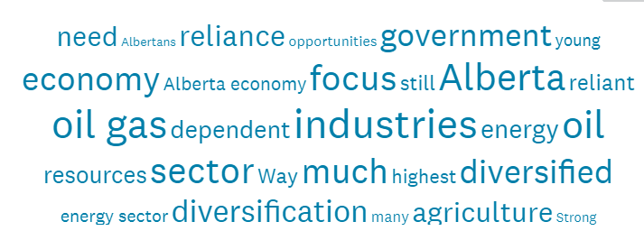

2020 Test of Alberta’s Economic Resilience: Significant downturn overall. Uneven across Locations and Sectors. Quick recovery and fix unexpected.
Episode #4. For Broadcast
November 26th, 2020

Slide 2
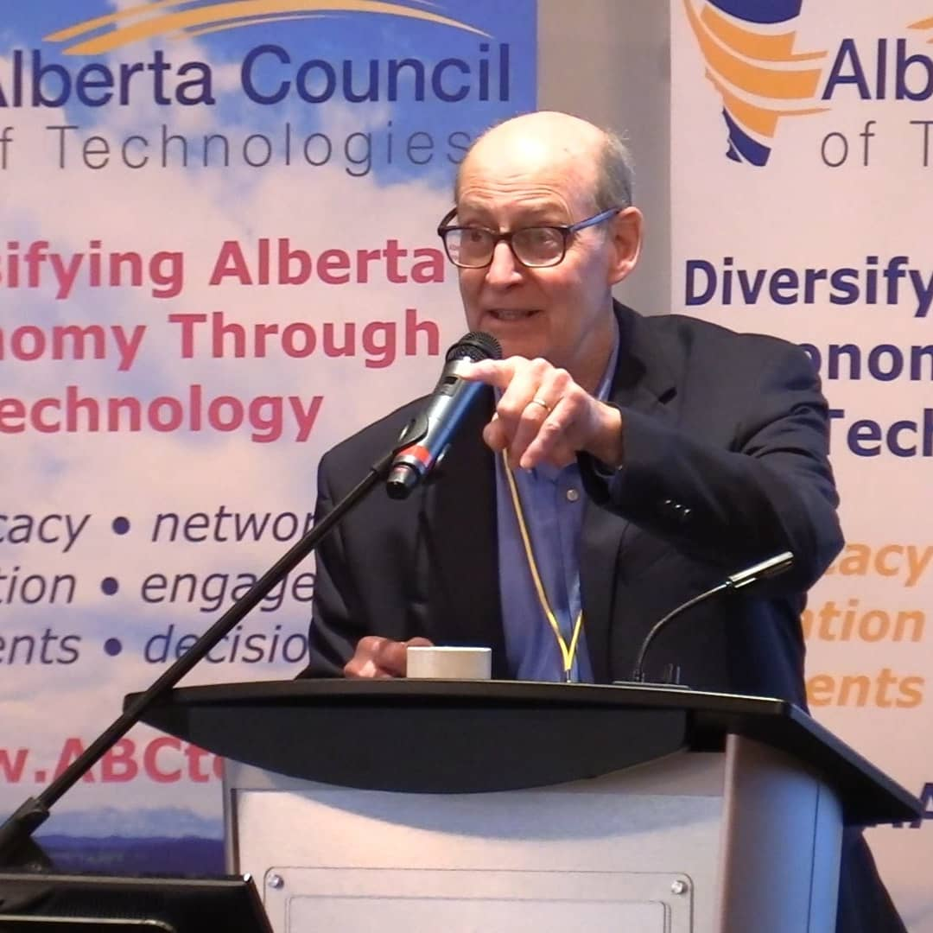

Welcome
Perry Kinkaide, MSc, PhD, CMC | A celebrated change agent throughout a varied career including senior positions as an academic and leader of NGOs, manager and consultant for numerous public and private organizations. Now in “retirement” Perry - as President of Kinkaide Enterprises Inc., mentors and finances start-ups employing emerging technologies, and routinely monitors the status of Alberta’s economy, diversification, and associated innovation ecosystem. Recognized as one of 50 most influential Albertans.
Contact: Perry@PerryKinkaide.com
Website: PerryKinkaide.com

Slide 3
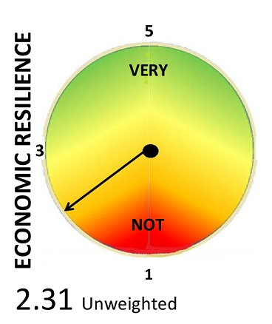
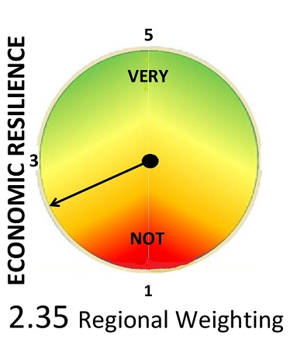

Alberta’s economic resilience - very weak
Fall 2020
= D
Review

Slide 4
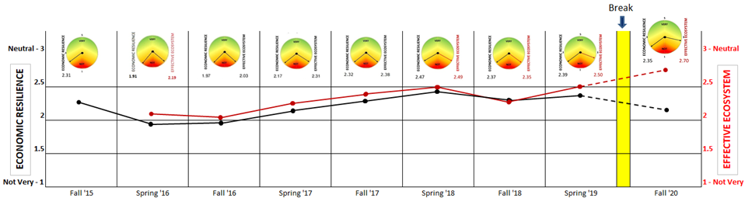
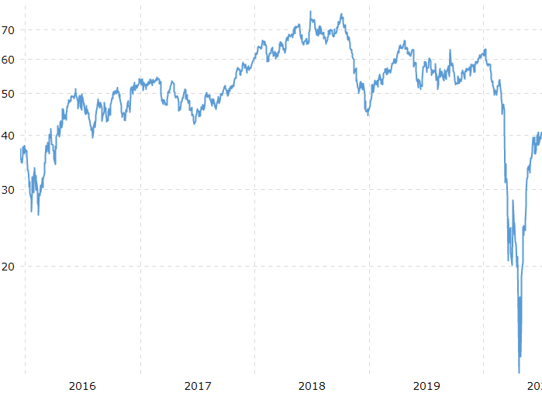
A gradual increase in economic resilience (the black line) from 2015 into the spring of 2018.
Weaker since triggered by issues in the energy industry and more so recently with the pandemic
Crude Oil Prices
https://www.macrotrends.net/1369/crude-oil-price-history-chart
2016
2017
2018
2019
2020
Review

Slide 5
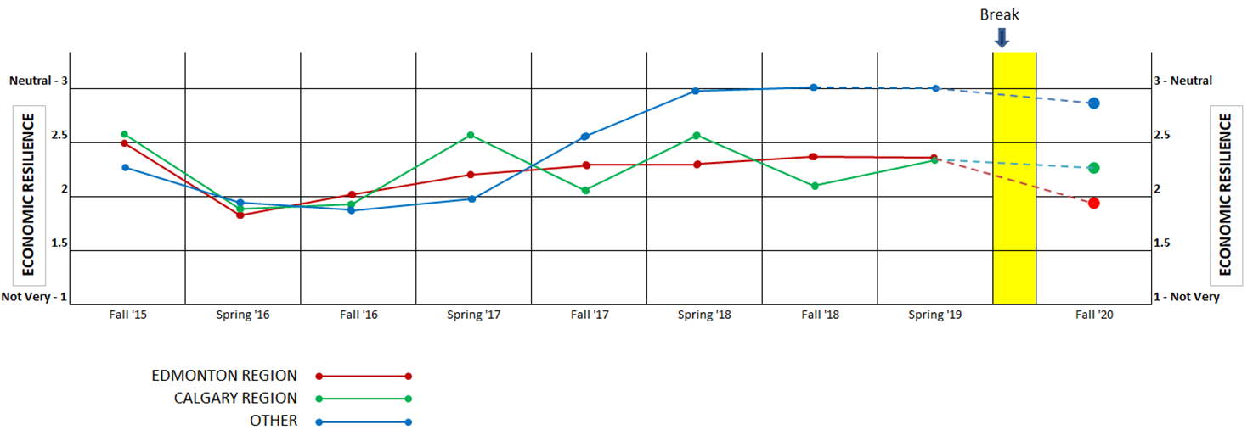
Economic Resilience - Year x Year -
for Alberta’s REGIONS
Downturn in Fall of 2020 UNEVEN – most severe for Edmonton REGION
Overall weak. Under 3.0 - since 2015
Some general progress evident since 2016 particularly for OTHER: Southern and Central
Calgary Region shows seasonal fluctuations
Review

Slide 6
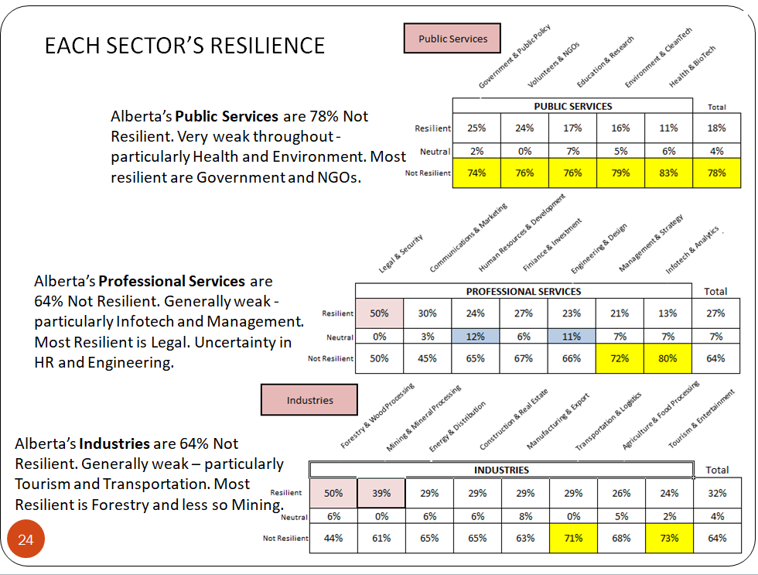
6
Review

Slide 7
PROGRAM OBJECTIVES
YOUR assessment and comments about Alberta’s economic diversification
EPISODE #1. YOUR sentiment and views – COUNT
EPISODE #2. Locations differ for 2020 – A LOT
  Introducing Locations: Regions and sub-Regions
  Regional differences in economic resilience 2020 and since 2015
EPISODE #3. Sectors differ – A LOT
    Introducing Sectors: Public Services, Professional Services, Industries
    Pausing first to reflect and address your questions
EPISODE #5. Summary Recommendations
EPISODE #4. Innovation can help – YES? Introducing the role of Government Assessing the Innovation Ecosystem

Slide 8
Roles for Government in Achieving Economic Resilience
Rank | % | Role Options
1 | 69% | Formulate policies and employ incentives for encouraging small business innovation
2 | 65% | Promote entrepreneurship and small business start-ups
3 | 60% | Fund educational and training programs for ensuring that graduates can create new jobs
4 | 59% | Negotiate trade agreements increasing access to markets for Alberta products and services
5 | 54% | Invest directly in RESEARCH offering long term job creation
6 | 42% | Use government purchasing power to develop and attract business to Alberta
7 | 37% | Invest directly in technology commercialization
8 | 26% | Invest directly in PROJECTS offering immediate job creation
Rankings are consistent overall other than Central and Northern Alberta that ranked the negotiation of trade agreements (Agriculture?) higher than elsewhere.

Slide 9
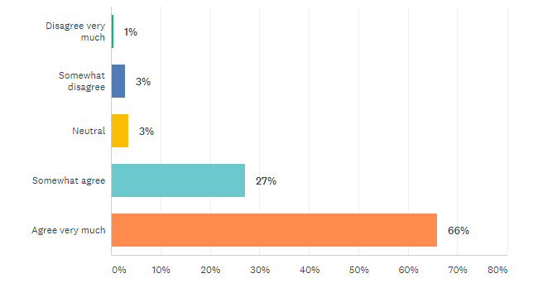
Question. 8. To achieve economic resilience/ diversification, a state/province needs an effective and continuously improving Innovation Ecosystem that supports the survival, growth and retention of it's entrepreneurs and small businesses. Do you agree?
Spring 2018
8%
5%
88%
Fall 2020
4%
93%
Comments for clarity

Slide 10
Comments
Agree very much
Conference Board of Canada has consistently shown AB to lag behind QC, ON and BC, as well as the Canadian average. This, while ICT investment, entrepreneurial ambition and labour productivity rank respectfully.
Absolutely! Entrepreneurs and SME are the backbone of our economy. But they do need more focus on ideas and development of R&D that reach the potential of our future.
And a strong education and research environment
Bear in mind, however, that in order for any innovation ecosystem to be sustainable, it has to address the needs of the marketplace and cannot be continually funded by tax dollars.
Government as facilitator, not driver.
Invest in emerging technologies and program to motivate investment, both from the private and public sectors
We cannot go back to what worked in the past. The world is moving on and we are actually and actively moving backwards
Disagree very much
Support entrepreneurs but let SMEs fail as their leader needs to move on to the next idea having learned from the previous experience. The Americans are very good at 'celebrating failures"

Slide 11
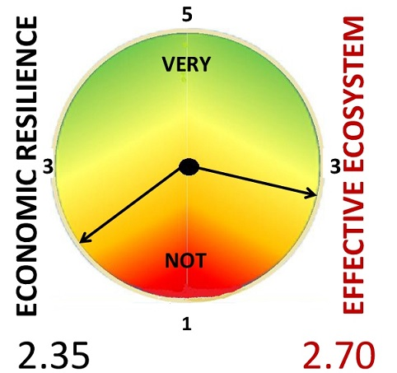
Fall 2020
The Innovation Ecosystem remains “ineffective” but…
Sustained improvement is evident

Slide 12
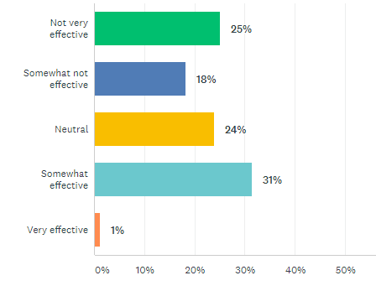
Question 9. Please rate how you view your state's/province's Innovation Ecosystem in supporting the survival, growth, and retention of entrepreneurs and small businesses.
Fall 2018 – 2.35
Fall 2020 – 2.70
34%
22%
21%
22%
2%
56%
43%
24%
32%
Effectiveness is continuing to increase

Slide 13
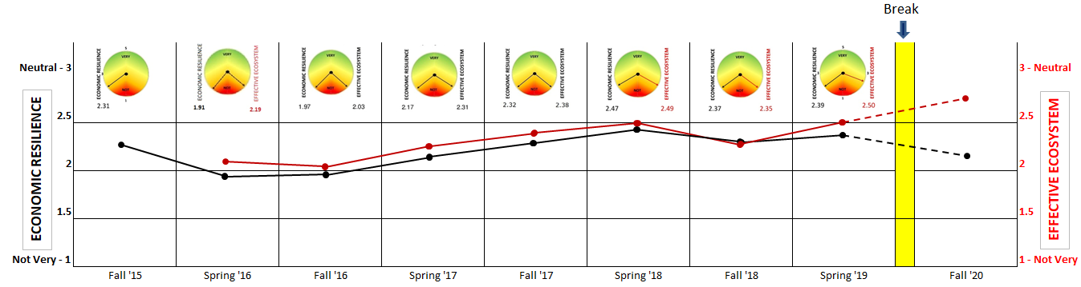
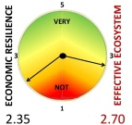
While still not effective (>3.0) the effectiveness of
the Innovation Ecosystem (red line) continues to increase
…and has done so ever since the downturn in economic resilience in the fall of 2018.
An apparent increased awareness of the importance of the innovation ecosystem for economic recovery and improving Alberta’s economic resilience.

Slide 14
Comments
Not very effective
Been in tech biz for 40 years have not seen one major success
Lack of government support for innovation and policies counter to its claim of supporting innovation will cause talented people to leave, and prevent talented people from locating in Alberta.
Very poor at supporting scaling companies -where jobs are created!
Somewhat not effective
Government hostility towards all but the energy sector will drive away key resources (health sector for example).
Still too many silos.
Higher education being weakened is very detrimental
Neutral
I do not think I am knowledgable about the Alberta Innovation Ecosystem.
Somewhat effective
Alberta government is the largest buyer (in Canada) of drugs, medicals, construction, education services. Use this power to attract interest by SMEs.
Recent steps of the AB government are headed in a more progressive direction
Very Effective
I believe there have been a large number of companies that have relied on different programs to get their product developed and to the marketplace
Things don't look hot right now, with oil prices and corona virus, but this is exactly the conditions conducive to [restructuring, reforming] (the "winter season of economic cycles).
More insight follows

Slide 15
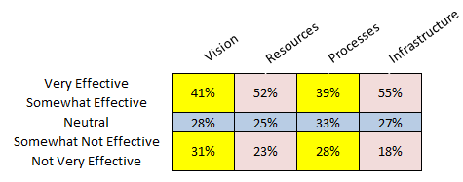
Question 10. The following elements comprise an Innovation Ecosystem. Please rate them in terms of their effectiveness in supporting your state's/province's entrepreneurs and small businesses today?
Vision & Leadership - purpose and inspiration Resources - talent, financing, information, facilities/land,
technology
Processes - communications, decision making, Infrastructure - internet, transportation/logistics, research, networking, organization, accountability advisory services - incubators/accelerators
Intangible
Tangible elements are strongest: Resources and Infrastructure
Intangible elements are weakest: Vision and Management Processes
“Neutral”/ uncertainty is quite high for all elements … the innovation ecosystem and it’s elements are not well known

Slide 16
Comments
Not very effective
To much focus on promoting government and service providers not enough focus on doing businesses and getting better at it
If referring to UCP gov't very ineffective otherwise AB is neutral or somewhat ineffective.
Somewhat not effective
To much focus on promoting government and service providers not enough focus on doing businesses and getting better at it
Not certain about the question. Is it asking about the Government support of the elements?
Neutral
Make incubators hard to get into but very facilitative and valuable to be in.
As a general rule, governments get in the way of prosperity by draining resources from things that work in order to support things that don't
Somewhat effective
Eliminate the provincial corporate tax. We need to give business an incentive to invest in Alberta
Rural broadband access acts as a great lever and growth stimulant AND Rural AB still needs internet access improvement
We need less govt interference in post secondary governance, We could also use way less corporate stock buybacks and high level management remuneration, and way more corporate investment in research and in developing its labor force. Employees are an asset not an expense.
Very Effective
I'm not really up on the details here. The question seems to focus on the government role. That's only part of the equation. Taxes for example, are out of kilter with today's conditions.

Slide 17

The Challenge

Slide 18

Concluding Episode #4.
In the next Episode #5 we wrap-up the “2020 TESTING Economic Resilience” Program series with a review of your recommendations including an Action Plan for increasing Alberta’s economic resilience and the effectiveness of it’s Innovation Ecosystem
This will be GOOD! So stay tuned.
Contact: Perry@PerryKinkaide.com
Comments welcome
PerryKinkaide.com

Slide 19


Thank you! CREDITS
Webinar Production
Fission Media – Tom Dodd
https://www.fissionmedia.com:-tom@fissionmedia.com
Websites in Edmonton – Michelle Lessard
https://websitesinedmonton.com/
Canada Institute for International Trade – Kevin McNulty
Survey Support
Economic Developers Alberta
Alberta Council of Technologies Society
AB POL ECON

