Slide 1
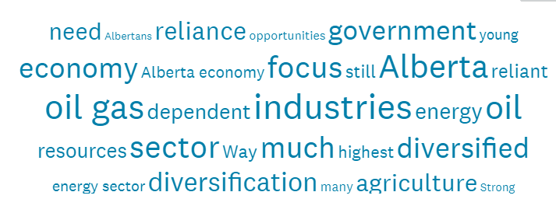

2020 Test of Alberta’s Economic Resilience: Significant downturn overall. Uneven across Locations and Sectors. Quick recovery and fix unexpected.
Prepared for Broadcast
November 19th, 2020

Slide 2

PROGRAM OBJECTIVES
YOUR assessment and comments about Alberta’s economic diversification
EPISODE #1. YOUR sentiment and views – COUNT
EPISODE #2. Locations differ for 2020 – A LOT
  Introducing Locations: Regions and sub-Regions
  Regional differences in economic resilience 2020 and since 2015
EPISODE #4. Innovation can help – YES?
  Introducing the Innovation Ecosystem
  Assessing it’s effectiveness
EPISODE #5. Summary Recommendations
EPISODE #3. Sectors differ – A LOT
    Introducing Sectors: Public Services, Professional Services, Industries
    Pausing first to reflect and address your questions

Slide 3
Pause
Newcomers and Questions Received
Who is our host?
What are our objectives?
Revisiting the insights to date

Slide 4
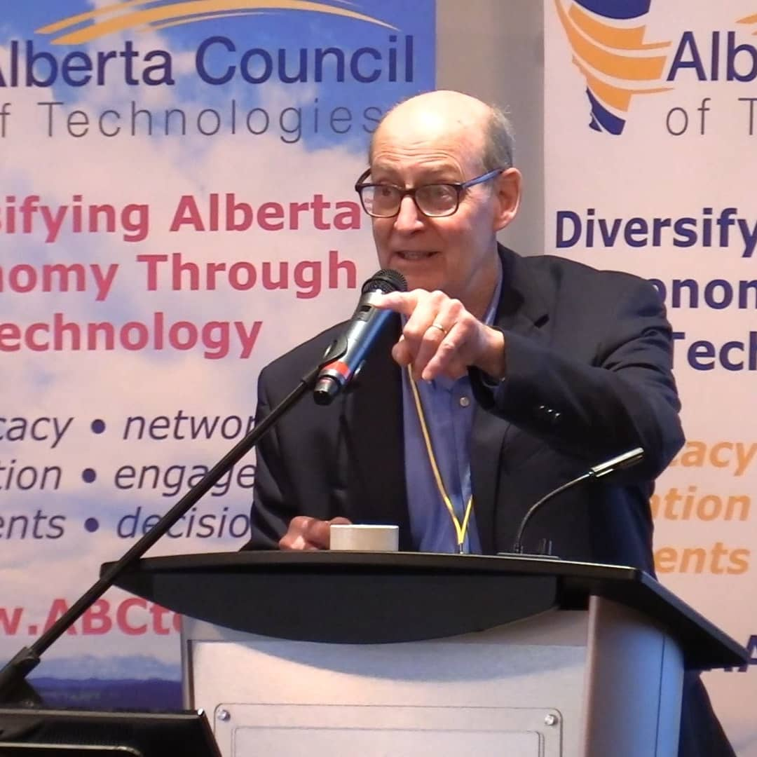

Welcome
Perry Kinkaide, MSc, PhD, CMC | A celebrated change agent throughout a varied career including senior positions as an academic and leader of NGOs, manager and consultant for numerous public and private organizations. Now in “retirement” Perry - as President of Kinkaide Enterprises Inc., mentors and finances start-ups employing emerging technologies, and routinely monitors the status of Alberta’s economy, diversification, and associated innovation ecosystem. Recognized as one of 50 most influential Albertans.
Contact: Perry@PerryKinkaide.com
Website: PerryKinkaide.com

Slide 5
Episode #1
Alberta’s Overall Economic Resilience
  Current sentiment
  Changing since 2015
The Most Sensitive Measures of Economic Resilience

Slide 6
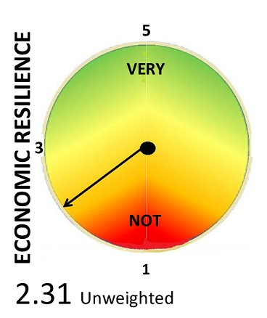
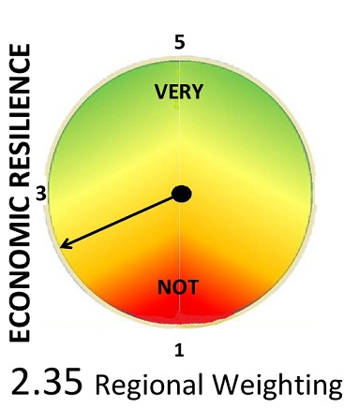
Alberta’s economic resilience - very weak
Fall 2020
= D

Slide 7
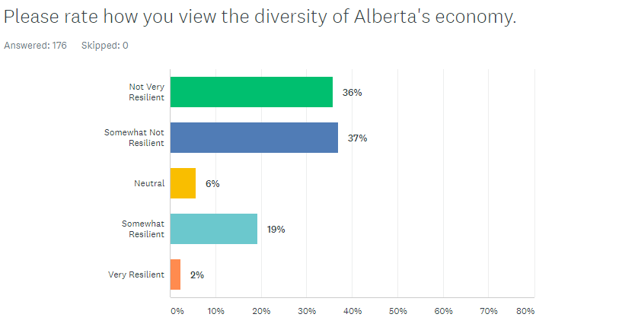

Two clusters – Alberta’s economy is viewed as Not Resilient by 73% and Resilient by 21%. Uncertainty is low at 6%.
Q1. Please rate how you view the diversity of Alberta’s economy.
Not Very Resilient
Somewhat Not Resilient
Neutral
Somewhat Resilient
Very Resilient

Slide 8
Has economic resilience changed since the fall of 2015?

Slide 9
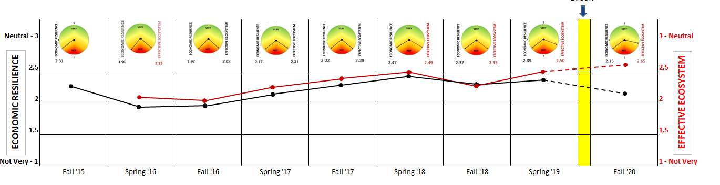
Alberta’s 2020 economic resilience (the black line) – weak and weaker since the Spring of 2019

Slide 10
What are the most sensitive measures contributing to the sentiment of economic resilience?

Slide 11
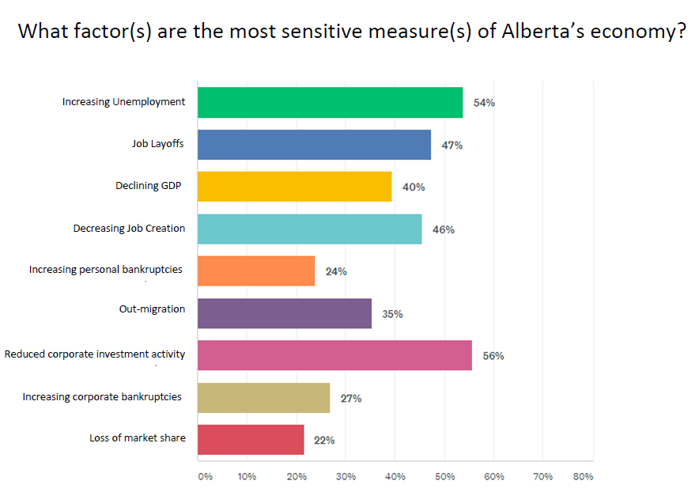

The most sensitive measures of Alberta’s economy are Corporate investment activity and Job-related measures

Slide 12
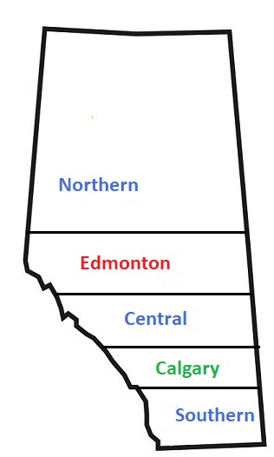
LOCATION – 2020 Survey respondents
    ALBERTA Overall
      Edmonton Region 61%
      Calgary Region 22%
      Other: 17%
        Northern Alberta 23%
        Central Alberta 57%
        Southern Alberta 20%

Slide 13
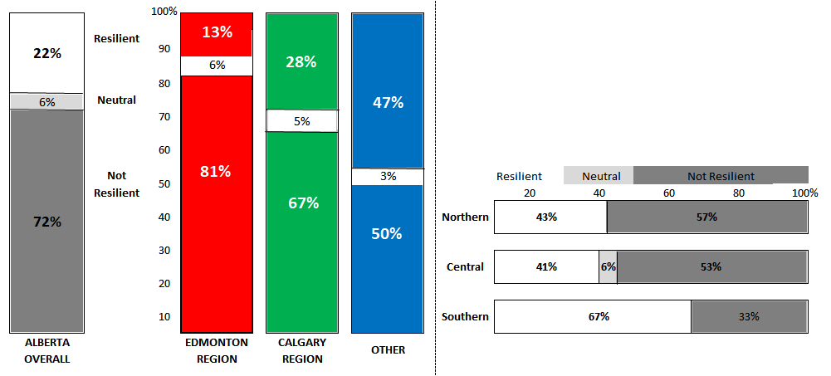
REGIONAL Economic Resilience – Fall 2020
OTHER
Unweighted
Edmonton Region is the least economically resilient followed by Calgary
Other is comprised of the 3 Regions North, South, and Central each is viewed as more resilient than both the Edmonton and Calgary Regions
Southern Alberta is the most economically resilient with Edmonton the least

Slide 14
What is contributing to the sentiment of economic resilience?
Here are the most frequently mentioned most sensitive measures of economic resilience

Slide 15
Measures of economic resilience – Regional rankings
Measures are generally consistent across Alberta. Exceptions are outside Edmonton and Calgary.
Reduced Corporate Investment
Increasing unemployment
Job Layoffs
Declining GDP
Decreasing Job Creation
Out Migration
Loss of market share
Corporate bankruptcies
Personal bankruptcies
ALBERTA | 1 | 2 | 3 | 4 | 5 | 6 | 7 | 8 | 9
Edmonton | 2.5 | 2.5 | 2.5 | 4 | 6 | 5 | 9 | 8 | 7
Calgary | 1 | 2 | 4.5 | 3 | 4.5 | 6 | 8 | 7 | 9
Other | 2 | 1 | 3 | 7.5 | 5 | 7.5 | 4 | 6 | 9
Northern | 3.5 | 1.5 | 6 | 8.5 | 1.5 | 6 | 6 | 8.5 | 3.5
Central | 1.5 | 1.5 | 4.5 | 8 | 7 | 6 | 3 | 4.5 | 9
Southern | 3.5 | 3.5 | 3.5 | 3.5 | 8 | 8 | 5.5 | 5.5 | 8
Decreasing Job Creation ranks lower for both the Northern and Central Regions. Out Migration and Corporate bankruptcies rank higher for the North. Loss of market share and Personal bankruptcies rank higher for Central.

Slide 16
How do the changes in economic resilience differ between the Regions since the fall of 2015?

Slide 17
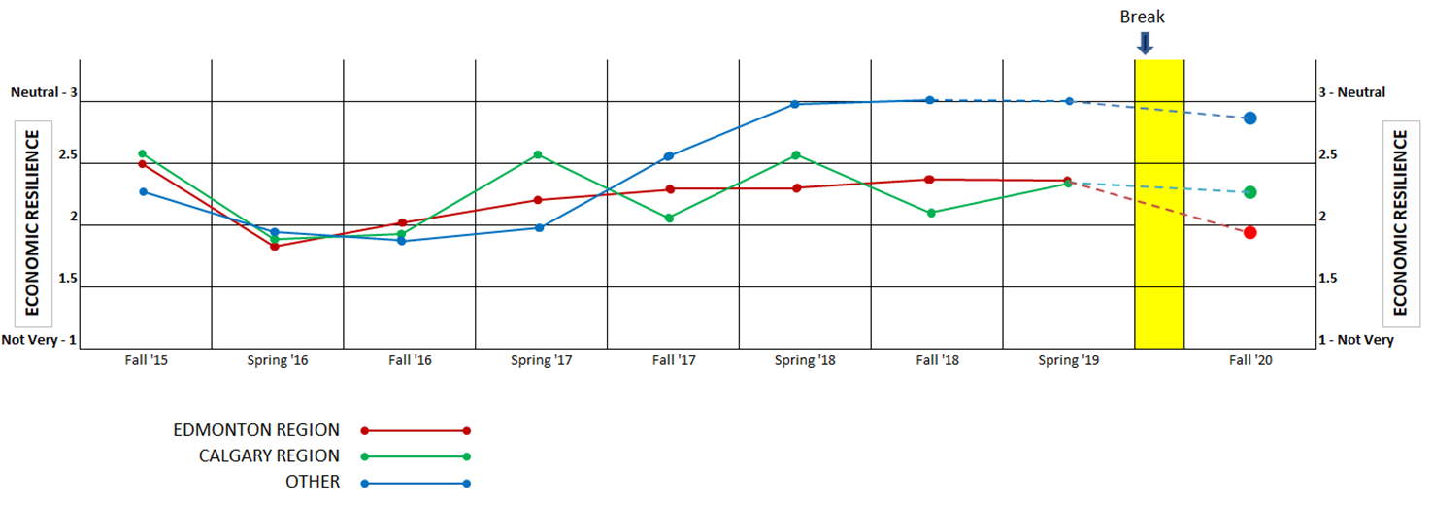
Economic Resilience - Year x Year -
for Alberta’s REGIONS
Downturn in Fall of 2020 UNEVEN – most severe for Edmonton REGION
Overall weak. Under 3.0 - since 2015
Some general progress evident since 2016 particularly for OTHER: Southern and Central
Calgary Region shows seasonal fluctuations

Slide 18
Your comments provide further clarification….

Slide 19
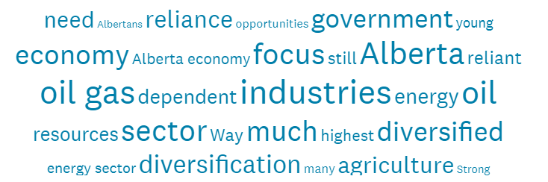
Comments - Episode 2. LOCATIONS
Northern Alberta. Somewhat Resilient. For such an independent, entrepreneurial small population Alberta has and will always punch over our weight class.
Central Alberta. Somewhat Resilient. Alberta has a young population with many who have become entrepreneurs. These young entrepreneurs are creating jobs for many Albertans.
Southern Alberta. Somewhat Resilient. Strong agriculture and agrifood sector, growing manufacturing sector.
Edmonton Region. Not Resilient. Resource based extraction: limited market access, sunset industry and world competitive forces possibly stranding the asset.
Somewhat Not Resilient. Too dependent on traditional primary resource industries (oil, forestry, mining, agriculture). Resource extraction and exporting are important, but they should serve as the base of building secondary and tertiary value-add clusters around those industries.
Neutral. The agri sector has the greatest potential given the emerging focus on the environment followed by natural gas.
Somewhat Resilient. We are gradually moving away from reliance on the dying oil industry.
Calgary Region. Not Resilient. Government revenues are too heavily dependent upon resource royalties. Diversification is viewed as anti-energy.
Somewhat Resilient. The media noise from the oil patch virtually ignores our agri-business and tech sectors, to say nothing of other aspects of Alberta's already diverse economy.
Very Resilient. Already diversified.

Slide 20
PROGRAM OBJECTIVES
YOUR assessment and comments about Alberta’s economic diversification
EPISODE #1. YOUR sentiment and views – COUNT
EPISODE #2. Locations differ for 2020 – A LOT
  Introducing Locations: Regions and sub-Regions
  Regional differences in economic resilience 2020 and since 2015
EPISODE #4. Innovation can help – YES?
  Introducing the Innovation Ecosystem
  Assessing it’s effectiveness
EPISODE #5. Summary Recommendations
EPISODE #3. Sectors differ – A LOT
    Introducing Sectors: Public Services, Professional Services, Industries
    Pausing first to reflect and address your questions

Slide 21
Clustered Sectors of Respondent’s Top 5 Interests (%) Most resilient to Least resilient
Public Services – 34%
  1. Government & Public Services – 31% 2. NGO - Non Government Organization – 14%
  3. Education & Research – 33% 4. Environment & CleanTech – 47%
  5. Health & BioTech – 37%
Note. High interest – low resilience
Professional Services – 26%
  1. Legal & Security – 3% 2. Communications & Marketing – 15%
  3. Human Resources & Development – 9% 4. Finance & Investment – 18%
  5. Engineering & Design – 21% 6. Management & Strategy – 25%
  7. Infotech & Analytics – 33%
Note. High interest – low resilience
Industries – 40%
  1. Forestry & Wood Products – 11% 2. Mining & Mineral Processing – 11%
  3. Energy & Distribution – 42% 4. Construction & Real Estate – 21%
  5. Manufacturing & Export – 28% 6. Transportation & Logistics – 19%
  7. Agriculture & Food Processing – 46% 8. Tourism & Entertainment – 23%
Survey attracted those interested and concerned about the weak status of their sector in Alberta’s economy.

Slide 22
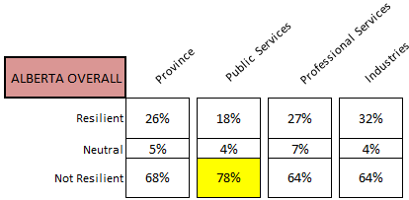
ALBERTA’s SECTOR RESILIENCE
Attention
>35%
>8%
>70%
Weighted
Sectors are all Somewhat Not Resilient. Public Services is Least at 78%. Industries is Somewhat Resilient at 32%. Current Uncertainty (“Neutral”) is high among Professional Services.

Slide 23
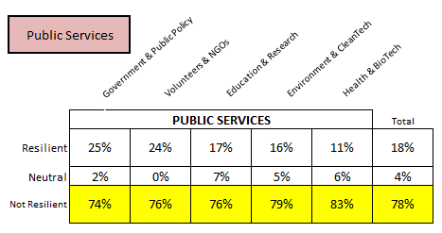
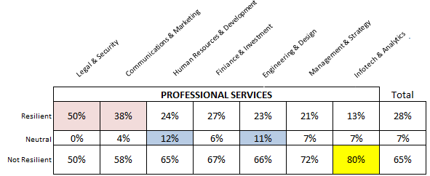
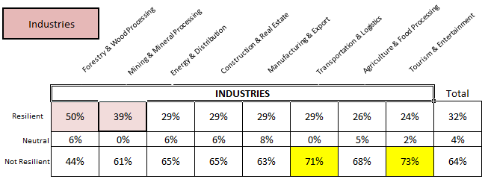
EACH SECTOR’S RESILIENCE
Alberta’s Public Services are 78% Not Resilient. Very weak throughout - particularly Health and Environment. Most resilient are Government and NGOs.
Alberta’s Professional Services are 64% Not Resilient. Generally weak - particularly Infotech and Management. Most Resilient is Legal. Uncertainty in HR and Engineering.
Alberta’s Industries are 64% Not Resilient. Generally weak – particularly Tourism and Transportation. Most Resilient is Forestry and less so Mining.

Slide 24
PROVINCIAL and REGIONAL OVERVIEW
Economic Resilience for the Province of Alberta overall is weak, particularly in the Edmonton Region and less so outside the Edmonton and Calgary Regions.
SECTORS
The weakest sector is Public Services - Health and Environment, followed by Professional Services – Infotech and Management, and Industries – Tourism and Transportation. Some strength is evident in Legal and Communications, Forestry and Mining.
REGION and SECTOR OVERVIEW
The overall economic resilience is somewhat uneven across the various the Region’s Sectors. This analysis now follows.

Slide 25
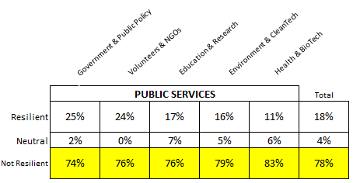
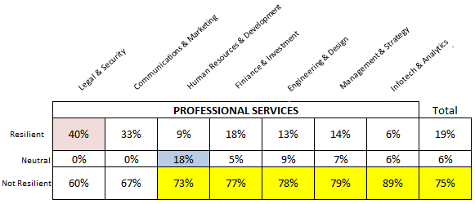
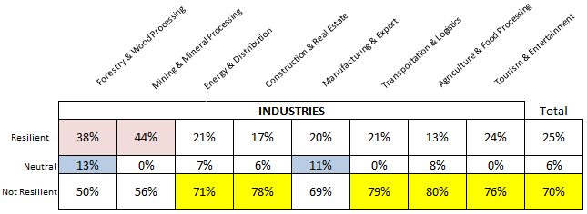
EDMONTON REGION
PUBLIC SERVICES. Not Resilient at 78%. Least Resilient – Health and several others. Most Resilient – Government and NGOs.
PROFESSIONAL SERVICES. Not Resilient at 75%. Least Resilient -Infotech and several others. Most Resilient - Legal. Uncertainty in Human Resources.
INDUSTRY. Not Resilient at 70%. Least Resilient – Agriculture, Transportation and others. Most Resilient - Forestry and Mining. Uncertainty in Forestry and Manufacturing.

Slide 26
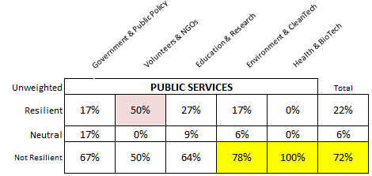
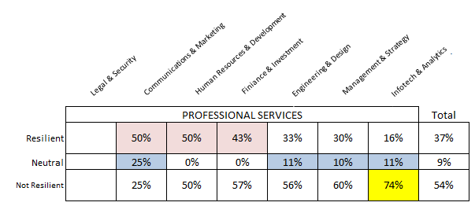
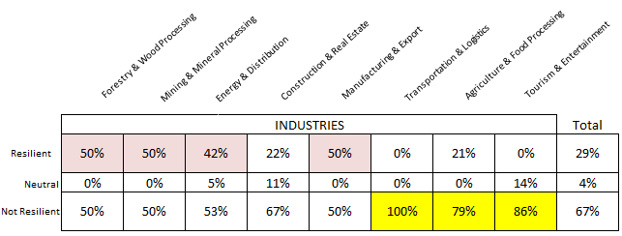
CALGARY REGION
PUBLIC SERVICES. Not Resilient at 72%. Least Resilient - Health and Environment. Most Resilient - NGOs.
PROFESSIONAL SERVICES. More Resilient than other Regions at 37%. Least Resilient - Infotech. Most Resilient - HR, Communications, Finance. Uncertainty widespread for Communications, Engineering, Infotech, Management.
37%
INDUSTRIES. Not Resilient at 67%. Least Resilient – Transportation, Tourism, Agriculture. Most Resilient - Forestry, Mining, Manufacturing, Energy.

Slide 27
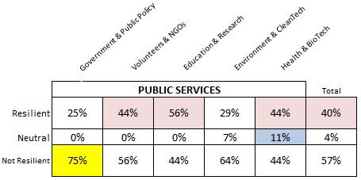
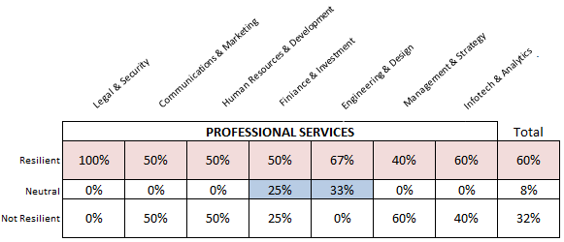
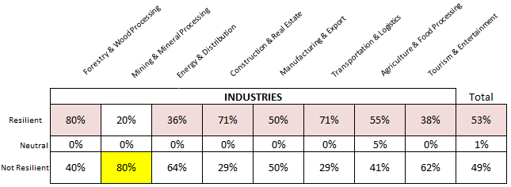
OTHER
PUBLIC SERVICES. Most Resilient of the Regions at 40%. Least Resilient - Government. Most Resilient - Education, Health, NGOs. Uncertainty in Health Sector.
PROFESSIONAL SERVICES. Most Resilient of the Regions at 60%. Least Resilient - Management. Most Resilient - Legal and Engineering. Uncertainty in Engineering and Finance.
INDUSTRIES. Most Resilient of the Regions at 53%. Resilience evident among all industries with exception of Mining.

Slide 28
Comments - Episode 3. SECTORS
PUBLIC SECTOR. Rural folks tend to be nibble – inventive/ to survive. Southern Alberta. Somewhat Not Resilient
Too much dependence on oilsands, etc. Edmonton Region. Not Resilient
Failure of trickle down economics to spur actual investment in jobs. Northern Alberta. Not Resilient
The false belief that oil & gas will recover to former levels is preventing companies from pivoting, retraining, and diversifying. Central Alberta. Not Resilient
PROFESSIONAL SERICES. The economy could be much better if Govt. policy were to be conscious of the abilities of Albertans to adapt. Edmonton Region. Somewhat Not Resilient
Lack of diversity. Too much oil and gas focus for too long. Calgary Region. Somewhat Not Resilient
Too dependent on traditional primary resource industries (oil, forestry, mining, agriculture). Edmonton Region. Not Resilient
Alberta's economy is more diversified than most people believe. However, as diversified as it is, it is not balanced. Calgary Region. Somewhat Resilient
INDUSTRIES. The agri sector has the greatest potential given the emerging focus on the environment followed by natural gas. Edmonton Region. Neutral
We are still too dependent on the production and sale of bitumen or otherwise crude oil. We should be upgrading a lot more and adding value. Edmonton Region. Somewhat Not Resilient
Alberta economy is still focused on energy, and second tourism. I think there is a great opportunity in agriculture and agriculture related industries. Calgary Region. Not Resilient
There has never been a serious and sustained conversation in Alberta about our responsibility for the messes we have gotten into and those we are now in. Until this happens, not much will happen except our future will continue dribble away. Some young folks have already figured this out and are leaving now. Call them early adaptors. Calgary Region. Not Resilient

Slide 29

That’s it for Episode #3.
In the next Episode #4 we begin the search for solutions by exploring your views of the relevance and roles for Government and Alberta’s Innovation Ecosystem.
There are several surprises so stay tuned.
Contact: Perry@PerryKinkaide.com
Comments welcome
PerryKinkaide.com

Slide 30


Thank you! CREDITS
Webinar Production
Fission Media – Tom Dodd
https://www.fissionmedia.com:-tom@fissionmedia.com
Websites in Edmonton – Michelle Lessard
https://websitesinedmonton.com/
Canada Institute for International Trade – Kevin McNulty
Survey Support
Economic Developers Alberta
Alberta Council of Technologies Society
AB POL ECON

