Slide 1
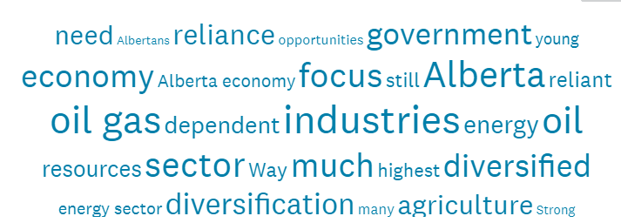

2020 Test of Alberta’s Economic Resilience: Significant downturn overall. Uneven across Locations and Sectors. Quick recovery and fix unexpected.
Prepared for Broadcast
November 12th, 2020

Slide 2

PROGRAM OBJECTIVES
YOUR assessment and comments about Alberta’s economic diversification
EPISODE #1. YOUR sentiment and views – COUNT
EPISODE #3. Sectors differ – A LOT
EPISODE #4. Innovation can help – YES?
Introducing the Innovation Ecosystem
Assessing it’s effectiveness
EPISODE #5. Summary Recommendations
EPISODE #2. Locations differ for 2020 – A LOT Introducing Locations: Regions and sub-Regions Regional differences in economic resilience 2020 and since 2015

Slide 3
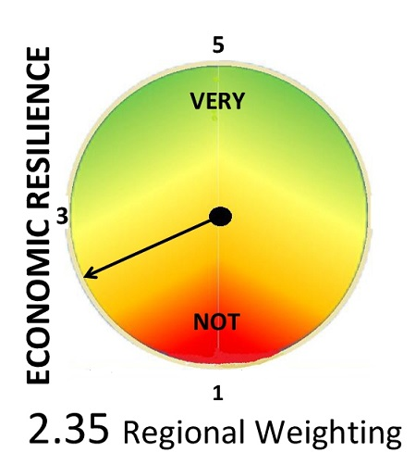
Alberta’s economic resilience - very weak
Fall 2020
4
B
C
2
D
F
= D

Slide 4
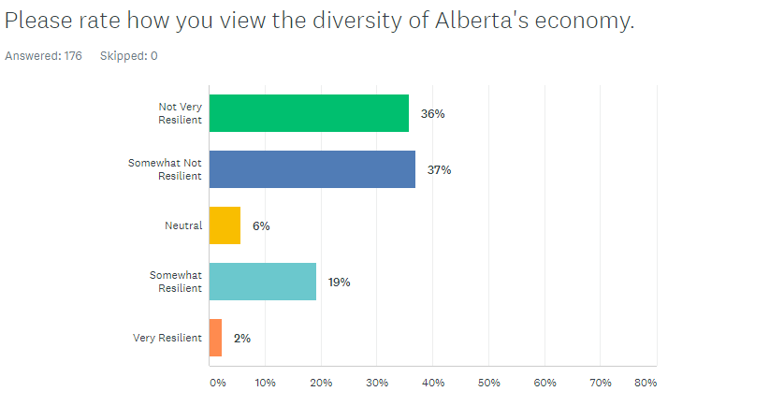

Two clusters – Alberta’s economy is viewed as Not Resilient by 73% and Resilient by 21%. Uncertainty is low at 6%.
Q1. Please rate how you view the diversity of Alberta’s economy.
Not Very Resilient
Somewhat Not Resilient
Neutral
Somewhat Resilient
Very Resilient

Slide 5
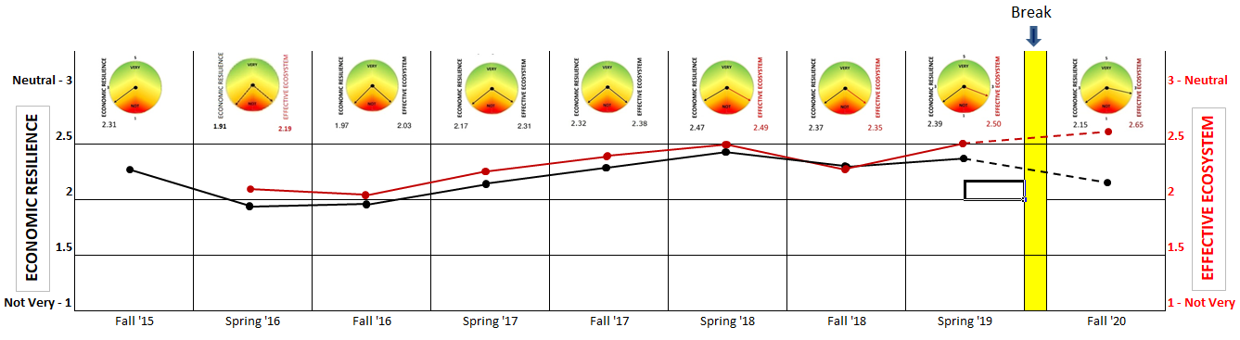
Alberta’s 2020 economic resilience – weak and weaker since the Spring of 2019

Slide 6
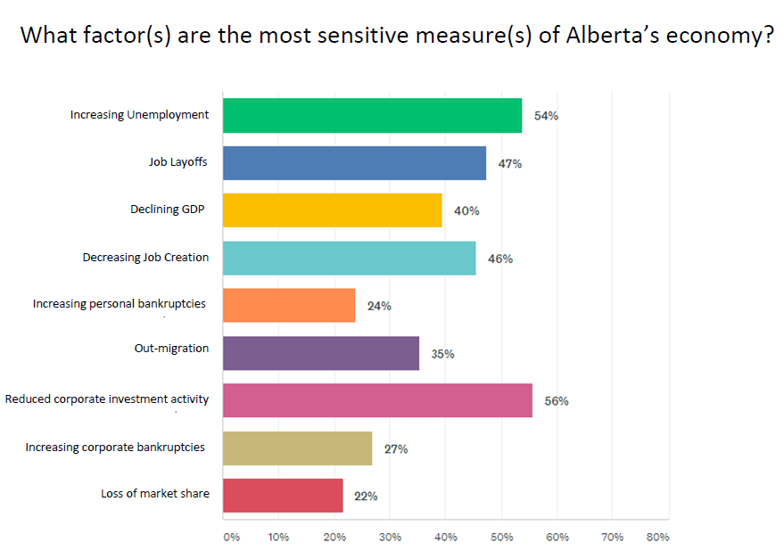

The most sensitive measures of Alberta’s economy are Corporate investment activity and Job-related measures

Slide 7
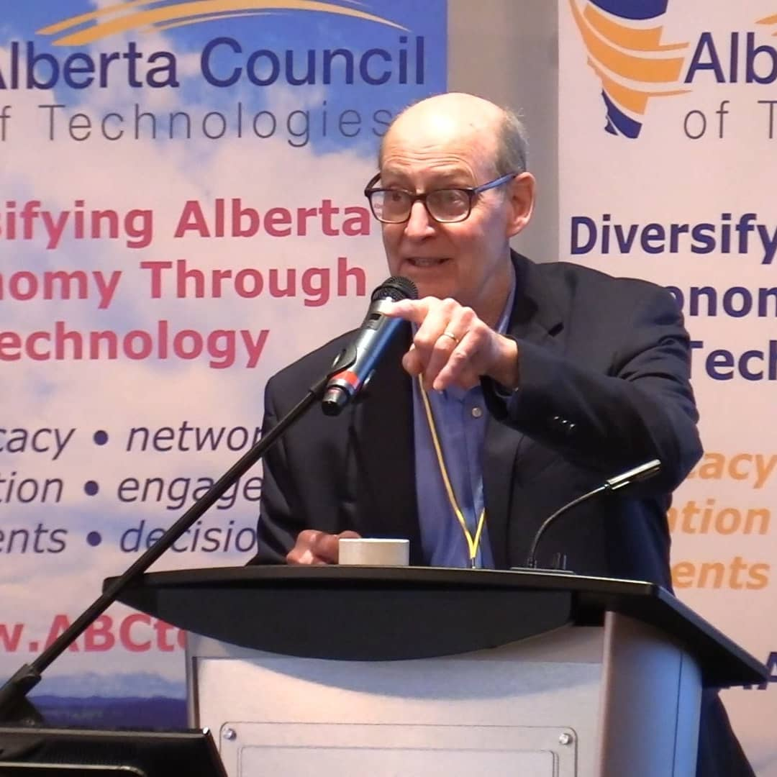

Welcome
Perry Kinkaide, MSc, PhD, CMC | A celebrated change agent throughout a varied career including senior positions as an academic and leader of NGOs, manager and consultant for numerous public and private organizations. Now in “retirement” Perry - as President of Kinkaide Enterprises Inc., mentors and finances start-ups employing emerging technologies, and routinely monitors the status of Alberta’s economy, diversification, and associated innovation ecosystem. Recognized as one of 50 most influential Albertans.
Contact: Perry@PerryKinkaide.com
Website: PerryKinkaide.com

Slide 8
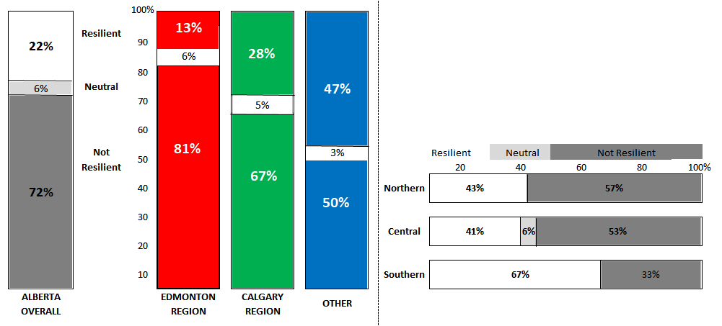
REGIONAL Economic Resilience – Fall 2020
OTHER
Edmonton Region is the least economically resilient followed by Calgary
Other is comprised of the 3 Regions North, South, and Central each is viewed as more resilient than both the Edmonton and Calgary Regions
Southern Alberta is the most economically resilient with Edmonton the least

Slide 9
Measures of economic resilience – Regional rankings
Measures are generally consistent across Alberta. Exceptions are outside Edmonton and Calgary.
Reduced Corporate Investment
Increasing unemployment
Job Layoffs
Declining GDP
Decreasing Job Creation
Out Migration
Loss of market share
Corporate bankruptcies
Personal bankruptcies
Alberta | 1 | 2 | 3 | 4 | 5 | 6 | 7 | 8 | 9
Edmonton | 2.5 | 2.5 | 2.5 | 4 | 6 | 5 | 9 | 8 | 7
Calgary | 1 | 2 | 4.5 | 3 | 4.55 | 6 | 8 | 7 | 9
Other | 2 | 1 | 3 | 7.5 | 5 | 7.5 | 4 | 6 | 9
Northern | 3.5 | 1.5 | 6 | 8.5 | 1.5 | 6 | 6 | 8.5 | 3.5
Central | 1.5 | 1.5 | 4.5 | 8 | 7 | 6 | 3 | 4.5 | 9
Southern | 3.5 | 3.5 | 3.5 | 3.5 | 8 | 8 | 5.5 | 5.5 | 8
Decreasing Job creation ranks lower for both the Northern and Southern Regions. Out migration and Corporate bankruptcies rank higher for the North. Loss of market share and Personal bankruptcies rank higher for Central.

Slide 10
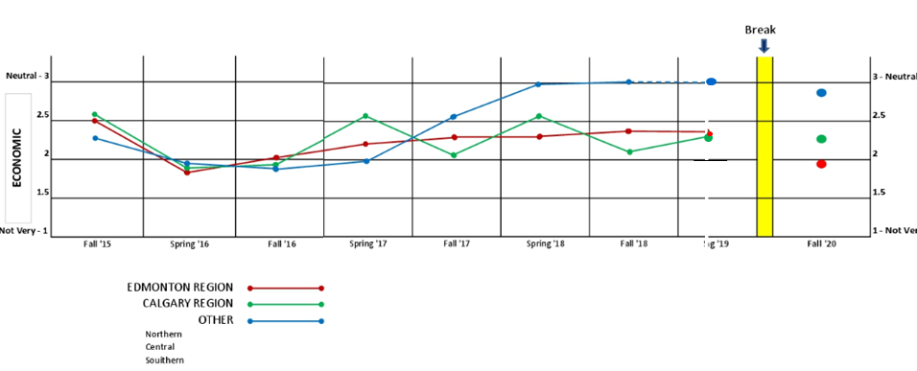
Economic Resilience - Year x Year -
for Alberta’s REGIONS
Overall weak. Under 3.0 - since 2015
Some general progress evident since 2016 particularly for OTHER: Southern and Central
Calgary Region shows seasonal fluctuations
Downturn in Fall of 2020 UNEVEN – most severe for Edmonton REGION

Slide 11
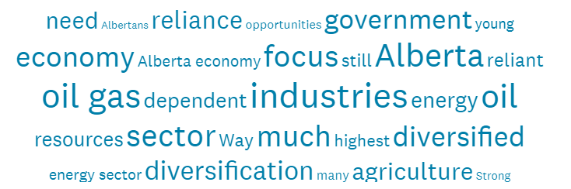
Comments - Episode 2. LOCATIONS
Northern Alberta. Somewhat Resilient. For such an independent, entrepreneurial small population Alberta has and will always punch over our weight class.
Central Alberta. Somewhat Resilient. Alberta has a young population with many who have become entrepreneurs. These young entrepreneurs are creating jobs for many Albertans.
Southern Alberta. Somewhat Resilient. Strong agriculture and agrifood sector, growing manufacturing sector.
Edmonton Region. Not Resilient. Resource based extraction: limited market access, sunset industry and world competitive forces possibly stranding the asset.
Somewhat Not Resilient. Too dependent on traditional primary resource industries (oil, forestry, mining, agriculture). Resource extraction and exporting are important, but they should serve as the base of building secondary and tertiary value-add clusters around those industries.
Neutral. The agri sector has the greatest potential given the emerging focus on the environment followed by natural gas.
Somewhat Resilient. We are gradually moving away from reliance on the dying oil industry.
Calgary Region. Not Resilient. Government revenues are too heavily dependent upon resource royalties. Diversification is viewed as anti-energy.
Somewhat Resilient. The media noise from the oil patch virtually ignores our agri-business and tech sectors, to say nothing of other aspects of Alberta's already diverse economy.
Very Resilient. Already diversified.

Slide 12


Thank you - CREDITS
Webinar Production
Fission Media – Tom Dodd
https://www.fissionmedia.com:-tom@fissionmedia.com
Websites in Edmonton – Michelle Lessard
https://websitesinedmonton.com/
Canada Institute for International Trade – Kevin McNulty
Survey Support
Economic Developers Alberta
Alberta Council of Technologies Society
AB POL ECON

