Slide 1
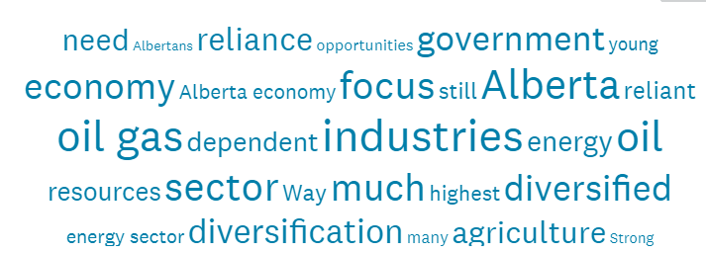

2020 Test of Alberta’s Economic Resilience: Significant downturn overall. Uneven across Locations and Sectors. Quick recovery and fix unexpected.
Prepared for Broadcast
November 5th, 2020

Slide 2
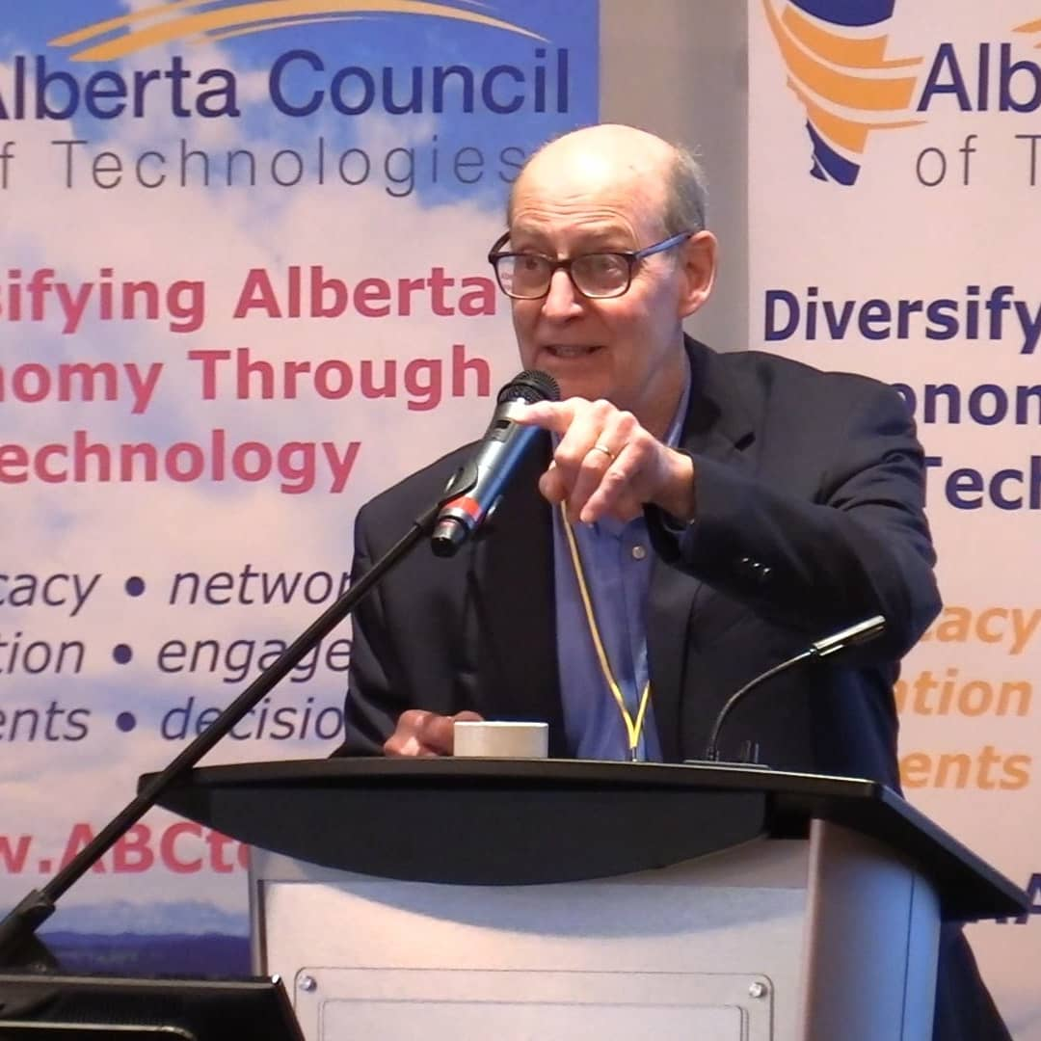

Welcome
Perry Kinkaide, MSc, PhD, CMC | A celebrated change agent throughout a varied career including senior positions as an academic and leader of NGOs, manager and consultant for numerous public and private organizations. Now in “retirement” Perry - as President of Kinkaide Enterprises Inc., mentors and finances start-ups employing emerging technologies, and routinely monitors the status of Alberta’s economy, diversification, and associated innovation ecosystem. Recognized as one of 50 most influential Albertans.
Contact: Perry@PerryKinkaide.com
Website: PerryKinkaide.com

Slide 3

PROGRAM OBJECTIVES
YOUR assessment and comments about Alberta’s economic diversification
EPISODE #1. YOUR sentiment and views – COUNT
The current status of Alberta’s economic diversification/resilience
How sentiment has changed since 2015
Factors influencing your sentiment on diversification
YOUR comments – for clarity and additional insight
EPISODES #2 – 3. Locations and Sectors differ – A LOT
EPISODE #4. Innovation can help – YES?
Introducing the Innovation Ecosystem
Assessing it’s effectiveness
EPISODE #5. Summary Recommendations

Slide 4
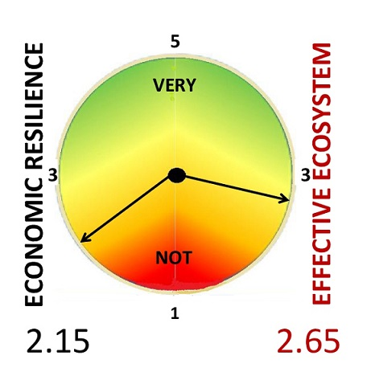
Alberta’s economic resilience - very weak
Fall 2020
4
B
C
2
D
F
= D
= C-
What are the proportions of those who view the economy as Resilient and Not?

Slide 5
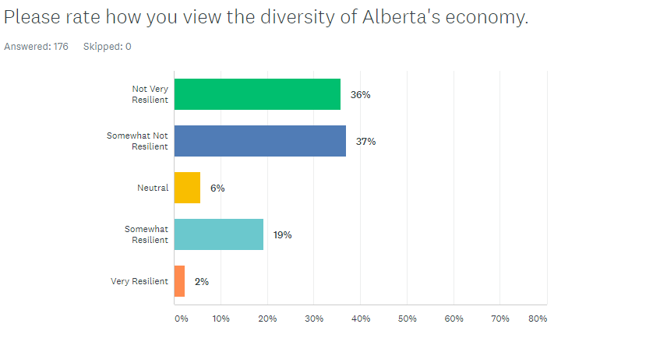

Two clusters – Alberta’s economy is viewed as Not Resilient by 73% and Resilient by 21%. Uncertainty is low at 6%.
Q1. Please rate how you view the diversity of Alberta’s economy.
Not Very Resilient
Somewhat Not Resilient
Neutral
Somewhat Resilient
Very Resilient

Slide 6
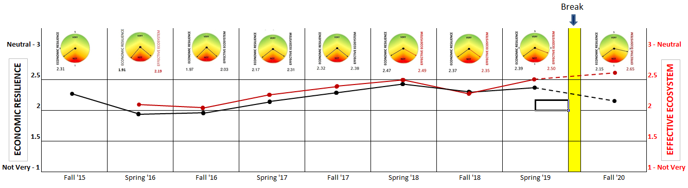

Alberta’s 2020 economic resilience – weak and weaker since the Spring of 2019
Your comments add clarity and insight

Slide 7
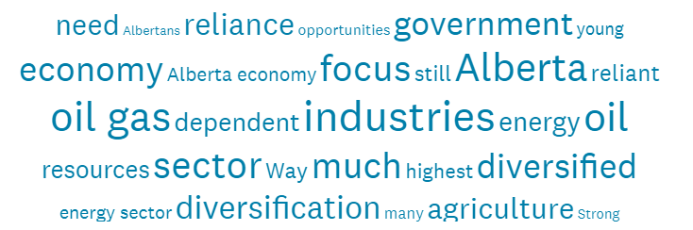
Comments
2% Very Resilient. Central Alberta. We have the highest GDP per capita among the provinces in Canada; highest CAPEX per person & worker; highest (% terms) population growth of all provinces and US States; highest income per person; lowest debt of all provinces.
19% Somewhat Resilient. Edmonton Region. The disruption in energy markets over years has driven some efforts to diversify both through policy and creative destruction. In more recent years Alberta seems to have become more dependent on construction/property development which is a potential crutch.
Southern Alberta. Our Alberta economy is ticking along – some better than other…is that opportunity or goof luck?
6% Neutral. Edmonton Region. While diversity is improving, largely forced by the realities of the demise of the hydrocarbon energy sector, Albertan investors continue to lack vision.
37% Somewhat Not Resilient. Calgary Region. Economy and government actions overly dependent on what happens to the oil & gas industry.
Edmonton Region. We are still too dependent on the production and sale of bitumen or otherwise crude oil. We should be upgrading a lot more and adding value.
36% Not Very Resilient. Calgary Region. Alberta economy is still focused on energy, and second tourism. I think there is a great opportunity in agriculture and agriculture related industries.
Northern Alberta. Way too much reliance & emphasis (coming from current policy makers) on the Fossil Fuel industry & it's dependents. Not enough recognition of other energy & efficiency industries (namely the shift to a green based
economy) other natural resources, tech based sectors, & the arts & culture related fields.

Slide 8
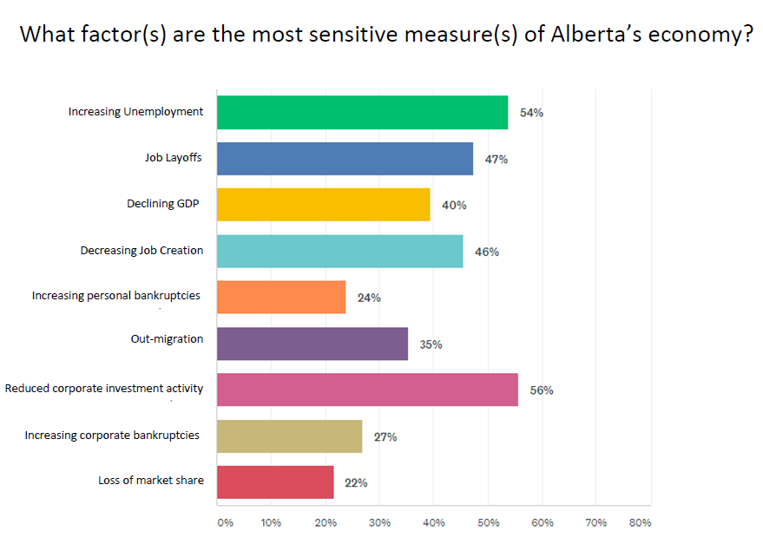

The most sensitive measures of Alberta’s economy are Corporate investment activity and Job-related measures

Slide 9

Time is up…but stay tuned
EPISODE #2. Economic resilience differs across Locations – A LOT! Comparing
Edmonton Region, Calgary Region, and Others: Northern, Central, Southern Alberta
EPISODE #3. Economic resilience differs across Sectors – Also A LOT! Comparing Private, Professional, and Public Services
EPISODE #4. Innovation can help. But is Alberta’s Innovation Ecosystem effective?
EPISODE #5. Conclusions and recommendations

Slide 10


Thank you - CREDITS
Webinar Production
Fission Media – Tom Dodd
https://www.fissionmedia.com:-tom@fissionmedia.com
Websites in Edmonton – Michelle Lessard
https://websitesinedmonton.com/
Canada Institute for International Trade – Kevin McNulty
Survey Support
Economic Developers Alberta
Alberta Council of Technologies Society
AB POL ECON

