Slide 1

Environment & CleanTech
Jason Switzer, Executive Director
26 November 2016 | Creating the New Alberta
Notes:
3 imperatives for change
3 ingredients to the new Alberta Advantage
4 principles to follow in investing our money in big bets
8 big bets – ideas that can pay off massively

Slide 2
“Collaborators”
Rus Matichuk
Simon Knight
Michael Cohen
Meera Nathwani
Brian Doucette
Paul Leroux
John Goetz
Stuart Lomas
Heather Campbell
Judy Fairburn
James Chepya
Yvonne Gruenthaler
Dan Matross
Rainforest Summit
Sara Hastings Simon
Julia-Maria
Karl Miller
Zach Adolphe
Breakthrough Institute
MIT Energy Lab
Jane Kearns, Denis Leclerc, Jon Rhone, Marty Reed, JF Beland, Victoria Smaniotto
Notes:
ACTIA was established to be the voice for the change agents in companies today as well as for the companies and industries of tomorrow.
Collaborators: influenced by discussions that I’ve been a part of over the course of the last several months.
stablished in 2011 to position Alberta as a global CT leader
Board: investors, entrepreneurs, ENGOs, major energy companies
Co-founded Canada Cleantech Alliance in summer 2016
Members: MaRS (ON), BC CT CEOs, Ecotech (QC) and ACTia (AB)
Activities:
Data & Connectivity – Survey & Map
Collaboration – Events, Analysis, Coalitions
Voice – Policy advocacy, Celebration of Alberta’s successes

Slide 3
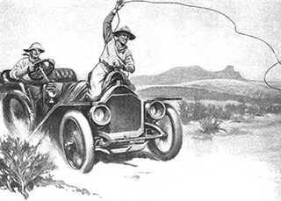
THE CHANGE IMPERATIVE
1
Economic Competitiveness
Environmental Constraints
Transformational Innovation
2
3
Notes:
Why: The Forces and Sources of Change. What is driving change in the industry or profession?
-Compelled by Economic Circumstance
-Impeded by social license failures
-Imperiled by market transformations brought about by technology change

Slide 4
Innovation is transforming our markets and our industries
Notes:
Exponential pace of change. These are drawn from IT, where moore’s law regarding doubling time in processing capability is changing the game in new and unforeseen ways. In the early 1990s no one had a computer at home and desktops at work were just becoming common place. Now most of us in this room have several considerably more powerful computers with us right now.
But in some ways that was a small change, migrating work we were already doing to a different ‘virtual’ desktop. Incremental improvement. Secretary pools started to disappear.
Then we started plugging those ocmputers into the internet. And … boom… whole industeies have emerged as others have nearly winked out of existence. Zellers is gone. Hello Amazon.
radical or disruptive changes can bring about major upheavals in the industries they impact, transforming relationships between customers and suppliers, restructuring marketplace economics, displacing existing competitors, and creating entirely new product categories. The consequences can also invalidate existing business models and organizational architectures. An example of disruptive innovation is Uber, which threatens the viability of the taxi business model globally. Disruption in related markets, such as freight, food delivery and public transit, will likely follow.

Slide 5
Environmental constraints & society’s response impede growth
Notes:
We all know that we are in a time of significant environmental change as well. Major natural system thresholds are under threat, posing moral challenges – what makes us believe we have any greater right to occupy the world than any other species – to existential – at what point does climate change or ocean acidification become severe enough to pose risks to global food security?
And how we choose to respond, or fail to choose, which is a choice too – will help to define how much we pay, and to whom the bill shall come due (us, our children or grandchildren)
This is playing out right now in a debate over pipelines and market access, over carbon pricing and coal phase out. Will environmental limits be a constraint to economic growth?

Slide 6
Alberta’s economic competitiveness – our jobs & welfare – are at risk
Notes:
environmental and associated social license constraints are impedients to economic success of our energy sector. market acess aside, our dominant industry, oil and gas, is being disrupted right now by horizontal drilling and hydraulic fracturing. Ideas that were in some instances developed and perfected here are putting many of us out of work as the US, our primary customer, becomes our primary competitor. We are out there on the edge of the curve.
If you are in oil and gas today you recognize that the primary barrier to better pricing thru expanded market access for your product is failure to secure social license for pipelines
But you also know that reducing costs for operations is critical to keeping oilsands and unconventional oil and gas from falling off the supply curve. Some companies are already shutting in production in the current ‘lower for longer’ price environment
Those constraints offer massive business opportunities for people who have both the knowledge and the networks to transform them into deployable and scalable investments
Moreover, the machines may be coming for white collar workers more generally.
Bottom right a chart with an estimate of the range of professions or activities that can be automated using currently-demonstrated technologies a whole lot of jobs are under threat when computers can more effectively and efficiently diagnose diseases, undertake legal research and process prescriptions.
Clearly Alberta needs to be at the front end of technology

Slide 7
THE NEW
ALBERTA
ADVANTAGE
Alberta is uniquely
Young & Educated
Tech-preneurial
Collaborative
1
2
3
Notes:
But there is a more positive story to tell. We need to become smarter in how we use our assets in a world of environmental limits. Fortunately we have 3 unique strengths, the ingredients of the new alberta advantage.

Slide 8
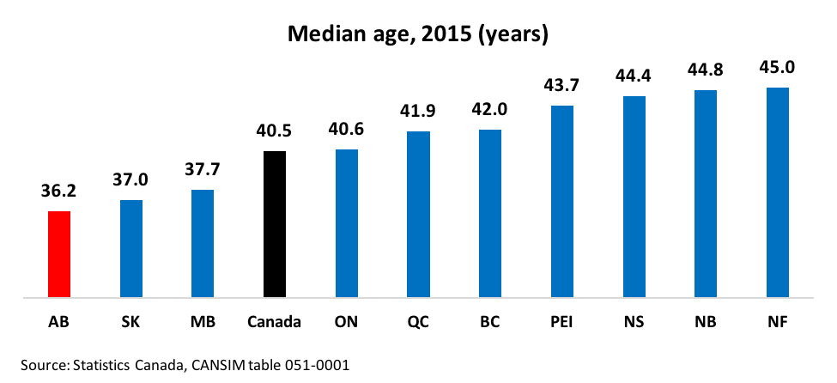
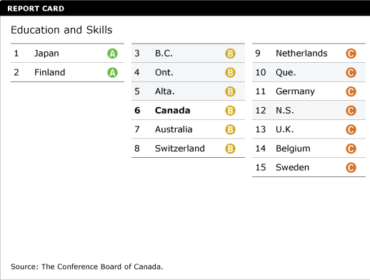
Alberta is a young, educated province
Notes:
We all know that youth, immigration and level of education are among the strongest predictors of innovation and entrepreneurship.
Alberta’s 4M people are the youngest of all Canadian provinces, with a median age of 36.2 years vs. global average of 30.
Alberta, like Canada, has a highly educated population with 90 per cent of our working age population* with at least a high school education. The average across Organisation for Economic Co-operation and Development (OECD) countries is 76 per cent. Among the OECD’s five leading jurisdictions for education
Disproportionately high level of skilled trades. One of the world’s best education systems.

Slide 9
Alberta is entrepreneurial
Alberta 330-660
25-50
ACTIA:
Over 100 CT cos / 4M Albertans = 25+ CT companies per million people
Over 100 CT cos / [CAD$0.376 Trillion GDP x 0.8 USD$/CAD$ (2014)] = 332 CT companies / $USD T GDP
Notes:
we have an entrepreneurial culture:
Amid all the growth in the resource sector, and in spite of the competition for skilled talent, the number of employees in Alberta’s small business sector grew by 23.1 per cent between 2004 and 2014.
Alberta’s ICT industry includes about 4,500 companies and 59,000 employees, which generated about $15 billion in annual revenues in 2014, or roughly the same as its farming sector or its processed foods industries,

Slide 10
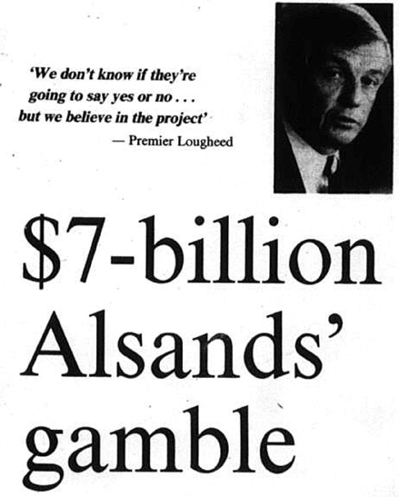
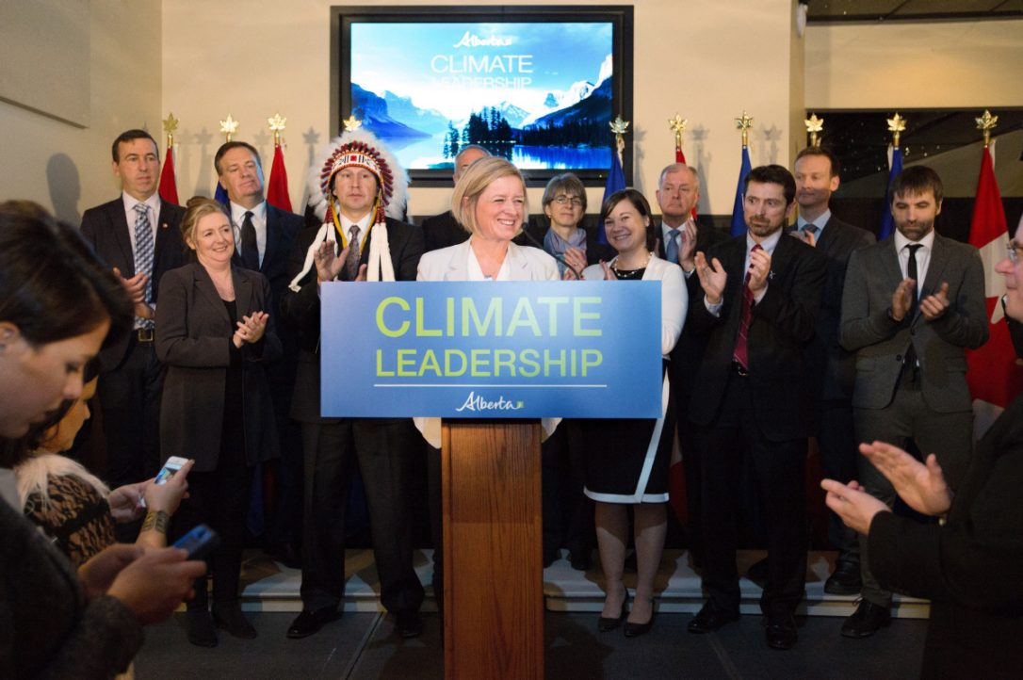
Alberta has a unique history of successful technology collaboration
Notes:
We are good at making big bets as a province and seeing them pay off.
$1B in public investment in AOSTRA translated into US$80B of investment in oilsands exploitation in a single year (2014) – unbelievable ROI
Other examples include the launch of the Canadian Oil Sands Innovaiton Alliance, unprecedented level of cooperation by companies to accelerate the clockspeed of their sector on the env’tal side; and yb the launch of our Province’s Climate Leadership Plan, which saw an unlikely set of allies across sectors stand together with the Premier to support its launch.

Slide 11
BUT WE HAVE LIMITED RESOURCES
4 Principles for
‘Big Bets’
Build on existing strengths
Focus on big prizes
Leverage adjacent competencies
1
2
3
Notes:
Byt we cant do everything. How do we pick?
We are good at many things. Lets double down on our strengths. Indeed lets do some things that provide wins to our existing large companies. We need to. This is part of the political economy of a resilient decision.
Lets focus on big prizes. The oilsands was an immense opportunity that focused minds and money. We need to focs on similar scale opportunities.
Like building on existing strengths, lets ask ourselves what are we good at that opens up new opportunities. A great example is geothermal energy. We have detailed knowledge of our subsurface resource thanks to the half million wells that have been drilled in this province, we have the skillsets and now – we have the opportunity for change in the electricity sector. Lets crack this type of energy for global benefit – no one has done this well globally outside of places with lots of volcanoes. But don’t forget- plenty of host spots – Banff Springs? We could be the first ion the world thru the door.
Industry for tomorrow
4. The Big Idea
Public sector role. Market failures that have to be corrected – invest in the future, voice, patient capital, signaling
Govt role is to alieve inefficiencies and respond to externalities
The future company doesn’t have a lobby. Theres a lot of incumbents in this space. Disruptive innovation doesn’t come from the incumbents due to risk appetite and due to lock in.
Have direct understanding of how environmental and associated social license constraints are impedients to economic success
If you are in oil and gas today you recognize that the primary barrier to better pricing thru expanded market access for your product is failure to secure social license for pipelines
But you also know that reducing costs for operations is critical to keeping oilsands and unconventional oil and gas from falling off the supply curve. Some companies are already shutting in production in the current ‘lower for longer’ price environment
Those constraints offer massive business opportunities for people who have both the knowledge and the networks to transform them into deployable and scalable investments

Slide 12
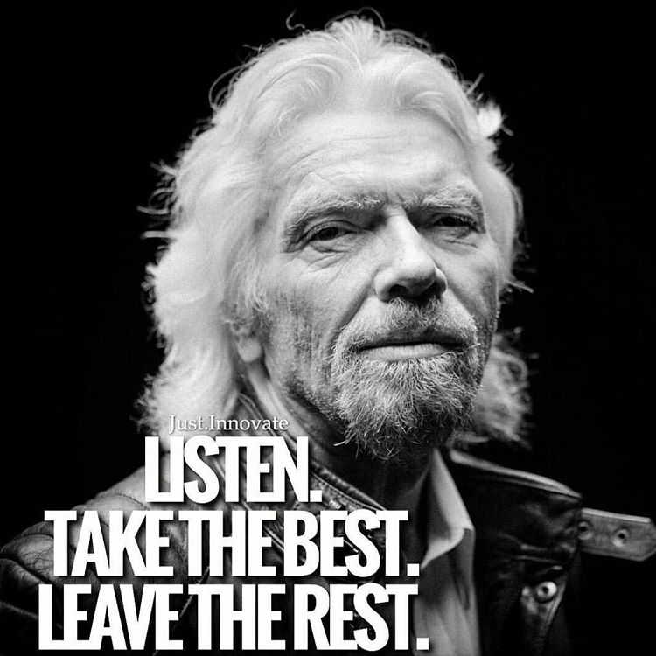

1.
RETHINK THE OBJECTIVES OF RESOURCE DEVELOPMENT GOVERNANCE
Notes:
From no project left behind to ‘take the best, leave the rest’. ‘Purity’ problem. Going after that last 1 percent vs. .1 percent requires an exponential increase in energy and water use. We could make our oil and gas industry more profitable, with a dramatically smaller footprint oer a shorter timeframe, if we reduced the amount of resource they are obliged to go after. In mining, this is called ‘high grading’. A failure to do this is a driver for the size of our steam plants and energy use. This was recognized in our recent royalty review, and is being embraced by some of the oilsands miners. We need to widen this thinking. What are we trying to do with our natural resource endowment?

Slide 13
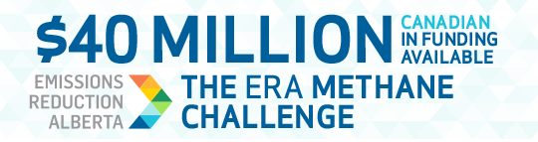
2.
TREAT ENVIRONMENTAL POLICY AS INDUSTRIAL POLICY
Smart Regulation triggers
Notes:
Twenty five years ago, Harvard Business School economist and strategy professor Michael Porter stood conventional wisdom about the impact of environmental regulation on business on its head by declaring that well-designed regulation could actually enhance competitiveness. He wasn’t the first to suggest this, but coming from the sage of business strategy at Harvard, it mainstreamed what had been a fringe view.
Strangely, in spite of the business case for hidden value in environmental performance, it remains viewed as an ‘either /or’ in public debates. We need to move past this, and look at how to use public policy to increase the productity and competitiveness of our key industrial sectors, to drive up the clockspeed of the sector.
Our methane regulation is an example of how this could look more widely. We set an ambitious target to reduce methane emissions in upstream oil and gas. This same policy was embraced by our key trading partners – the US and Mexico. We created a technology funding opportunity to enhance our competitiveness in this space – deploy and prove out the business models here, and then export to the US and Mexico, who collectively represent 20% of world oil and gas methane emissions.

Slide 14

3.
ESTABLISH A MARKET VALUE FOR BETTER ENVIRONMENTAL AND SOCIAL PERFORMANCE
Notes:
Business strategy tells us you can compete on price or on quality. If you are in a commodity business, you can only compete on price – be the lowest cost producer. But in industry after industry, we see the emergence of certifications – price premiums – for environmental and social performance.
In the early 2000s, Canada played a key role in creating the Kimberley Process, aimed at screening out of global markets so-called ‘conflict diamonds’, diamonds that were key to financing violent conflict in west Africa. Canada was simultaneously developing its first diamond mines in the North West Territories. While production costs were higher than diamonds from sub-Saharan Africa and Russia, Canadian diamonds came from nowhere to become #3 globally. Certification works. We’ve done this before. Alberta is home to the world’s largest forest stewardship council certigied forest management area. We can do this.

Slide 15

4.
BUILD A TOP-RANKED BUSINESS SCHOOL IN ALBERTA
Notes:
York 56 Western59 Queens 79 - Economist
U of T - 60th FT
HEC-Montreal – 11th – Forbes
No one in Canada is ranked in the world’s top fifty business schools. Canada needs this. Alberta needs this.
tech-heavy entrepreneurship
Greatest gap is in Marketing and developing effective business models
Leverage existing strengths

Slide 16
5.
CONQUER THE CLEAN TECH COMMERCIALIZATION VALLEY OF DEATH
FINANCE MECHANISMS
TEST BED FACILITIES
INNOVATION WAIVERS
Notes:
To move a technology from the pilot/demonstration stage to the commercialization stage, the central challenge is accumulating enough capital for the commercialization, production, and manufacturing processes associated with demonstration and market launch. Clean energy technologies are routinely more capital-intensive than e.g. launching an App. large sums of capital, often on the order of hundreds of millions of dollars, are necessary to build commercial-scale facilities and demonstrate the validity of a first-of-a-kind technology in the field. This is particularly acute in Energy tech, where innovation is very capital intensive, markets are commoditized (low margin), and IP is difficult to hold. And any change in technology creates regulatory approval uceetainty
To overcome these barriers
Finance mechanisms to support large capital pilots. A counterpart to SDTC which funds early stage, need to underwrite additional deployments
Test bed facilities – plug and play centres where people can demonstrate field viability of their technologies. Reduces the capital barrier and enales ‘faster failure’. Oildsands water tech centre will be launched soon. Similar platform for carbon utilization off back end of existing CCGT here for carbon capture and utilization.
REGULATORY INNOVATION WAIVERS to enable companies to pilot tech and fail, with appropriate safeguards. Exist in US under Clean Air and clean Water Acts.

Slide 17
6.
RETHINK BUSINESS MODELS
Notes:
1-5 were about what government could do. But lets talk about what our companies and entreprenuers need to do. Uber has disrupted the taxi industry, and is coming after freight, food delivery and car ownership itself. The model matters more than the technology.
Unlocking the full benefits of a novel technology, such as in the information and communications domain, requires entirely-new ways of thinking about the organizational architecture and business model of the oil and gas company itself. One study of IoT in oil and gas concludes that “managers [are] cautiously deploying ‘digital oil field of the future’ technologies in a way that preserves existing organizational boundaries and disciplinary silos…rather than fundamentally changing them.” What are you really selling? What is the unique value proposition. One company in town is trying to create a direct sales relationship with buyers by presenting itself as the environmental and social performance leader. Not selling a commodity.

Slide 18
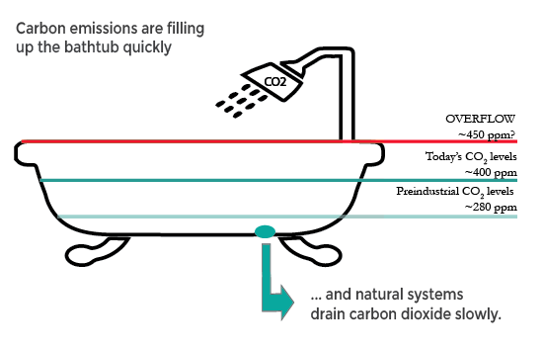
7.
LAUNCH THE BUSINESSES OF TOMORROW
Center for Carbon Removal
Notes:
We are going to overflow. Even before the election of Donald Trump, In all but the rosiest of forward carbon emission projections, we are going to need to come up with ways of increasing our removal of carbon from the atmosphere thru net-negative technologies: carbon capture and storage, air removal of carbon, carbon utilisation, transformation of agric systems to pull co2 out of the air. Alberta could bea world leader in this space. One of the leading technology plays in this space launched here at U of C – carbon engineering. Similarly, we are a global leader in development of agric techniques that reduce carbon emissions, including fertizilizers, chaging aniumal feed practices and producing biochar. Watch this space.

Slide 19
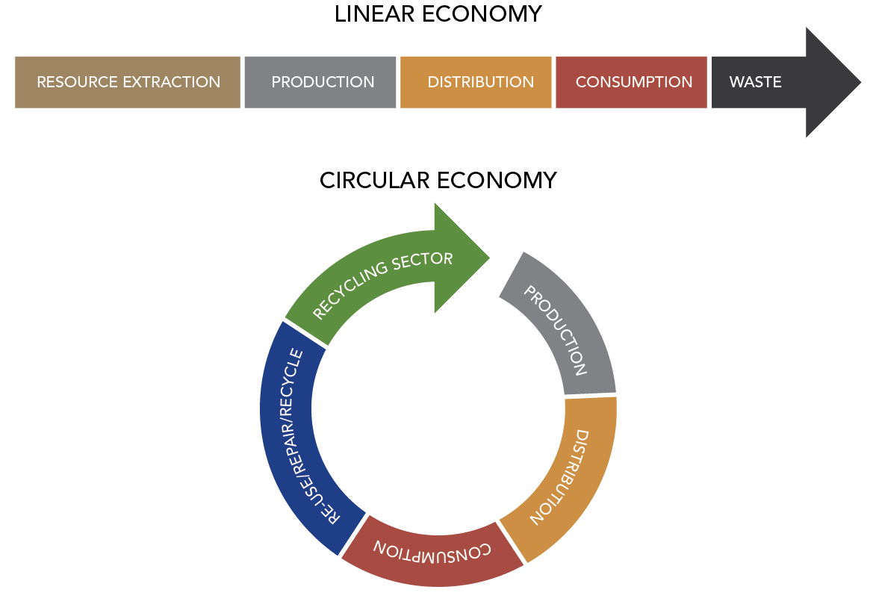
8.
CHANGE BUSINESS CULTURE
Notes:
We need to transform how we think about doing business. Disrupt old models of thinking. “eat the feet”
Making use of waste materials – shell sulphur products from sour gas waste – better cement, better fertilizer – even carbon reduction benefits
Titanium Corporation – extracting valuable metals from tailings
Geothermal from high-water cut wells

Slide 20

CREATE A NEW ALBERTA MYTH
Notes:
This last recommendation is for us all. Ultimately, we need to transform the story we tell ourselves about ourselves, and live up to that story. Alberta tells ourselves that we are an entrepreneurial place, where people work together and overcome challenges. We are an Olympic province. A sophisticated province. A place that isn’t looking back, but instead is looking forward.
Silicon Valley tells itself a story of ‘yes and..’, of making opportunities open to everyone who goes out seeking them. it’s a place where a crazy kid with an idea in a garage can get a meeting with a billionaire.
We have all the ingredients we need. Right now. to be the place that people come to. Where innovation happens.

