Slide 1
NEW ECONOMIES & DIVERSIFICATION
ENGINEERING & DESIGN
Presented by Craig Eastman, Ph.D., P. Eng., EFC-CORP

Slide 2
CONTRIBUTORS
Ronald W. Maine P.Eng. FEC, LEED®AP, Maine Consultants Ltd.
Alberta Council of Technologies
The Internet and various Databases

Slide 3
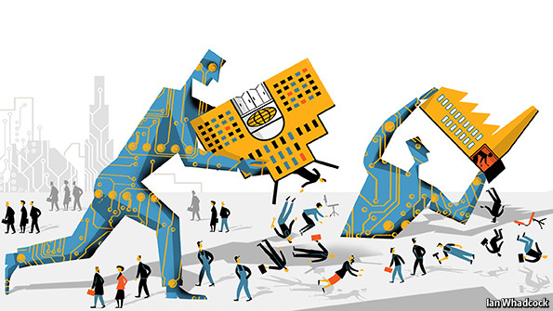
SOURCE of Change - THE NEW ECONOMIES
Humans will change – becoming smarter and healthier and living longer
Business will change – becoming predictive, agile, moral, innovative
Technology will change – becoming connected, faster, intuitive
New business models – New Innovations – New Global Risks – New Competitors – New Markets – New Powers

Slide 4
ENGINEERING PROFESSION in Alberta
Association Professional Engineers Geology Association (APEGA)
Professional Members (Eng.) 42,349 (2011) 51,241 (2015)
Professional Members (Geo.) 4,915 (2011) 5,222 (2015)
Engineers in Training (E.I.T.) 8,412 (2011) 13,001 (2015)
Geoscientists in Training (G.I.T.) 1,002 (2011) 1,314 (2015)
Other 6,310 (2011) 6,980 (2015)
TOTAL NUMBER IN 2015 = 77,758

Slide 5
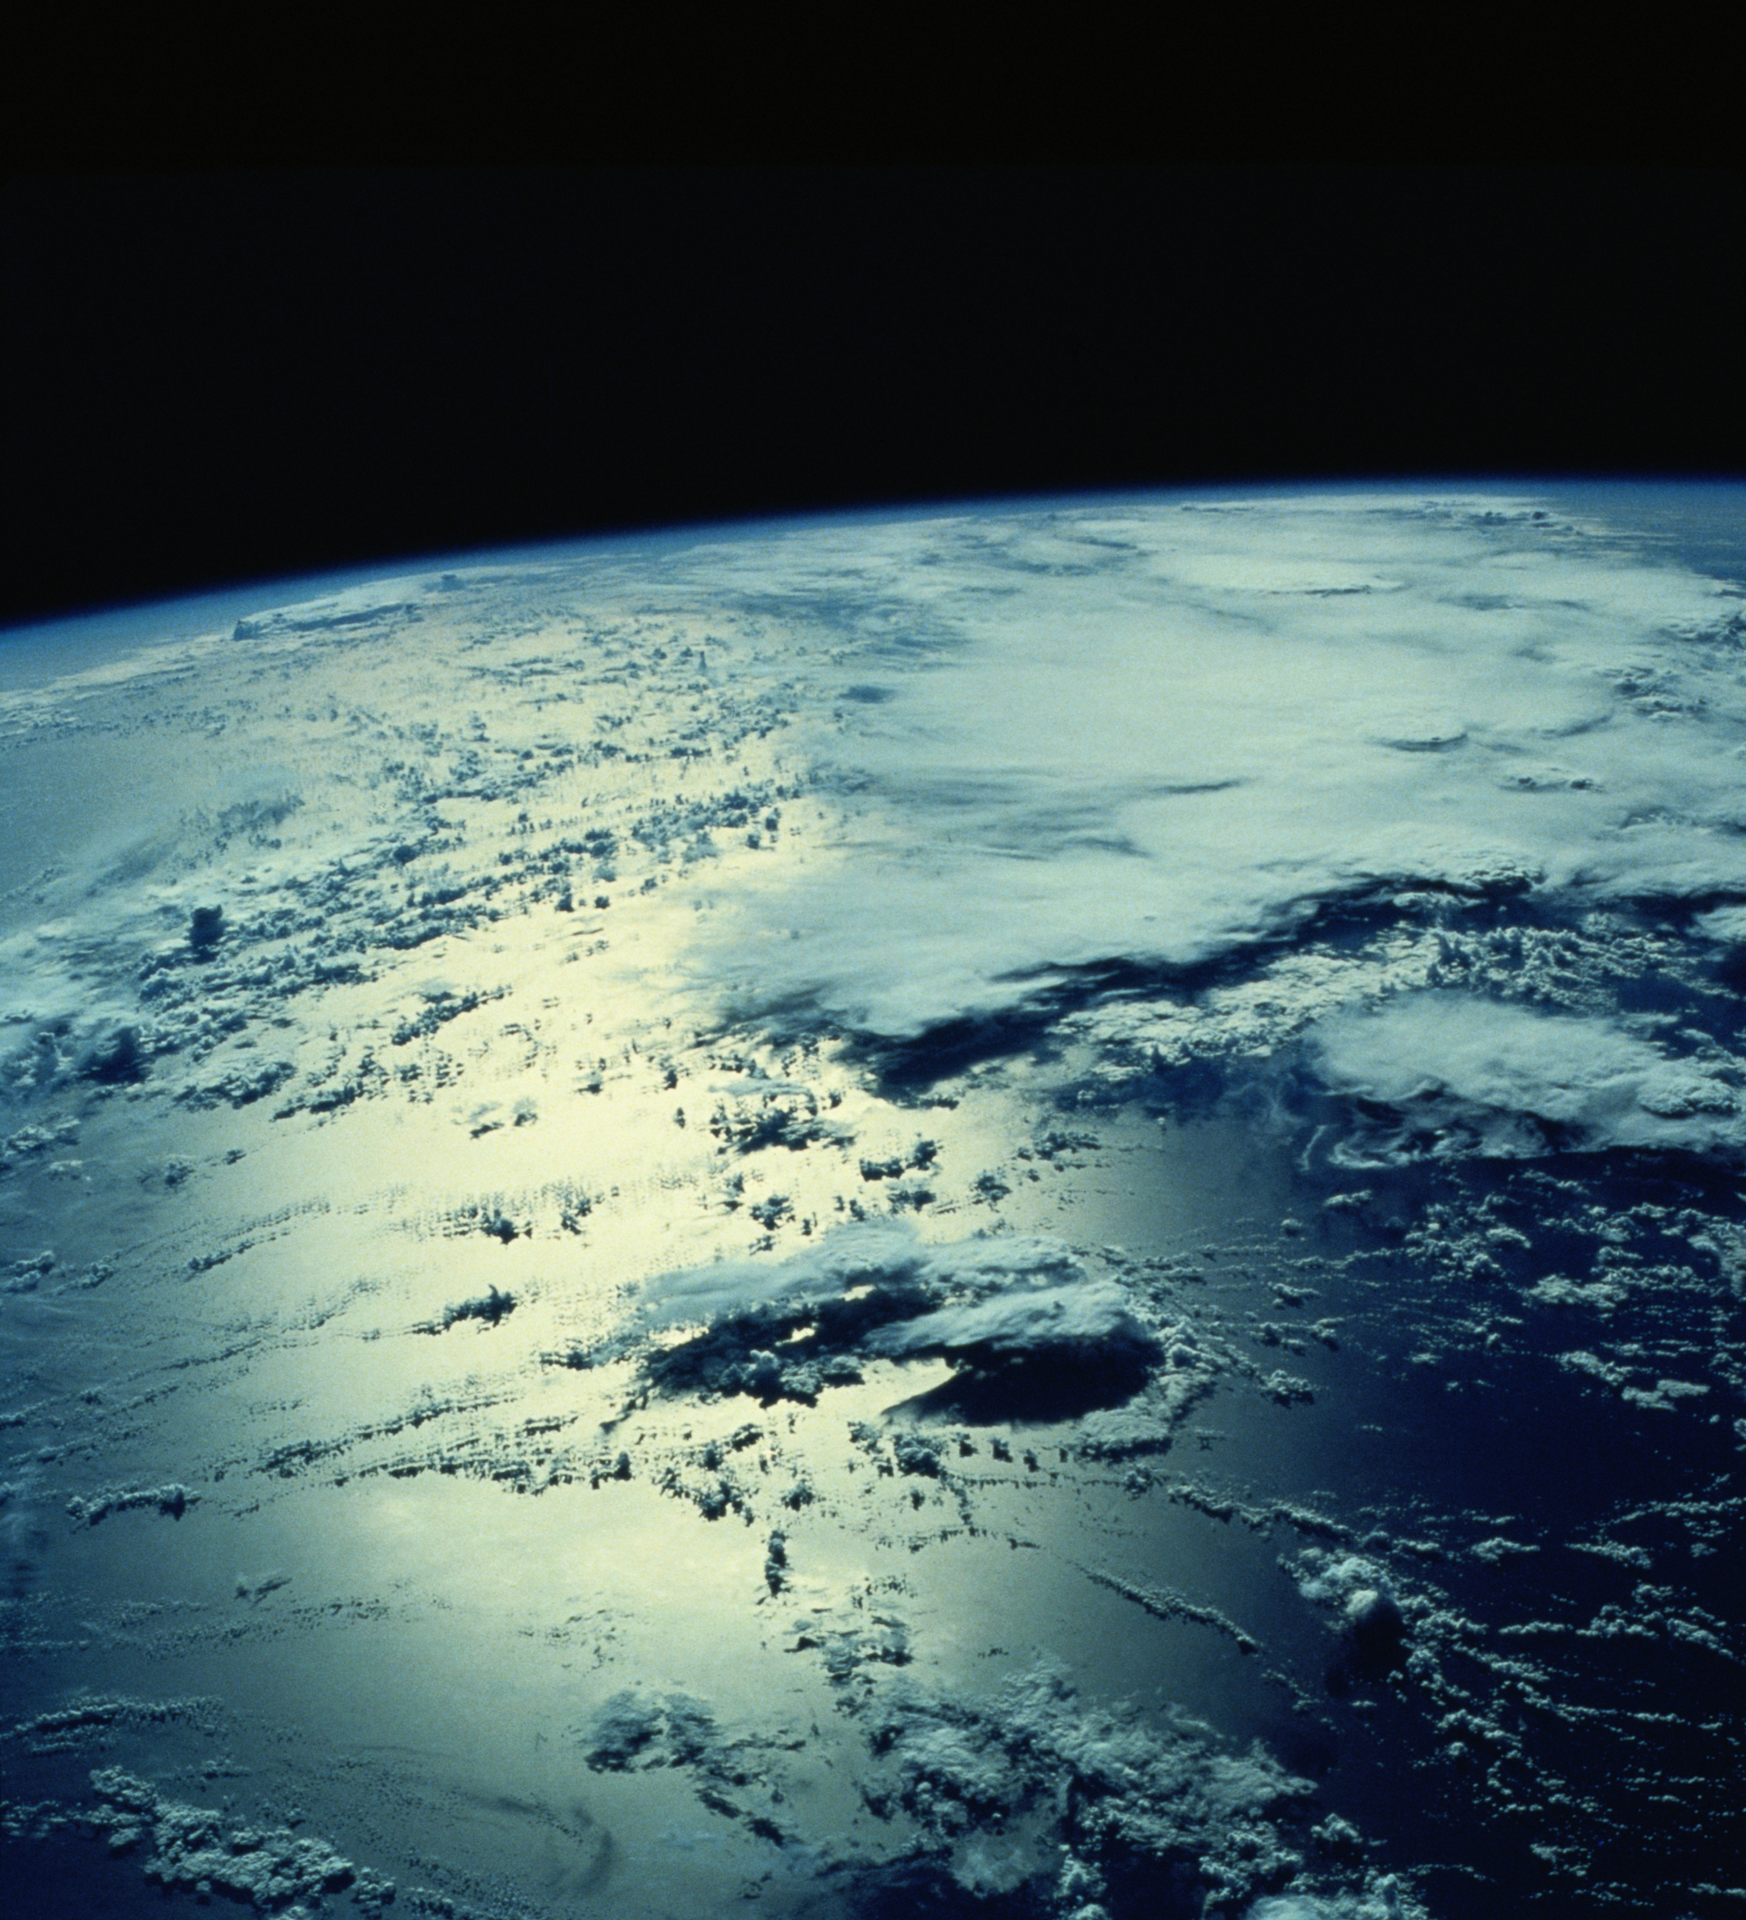
Managing climate change
Managing Climate Change is a New Industry – the biggest self inflicted problem to face humanity due to the Industrial Revolution.
Solutions to global CO₂ emissions include; Solar Power, Wind Power, Hydroelectric, Fusion/Fission, Carbon Neutral Hydrocarbon Synthesis, Smart Cities, etc.
This has an obvious connection with Canada’s present oil and gas industry, suppliers of energy sources
Need to develop a strategy to replace use of fossil fuels, there is the potential for global business opportunities

Slide 6
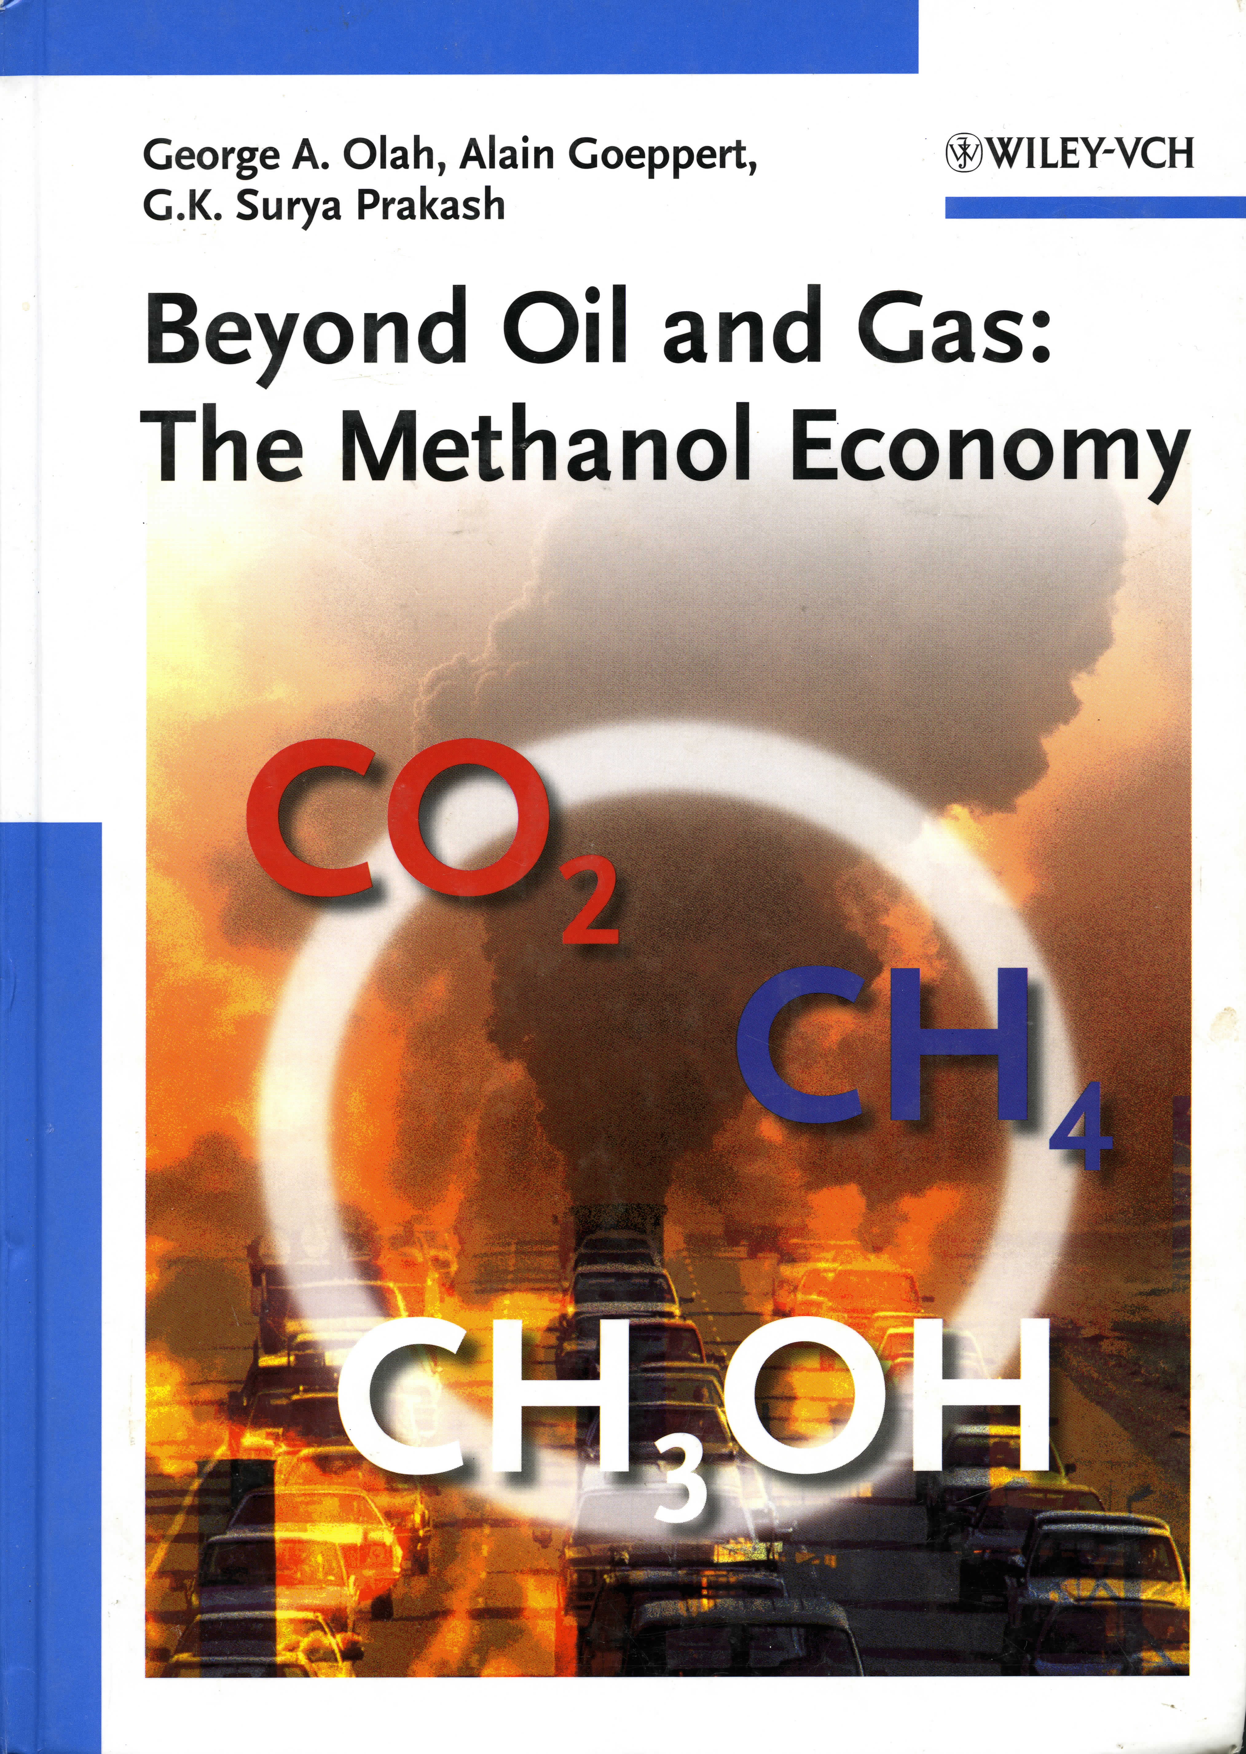
METHANOL ECONOMY
Utilizing CO₂ present in the atmosphere and in oceans it is possible by utilizing sustainable energy, i.e. wind, solar, geothermal, hydroelectric, tidal, or fusion/fission to synthesize hydrocarbons (i.e. Methanol, Ethanol, Butanol, Dimethyl Ether) for decarbonization of the transport industry and as feedstock for the petrochemical industry
Biggest challenge is to decarbonize the transport industry, Li batteries at 0.9 MJ/kg versus 26MJ/kg for ethanol – liquid fuels are ideal vehicle for storing electrical energy
Distributed storage of energy in production of hydrocarbons, security in supply, carbon neutral, natural recycling, no more fossil fuel extraction

Slide 7
FUSION ECONOMY
Nuclear fusion can provide a virtually unlimited source of energy derived from seawater, lunar soil or the atmosphere of Jupiter
Products produced consist of heat(neutrons) and Helium and can be turned on and off at will – minimal radioactive waste with short half-lives
Electricity Costs: Fusion ($30/MWhr), Natural Gas ($64/MWhr), Fission ($96/MWhr), Solar ($130/MWhr)
Energy Source | kWhr/kg
Wood | 4.2
Coal | 8.4
Petroleum | 14.1
Uranium | 22,000,00
Deuterium | 95,000,000
Antimatter | 106,000,000,000

Slide 8
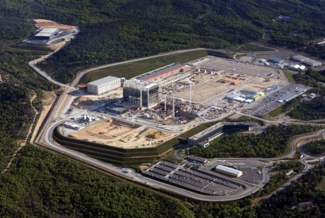
FUSION ECONOMY – International Thermonuclear Experimental Reactor
International Thermonuclear Experimental Reactor (ITER) project in France to building the World’s largest fusion reactor (500MW) costing $16-50 Billion USD, first Plasma 2025, Deuterium-Tritium in 2035

Slide 9
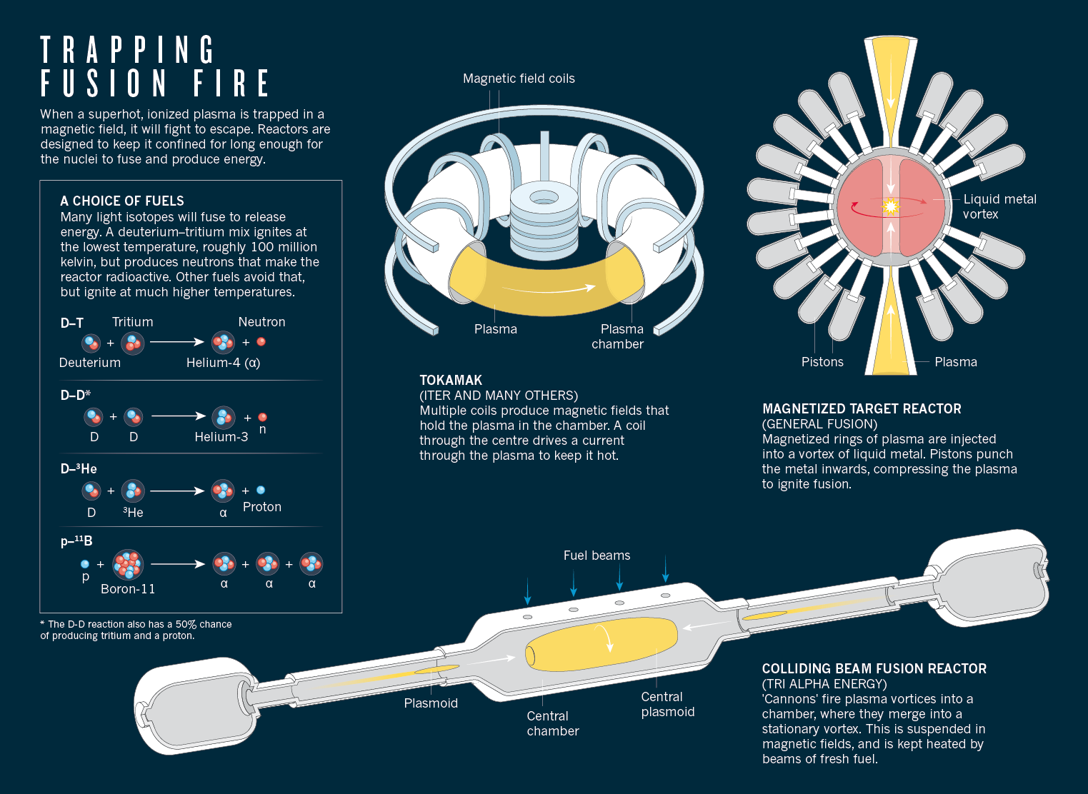
FUSION ECONOMY
Over 440 commercial nuclear fission reactors operating in 31 countries, producing over 390,000 MWe of electrical power, representing 11% of World’s electricity (increasing to 16% with 60 more reactors under construction)
Fusion reactors utilize lasers (inertial confinement), magnetized target reactor (plasma injected into liquid lead and compressed), colliding beam fusion reactors (cannons firing plasma vortices into a chamber.
There is also the Low Energy Nuclear Reaction (LENR) systems such as electrolytic-palladium (cold fusion), gas loading method (Palladium, Nickel pressurized with Hydrogen or Deuterium), Sonic Method (cavitation of deuterated Electroliquids), Pyroelectric (heated pyroelectric crystal in deuterated atmosphere), Electro-diffusion (Voltage applied to ionic material), and the gas discharge method (short pulses of high voltage in low pressure deuterium gas), etc.

Slide 10
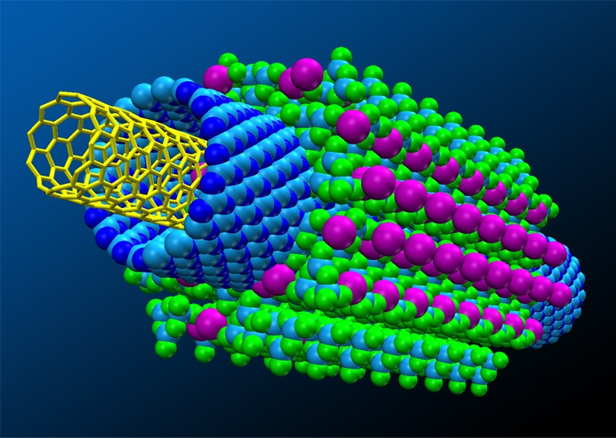
Nanotechnology
Edison tested 1,600 materials before picking a type of bamboo for the first filament in an incandescent light bulb
In contrast today the massive increase in computer power allows the exploration of material properties as “virtual materials”
We will be able to determine materials with the desired properties for a particular application without an “Edisonian” development process

Slide 11
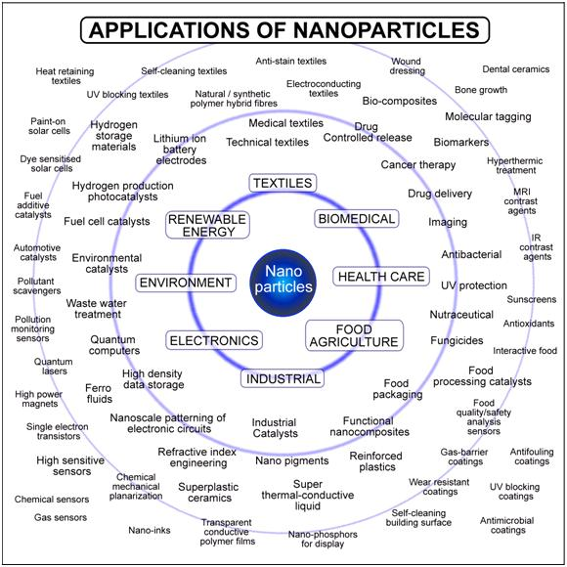
Nanotechnology
How do we harness Nanotechnology to produce companies that will diversify the Alberta economy?
Need a strong strategy to utilize both local and global nanotechnology advancements defined by market needs – with Alberta and Canada benefiting
Need funding strategies for the “missing middle” to produce technology at scale

Slide 12
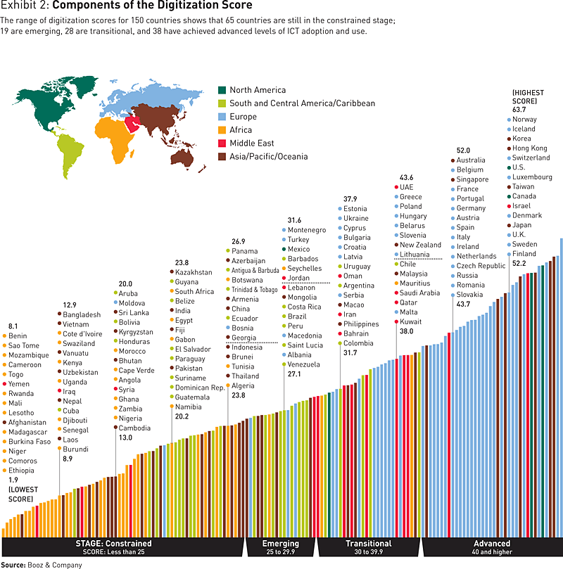
Digitization of economy
Digital Entrepreneurs will make up 70% of the global economy
Virtual and Augmented reality is transforming training, marketing, customer experience, etc.
Manufacturing is going digital which will transform the way goods are made, smaller product batches with mass customization, e.g. 3D printing
Enhancement of existing products and service, e.g. healthcare, peer-to-peer lending systems, analytic maintenance systems

Slide 13
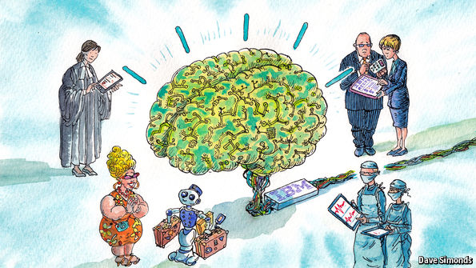
Artificial Intelligence –
Computers as smart as humans?
Optical, Quantum, DNA computing for Moores Law to continue?
26 Billion devices on Internet by 2020
“Kurzweil Singularity” when A.I. equals human intelligence in 2035
Lots of warnings as this being the biggest existential threat to humanity
Regardless, Artificial Intelligence will augment a wide array of activities, e.g. medicine, speech recognition, engineering, research and development, service industries, education, etc.

Slide 14
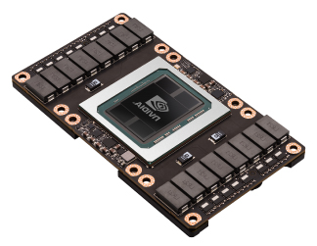
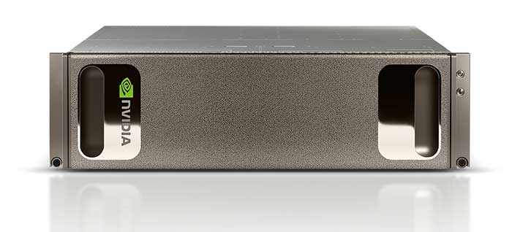
Artificial Intelligence –
DEVELOPMENT PLATFORMS
Intel announces NERVANA an AI customized chip to be released in 2017
nVidia spends $2 Billion on P-100 AI chip with 15 Billion transistors
nVidia’s AI super computer uses eight P-100 chips and costs $129,000 USD
170 TeraFLOPS, equal to 250 servers
Google, Microsoft, Amazon, Facebook and Baidu are all working with AI and Deep Neural networks providing open source AI development tools

Slide 15
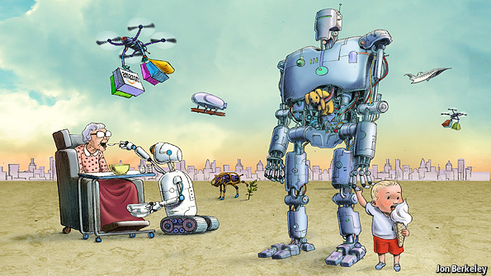
ARTIFICIAL INTELLIGENCE: RISE OF ROBOTS
Robots will be a $500 Billion industry – how should we respond in Alberta to this opportunity?
The exponential growth in computing power, digital sensors and high bandwidth communications is dramatically improving robots
Aerial robot drones applied to agriculture, forestry?
Amazon, Google have been investing in robots

Slide 16
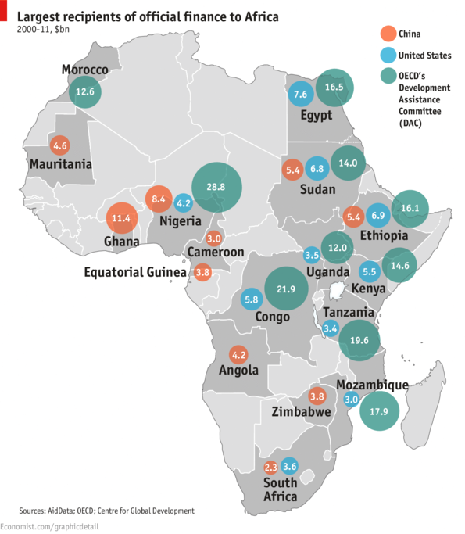
AFRICA BECOMES NEXT CHINA
Africa becomes the next China – as growth slows in China, Africa is the new source of rapid growth,
The road out of poverty is linked to abundant cheap labor, land and minerals
Africa needs more factories in addition to resource development
African Centre for Economic Transformation (ACET) in Accra, Ghana
Is this an opportunity for the Alberta Engineering business ecosystem in Africa?

Slide 17
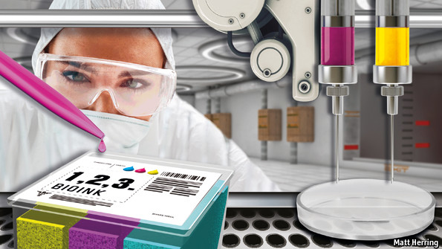
REGENERATIVE MEDICINE
Extending Life & Health
The promise is to repair or replace worn-out hearts, livers, kidneys, and other organs
Pluripotent stem cells are able to become any other type of cell
By shining a laser at dentine the tissue underlying a tooth’s enamel coat repairs itself
Bioprinting, building of living tissue with a 3D printer will produce whole organs for transplant
There are opportunities for engineers to contribute with medicine in development of new technology

Slide 18

MOBILE Commerce & Applications
Mobile commerce and applications transforms economies
Presently average download speed is 25.21 Mbps and upload speed is 8.62 Mbps as reported on Aug-2016
LTE Advanced is 1,000 Mbps download and 500 Mbps (Theoretical Maximum Speed)
The inevitable increase in mobile bandwidth will create markets for applications that haven’t been created yet

Slide 19
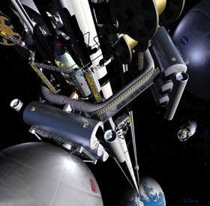
Industrialized space
Space mining revenues will exceed $125 Billion by 2030
Why mine asteroids in space? A single 500 metre asteroid could contain all the platinum and the rare earth group metals to mined to date
Heavy industry moved to low orbit and Solar Power beamed to Earth
Water contained in space is utilized for hydrogen and oxygen
The price of getting into space is dropping due to competition, SpaceX (Musk-Tesla-PayPalI, Blue Origin (Bezos-Amazon), Boeing, Rocket Lab (Beck-New Zealand), Firefly (Space-X veterans), Virgin Galactic (Launcher-One), Stratolaunch-Scaled Composites (Allen-Microsoft) - $1,600/kg for low orbit with SpaceX Falcon Heavy
Space elevator would reduce costs to $200/kg
Space travel is moving from government to V.C. startups
Asteroid mining industries ($200MM), Deep Space Industries, Planetary Resources

Slide 20
RECOMMENDATIONS
Develop alternative high density energy sources and storage systems for energy – Alberta is very good at selling energy products
Formulate a strategy that utilizes existing strengths in Traditional Engineering, Petrochemical Industry, Medicine, Electronics, Software, Nanotechnology, etc.
Develop a source of “middle level funding” for start up business ventures, we need a significant increase in start ups
Provide incentives that reward success, tax breaks, tax free zones ?

