Slide 1


CREATING THE NEW ALBERTA
Taking sentiment into account in an economy where people count
But first – my biases

Slide 2
CREATING THE NEW ALBERTA
My Evolution:
Immigrated to Edmonton, Alberta, Canada
1960-1972 Academia – College & University of Alberta
1972-1986 Government - Alberta
1987-2001 Corporate – KPMG Consulting
2001-2005 Angel Investor – Kinkaide Enterprises
2006-2019 NGO – Alberta Council of Technologies
2019-2032 Play - Geriatric G-force
My Passions:
Change management – Personalizing systems and services
Now about Alberta

Slide 3
CREATING THE NEW ALBERTA
ABOUT ALBERTA’S ECONOMY
Agriculture, Forestry, Energy (O&G)
Trucking, Rail, Pipelines
Wealth creation $ Wealth distribution
through
Raw carbon production and construction, transportation and tourism, financing public sector services of health, education and utilities
GOVERNMENT INTENSIVE

Slide 4
CREATING THE NEW ALBERTA
Alberta advantage – raw carbon resources, political stability/certainty, proximity to the US, and appeal to well-educated labor - in spite of the weather
The PPP economic responsibility defaults to government: taxation/regulations, trade agreements, and capacity to attract corporate investment capital
Political economic rhetoric is largely ideological – backed up by debt, stirred by crises and periodic whimsy for diversification – such as NOW
GOVERNMENT INTENSIVE

Slide 5
CREATING THE NEW ALBERTA
Surprise! No standard measure of economic diversity.
Ralph Klein, economic surgeon, “When driven by ideology, I’ll know
when to respond when I hit the bone.”
OPTION
Find or develop a measure of economic diversity for guiding development, assessing progress, and accountability to the taxpayer
“Get them by their measures and their hearts and minds will follow.”

Slide 6


CREATING THE NEW ALBERTA
What is the status of Alberta’s economic diversity and the capacity to change?
In 2015 ABCtech designed and launched a semi-annual (MAR and SEP) On-line sentiment survey of it’s network. EDA joined in 2018. ODA pending for 2019.

Slide 7
CREATING THE NEW ALBERTA
Survey of 7 standard questions – unchanged
  Is the Alberta economy resilient?
  What are the most sensitive measures of resilience?
  What is your location?
  What are your industry(s) of interest?
  What is government’s role in economic diversification?
  Is an innovation ecosystem needed for supporting entrepreneurs and SMEs?
  Is Alberta’s innovation ecosystem effective?
What have we learned?

Slide 8
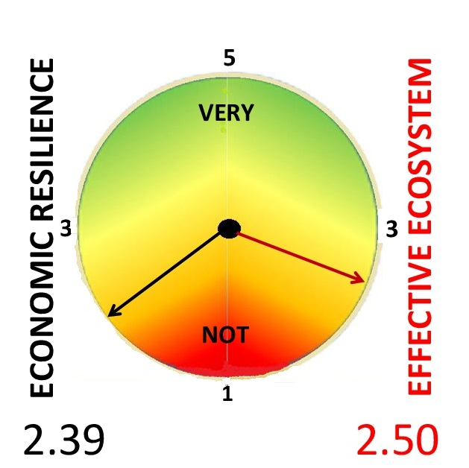
CREATING THE NEW ALBERTA
THE CURRENT REALITY – Spring 2019
Edmonton Region | 2.44 | 2.57
Calgary Region | 2.39 | 2.32
Other: | 2.25 | 2.54
North Central South | 2.10 2.33 3.30 | 2.50 3.00 3.60

Slide 9
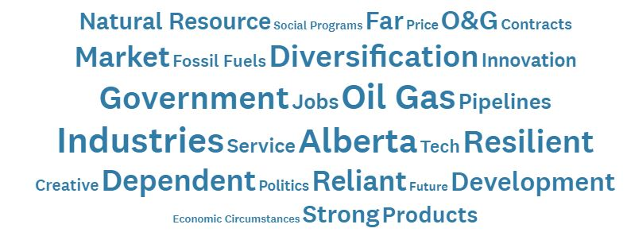
CREATING THE NEW ALBERTA

Slide 10
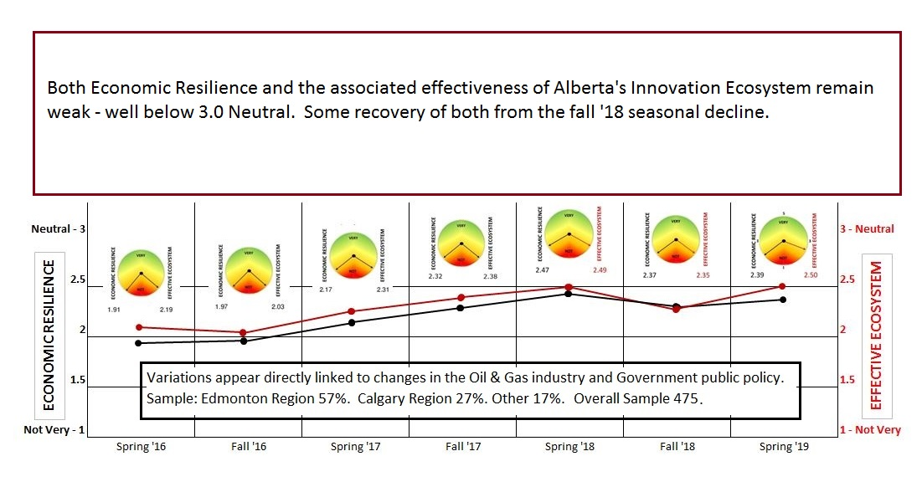
CREATING THE NEW ALBERTA

Slide 11
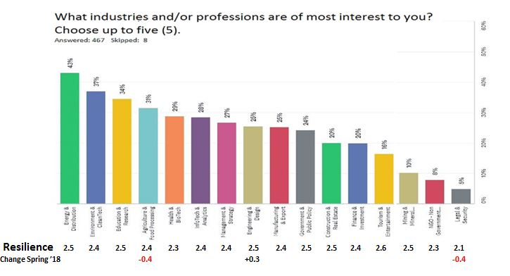
CREATING THE NEW ALBERTA

Slide 12
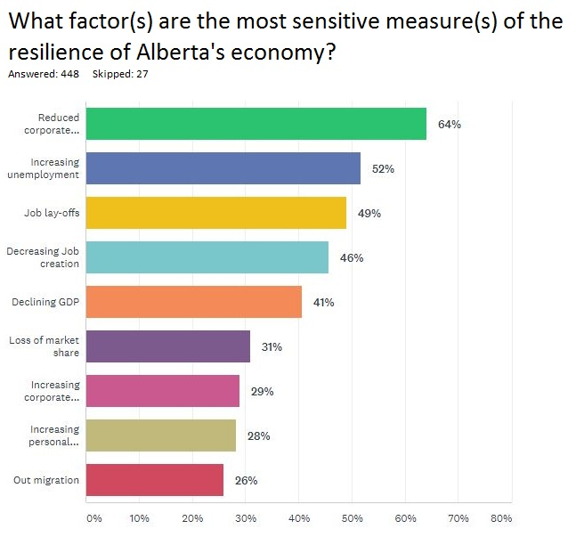
CREATING THE NEW ALBERTA
Corporate investment
Jobs
Bankruptcies

Slide 13
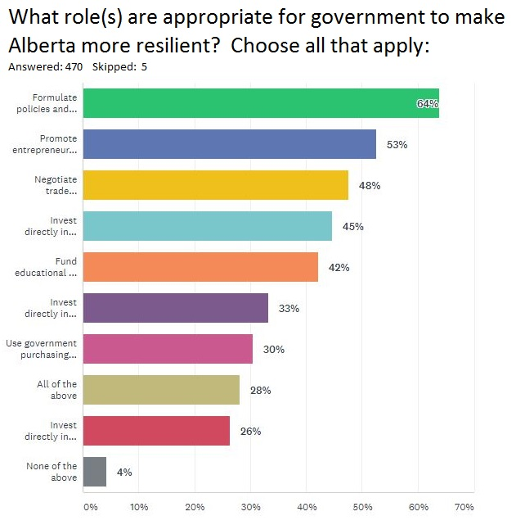
CREATING THE NEW ALBERTA

Slide 14
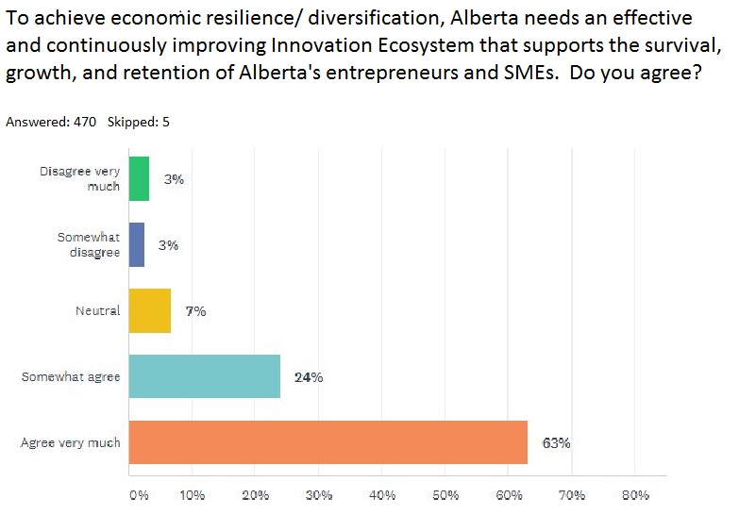
CREATING THE NEW ALBERTA
6%
87%

Slide 15
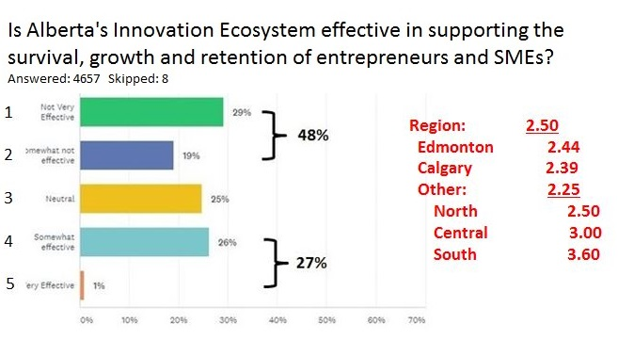
CREATING THE NEW ALBERTA
27%

Slide 16
CREATING THE NEW ALBERTA
OVERVIEW
Alberta’s economy is not diversified – overly dependent on the oil and gas and public sector services and not progressing.
WHY NOT?
Impediments for change are significant

Slide 17
CREATING THE NEW ALBERTA
THE WILLED FUTURE
A diversified and demand driven economy engaged and global, nimble and market responsive, collaborative and sharing.
Where data enables service and product customization.
Accommodating emerging technologies (AI) that are rapidly automating decision-making and disrupting/ displacing the knowledge economy, e.g. personalized healthcare.

Slide 18
CREATING THE NEW ALBERTA
IMPEDIMENTS/OPPORTUNITIES
SENTIMENT REVEALS
Public sector institutional (and professional) rigidity and supply management mentality of health, education, and public utilities
Former illusions prevail of ever-lasting prosperity - hope and euphoria
Education and data access driving clients to become consumers. The beginning of the end of the knowledge economy
Undervalued contribution of people and their enterprise. Witness SMEs failure (80%), to grow, to stay
$T intergenerational transfer languishing and public debt
Fragmentation and sustained dependency on public grant's
Activism among frustrated populist extremes
Lack of vision and sustained leadership

Slide 19
CREATING THE NEW ALBERTA
ACTION PLAN
Move the needle. Formula for a transition:
- Prepare the people. Targeting youth and relational skills
- Prepare the community. Networks of innovation/ creativity
- Develop the infrastructure. An innovation ecosystem

Slide 20

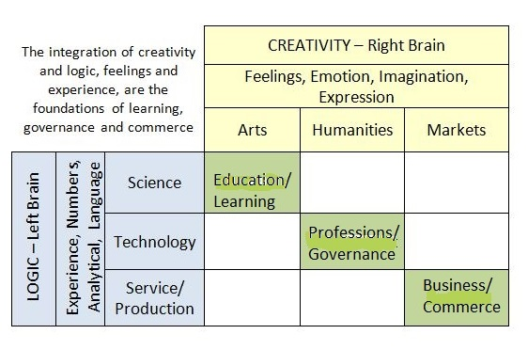
CREATING THE NEW ALBERTA
Mobilizing the Creative Economy by bridging/ blending of arts and science, humanism and technology, markets and production.

