Slide 1


Construction
&
Real Estate
Presenter
Pete Wardell
Chandos Construction

Slide 2







Contributors

Slide 3
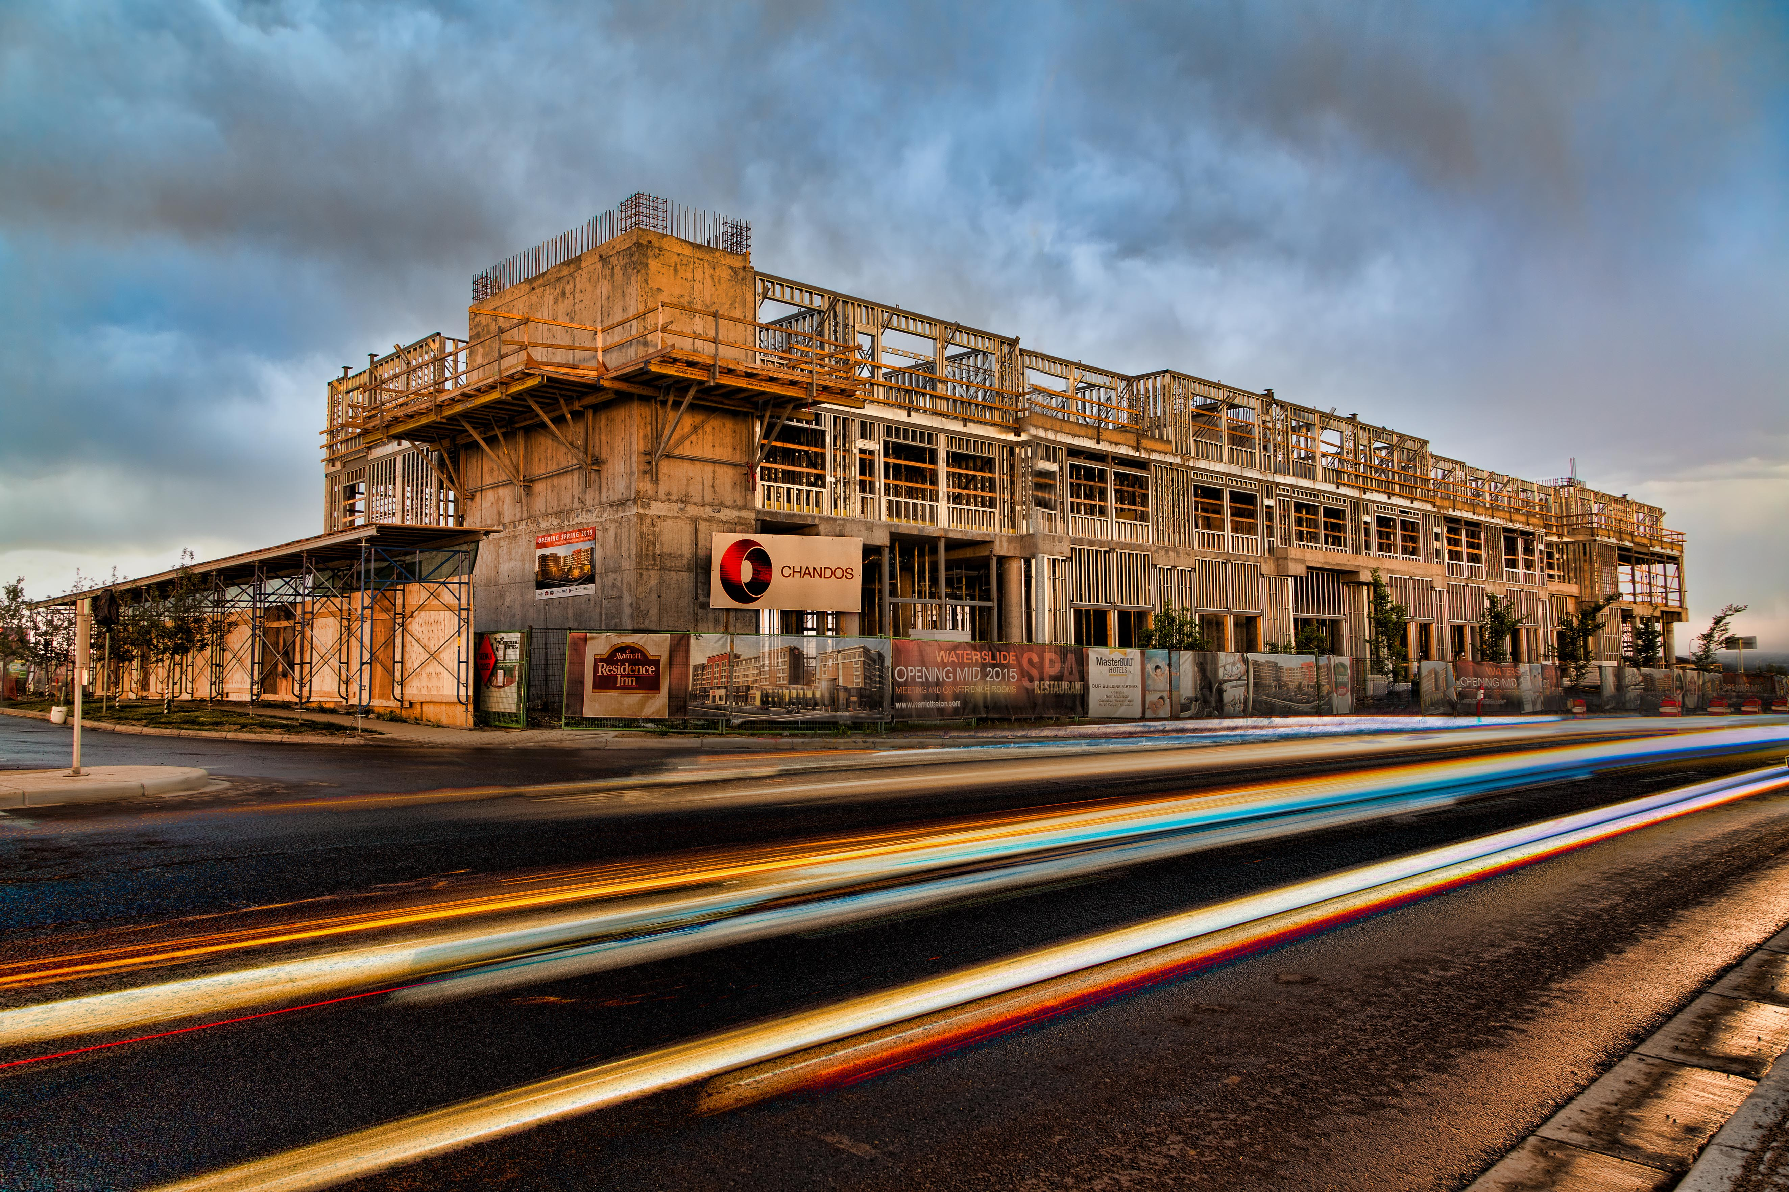
The Forces & Sources of Change
Regulation
Technology
Economy
Notes:
Regulation – 2011 National Energy Code of Canada, Nov 1st. Carbon Tax of $20 per tonne will come into effect on Jan. 1, 2017. That price will rise to $30 per tonne on Jan. 1, 2018. MAYBE - Movement towards lowering carbon footprint of RE Sec. UK and AU BIM, CoE mandating LEED Gold as a minumum, NEC Nov 1st
Technology – With the vastly reducing costs of certain technologies, namely solar, we’re starting to
Economy – With the downturn we’re finding new ways of being more efficient, more lean ultimately finding ways to increase produtivity
Productivty - Seeing what the supply and demand dynamics of more than 2 years of depressed oil prices have created a new push for LEAN practices to start entering the construction industry in a big way.
Productivity – Very much connected at the hip with the economy we’re starting to see both govt and private industry take a stand against the mulit-decade erosion of Productivity in the constrctuon and industryl…
The vast majority of real estate built globally is profit driven and very much at the mercy of free market supply and demand dynamics. This ties well into the next slide of productibity…which is why we have government initiaitves likes GOProducutivy and Alberta Innovates for govt to assist the private sector in becoming more productive and ultimately more compeotitibe in this ever increasing global playing field.

Slide 4
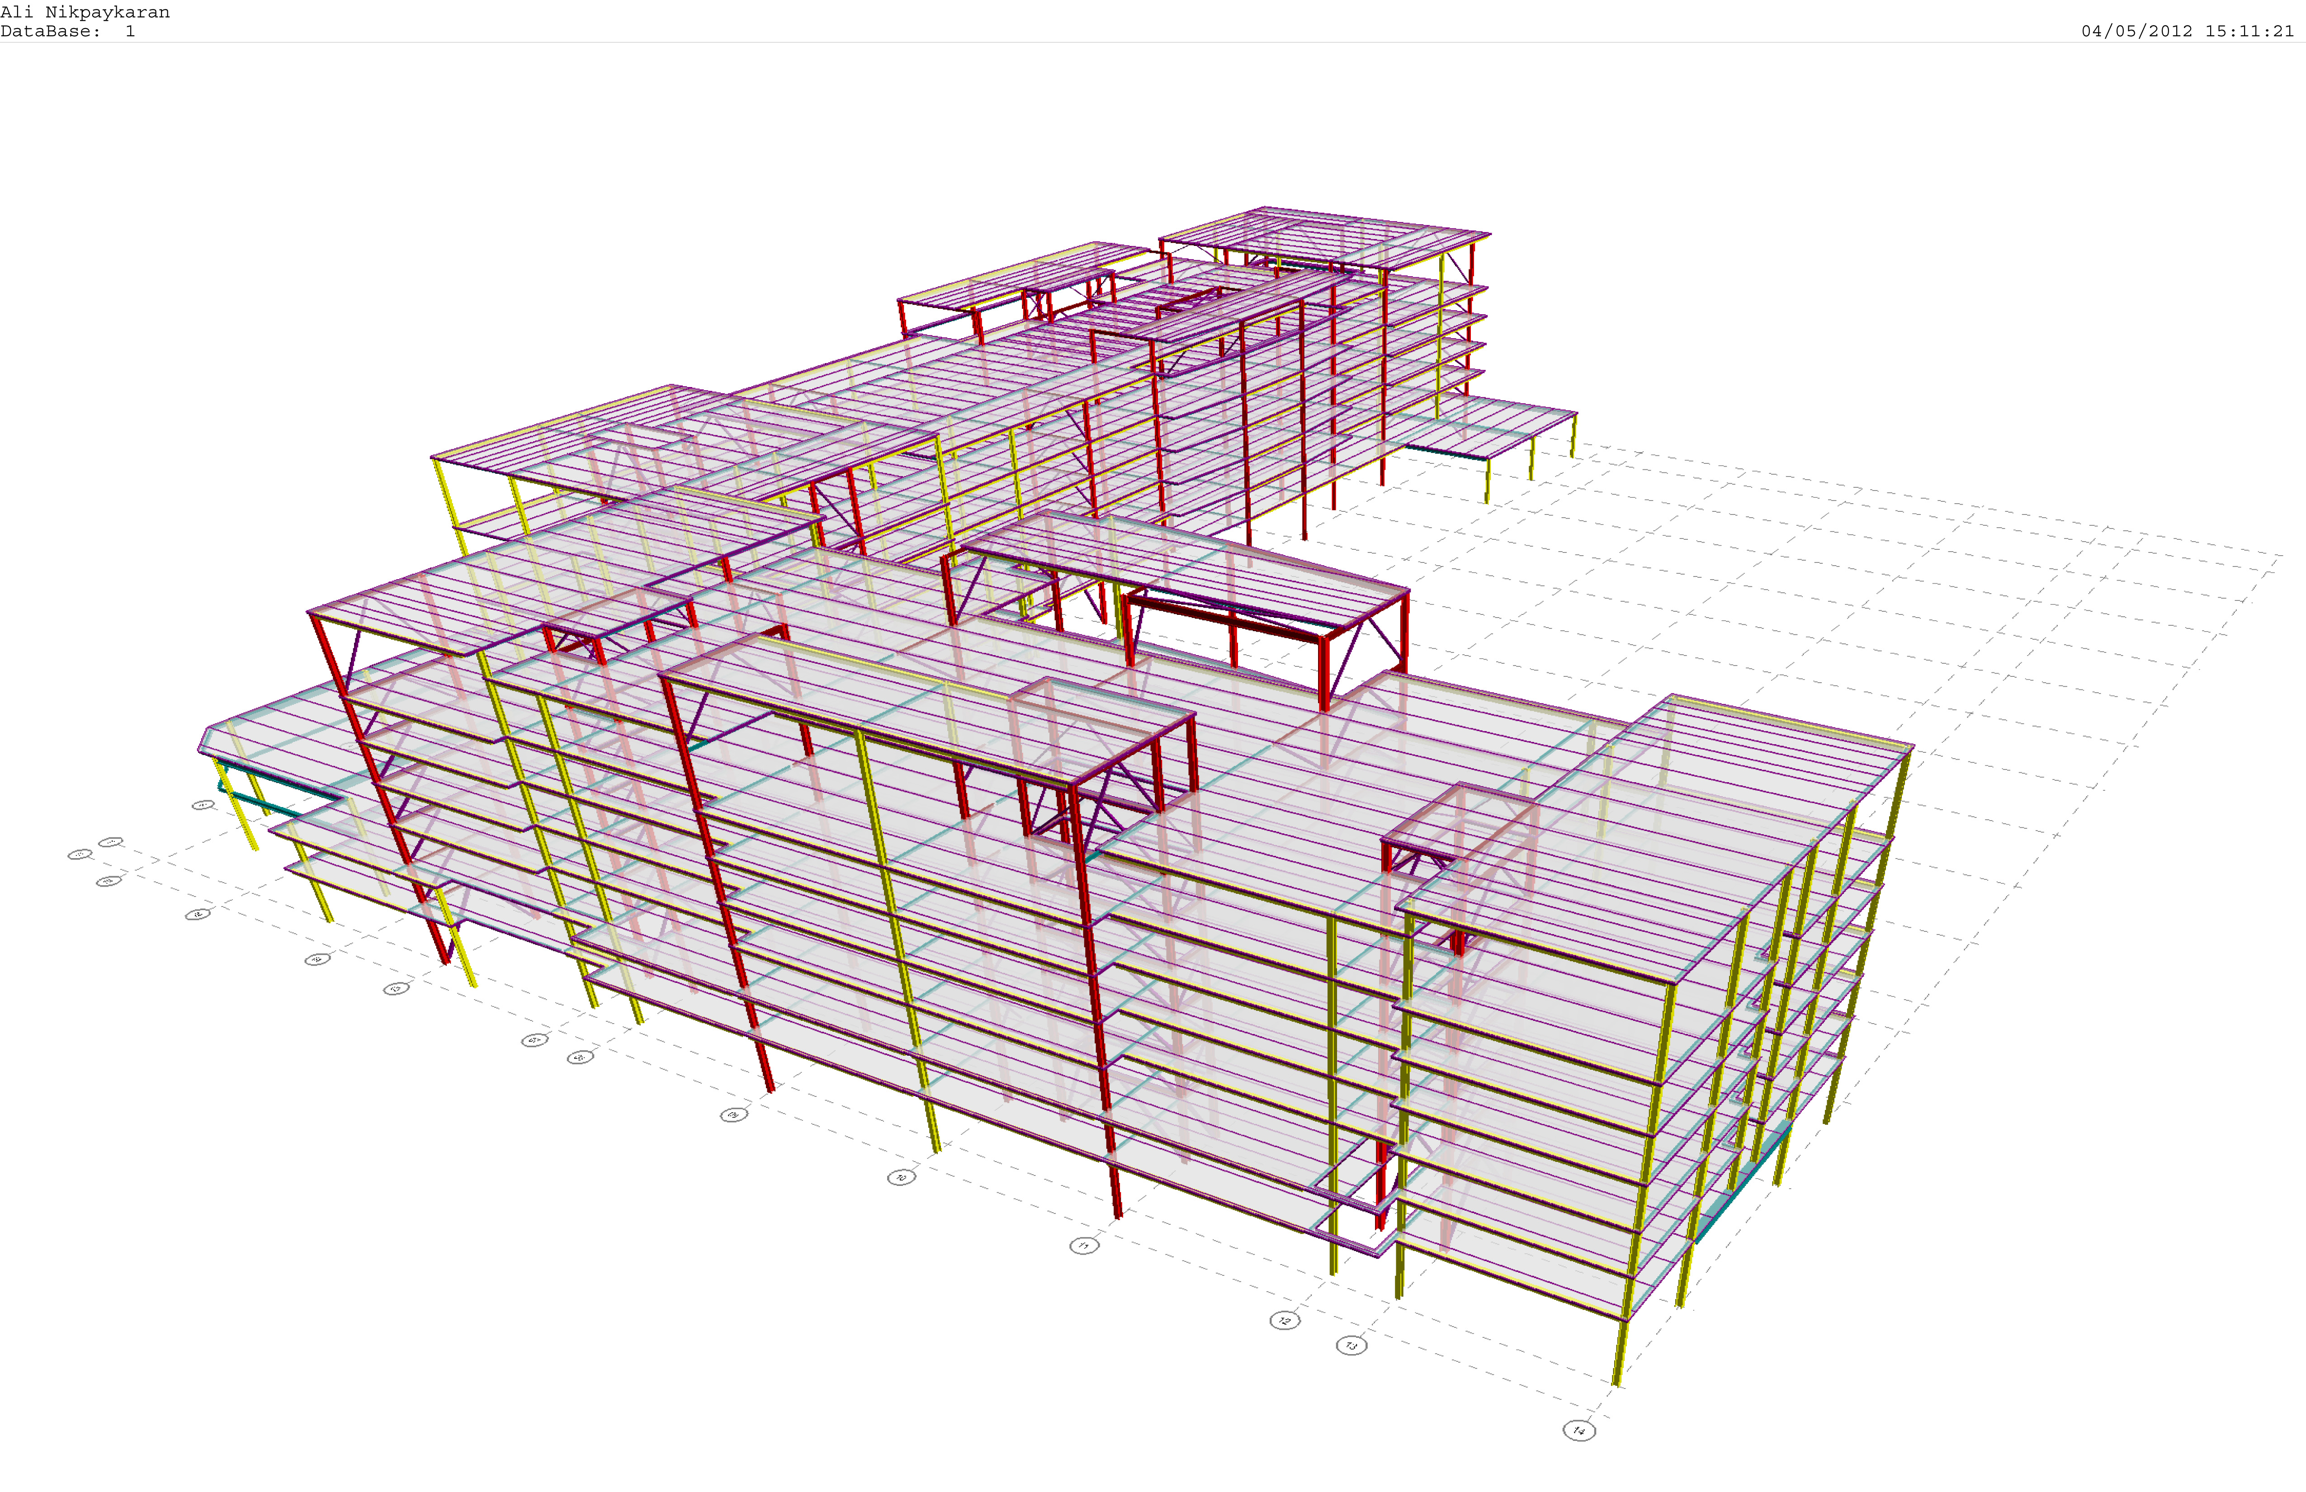
Current Technologies
Notes:
1. - Stock photo ID:90933443 (interestingly enough it’s more about people and the manner is which we interact than it is about technology) We’re going to cover
BIM
Lean Construction
Pre-fab/off-site construction
Evolution of Construction Contracts we use
Geothermal and Solar/PV

Slide 5
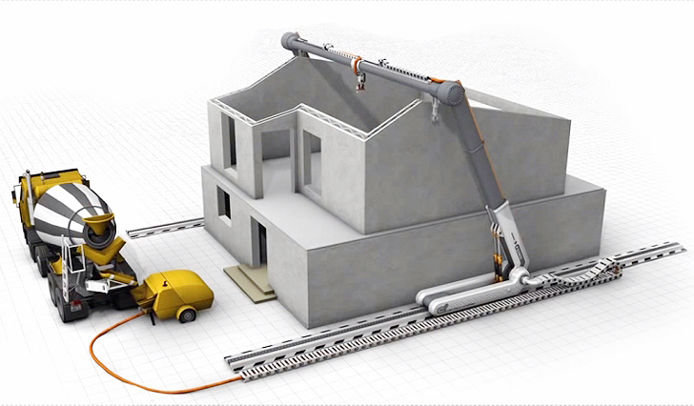
Future Tech
Notes:
2. Future tech - Stock photo ID:77641997. Some of these technologies we’re firmly entranced in using today, others are what the pendants believe will change the way we approach construction and real estate and should be seriously considered if AB is to be at the leading edge of technological advancements in construction and real estate.
3D Printing Buildings,
2) Carbon sequstering concrete
3) net zero becoming the rule as opposed to the exception design guidelines
4) Augmented Reality

Slide 6
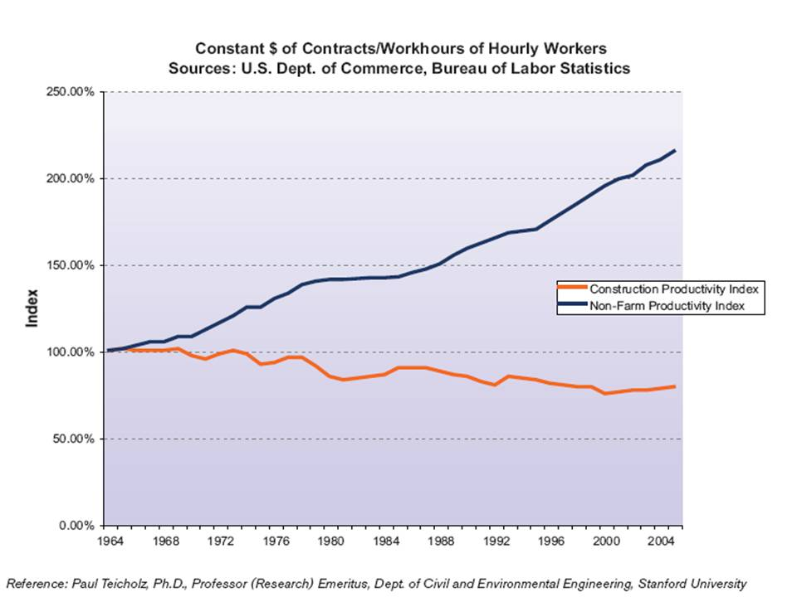
Construction Productivity
The heart of the issue
Notes:
GOOD ONE TO LEARN!!! Before we delve into these BIG IDEAS, it’s important we start with the heart of the issue. (productivity graph…group 2 presentation). Over the last 50 years, construction productivity decreased 20% while every other non-farm industry increased 220% on average. This is irresponsible and it's unsustainable, and it’s a big concern for our industry and our governments, where infrastructure and the affordable delivery of our infrastrucure, is paramount to advancing our economy and our society in general. There is a better way. It calls us to have strength to challenge the status quo and it calls us to put the project before ourselves.
productivity (show graph...the amount of man hours we spend in construction yield less value in finished product, inflation adjusted, than in 1960. Govt concerned about this. Private market is concerned also, due to construction cost usually being the largest input when making a Proforma work.

Slide 7
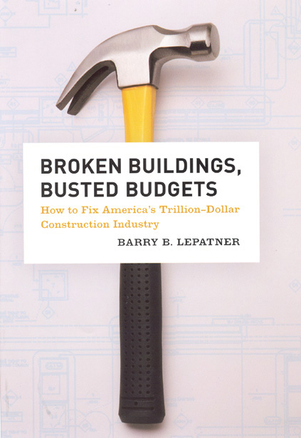
Delivery Methodology Modernization
Notes:
If you read this book, broken buildings and busted budgets, you learn the major reason construction has been a productivity lagard has been due to the contracts we use, which ultimately determines the way in which individuals and companies are incentivised and hence interact during a project.
Of the 1052 north amercian projects that were researched by the auther of this book, 33.4% were over budget and 30% over schedule. (Industry stat (Bill Black)…next page...
Think how much Building technologies and building demands have advanced since the days of the Roman Empire, which is when the hard tender (lowest price wins). Today, it’s commonly know that lowest FIRST price very rarely equal over best value. I emphasize lowest FIRST price because it’s very common under the “hard bid” form of delivery methodology for projects to come in much higher. (Some international doozies are Sydney Opera House
Budgeted at an initial cost of $7 million, the Opera House ended up costing more than $100 million and took more than a decade to construct.
Oxford University's Bent Flyvbjerg, a Danish economic geographer, devoted his career to chronicling cost blowouts on so called "mega projects". Of 300 projects he has studied in 20 countries, including Europe's Channel Tunnel, Los Angeles' subway, London's Millennium Dome and China's Three Gorges Dam, 90 per cent suffered cost blowouts…..THEME IS CONTRATS AND DELIVERY METHODOLOGIES NEED TO EVOLVE FROM UNCOLLABORATIVE CONTRACTS THAT DON’T CREATE ALIGNMENT OF EACH CONTR9IBUTORS INTEREWST
This ties into the typs of contracts we engage design and construction to deliver projects.
One of the chief culprits is A) Contracts (fixed price is not fixed price…case in point…Boston Under ground, locally the Federal building. State percentage of projects over schedule and budget B) Fragmentation (dozens of firms on one project..get them all together on one!). Talk about IPD (show two slide difference between CM/DBB vs IPD (Jen H has).When you get to the unsophisticated, small, mom and pop type contractors it’s sadly a feast or famine mentaility and very rarely is their a focus on reinvesting volatile profits into continual improvement training.

Slide 8
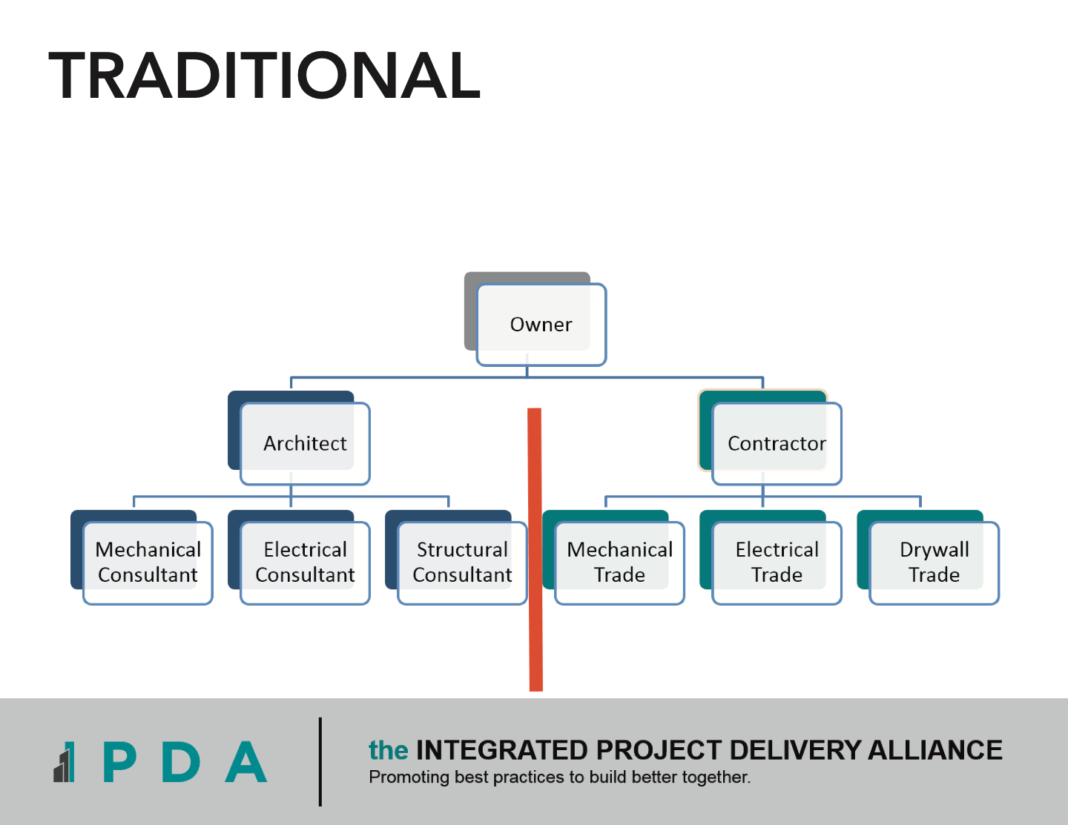
Notes:
The unfortunately reality, is that since the days of the Roman Colliseum, we have still be procuring and delivering projects under very much the same rules of engagement – Lowest price wins.
Fractured team from the get go.

Slide 9
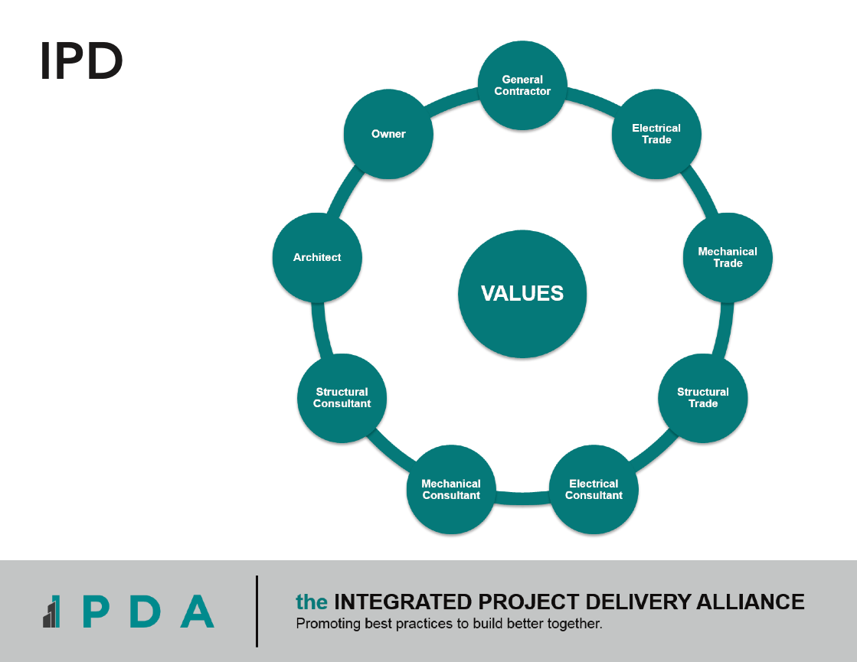
Notes:
Give example of where this was born and $1b coming in for $780m and all maintaining profitability
RDCS
trades work with each other vs against
drawings are better coordinated as you get the eng and assosicated trade parrtner (i.e. mechanical) designing together…how about that for a logical idea? Not rocket sci but the current delivery methodlogies we’re accumstoimed to don’t allow for this!
Quick turnaround on answer from the architect on minor issues, no cumbersome RFI’s for a one word answer
Way more accurate scheduling
MAYBE OTHER SLIDES…
- Big Idea #1 - Opportunity of collaborative vs non-collaborative models
- Big Idea #2 - Ability to evaluate success in other dimensions other than cost and schedule
Big Idea #3 - The single most important idea: Expand the timeframe around decisions made in the built environment.
"What is a team was brought together where everything threw their profit margins into one big pot, and that pot was placed on top of the identified cost of the project, and then the entire project team was now jointly at risk to deliver the project at or below that cost. If it goes above we all lose propetianelt, if it goes below cost we all gain proportionally. Juxtapose this at contacts like CCDC2 design build and in markets like we're in today the one with no fee wins and now the only way to make money is to poke holes in the contract to justify change orders. Allows for no innovation etc.

Slide 10
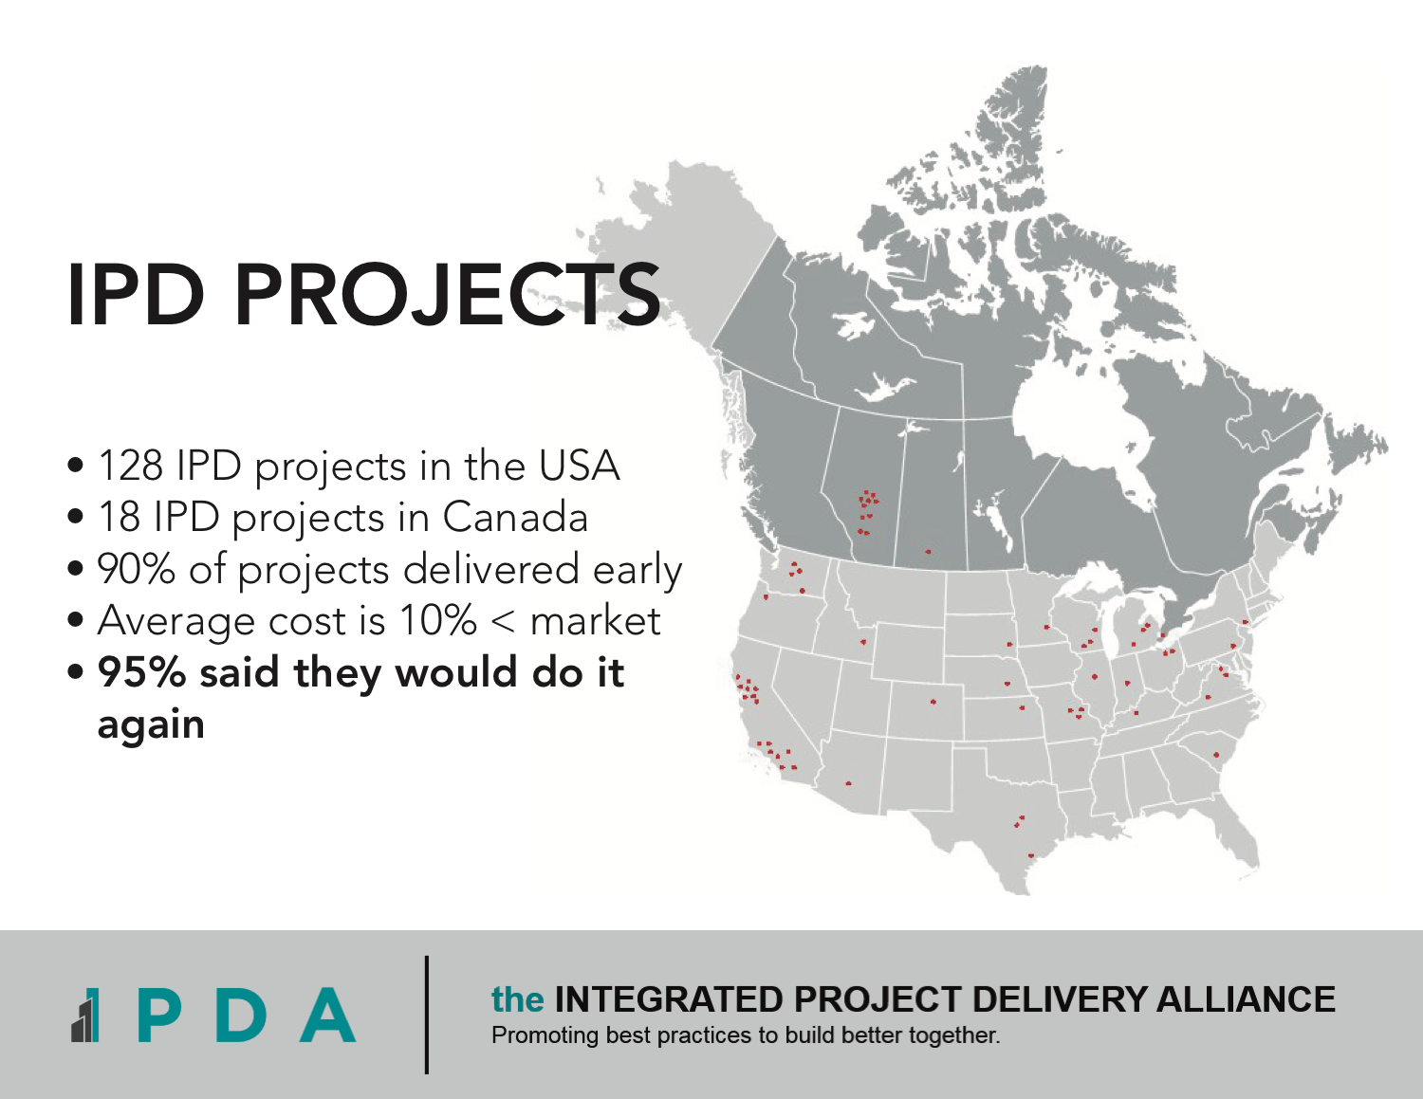
Notes:
Example - Mosaic centre 12% below market cost, 28% ahead of schedule and is NZ and LEED Platinum certified (Brany confirm).
We’re doing firstpublically procured IPD proejct in North Amercia with 2 schools in Red Deer which are ahead of schedule and below budget, of which budget savings have been reinvested into LED lightin throughout and a commercial kitchen in one of the schools….
Looks at email “3 biggest wins at RDCS”

Slide 11

Notes:
The percentage of tasks completed on any given week on a commercial construction site in Canada currently stands at 56%. This means this means that of all the tasks that are put up on a weekly work plan white with the little sticky notes, not even 6 out of 10 are completed. If you’re to compare that to manufacturing, it’s a bad week if output falls below 90% of their capacity. Now there are a myriad of reasons why the construction industry is sitting as low at 56%. What are we doing?
From Cut Culture eats strategy slide…
56% completion rate!!! This is biggest silver bullet in the industry, the biggest nut to crack. Much like exercise is the silver bullet to the obesity and heart disease epidemic, lean is the lowest hanging fruit to improve the ailing productivity stats plaguing the construction sector. It’s often over looked because it requires a hard work and a rigorous set systems and processes to follow. But before all of that it’s all about setting the right culture (culture east strategy for lunch Cuku slide)

Slide 12
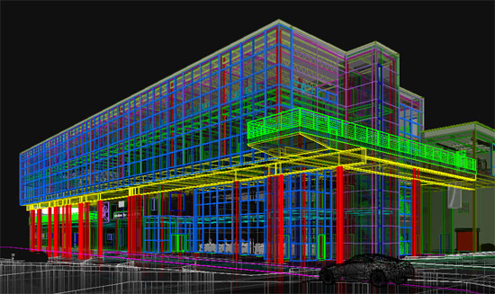
BIM
Notes:
AU and UK mandate that any government projects are designed in BIM
RDCS
We have the first time in company history we get to build the building twice once virtually and once in the real world. Involving the trades virtually we can solve issues before we get to site. Aka VDC
Underground plumbing was surveyed exactly in place, no need for the plumbers to do any of their own layout (and risk the location being wrong)…much more involvement from surveying crew who pull directly from the BIM model with lazer surveying equipment...so much so that Chandos now has 2 inhouse survey employees...
BIM in O&M (which you’ve mentioned) but I would go into detail about:
how FFE can be tagged and tracked with barcodes;
how buildings will be able to be controlled through the use of cloud computing and mobile software
how models will be used to manage the location of staff, streamline maintenance, and anticipate changing user needs
how models will be used to decommission buildings at the end of their life and facilitate the sustainable reclamation of materials.

Slide 13
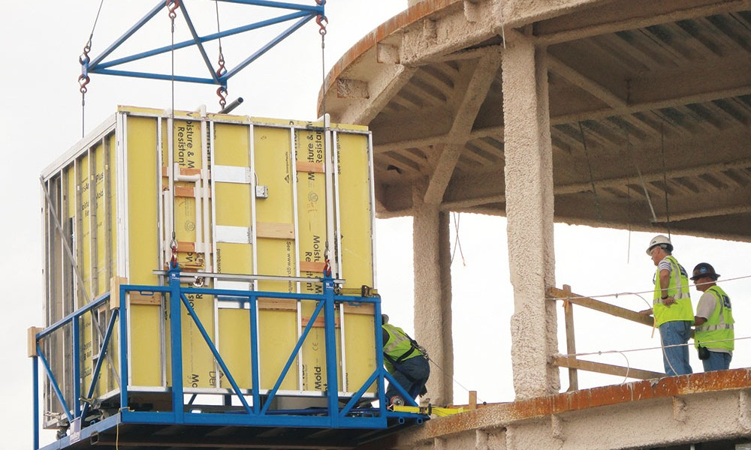
Prefabrication
Notes:
(AB Innovates in a pro govt initiative that helps the AB manuf and fabrication sectors to innovate…let’s get them helping mechanical, electrical and steel trades to tap into the most cutting edge innovations occurring around the world).
Roddy - (3D printing and large scale CNC production of building components). What we’re doing on Red Deer School (pre-cutting studs etc…ask Will)
RDCS examples!
Steel stud was pre cut from the manufacturer so it limits the cutting required on site so guys are more productive
Our plumbers started pre fabricating pipe runs in the block walls that were tested and insulated.

Slide 14
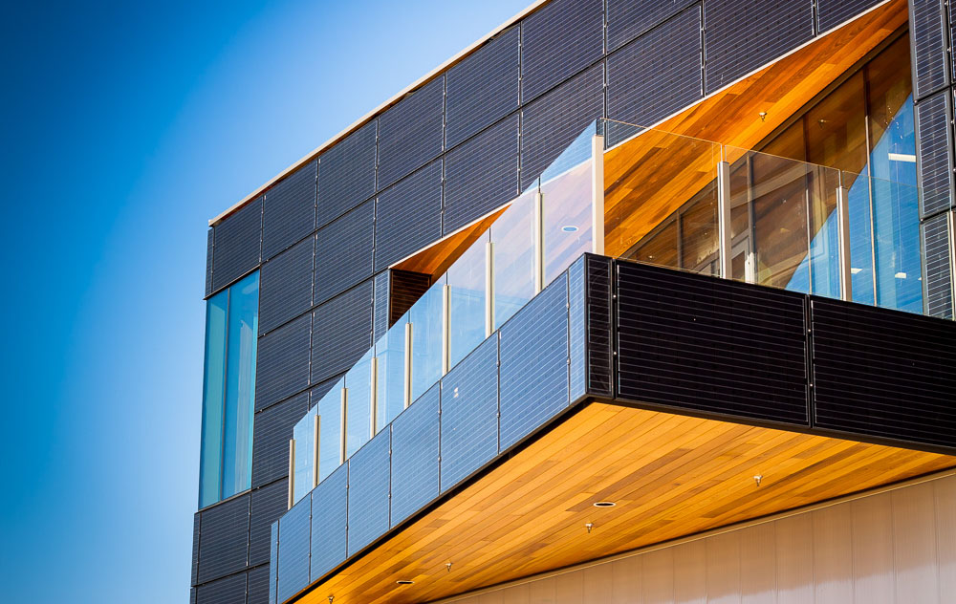
Geothermal
& PV
Notes:
currently the low hanging fruit in achieving net zero.

Slide 15

FUTURE TECHNOLOGY
Net Zero design guidelines becoming the norm
Notes:
-As of Nov 1 2016, the Govt of AB has adopted the National Energy Code which includers seven new codes, including building, energy, electrical, elevating devices, gas, pressure vessels and private sewage, all revolved around increasing energy efficiency of buildings.
-Devon and Vanc examples.
IF HAVE TIME - City of Edm stepping up to LEED Gold. Integrating net zero design guidelines into a community design expands options materials, utilities and energy requirements without sacrificing livability.

Slide 16
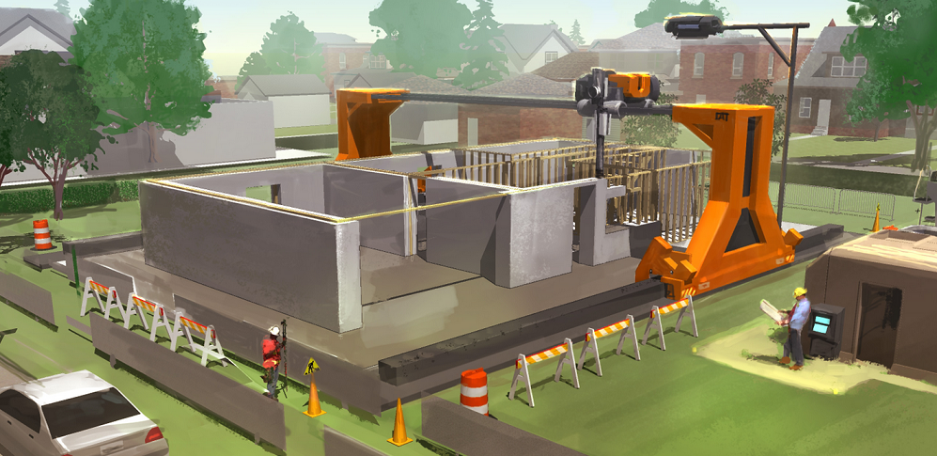
3D Printing Buildings
Notes:
Is anyone doing 3D printing in Alberta's building and construction sector? The chinese are now building high rises with 3D concrete printing techniques to assemble buildings structures within weeks, not months now.
Al at V3 - 3D Printing. If they can 3D print an entire house out of concrete in China, it is only a matter of time before we will see 3D printed, customized components for office, housing, retail and commercial uses in volume. Fast, cheap, custom products the size of small cars is just around the corner.
Building and components

Slide 17
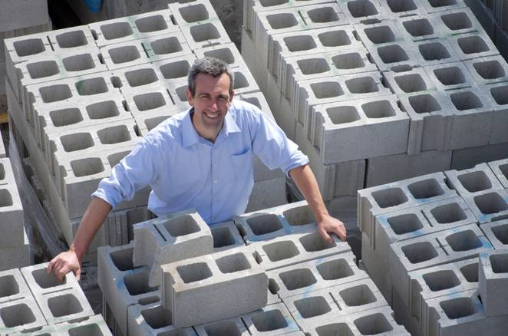
carbon sequestering concrete
Notes:
CONCRETE IS ONE OF THE WORST EMITTERS OF CO2 BUT BELIEVE OR NOT JOE BLOW FROM NS HAS INVESTED A WAY TO SEQUESTER CARBON INTO THE PRODUCTION PROCESS OF HIS CONCRETE. Recent Carbon XPrize semi finalists…HUGE POTENTIAL GAME CHANGER.
- What’s the % of CO2 contribution concrete makes to the construction industry.
- Bigger picture – What % does construction add to global CO2?
With some of the recent Carbon XPrize semi finalists producing carbon sequestering concrete, it would be a way of rapidly reducing green house gases.
http://
http://carboncure.com/news/alberta-based-burnco-installs-carbon-recycling-technology-and-competes-in-20m-nrg-cosia-carbon-xprize/ BURNCO installed the CarbonCure technology in its Shepard, AB concrete plant in June 2016, and conducted testing throughout the summer to confirm the technology’s performance. The CarbonCure technology injects CO2 sourced from the smokestacks of industrial emitters into concrete, where the CO2 becomes chemically converted into a mineral and permanently captured within the concrete. The process helps to improve concrete’s compressive strength, which enables concrete producers to realize operational efficiencies that further reduce their products’ carbon footprint.

Slide 18

Augmented Reality
Notes:
YOU’VBE PROBABLY THINK OF THE POPULAR POKEMAN GO GAME. IT’S ACTUALLY STARTING TO GAIN USE IN THE CONSTRUTION INDUSTRY, WITH THE MOST UPTAKE BEING IN THE INTERIOR CONSTEUCTION AND FURNITIRE INDUSTRY, WHERE MANUFACTIRES LIKE DIRTT AND STEELCASE ARE HELPING THEIR CLIENTS WALK THROUGH THEIR YET TO DEVELOPED SPACES BUT THRU THE COMPITER SCREEEN…FULLY DEVEOPED.
Use DIRTT and Stantec examples.
Interior Design and Construction is leading the charge allowing clients full AR walk throughs..
https://www.highbeam.com/doc/1G1-465809116.html#.WABkYDX8VoY.twitter “Using augmented reality to project 3D building renderings onto everything from tabletops to land sites, allowing clients to see a 360-degree view of a project before it's actually built.”

Slide 19
Recommendations
Silver bullet for productivity woes is in how we engage and incentivize our project teams.
Government needs to lead in procurement modernization
CCDC needs to provide access to modernized contracts
Notes:
Getting the project team/supply chain together value stream mapping.
Lets not forget we still need to get together and start messy and simple. The next generation of builders and real estate developers are not going to want to assume the same archaic rules of engagement the industry has been subject to for centries, nor will the new demands on the quality and performance of building allow that.

Slide 20
Recommendations
The first rule of any technology used in a business is that automation applied to an efficient operation will magnify the efficiency. The second is that automation applied to an inefficient operation will magnify the inefficiency.
Bill Gates
Notes:
Google Application of Drones in Construction.
James Dean
1. This is about how we should now take seriously drones as a surveying tool. They can compete in accuracy with ground based assessments and consistent studies are in fact showing that they are more accurate. If this is true it is very exciting because they can cover huge areas in very little time, meaning we can now have accurate information on a timely basis. they also allow us to build digital models of entire areas.
2. This is an example of a digital model and illustrates some use cases. Essentially digital copies are good for four things:
site information is at our fingertips so we can measure and make decisions quicker
combine diverse data sets to visualise in one place
automate repetitive tasks
generate an overall time stamp record for a higher degree of information

