Slide 1

Analytics Capstone Project - 2020
Strategic Customer segmentation
MONITORING ALBERTA’S ECONOMIC DIVERSIFICATION

Slide 2
Introduction
We have the data for gathered from the people of Alberta by means of online surveys which was gathered between 2015 and 2020.
The data has their responses in form of checkboxes data. We also had additional information of the respondents'’ IP addresses.
Problem
Extracting the geolocation data from the IP addresses
Sorting the checkbox type answers from the data into quantifiable data
Key Questions
How we can better segment the data in order to get a clearer picture of the people’s opinions.
We want to see that whether there is any change in the opinion of the people over the years or not.
Summary of Data
The data is gathered over 5 years between 2015 and 2020 and it is segregated by the time when it was collected e.g., Fall 2019, Spring 2018 etc.
It was collected via the means of online surveys which had multiple choice questions.

Slide 3
Methods
Firstly, we denoted a digit to all the responses and then counted these digits to produce a dataset that showed the number of each responses separately and segmented it by years in which the data was gathered.
The data was mostly clean and free of errors, so we did not have to do any extensive data cleaning processes during the project.
After this we made charts to represent the counts of each Reponses for all the questions and made the dashboard using these plots.
To extract the Geolocation data from the IP addresses, we utilized online tools which allowed us to get the data like City, Province, ZIP code and Geographical co-ordinates from IP addresses.
Our goal was to use this extracted location data and compare it with the location given in the responses by the survey participants to determine the respondents who were actually in Alberta or Canada.

Slide 4
Results of Analysis
Based on our analysis over the course of the project, we came to several findings and conclusions, which we showed using the PowerBI dashboards and by infographics.
We will be submitting the Infographics as well as the dashboard to our project partner, which can be used for them for reference.
Also, most of our analysis and dashboards are made in such a way that they can be scaled to new or higher volumes of data in future, with the exception of the geolocation data.
Some of the plots are presented in the next slides which gives us some conclusions about our data.

Slide 5
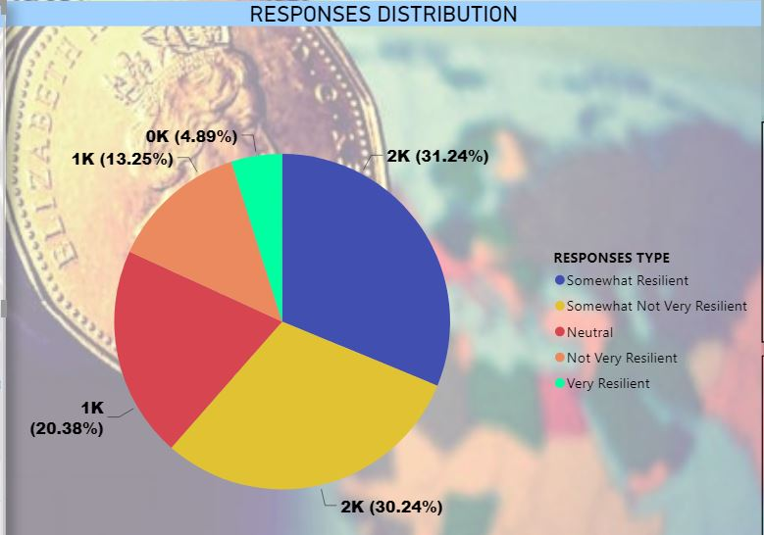
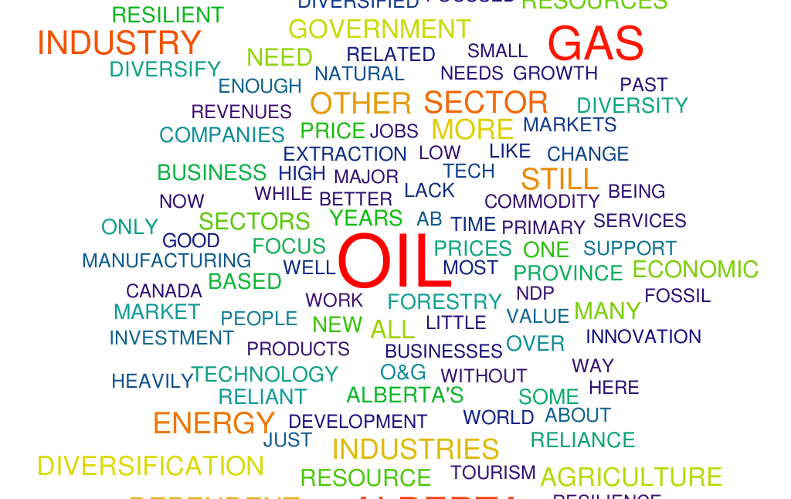
Plots and Visualizations - I

Slide 6
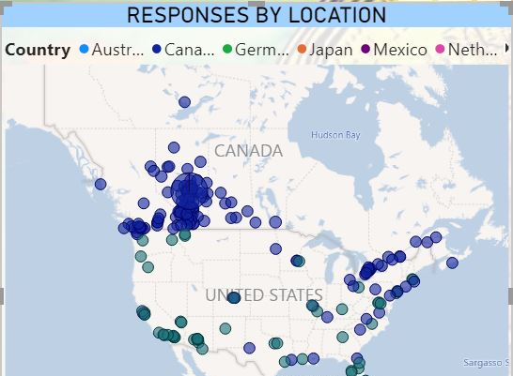
Plots and Visualizations - II
This is the Map which shows where do our North American respondents are based.
We see that as expected, most of our respondents are in Alberta. But in addition to that, we see that significant number of respondents are from places like Ontario and Quebec in Canada and some of them are in the United States as well.

Slide 7
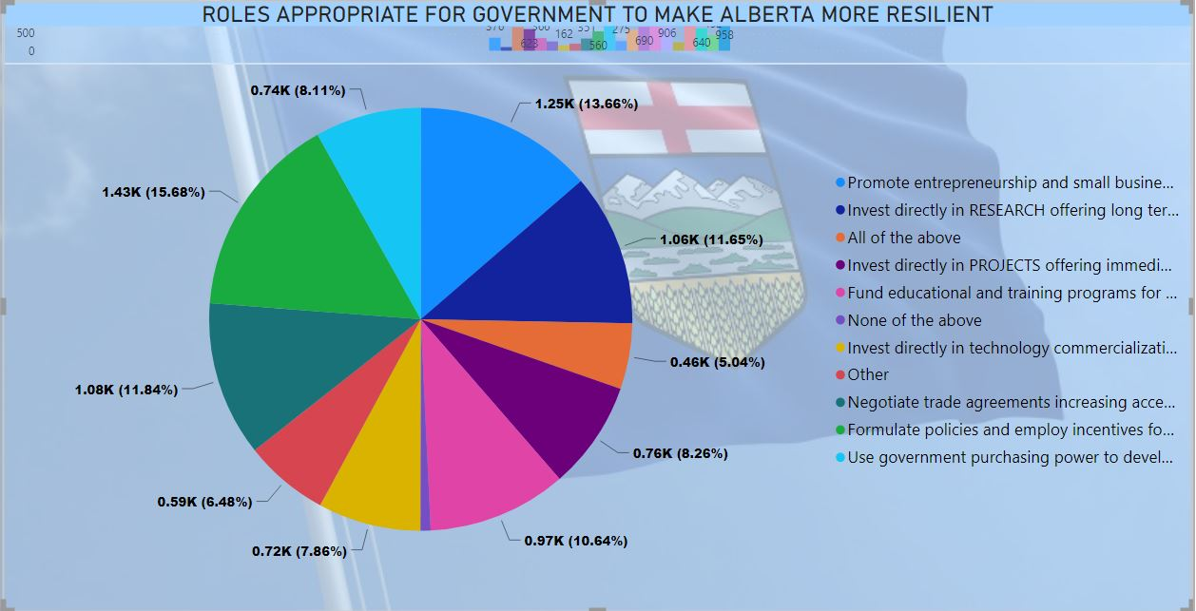

Plots and Visualizations - III

Slide 8
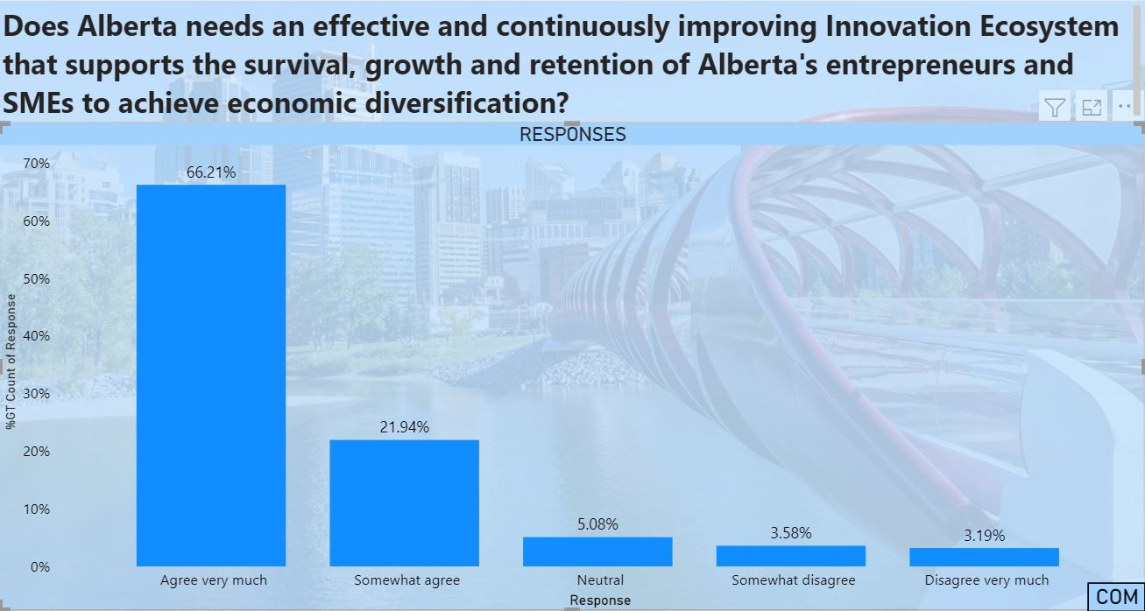
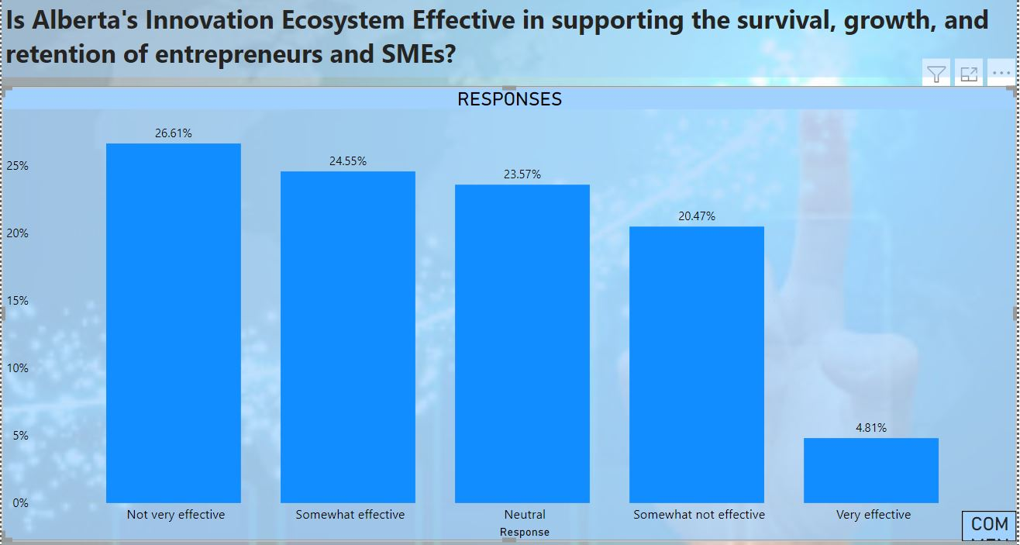
Plots and Visualizations - IV

Slide 9
Conclusion
Based on our analysis we would like to present these major conclusions and suggestions.
  We gathered from the geolocation comparison that a big number of respondents were not present in Alberta when they participated in the survey. Based on this, the genuinely of the respondents can not be made sure so we recommend to keep their responses out when coming to any conclusion and analysis.
  Secondly, we feel that some of the survey options might be perceived as somewhat difficult or ambiguous to potential respondents resulting in an inaccurate result.
  The word clouds which we made for some of the questions represent the suggestions and opinions given by the survey participants which indicates the most commonly talked about things These can be used as good indicators of peoples’ general opinion and it could be utilized by the policy makers when taking important decisions for the province’s economy,

