Slide 1

Prepared exclusively for PROBUS in St. Albert
November 6th, 2025

Slide 2
The Age of Creativity: From Knowing to Becoming
Your world, my world, our children’s and grandchildren’s world — is about to change.
Welcome artificial intelligence.

Slide 3
Looking Backward to See Ahead

Slide 4
Our Journey through Change - So Far

Slide 5
Welcome Artificial Intelligence. Welcome the Age of Creativity

Slide 6
Transition to the Present

Slide 7
AI: The Great Equalizer and Great Divider

Slide 8
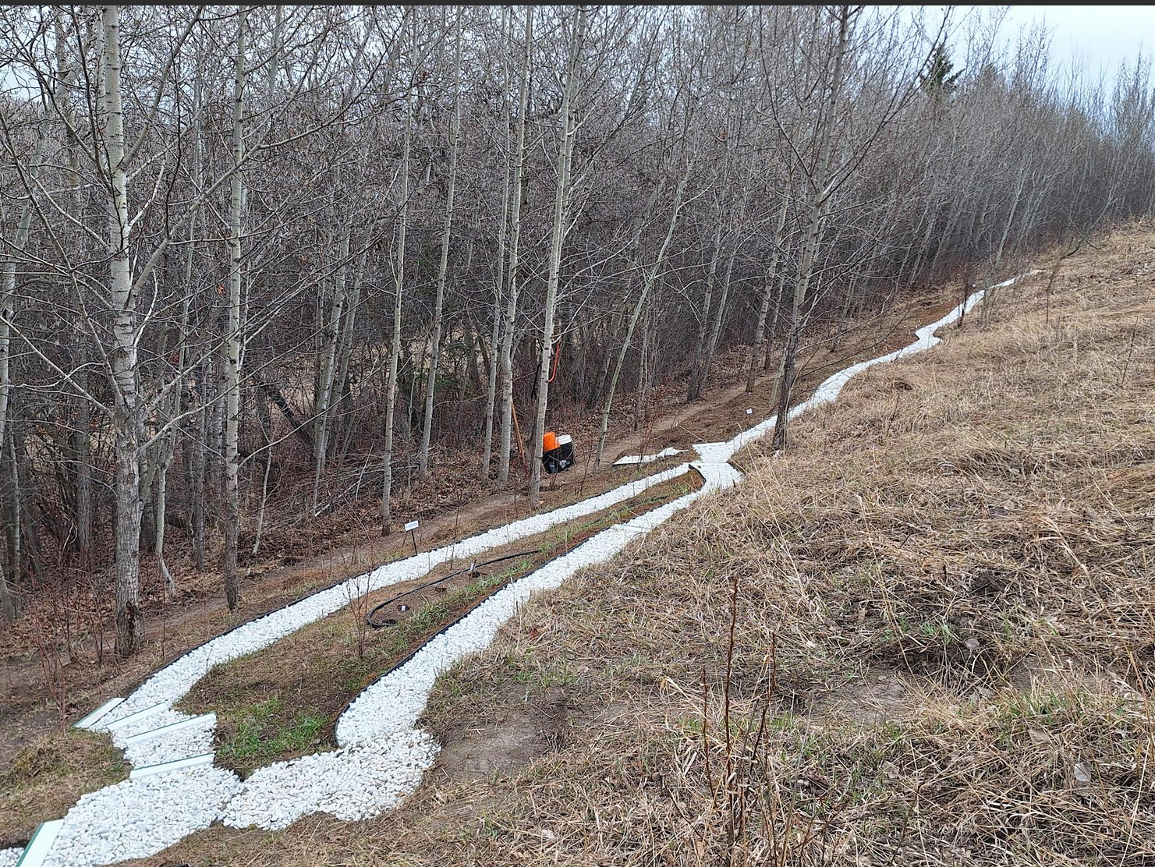

Slide 9
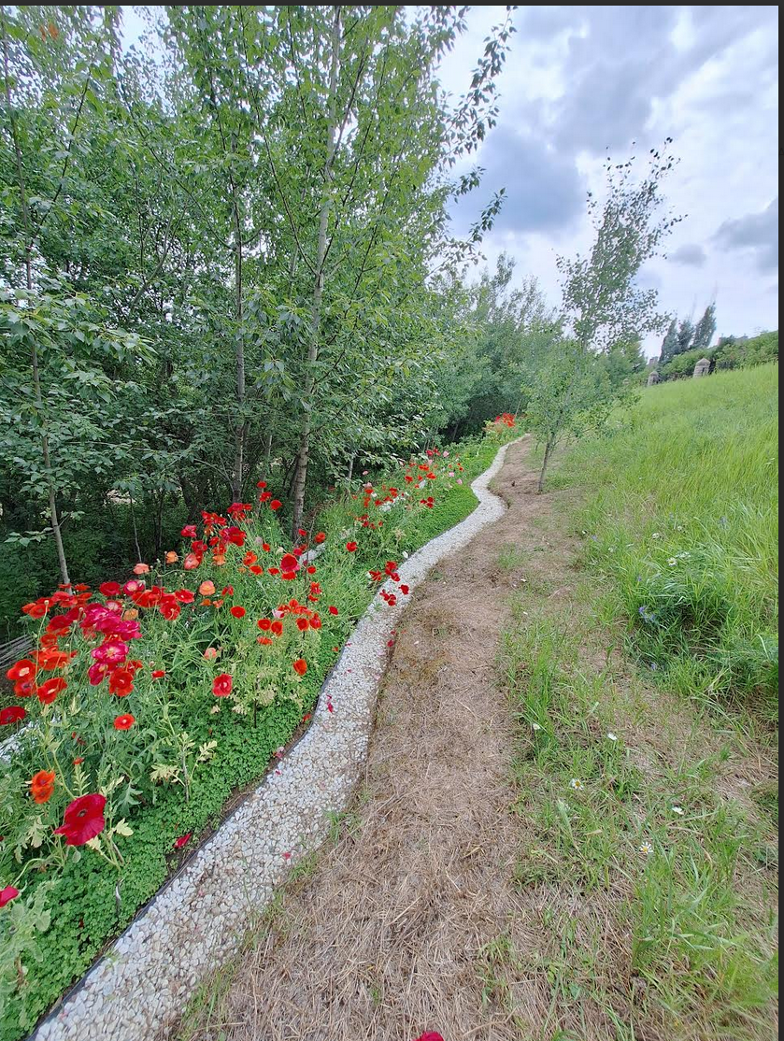

Slide 10
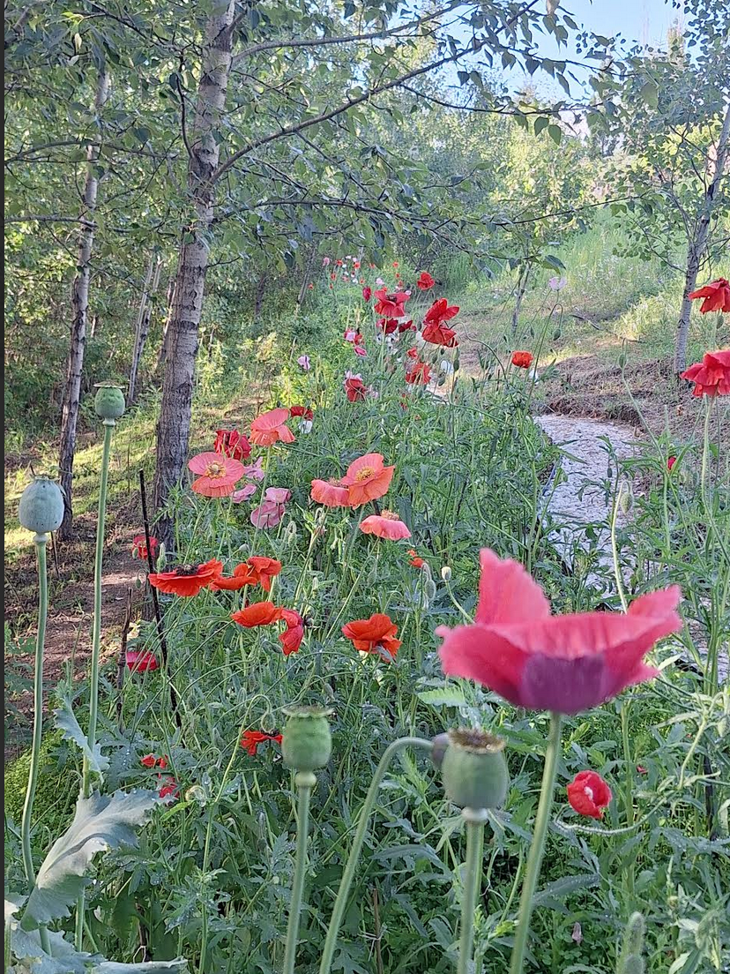

Slide 11
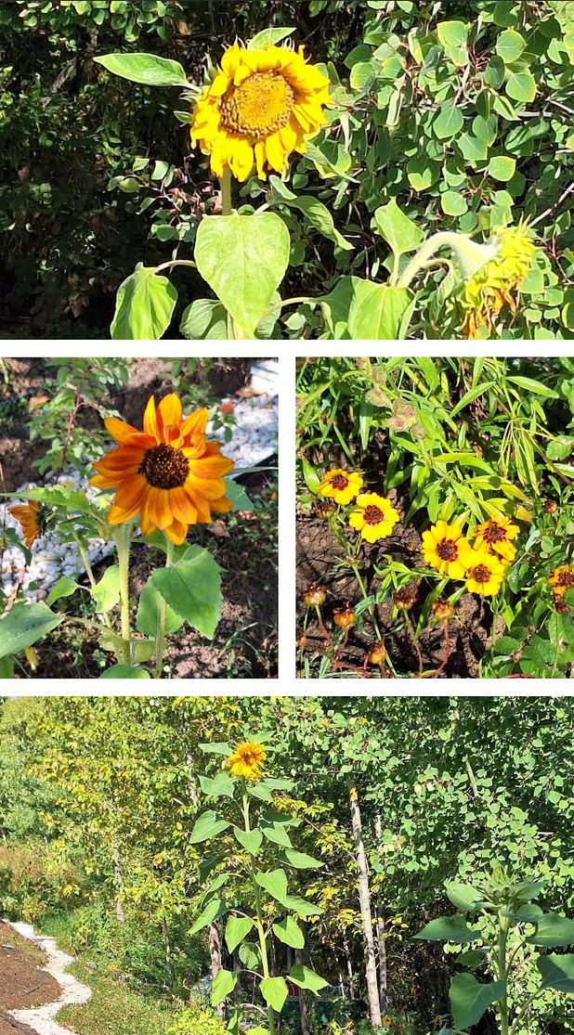

Slide 12
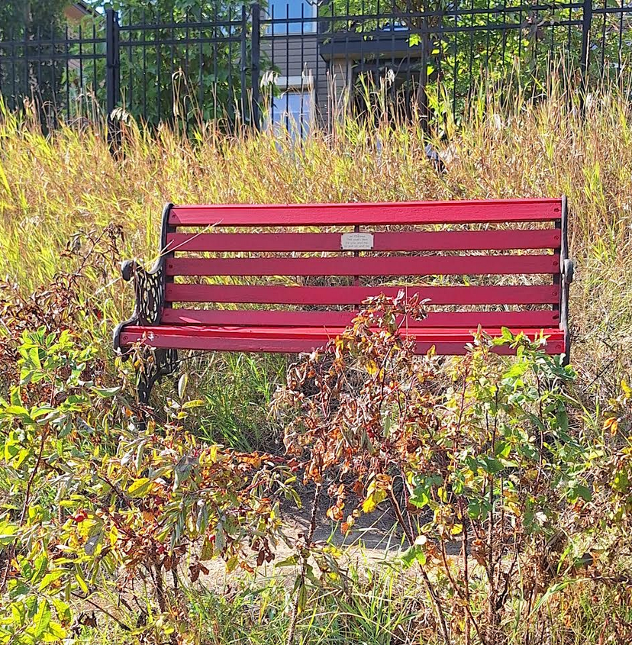

Slide 13
The Great Shift: From Knowing to Being
Personalization — not standardization — is the new frontier

Slide 14
Know Thyself: Humanity’s Last Great Frontier

Slide 15
The Forces and Sources of Change

Slide 16
The Human Advantage

Slide 17
From Change Agents to Creativity Curators

Slide 18
Closing Reflection

Slide 19

WARNING

Slide 20

Thank you!
Perry Kinkaide
KEInetwork.net
PerryKinkaide.com
pkinkaide@KEInetwork.net

