Slide 1


History & Hysteria About ChatGPT
Reshaping the knowledge economy and welcoming the …
Prepared for:
PROBUS Club of Central Edmonton
September 19th, 2023
Perry Kinkaide
KEInetwork.net

Slide 2
Setting Expectations
Introduction - Welcome and introduction of the topic. Brief overview of the importance of AI in our lives.
The Emergence of Generative AI - Explanation of generative AI and its significance. Milestones in the development of generative AI, including GPT models. Introduction to ChatGPT as a specific example.
Evolution of ChatGPT - The history and key versions of ChatGPT. Advancements in natural language processing and understanding. Real-world applications of ChatGPT.
Public Concerns: Misinformation - Discussion on the spread of misinformation through AI-generated content. High-profile examples of misinformation incidents involving AI. The impact on public trust and information integrity.
Public Concerns: Privacy - Explanation of privacy concerns related to AI and ChatGPT. Instances of privacy breaches or ethical dilemmas involving AI. The balance between innovation and privacy protection.
Addressing Concerns - Overview of measures taken by developers and organizations to address misinformation. Ethical guidelines and regulations in the AI industry. Ongoing research and development in AI ethics and safety.
The Future of ChatGPT and Generative AI - Potential directions and innovations. Balancing technological advancement with ethical considerations. The role of ChatGPT in shaping the AI landscape.
Conclusion - Recap of key points. Emphasis on the importance of responsible AI development. Encouragement for further discussion and exploration of AI's role in society.
Q&A - Invite questions from the audience.

Slide 3
7:30am – TODAY - September 19, 2023
Will AI Take Your Job? For some people, their fears surrounding AI have become a reality: A recent report found that AI replaced nearly 4,000 jobs earlier this year. We can expect to see more jobs become obsolete as the technology continues to develop. On the other side of the coin, the proliferation of AI will also create new jobs — a staggering 97 million of them according to The World Economic Forum.
Creativity and other human nuances will be at a premium. While generative AI is great for writing basic copy or serving as a jumping-off point for more complex texts, it struggles with context and can’t write with the nuance that makes human prose so unique and engaging. It can’t provide personal anecdotes, new ideas, or know how to do things like tactfully infuse humor into a eulogy, for instance
We’ll all need to become prompt engineers. The arrival of generative AI has launched us into a sort of second Socratic age. Greek philosopher Socrates notoriously emphasized the importance of asking questions, famously stating that, “the highest form of human excellence is to question oneself and others.”

Slide 4
http://poe.com

Slide 5
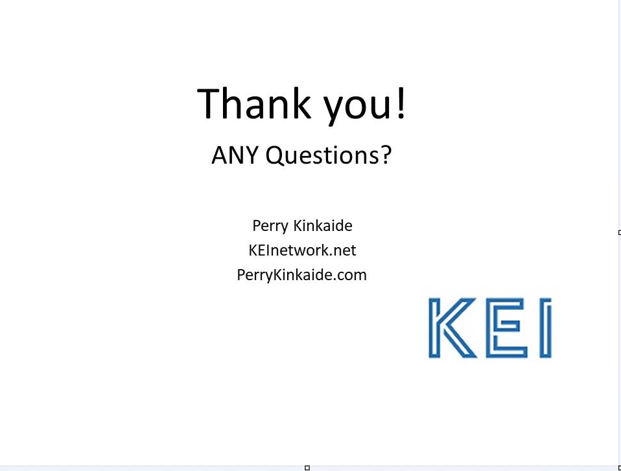

Slide 6






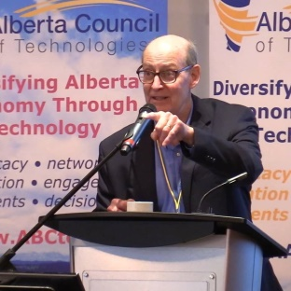
Questions?
Introducing my “posse”
Jwalant Jeff Michelle Brett Bud Ling
Desai Uhlich Lessard Duncan Norris Huang
Perry Kinkaide
KEInetwork.net
PerryKinkaide.com

